Slide 1
Party Organization

Slide 2
Introduction
Defining party organization
Organization structure
Hollow Parties?

Slide 3
Local Organization
Legacy of machine politics
Party Decline and Revitalization
Local Organizations today

Slide 4
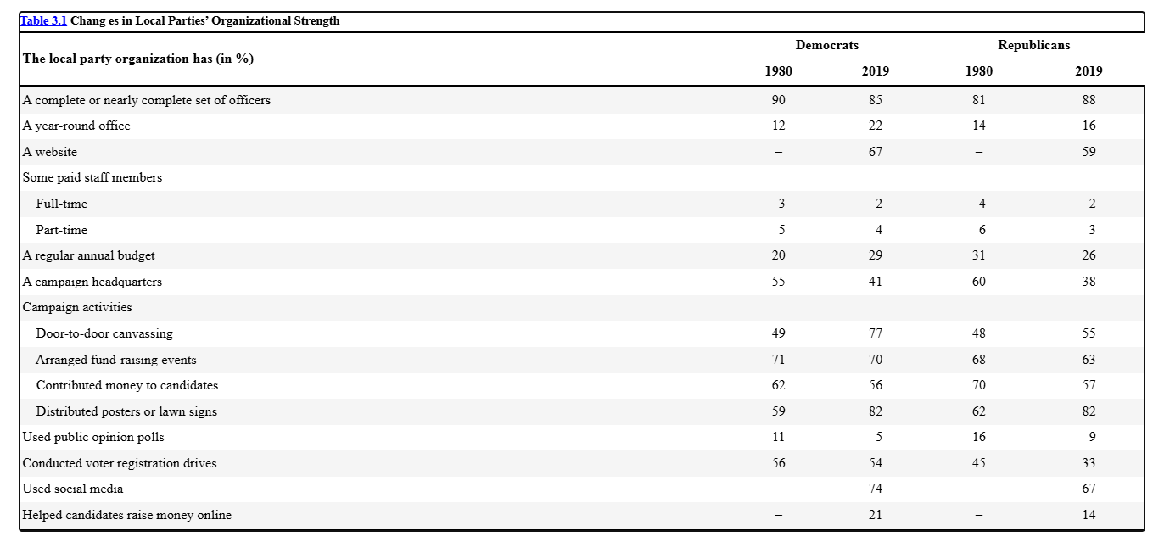

Slide 5
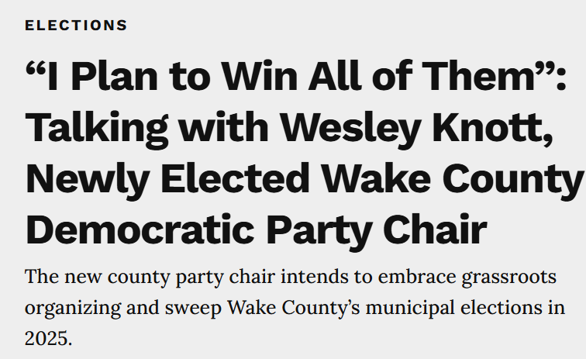
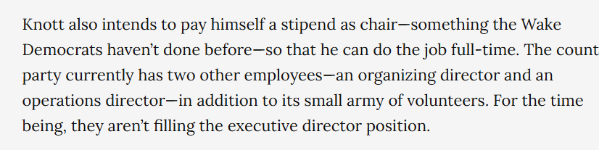

Slide 6
State Party Organization
Basics
Revitalization
Party-in-service

Slide 7
National Party Organization
Two paths to revitalization become one– the party in srervice
National Chair
Congressional Campaign Committees
National Party Activities
Strategic use of resources

Slide 8
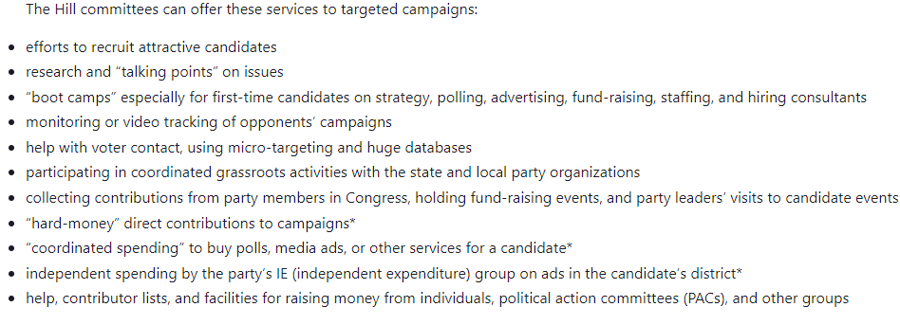

Slide 9
Impact of Changes
Nationalization of politics
Party power vs. candidate power
Re-invented parties
A remedy to hollowness– partyism?

Slide 10
Party Activists
Why be a party activist?
Material, solidary, and purposive incentives
Professional vs. Amateur
Who are the activists and how are they different?

Slide 11
