Slide 1
Parties in the Legislature

Slide 2
Introduction: Responsible Parties and the American context
What is it?
Separation of powers
Responsible Party Government (key features)
Case for party government
Case against party government
Party government in the U.S. context
Conditional party government
Divided Government
Responsible parties in an “irresponsible” system?

Slide 3
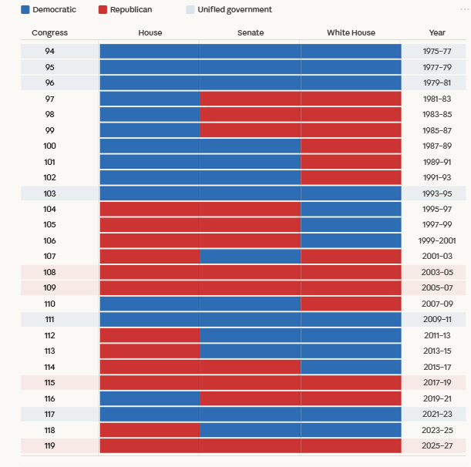
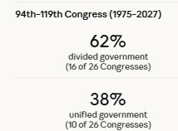
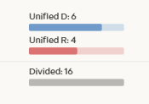
Divided government

Slide 4
Parties in the Congress
Party caucus
Caucus vs. leadership
Is Congress abdicating it’s institutional power? (yes)

Slide 5
Transformation of Party Leadership in Congress (and why it matters)
Party voting
A brief, but important, 20th century history
Czar rule
Committee ascendancy
Party resurgence
Party reforms
21st century– the Freedom Caucus
Party leadership in the Senate
Regularization of the filibuster

Slide 6
Party polarization and the US Congress
The evolution
Chartapalooza
Blame the politicians?
Recent Congresses and the rise of the Freedom Caucus
Party polarization and state legislatures

Slide 7
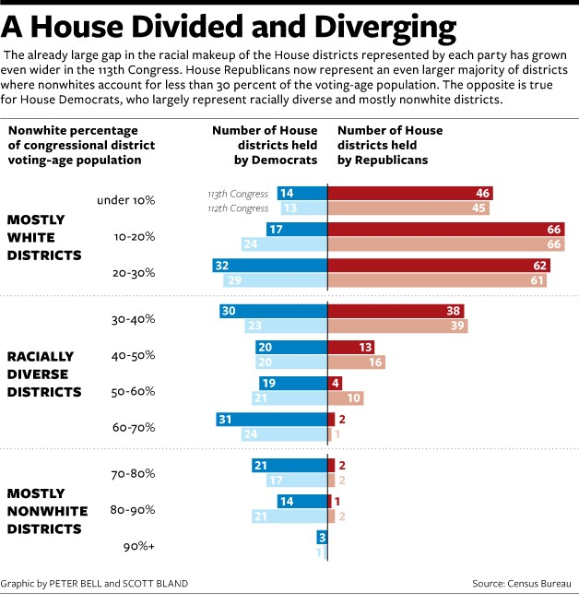

Slide 8
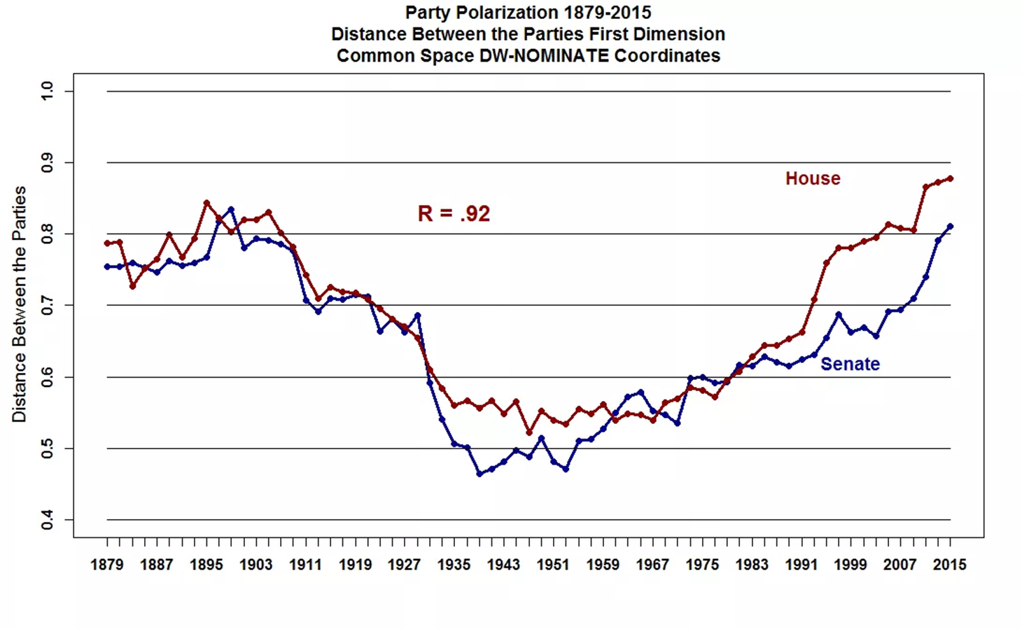
The stop blaming polarization on gerrymandering slide

Slide 9
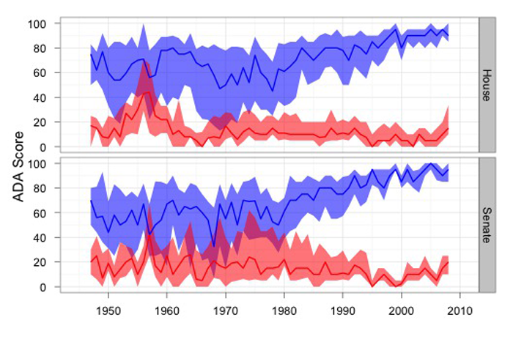

Slide 10
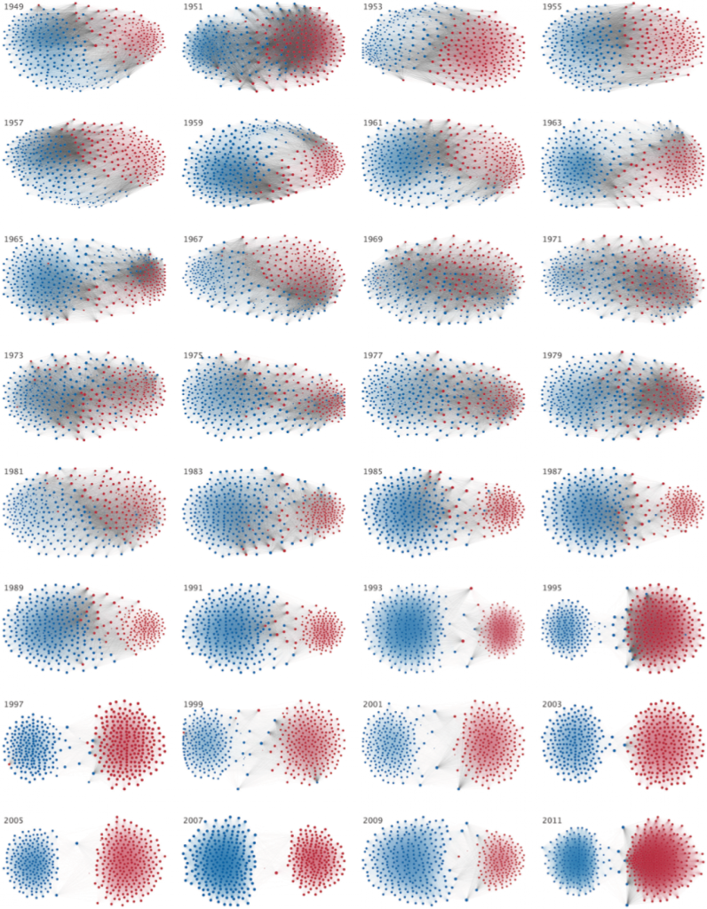

Slide 11
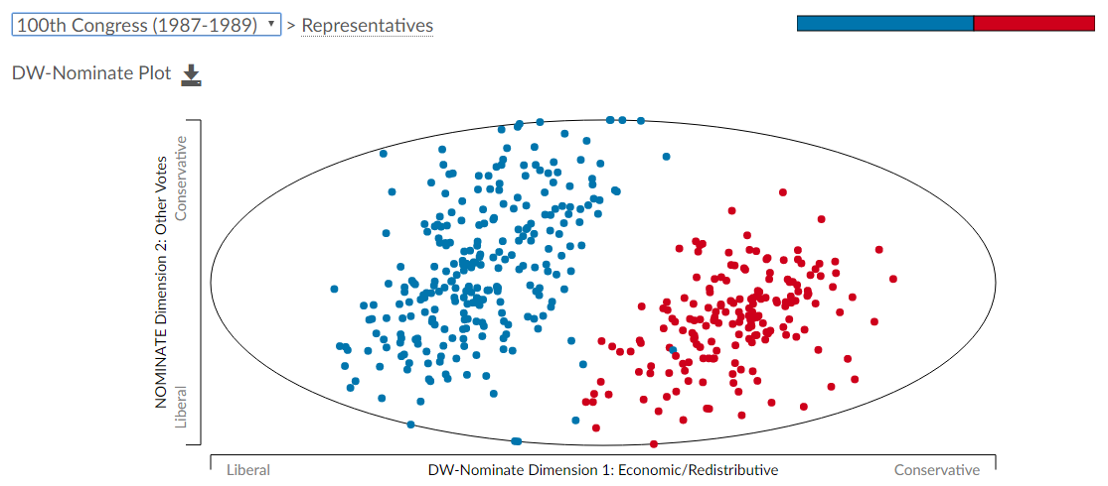
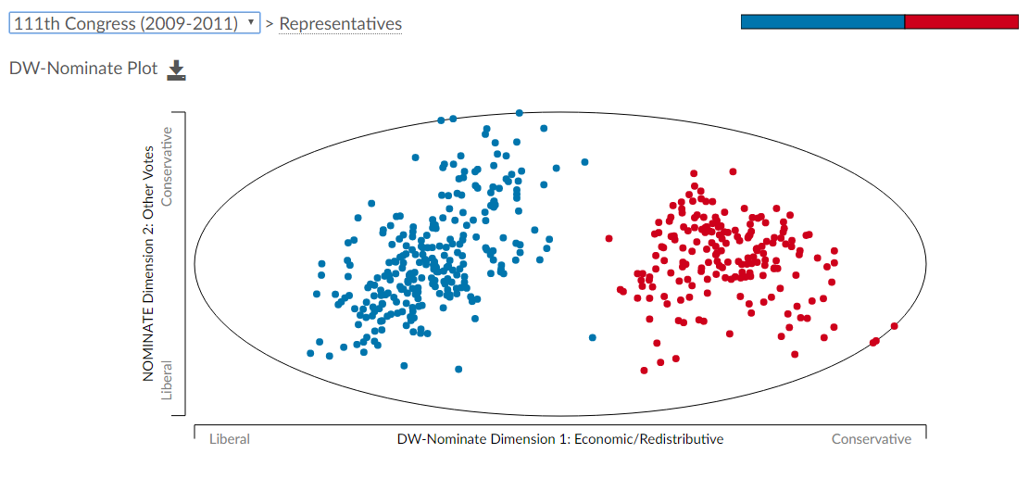
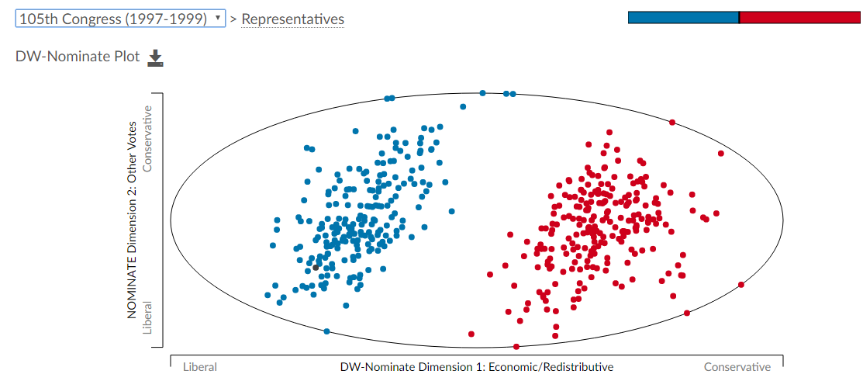
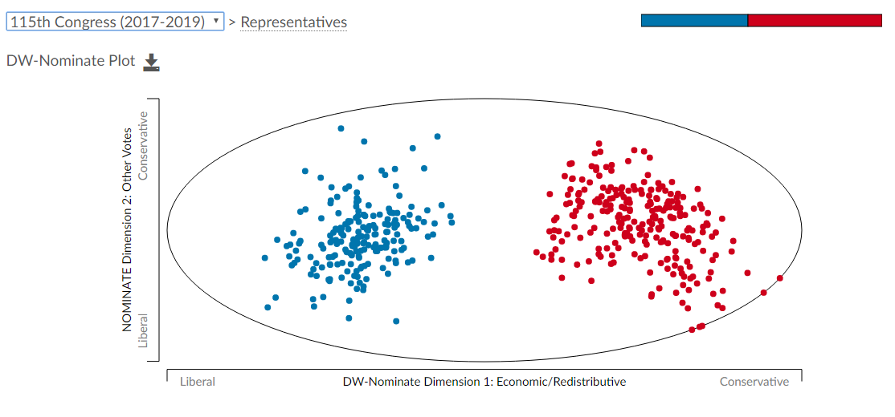

Slide 12
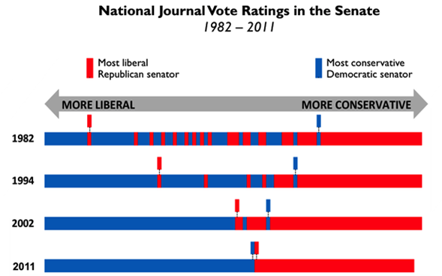

Slide 13
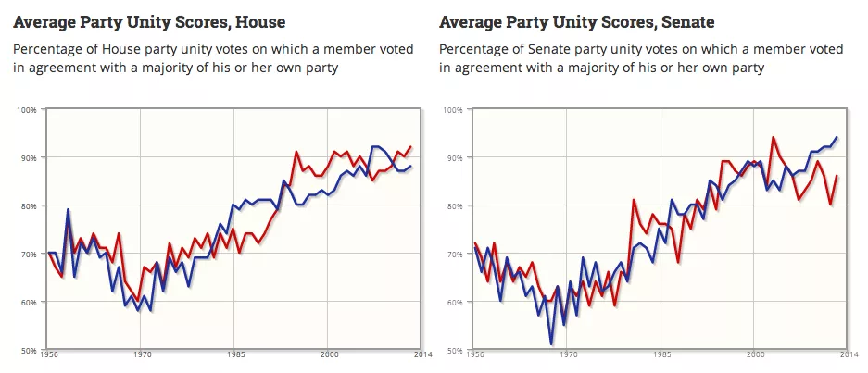

Slide 14
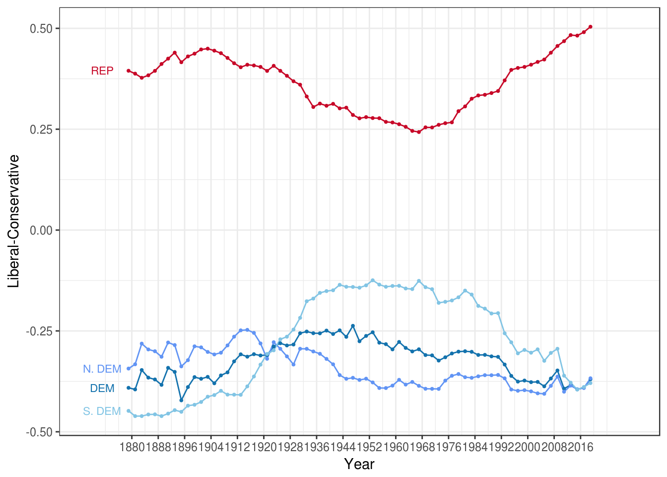
House of Representatives

Slide 15
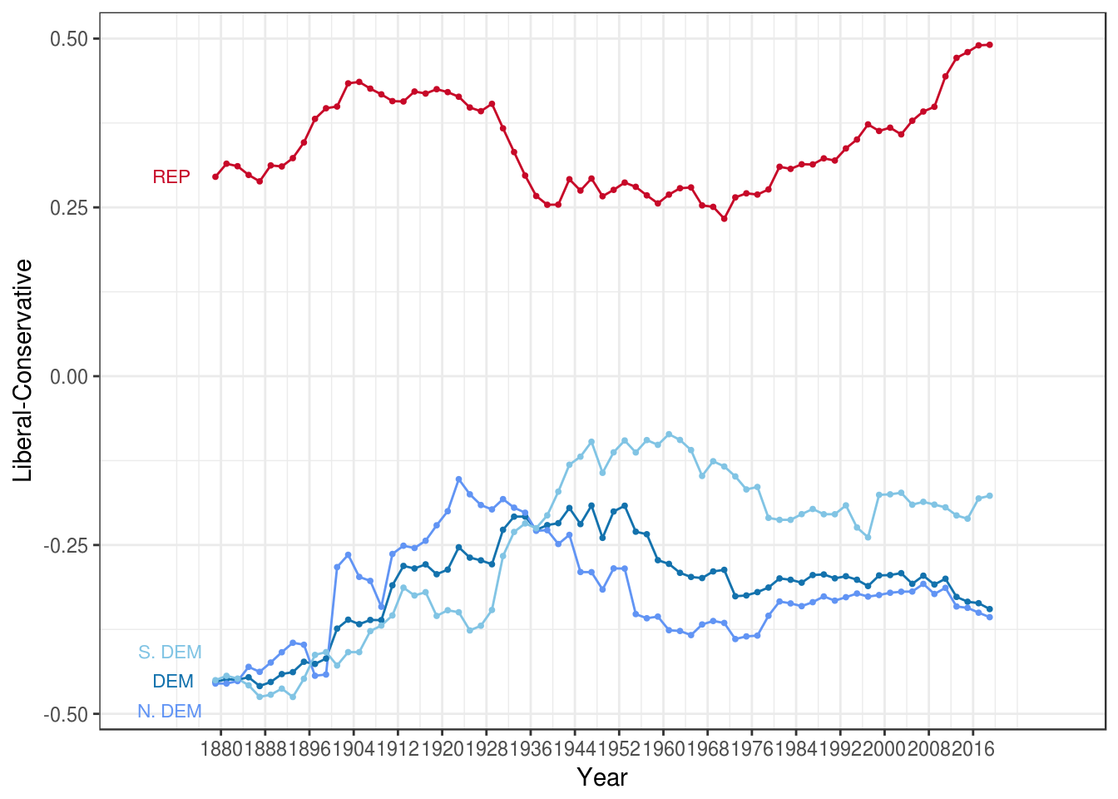
Senate

Slide 16
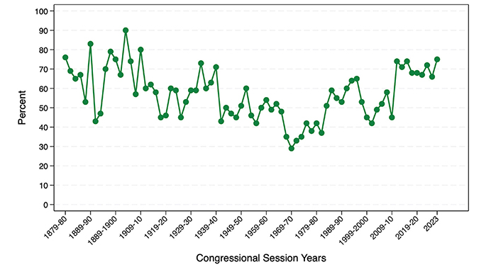

Slide 17
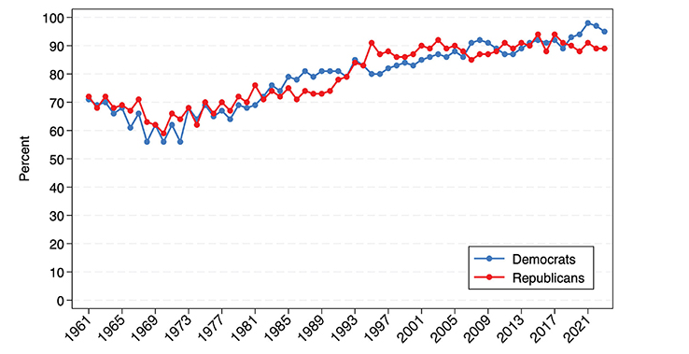

Slide 18
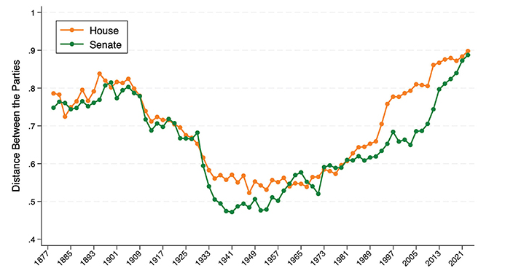

Slide 19
Congress in the age of Trump
Cohesion without accountability
This missing branch
Theory vs reality
The future?

