Slide 1
Campaign Finance

Slide 2
Introduction
The importance of money in elections
Where stand in chart form…

Slide 3
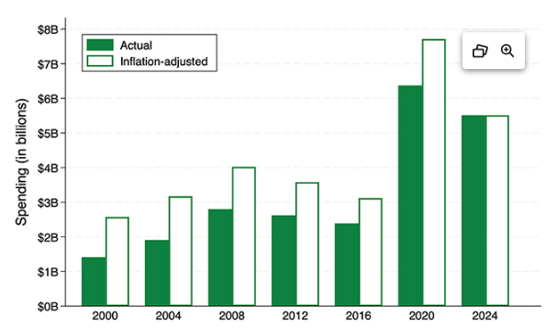

Slide 4
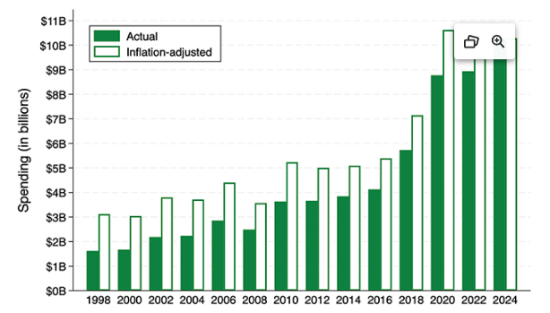

Slide 5
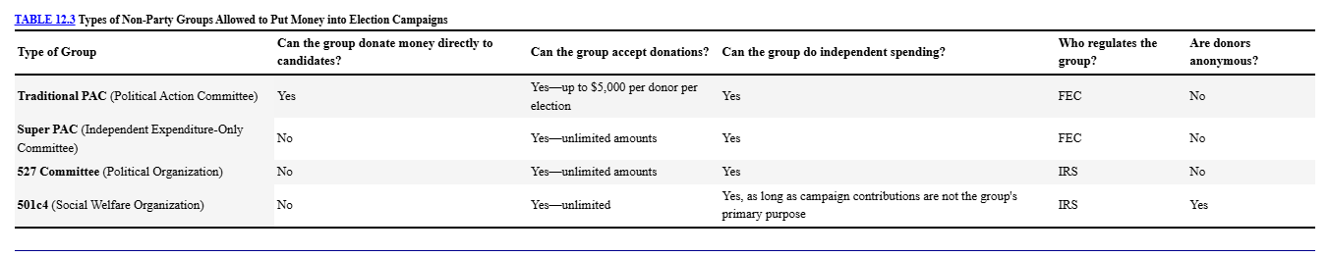

Slide 6
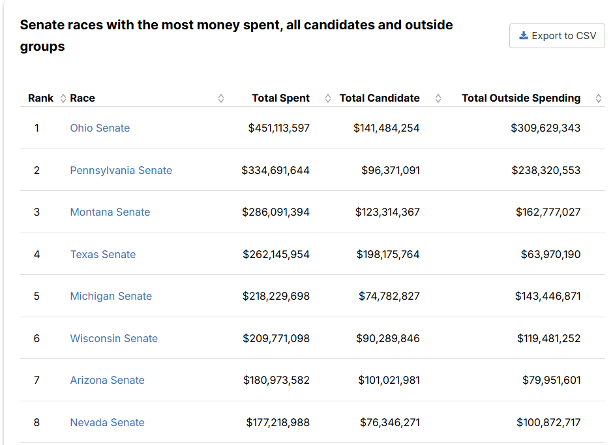

Slide 7
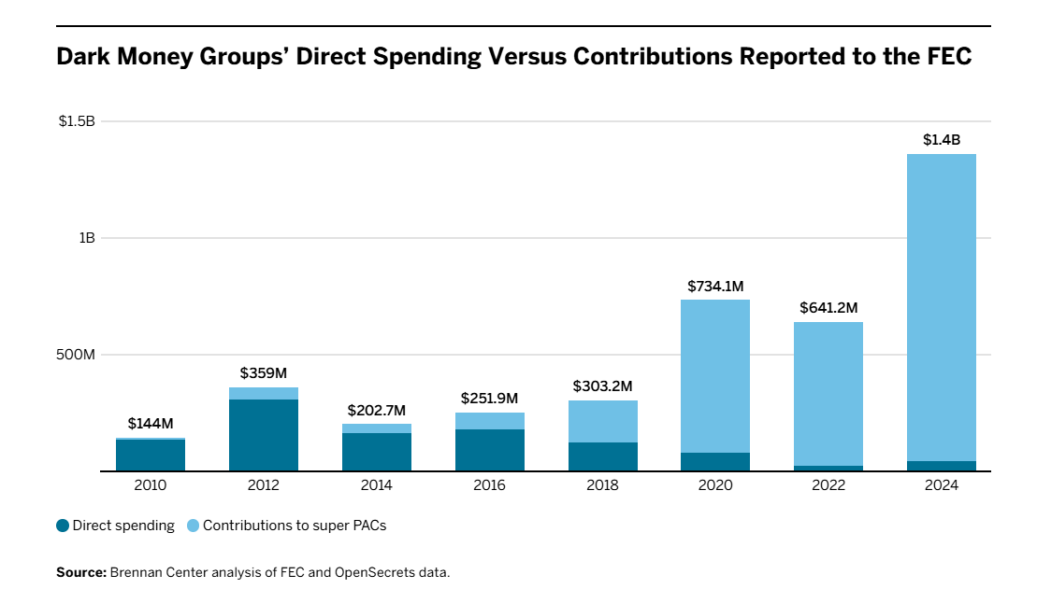

Slide 8
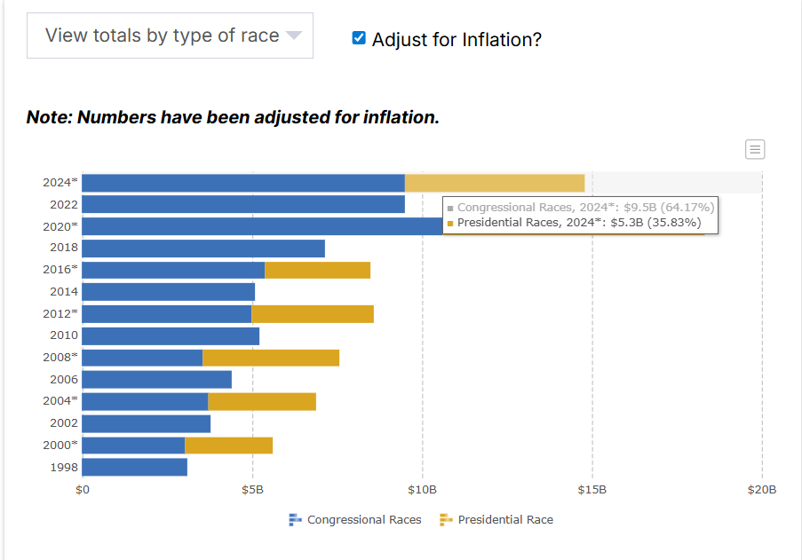

Slide 9
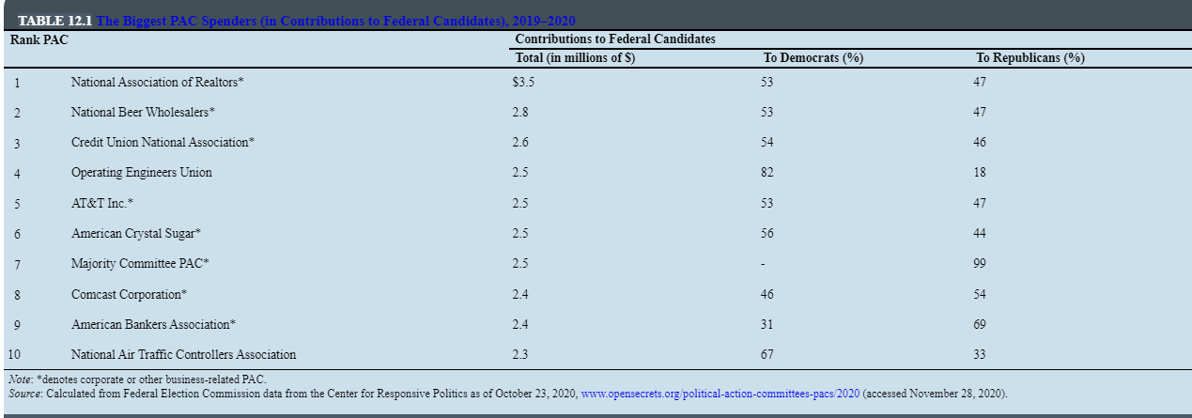

Slide 10
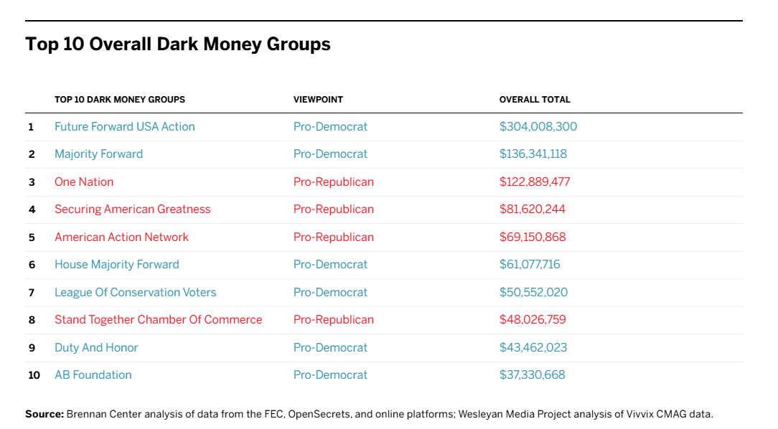

Slide 11
What do political contributions buy?
Electoral victory
Access
Votes
Activity
Not as much as people think
(Really rich political consultants)

Slide 12
Major Issues in Campaign Finance
Costs
Sources
Disclosure
Public Funding
Public Trust
Money vs. Speech
Small donors are bad
Megadonors are bad
Who is good?

Slide 13
The FECA “hard money” framework
1974 FECA
Publicity Requirements (www.fec.gov)
Contribution limits
Public Funding
Independent Expenditures
The Rise and Fall of Soft Money
The failure and lasting impact of BCRA

Slide 14
Post Citizens United world of campaign finance
Citizens United v. FEC
Role of Super-Pac’s and independent expenditures
Role of 501c’s and “dark money”
Massive rise in dark money and megadonors
Impact on Parties

Slide 15
What should we do?
Strengthen role of political parties
Public financing
Expanded disclosure
Constitutional Amendment
Nothing

Slide 17
