Slide 1
Party Polarization

Slide 2
Polarization in context
Affective polarization
Ideological polarization
Belief polarization

Slide 3
How we go here/what’s going on?
Polarization and the nationalization of politics
Racial realignment/racial issues realignment.
Education/Cultural realignment

Slide 4
Affective polarization

Slide 5
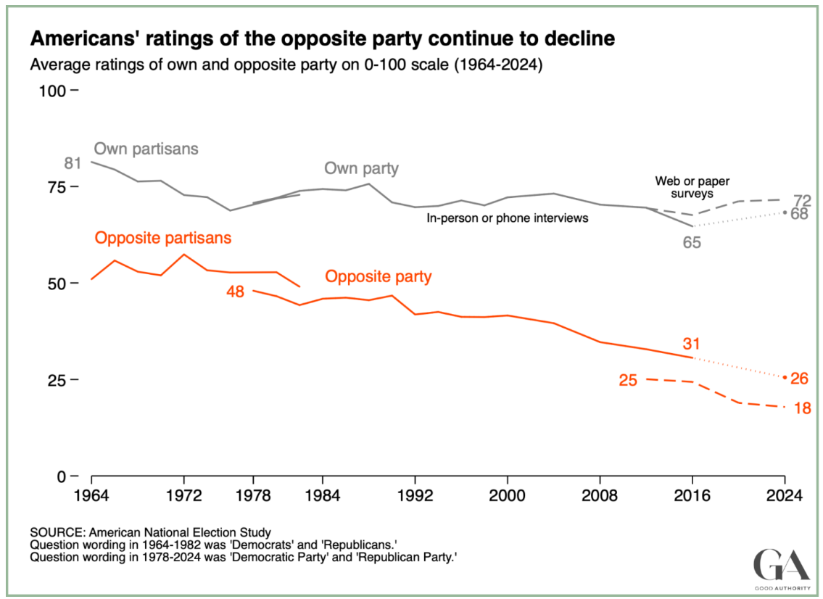

Slide 6
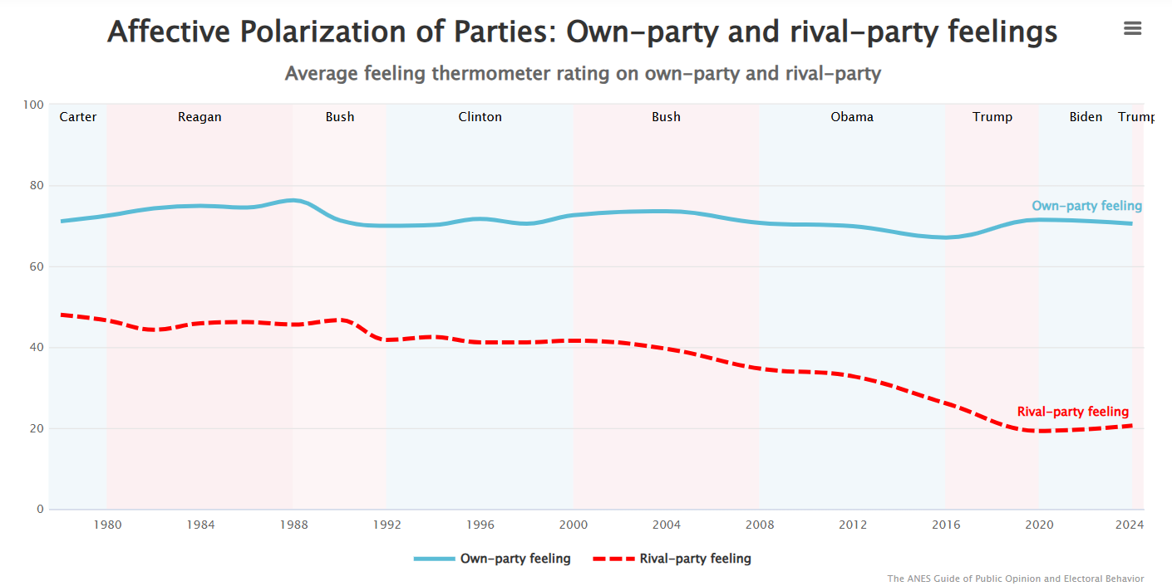

Slide 7
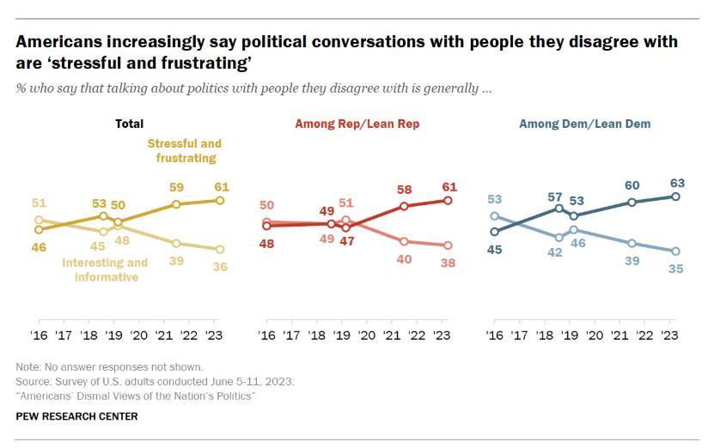

Slide 8
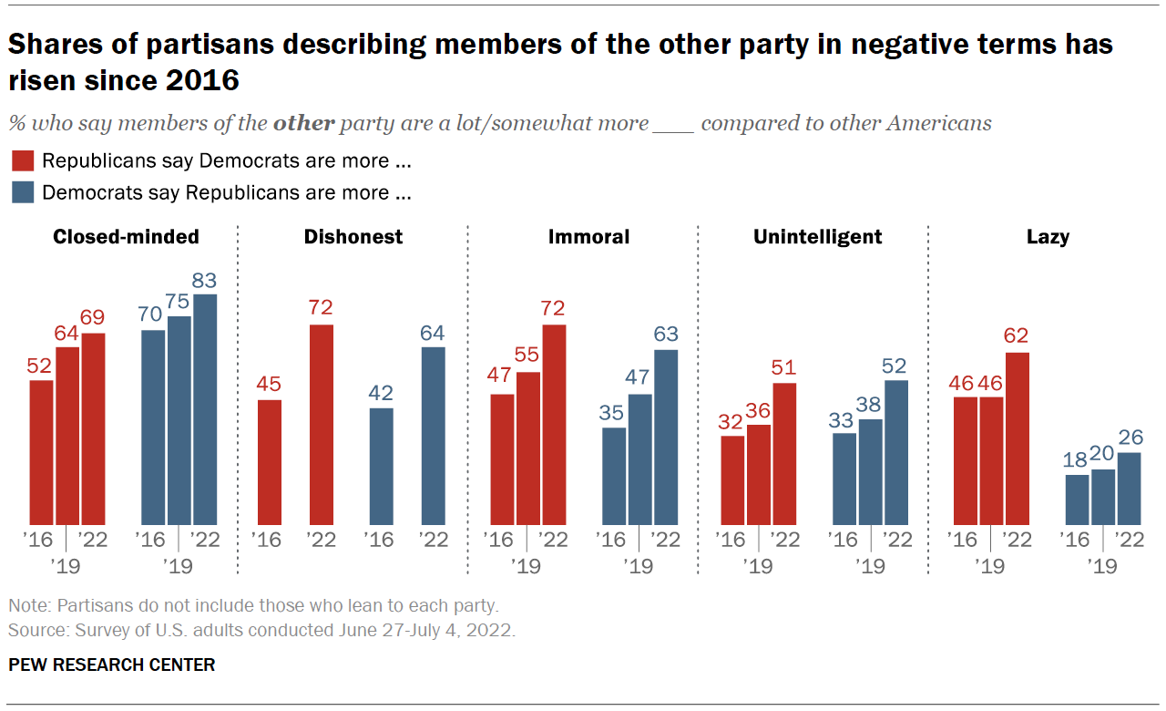

Slide 9
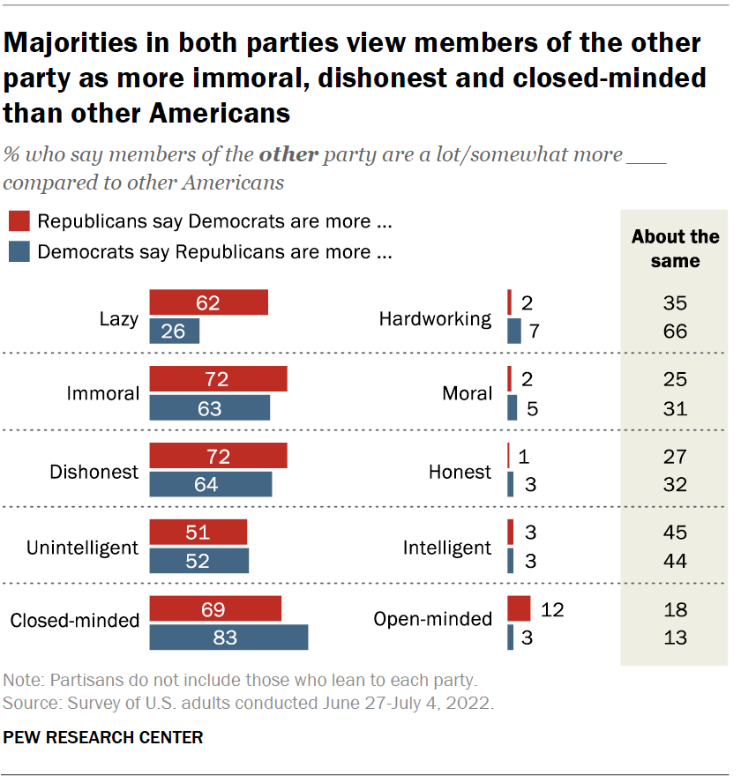

Slide 10
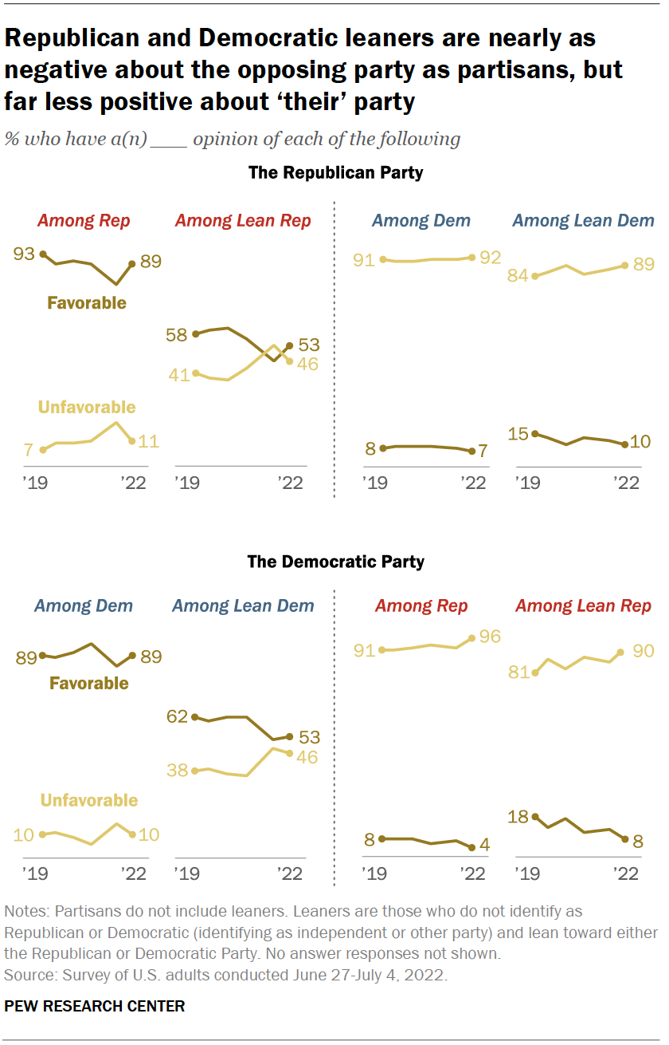

Slide 11
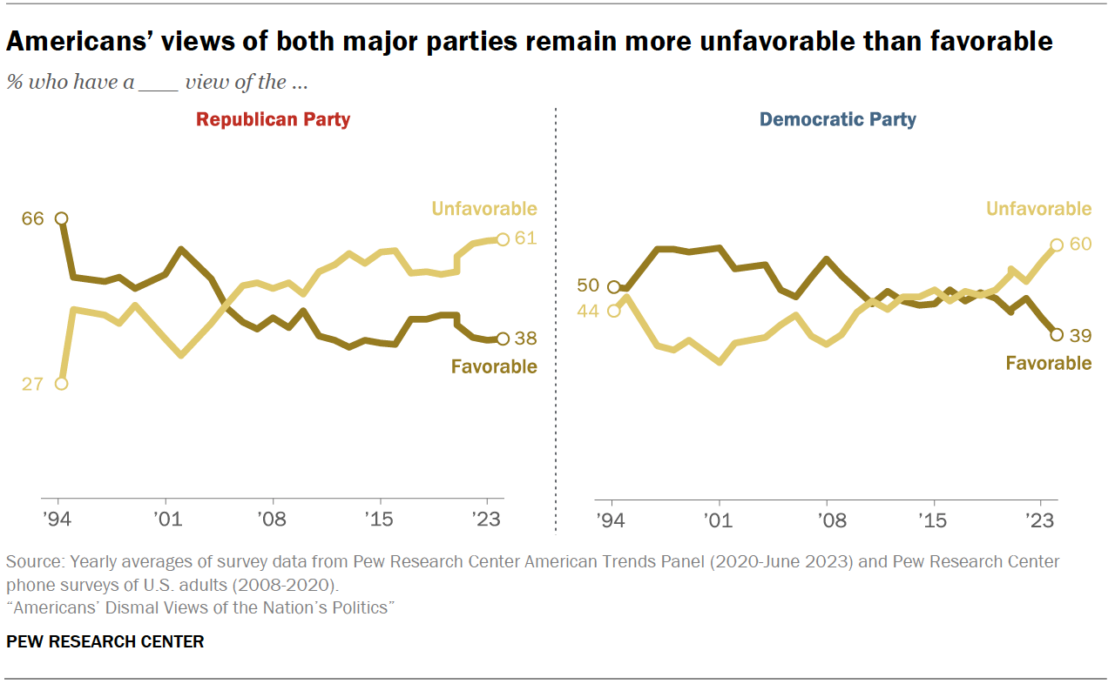

Slide 12
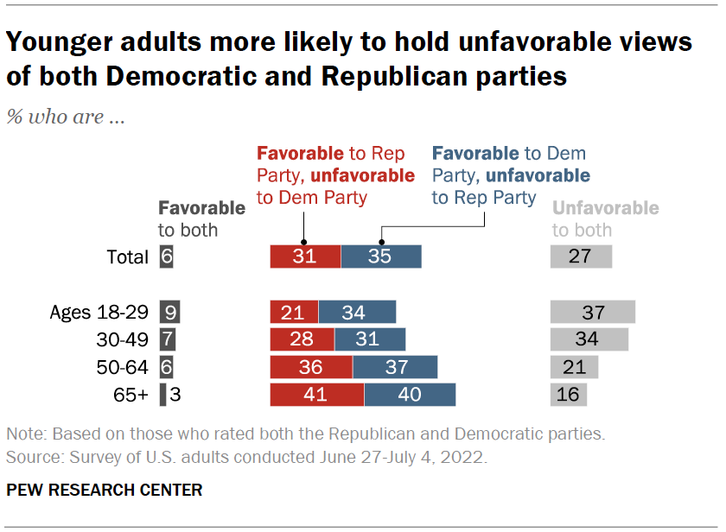

Slide 13
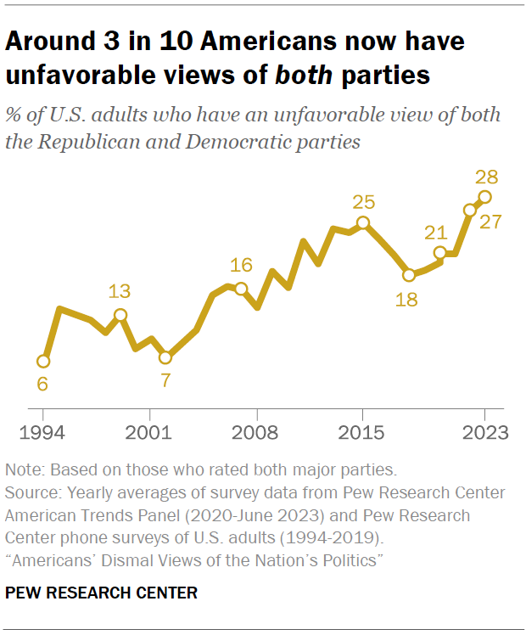

Slide 14
Ideological polarization

Slide 15
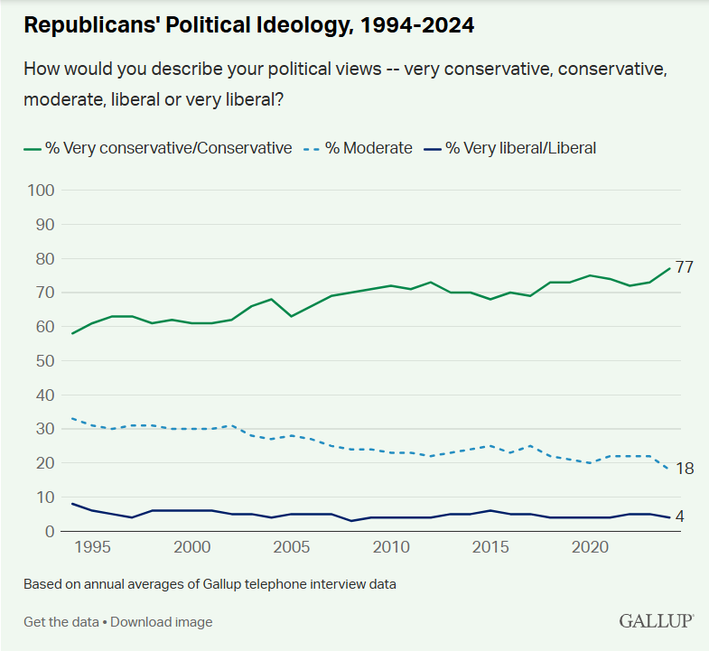

Slide 16
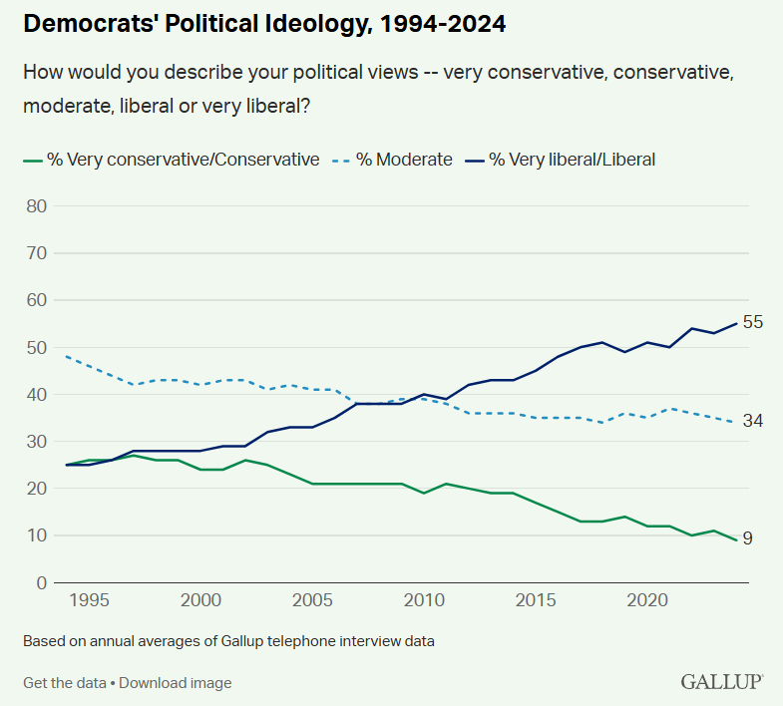

Slide 17
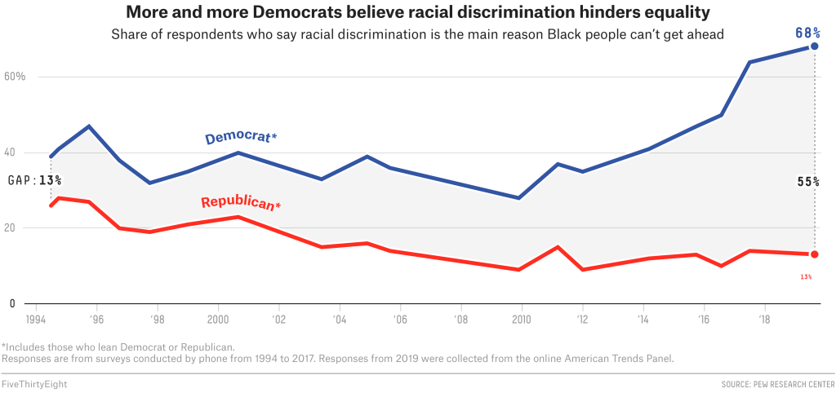

Slide 18
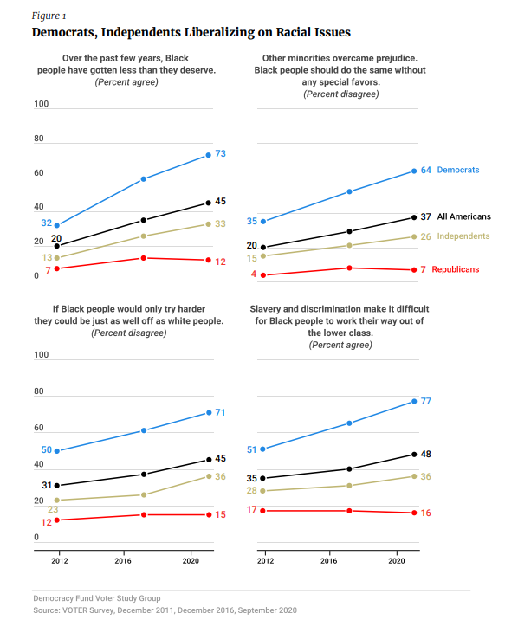

Slide 19
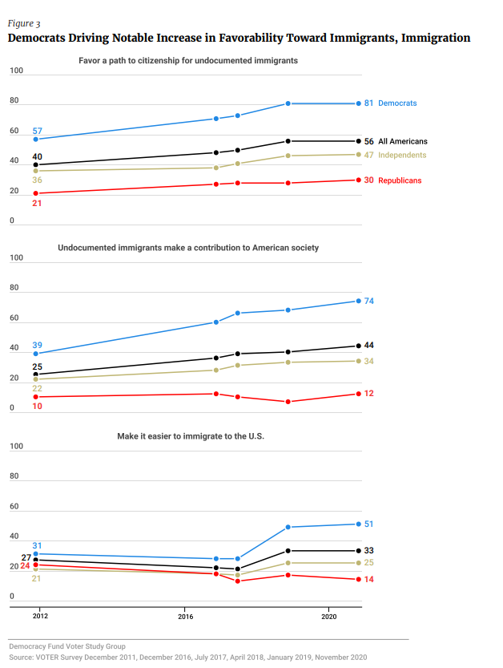

Slide 20
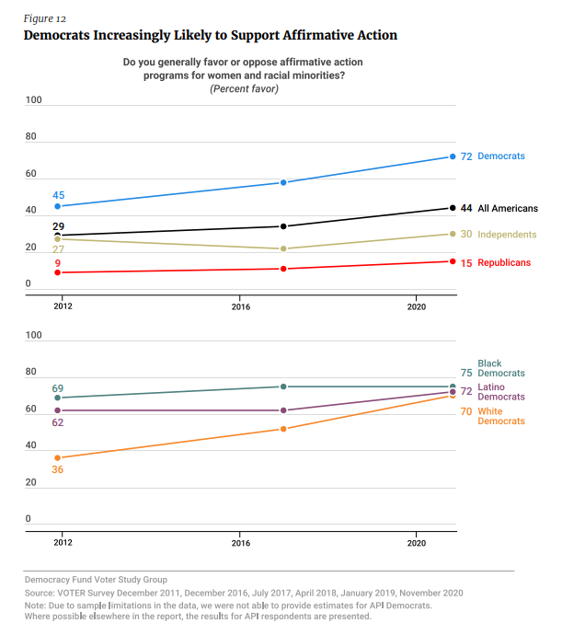

Slide 21
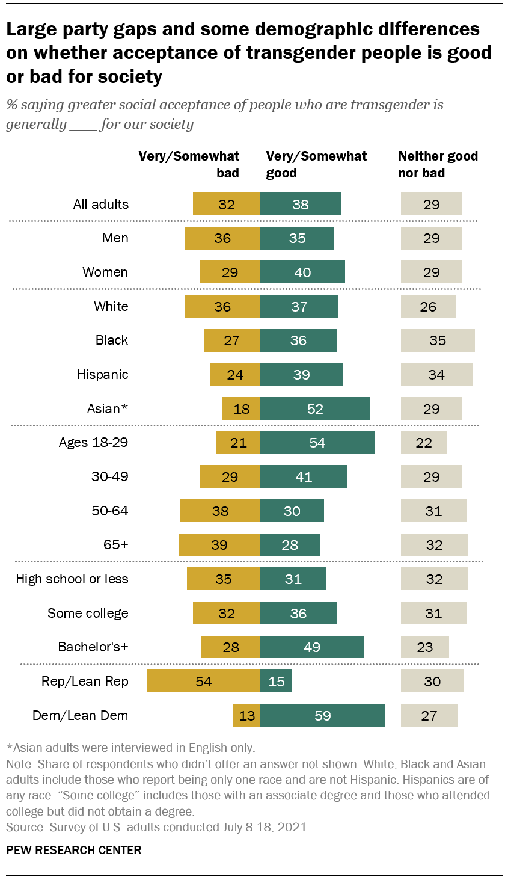

Slide 22
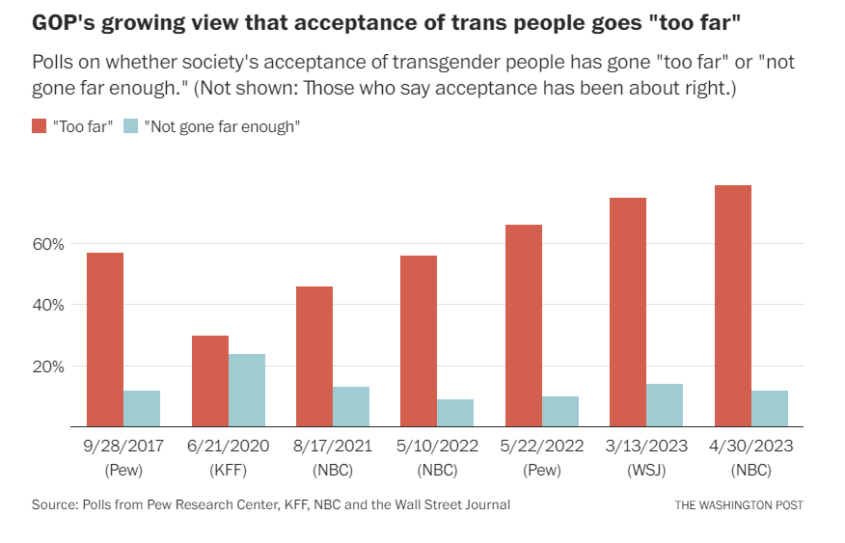

Slide 23
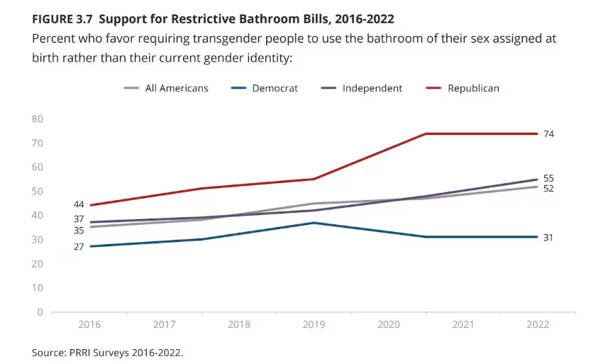

Slide 24
Demographic polarization

Slide 25
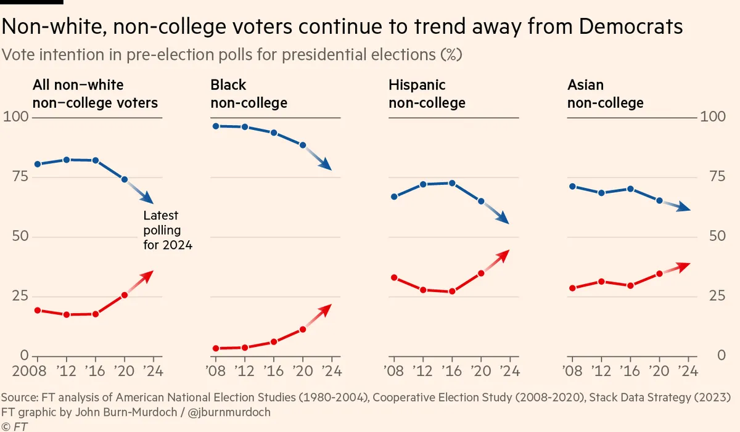

Slide 26
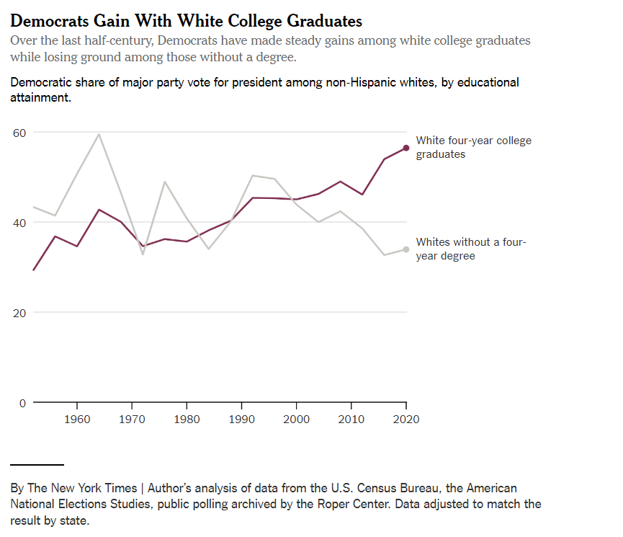

Slide 27
The future of polarization?
So, where is this all going? Do the parties need to change?

