Slide 1
Party Identification of the American Electorate

Slide 2
Introduction: Party in the Electorate
What is it?
Psychological attachment

Slide 3
Acquisition of Partisanship
Childhood influences
Adult influences

Slide 4
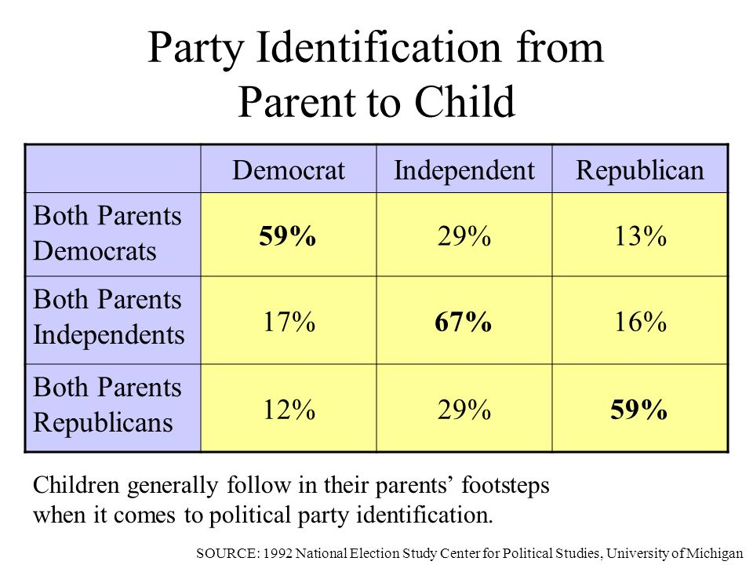

Slide 5
Modern Conceptions of Party Identification
Michigan (social-psychological) model
Partisanship and motivated reasoning
Social identity
Rational choice model
Party ID and “human nature” (genes/psychology)

Slide 6
Models of Partisanship
“real” political world (candidates, issues, etc.)
Partisanship
“real” political world (candidates, issues, etc.)
Partisanship
“real” political world (candidates, issues, etc.)
Partisanship

Slide 7
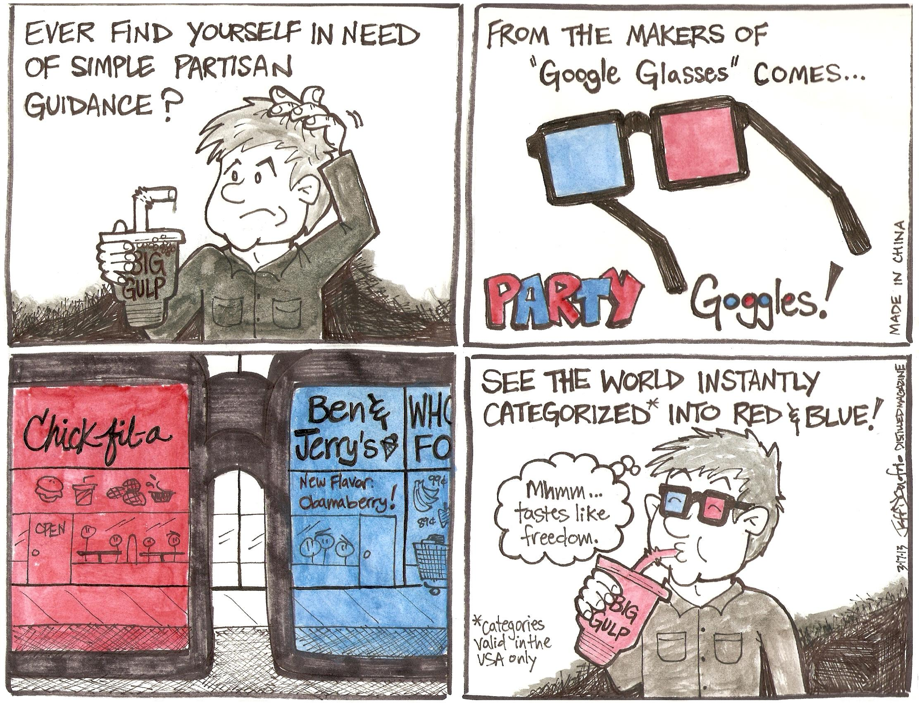

Slide 8
Measurement of PID
Michigan measure
Alternative measures
Political “independents” problem

Slide 9
Michigan PID measure
1. Generally speaking, do you usually think of yourself as a Democrat, Republican, Independent or what?
2A. Do you consider yourself a strong or not so strong Democrat/Republican
2B. Do you consider yourself to be closer to the Democratic Party, the Republican Party, or neither?

Slide 10
3 point and 7 point Michigan PID Scales
Strong Democrat
Democrat
Weak Democrat
Independent Democrat
Independent
Pure Independent
Independent Republican
Weak Republican
Republican
Strong Republican

Slide 11
2024 Party Identification (3 point)
Democrat | 34.8
Independent | 33.7
Republican | 30.3

Slide 12
2024 Party Identification (7 point)
Strong Democrat | 23.2% (26.3)
Weak Democrat | 11.6% (11.6)
Ind Democrat | 13.0% (12.9)
Pure Independent | 6.9% (3.3)
Ind Republican | 13.8% (12.2)
Weak Republican | 10.5% (10.3)
Strong Republican | 22.8% (23.3)

Slide 13
2024 Party Identification (3 point)-- reconsidered
Democrat | 47.9
Independent | 6.9
Republican | 45.2

Slide 14
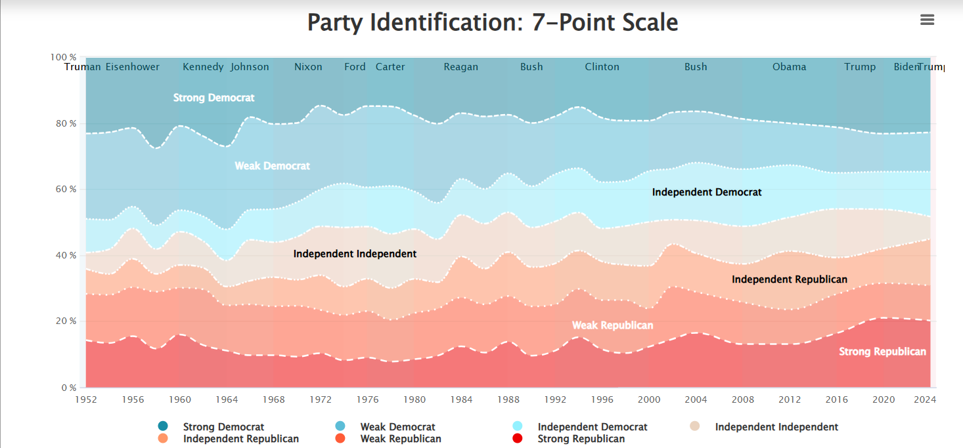

Slide 15
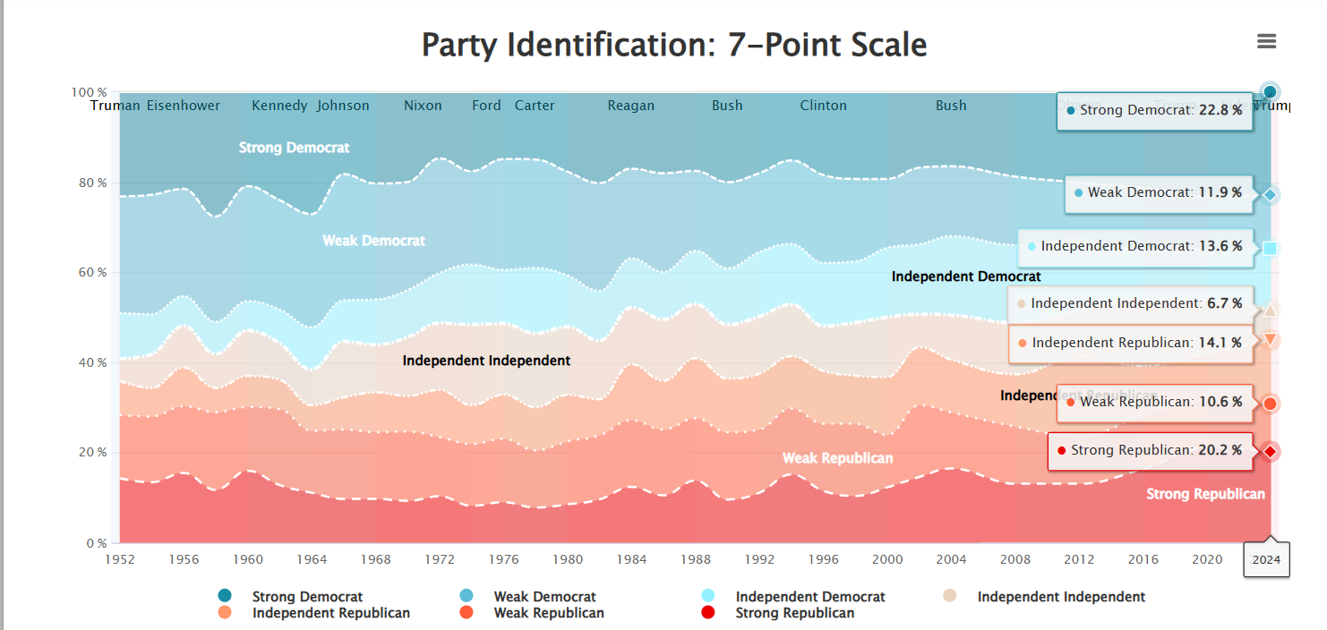

Slide 16
Political Impact of PID
Everything is PID
PID and the vote
Party vs. candidates and issues
Partisanship and political activity
The rise of party identity and tribalism
Rise of negative partisanship

Slide 17
Party Identification and Vote Choice
Party Identification | All | Harris | Trump
Democrat | 35% | 98% | 3%
Republican | 34% | 5% | 95%
Independent | 31% | 55% | 45%

Slide 18
Party Identification and Vote Choice (II)
Party Identification | All | Harris | Trump
Strong Democrat | 23% | 99% | 2%
Weak Democrat | 12% | 96% | 4%
Lean Democrat | 13% | 93% | 7%
Pure Ind | 7% | 55% | 45%
Lean Republican | 14% | 13% | 87%
Weak Republican | 11% | 13% | 87%
Strong Republican | 21% | 2% | 98%

Slide 19
Party Identification and Vote Choice
Party Identification | All | Biden | Trump
Democrat | 36% | 96% | 4%
Republican | 35% | 9% | 91%
Independent | 29% | 59% | 41%

Slide 20
Party Identification and Vote Choice (II)
Party Identification | All | Biden | Trump
Strong Democrat | 25% | 98% | 2%
Weak Democrat | 11% | 92% | 8%
Lean Democrat | 12% | 97% | 3%
Pure Ind | 8% | 60% | 40%
Lean Republican | 10% | 16% | 84%
Weak Republican | 11% | 20% | 80%
Strong Republican | 24% | 3% | 97%

Slide 21

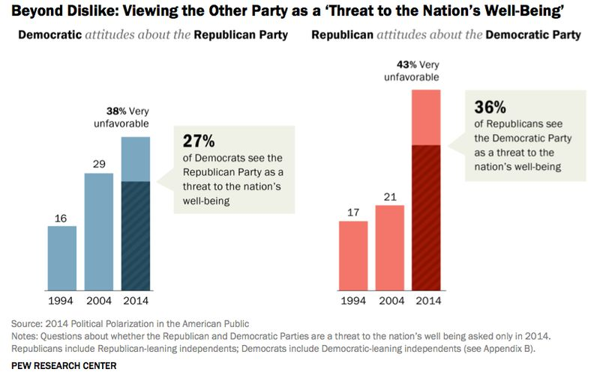

Slide 22
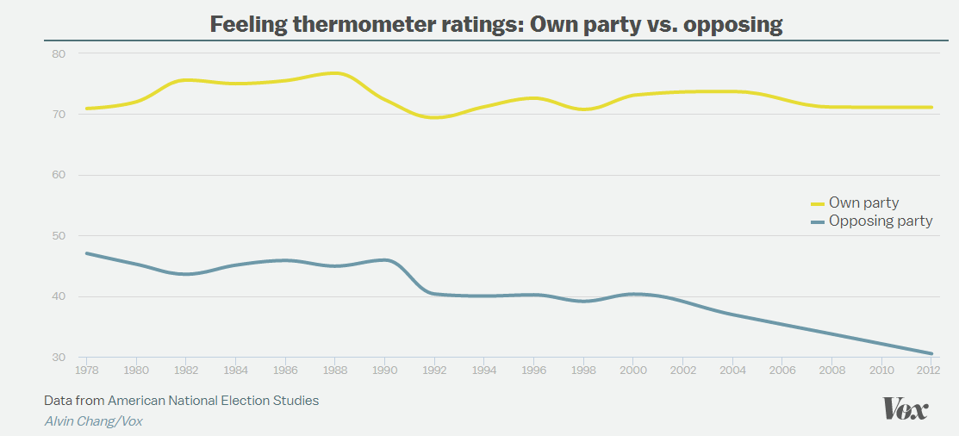

Slide 23
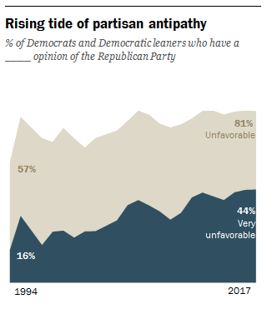
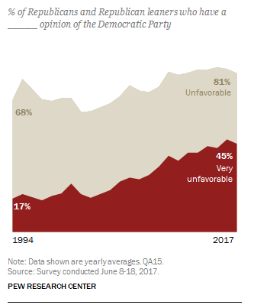

Slide 24
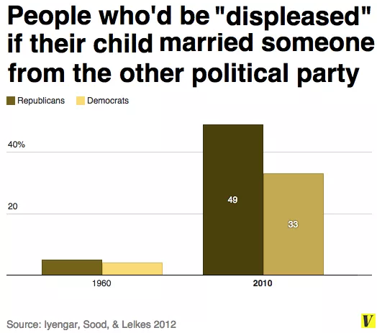

Slide 25
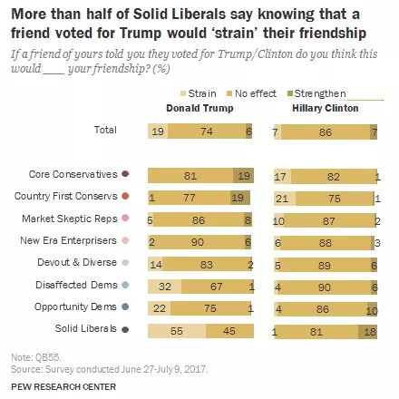

Slide 26
Social Bases of Partisanship
Partisan realignments and historical context
The 6th party system
Socio-economic status (SES)
Sectional cleavages
Religious cleavages
Race
Gender
Age/Generation
Growing education/class gap?
PID Quiz– thoughts?

Slide 27
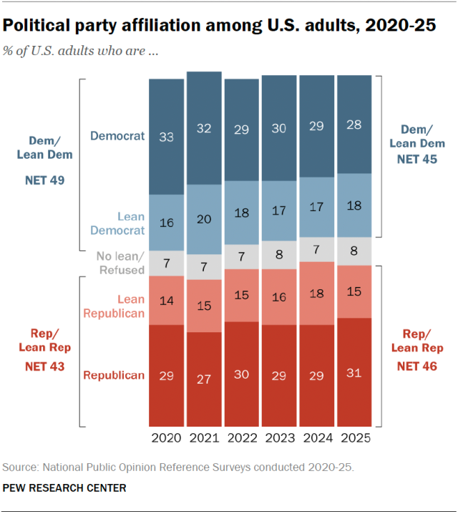

Slide 28
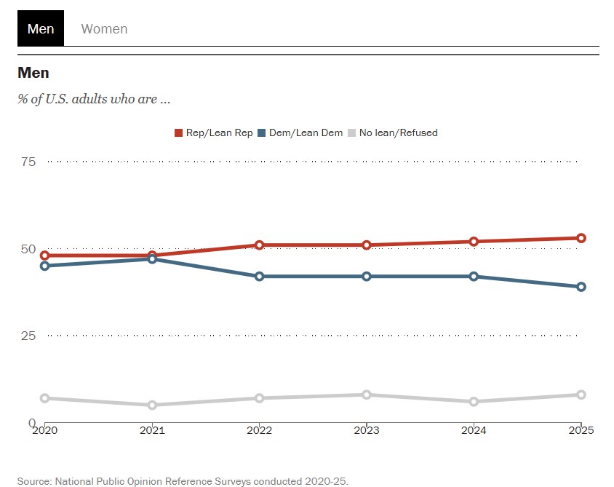
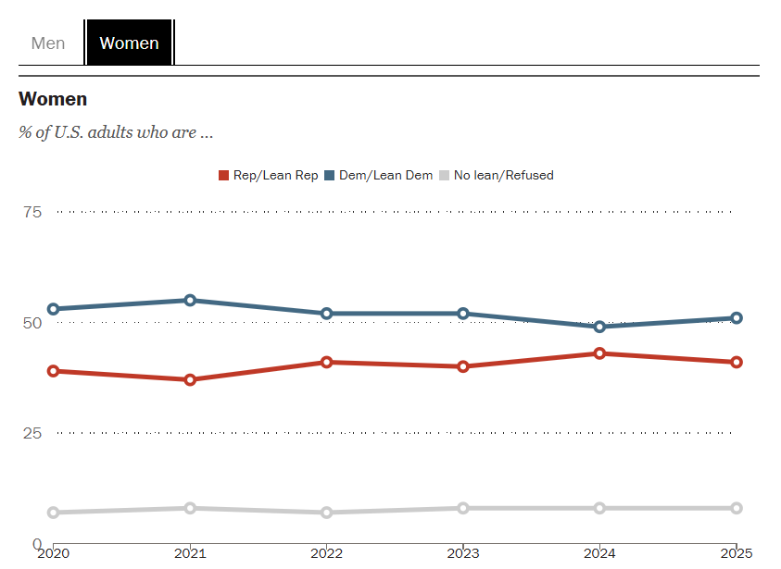

Slide 29
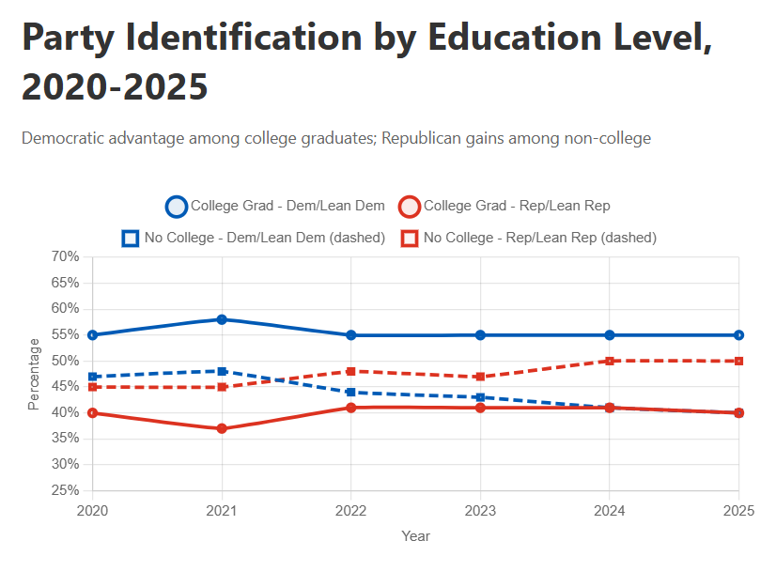

Slide 30
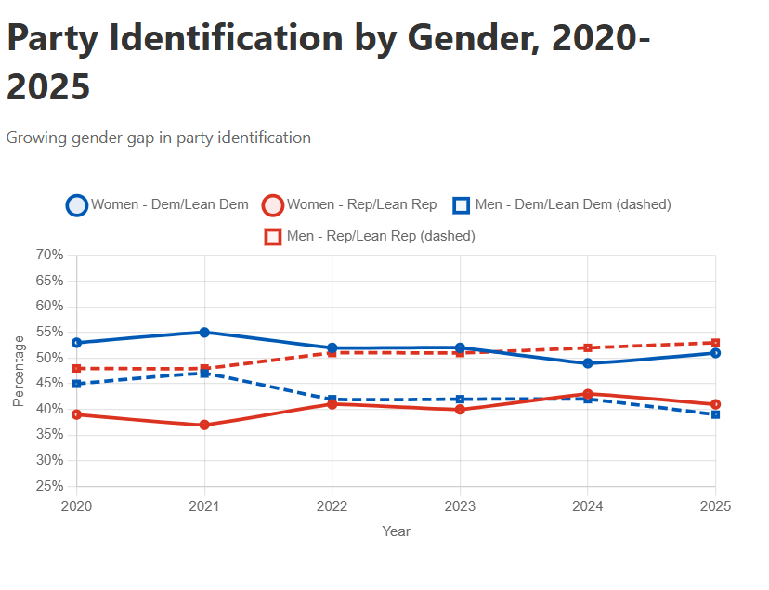

Slide 31
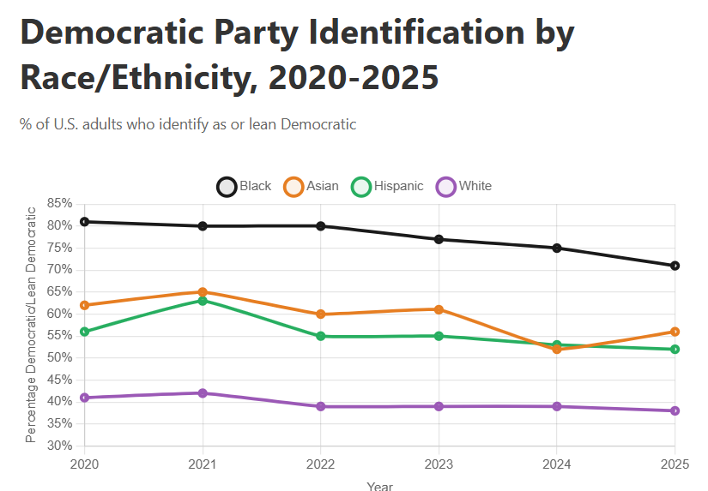

Slide 32
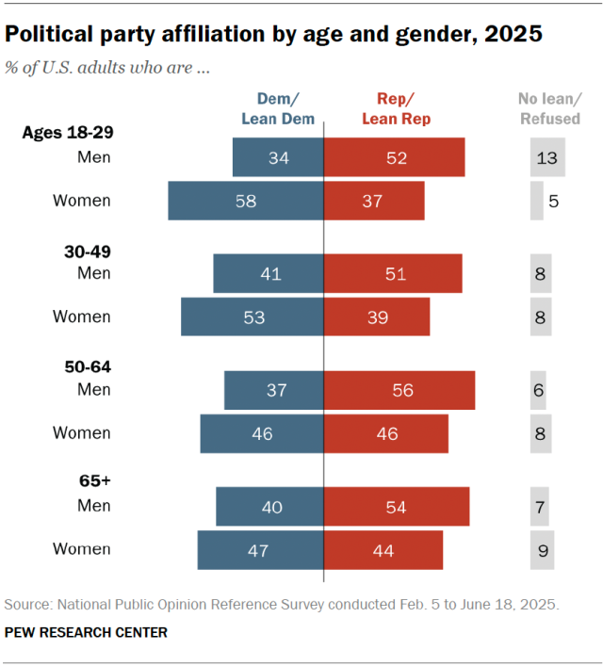

Slide 33
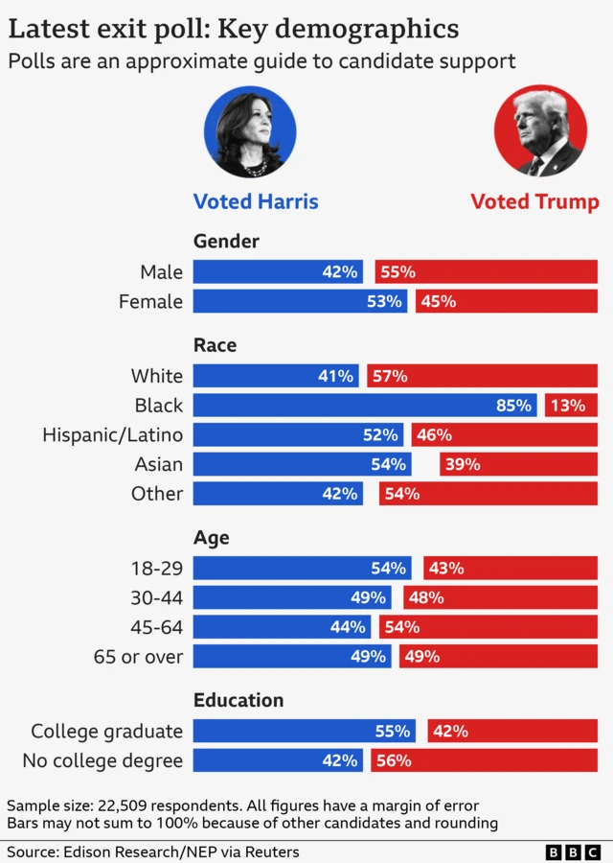

Slide 34
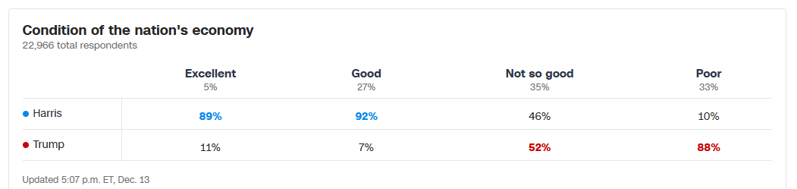

Slide 35
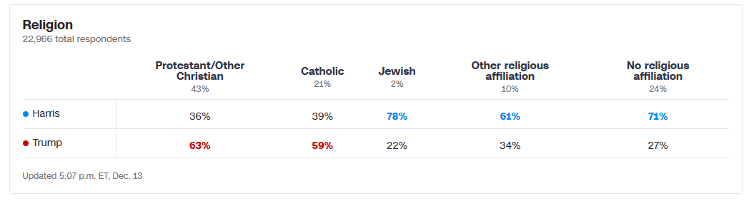
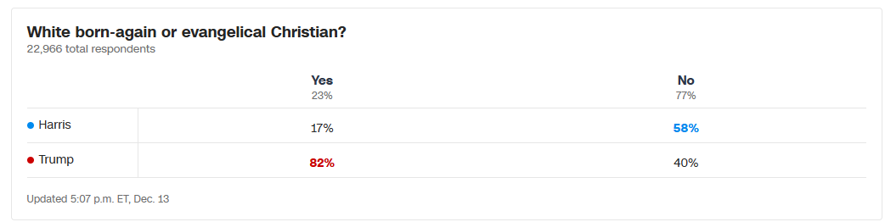

Slide 36
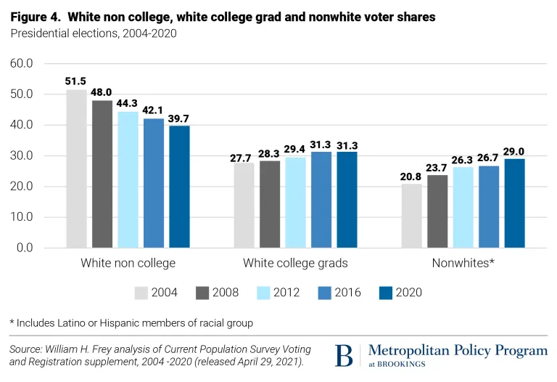
The changing electorate

Slide 37
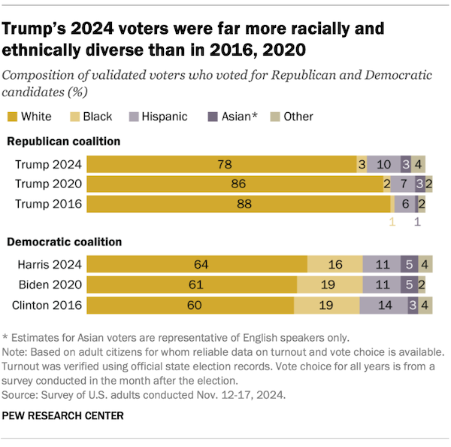

Slide 38
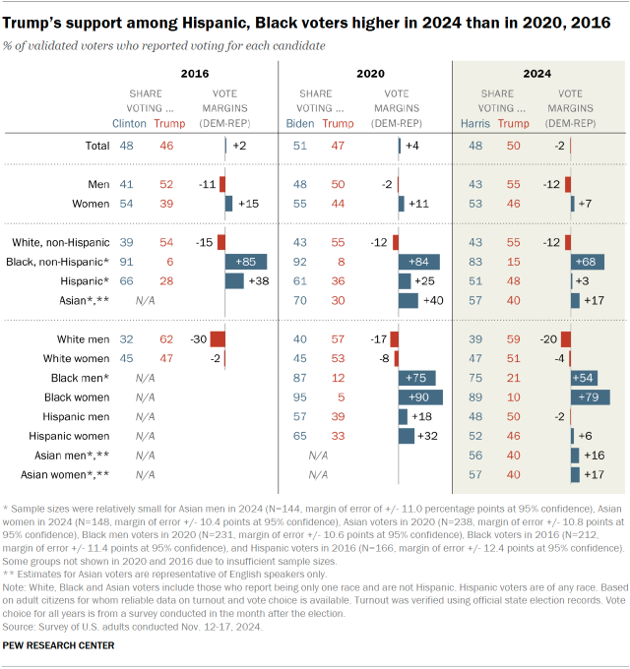

Slide 39
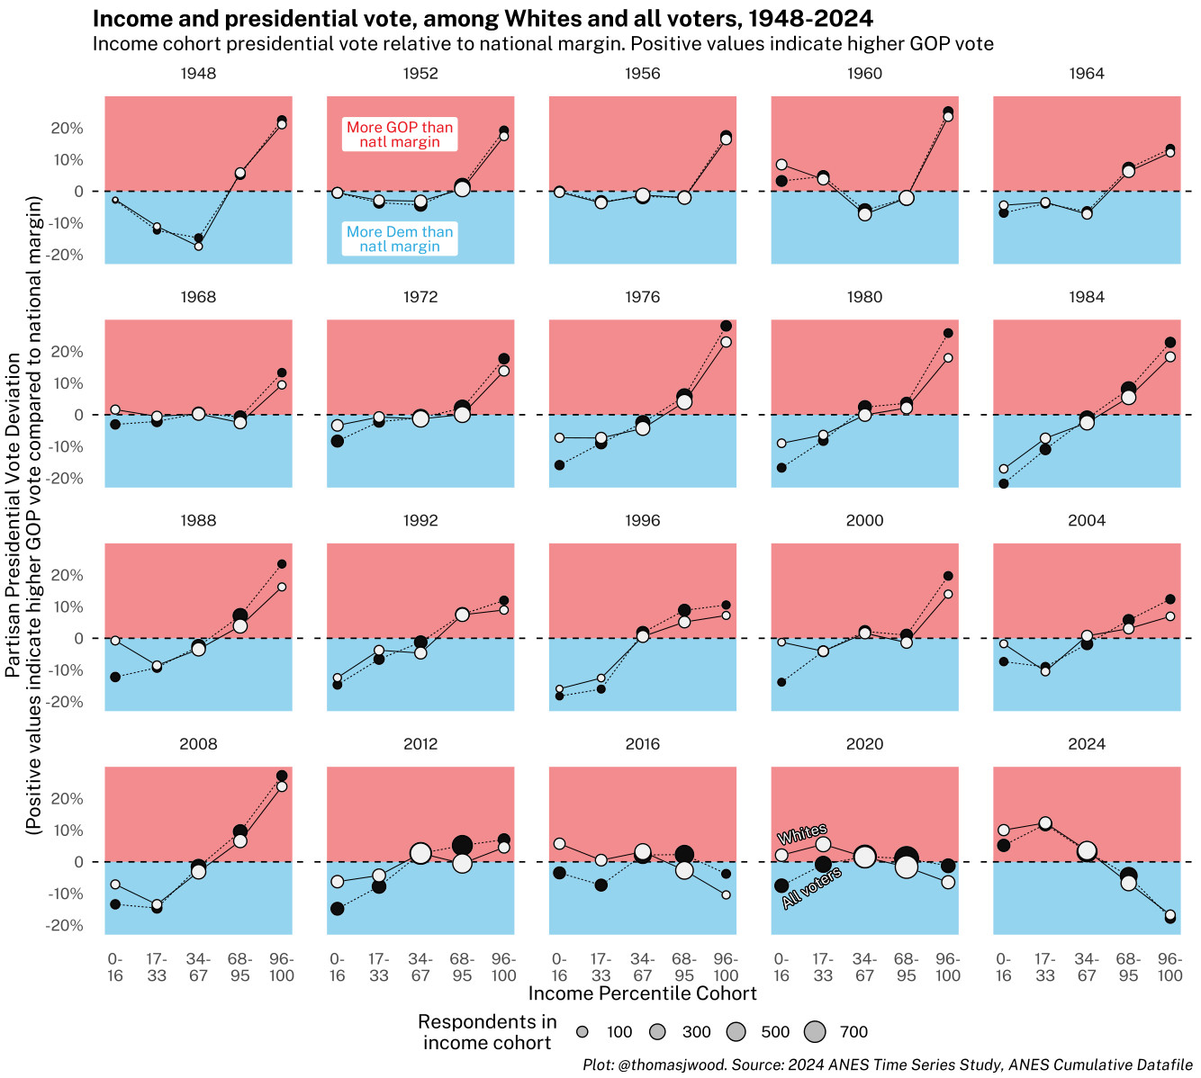

Slide 40
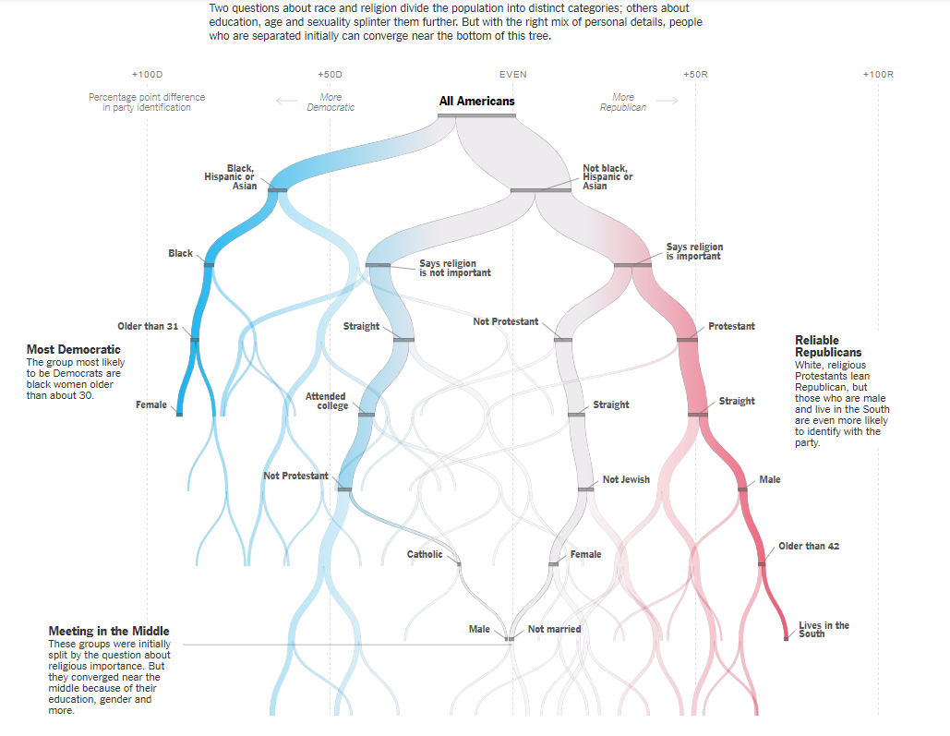

Slide 41
Partisanship in the Trump era
Ideological polarization
Changing influence of party coalitions
Educational and cultural polarization
Electoral balance

