Slide 1
The Structure of Party Systems

Slide 2
Thinking about parties through an alien perspective
Kang and Kodos

Slide 3
The Paradox of America’s Party system (in chart form)

Slide 4
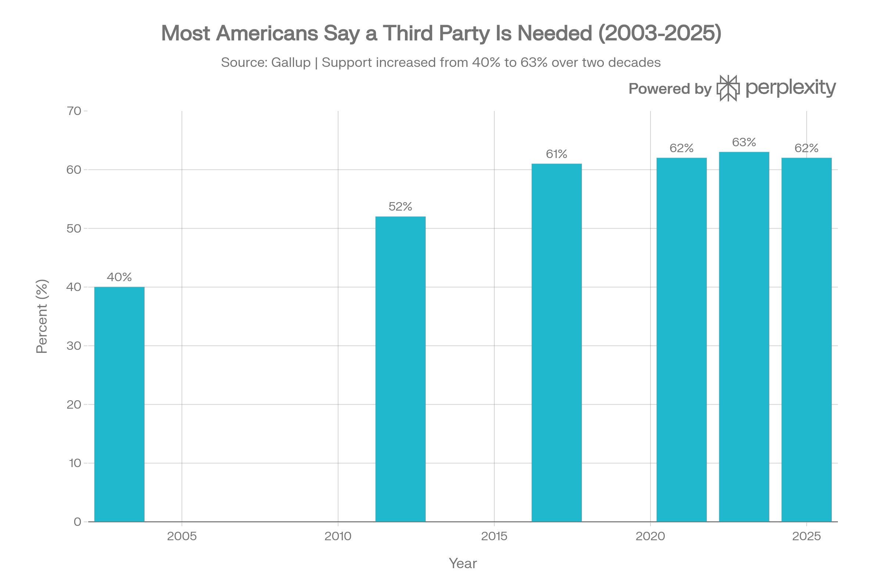

Slide 5
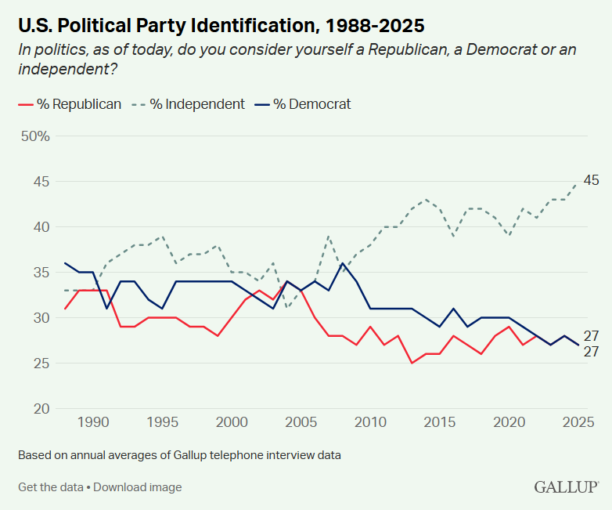

Slide 6
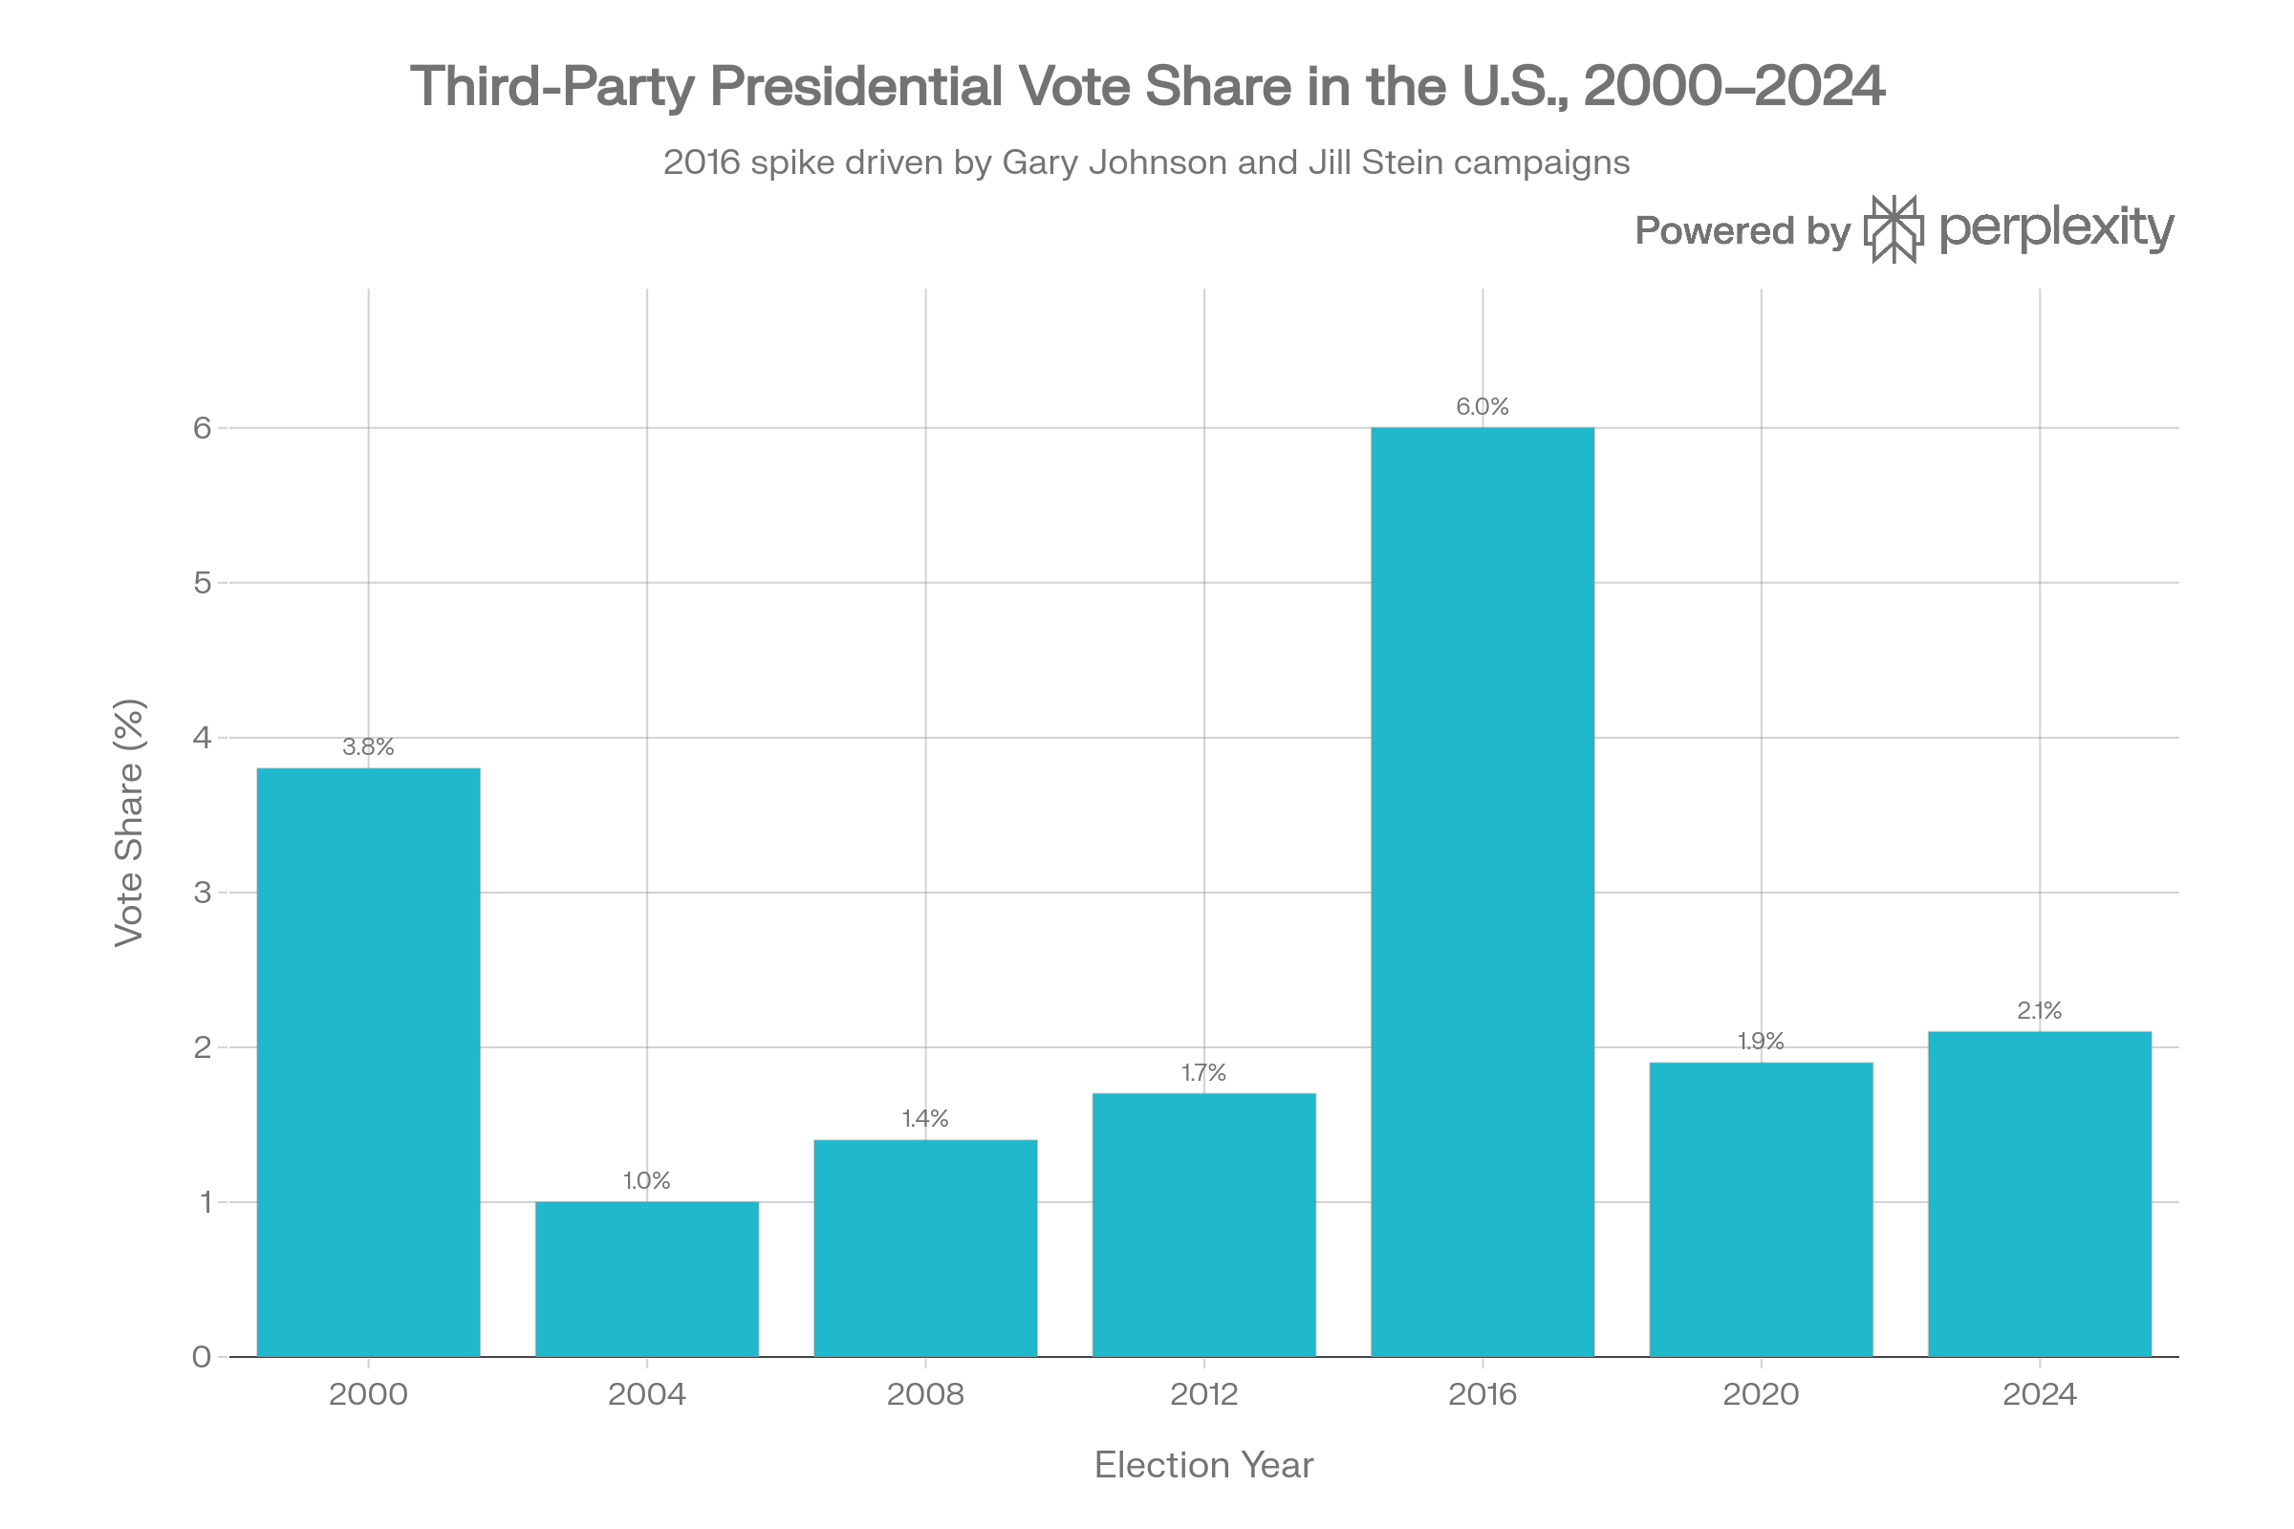

Slide 7
Electoral Systems
Diversity of party systems
Electoral Systems
First past the post/Plurality
Proportional Representation
  Party List
  MMP
Ranked Choice
  Majority
  Single transferable vote

Slide 8
Impact of electoral system on party structure
Duverge’s “Law”
PR systems
US Presidential nominations

Slide 9
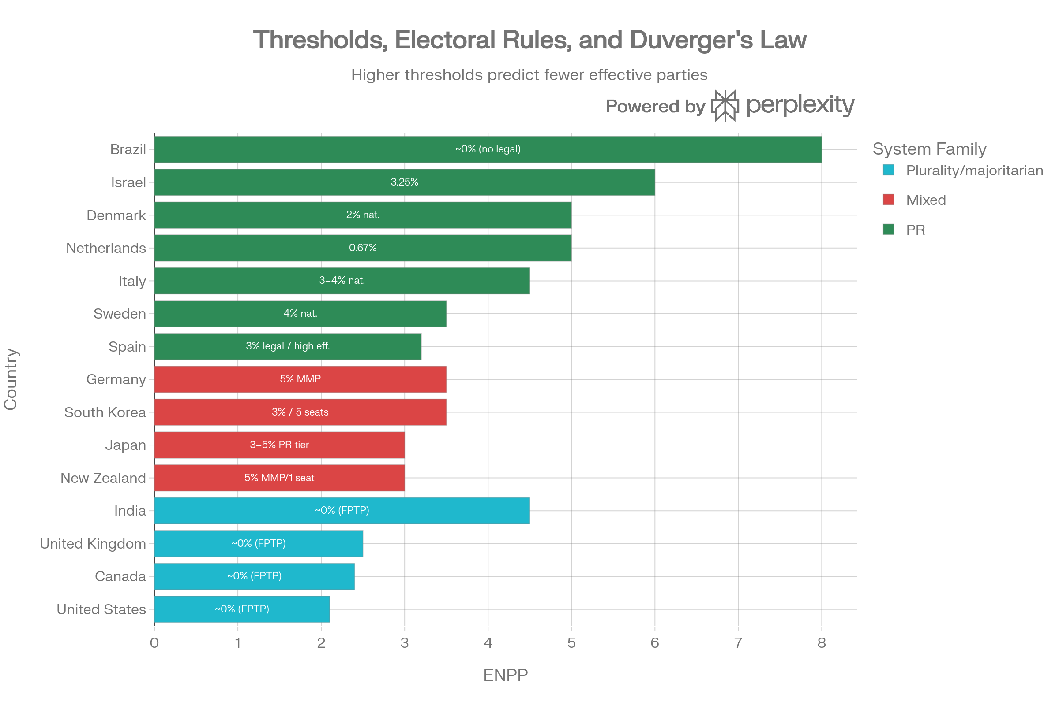

Slide 10
Dimension | Plurality (FPTP, single‑member) | Proportional Representation (PR)
Typical party system | Tends toward two major parties (Duverger’s law) | Stable multiparty systems
Proportionality of seats | Low: large parties overrepresented, small parties penalized | High: seat shares closely match vote shares
Representation of minorities | Often underrepresents smaller and diffuse groups | Better inclusion of smaller parties and social groups
Government formation | Single-party governments common; clear alternation in power | Coalitions common; power-sharing and bargaining routine
Clarity of responsibility | High: voters can more easily attribute policy to one governing party | Lower: coalition bargaining can blur accountability
Voter choice structure | Often binary major-party choice; third parties seen as “spoilers” | More genuine multiparty choice; fewer wasted votes
Thresholds and barriers | No formal legal threshold; strong de facto barriers via mechanical/psych effects | Legal thresholds or district magnitudes shape which small parties win seats

Slide 11
The American two-party system
Always two parties; not always the same parties (even when they have the same name)
Party systems and realignments
State party “systems”
The 20th century’s “hidden” multi-party system

Slide 12
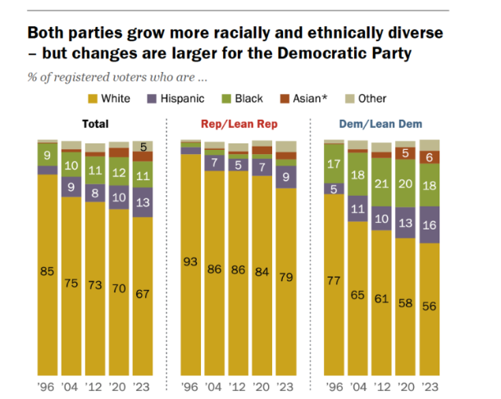

Slide 13
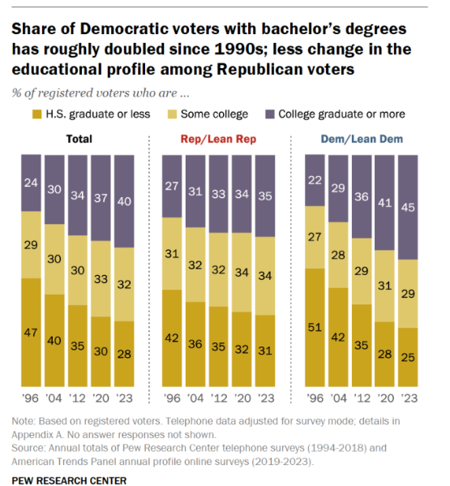

Slide 14
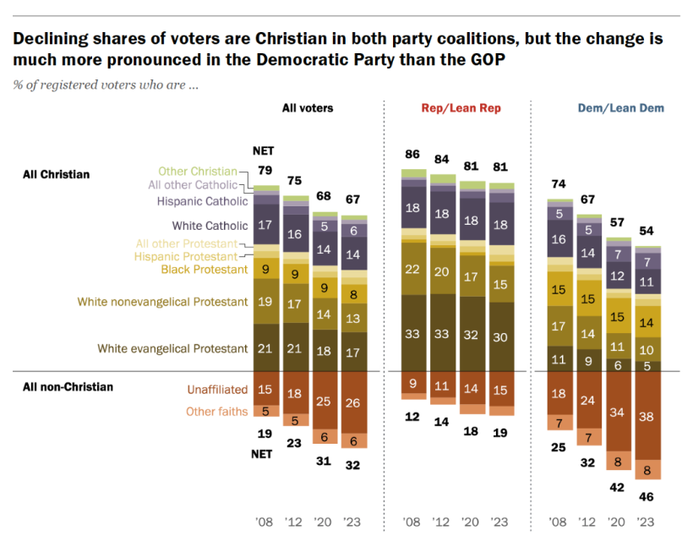

Slide 15
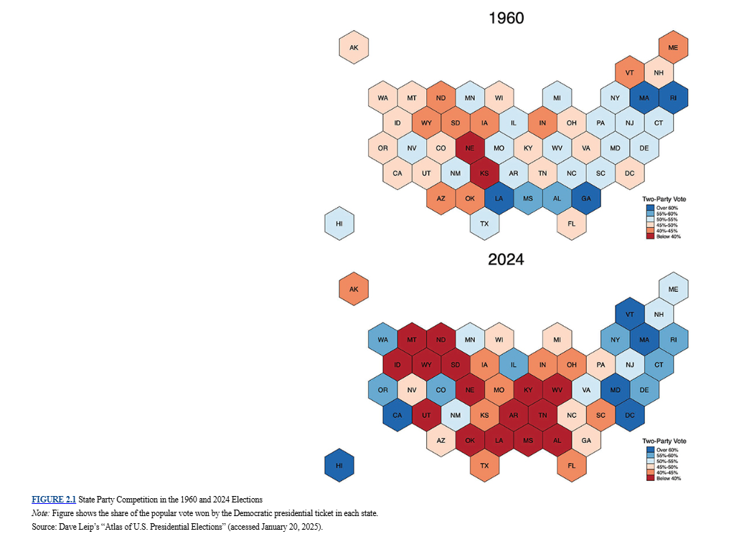

Slide 16
Third parties in America
U.S. Constitution (Duverge’s Law)
Historical evolution
Institutional barriers
Political barriers
The vicious cycle of failure
When third parties succeed

Slide 17
Is our two-party system bad for democracy?
Well?

Slide 18
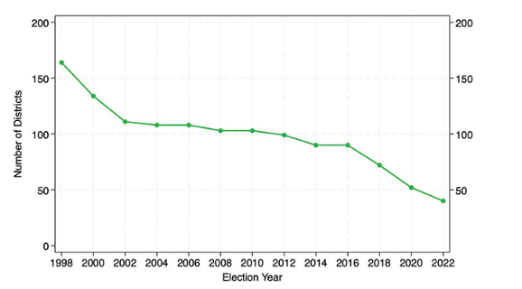

Slide 19
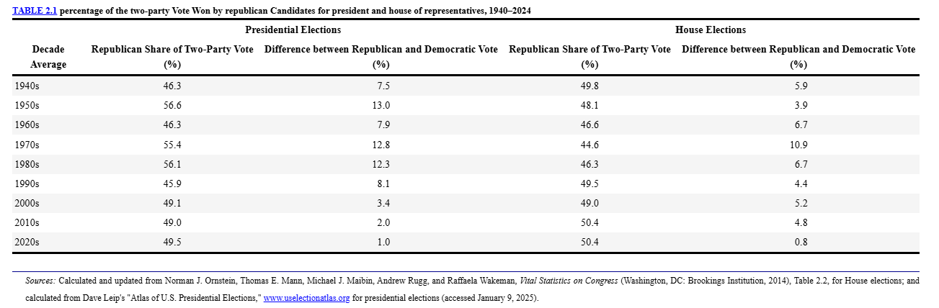

Slide 20
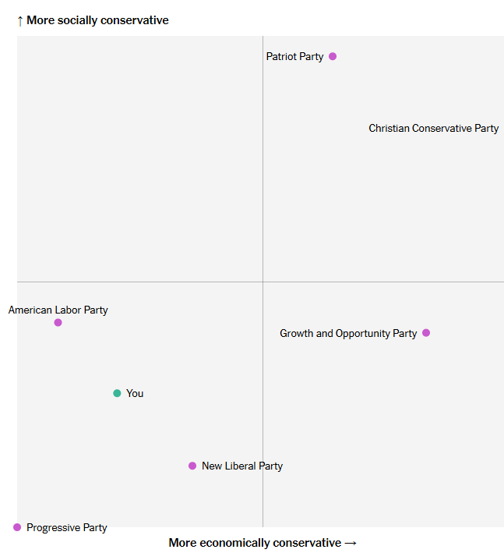

Slide 21
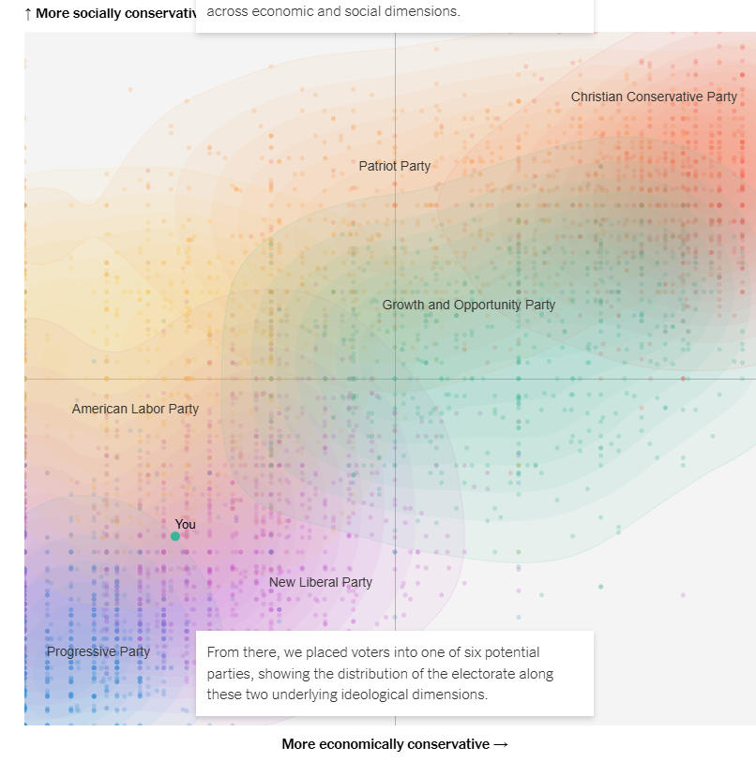

Slide 22
The Future?
Well?

