Slide 1
Equality: Race and Gender

Slide 2
Introduction: Equality
Equality under the law
Equality under the law in practice
Equality of opportunity
Defining equality of opportunity
Race, gender, and the 14th amendment
  Civil Rights Act

Slide 3
State of race and equality in contemporary America
So?
…some charts
The Racial Wealth Gap
Addressing the gaps with public policy

Slide 4
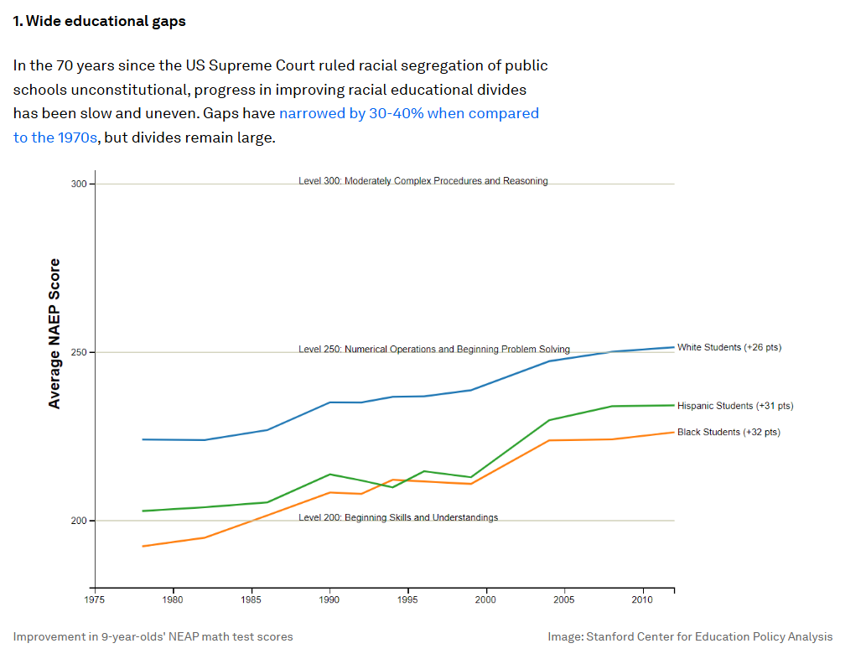

Slide 5
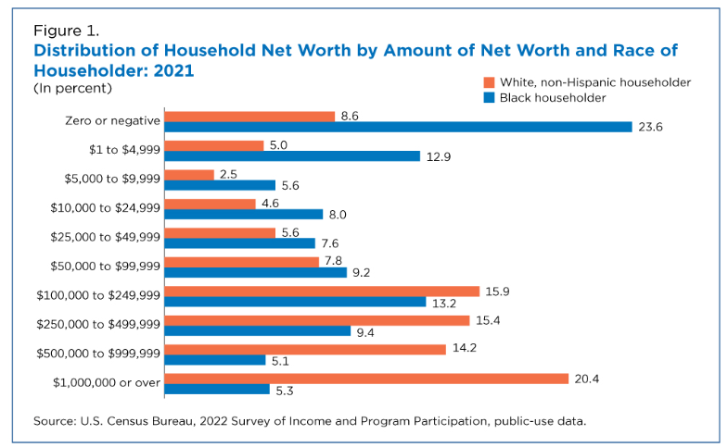

Slide 6
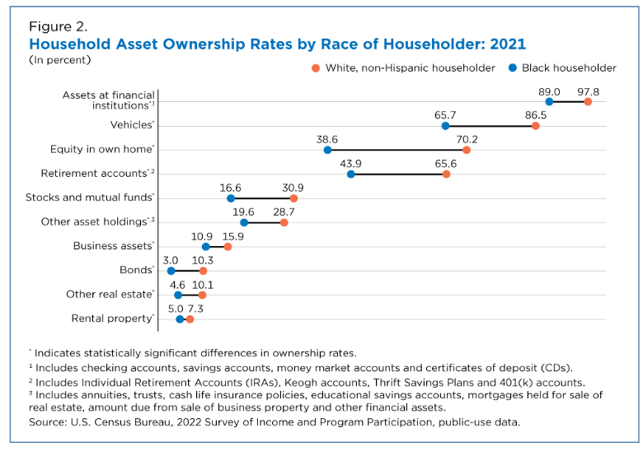

Slide 7
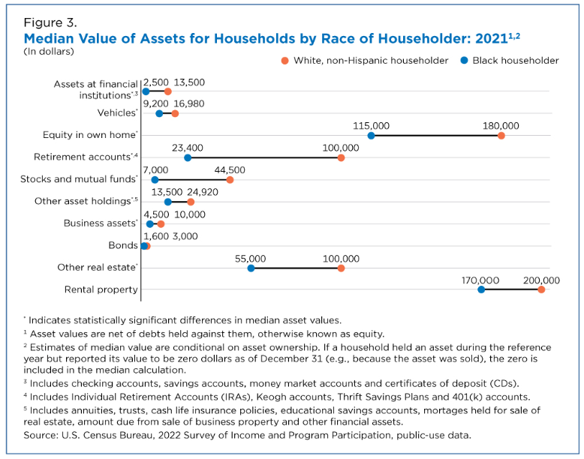

Slide 8
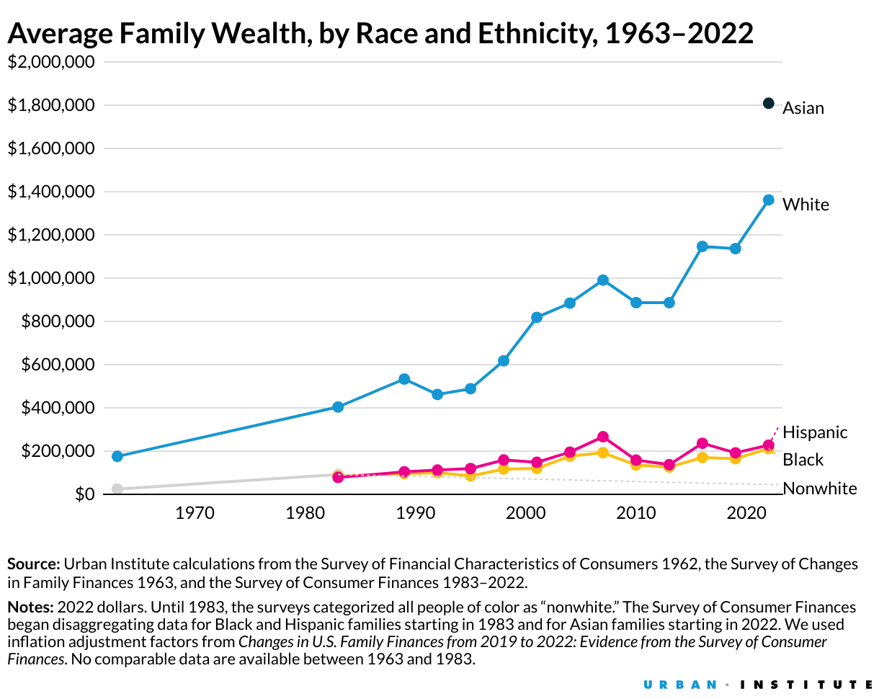

Slide 9
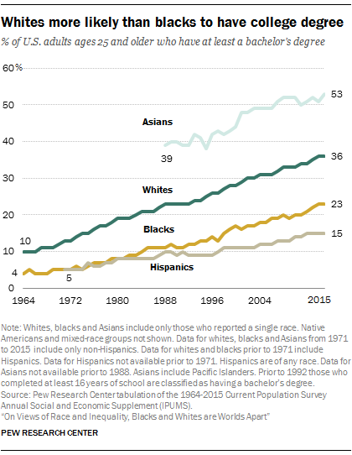

Slide 10
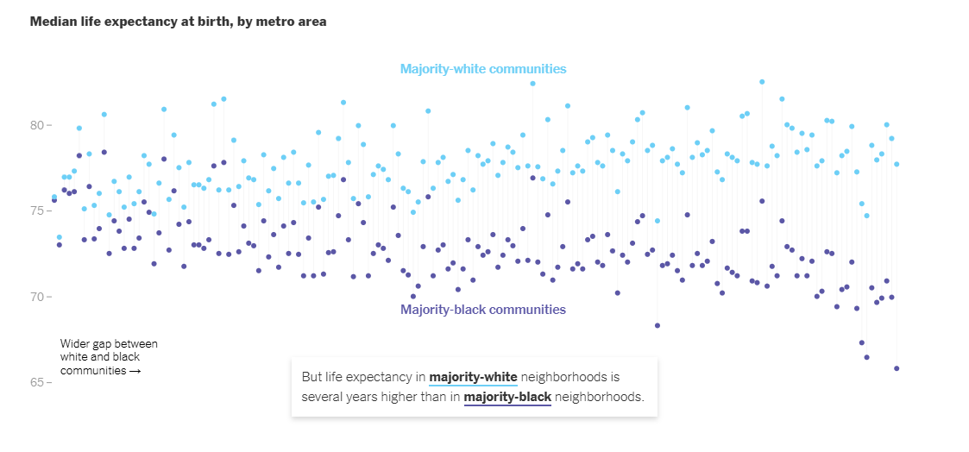

Slide 11
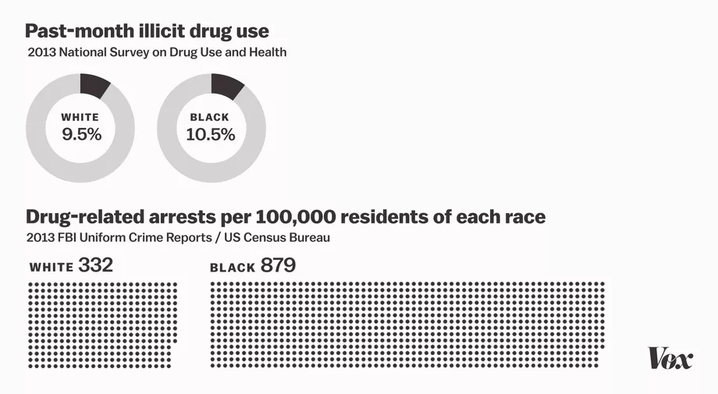

Slide 12
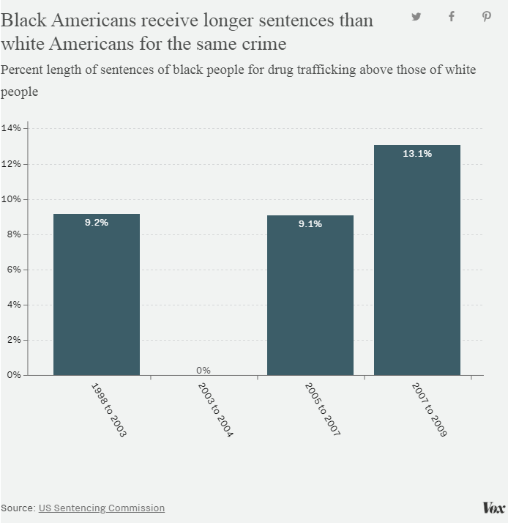

Slide 13
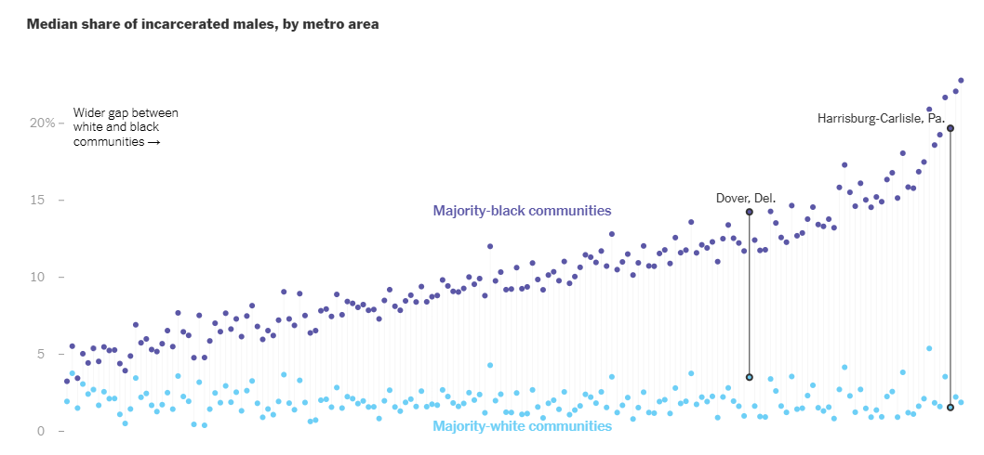

Slide 14
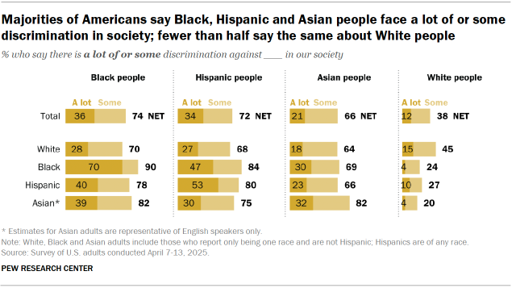

Slide 15
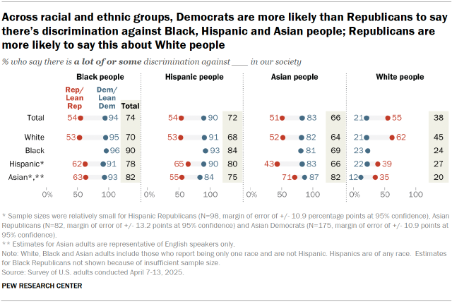

Slide 16
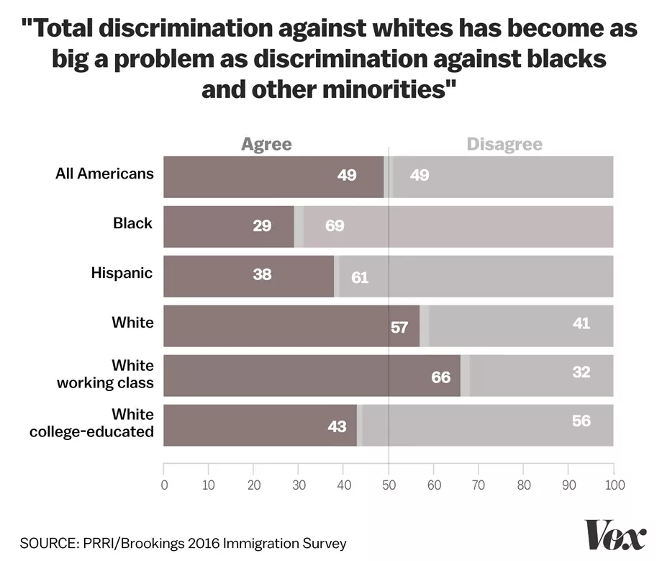

Slide 17
Affirmative Action
What is it?
Affirmative Action in Higher Education
  Students for Fair Admissions vs. Harvard
Thinking beyond affirmative action

Slide 18
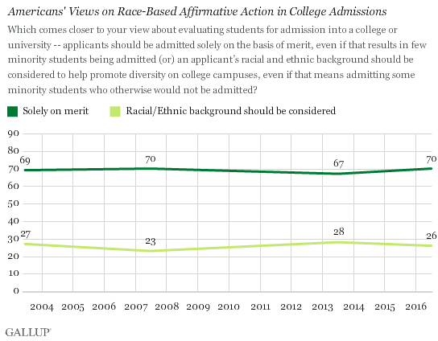

Slide 19
Gender Equality and the Constitution
Equal protection?
Gender equality in contemporary America?
Equal Rights Amendment (ERA)
14th Amendment Reconsidered

Slide 20
Gender Equality and the Economy
Economic participation
Civil Rights law
  Title VII and Title IX
Understanding the Earnings Gap

Slide 21
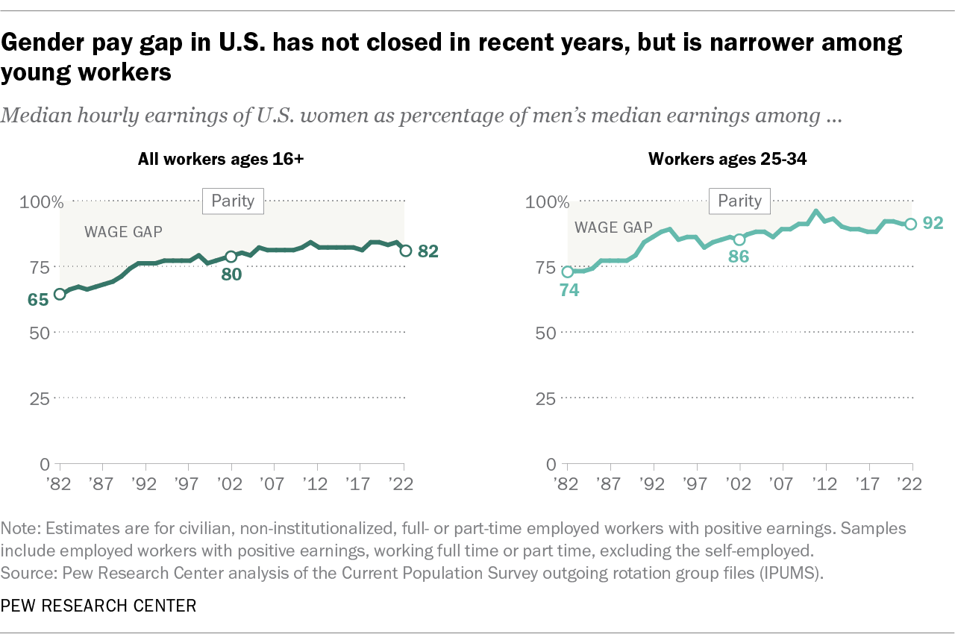

Slide 22
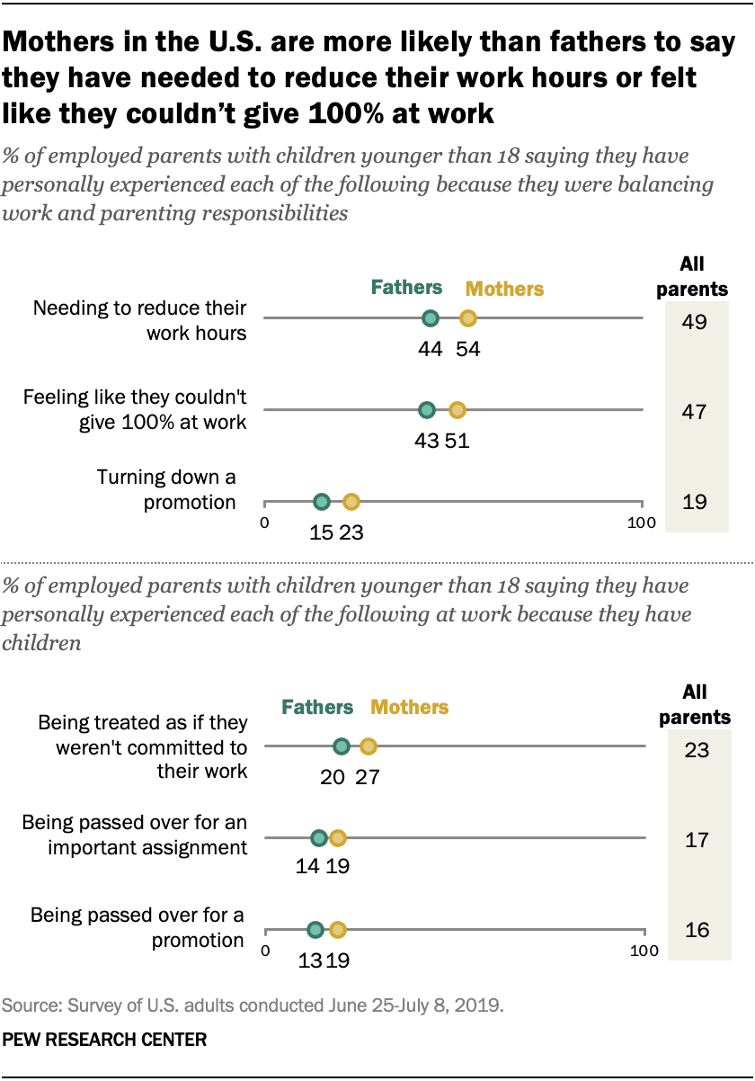

Slide 23
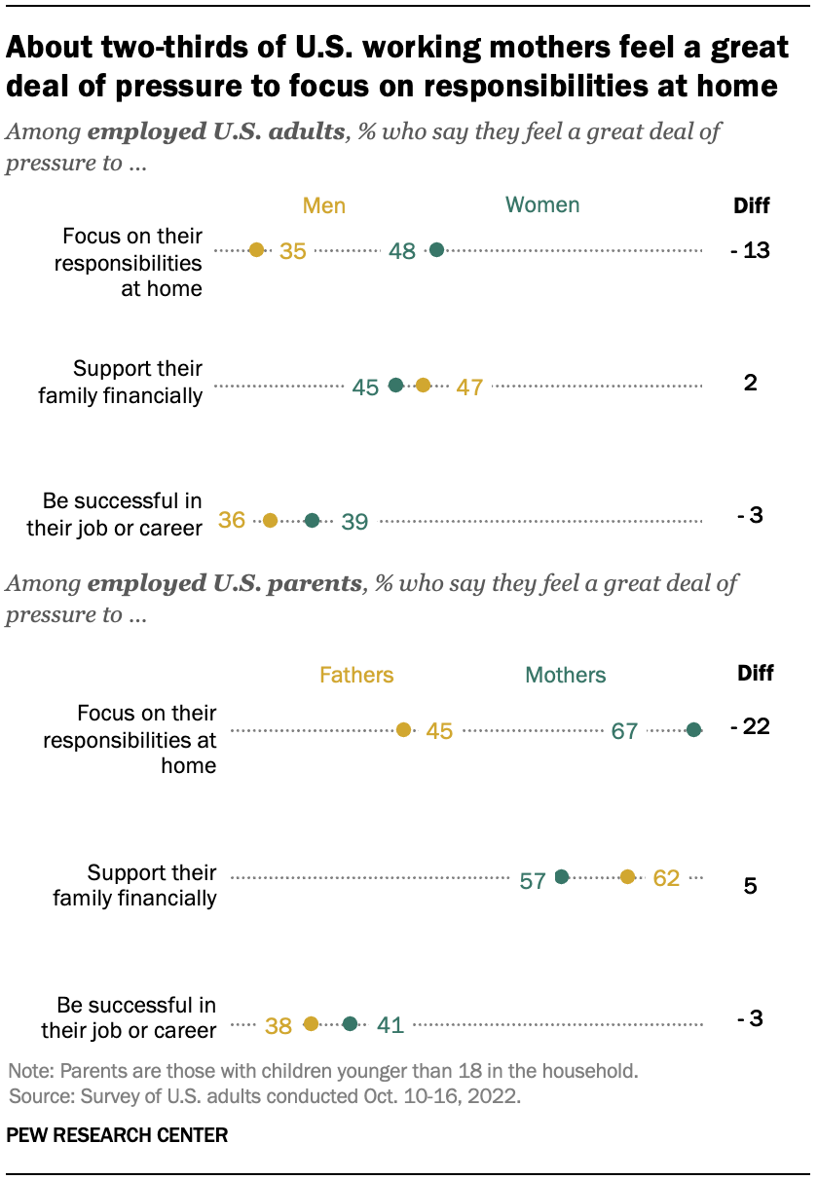

Slide 24
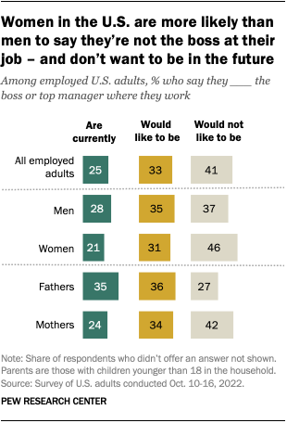

Slide 25
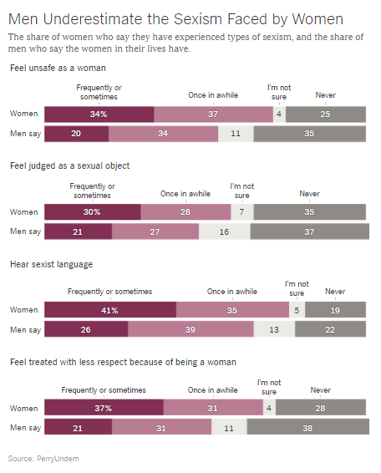

Slide 26
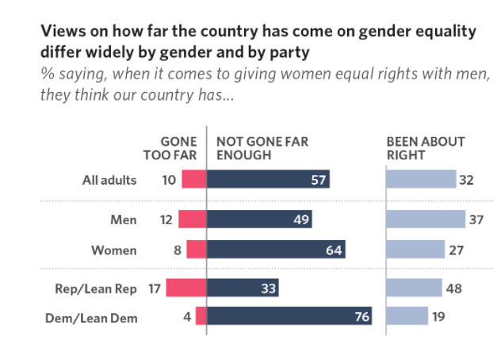

Slide 27
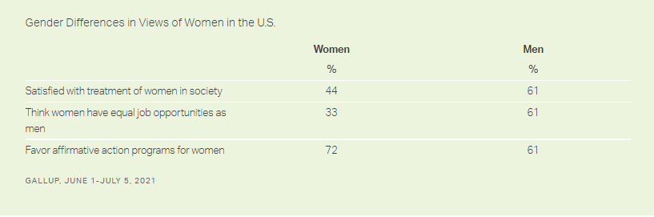

Slide 28
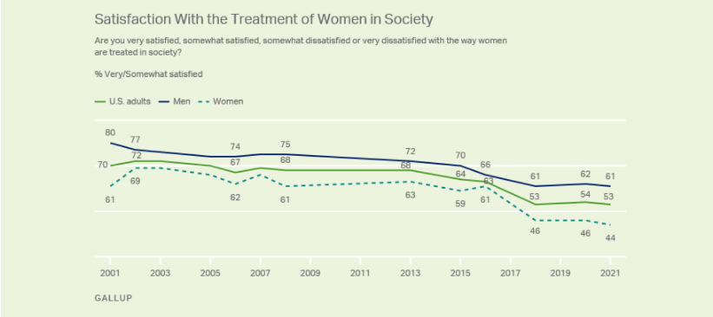
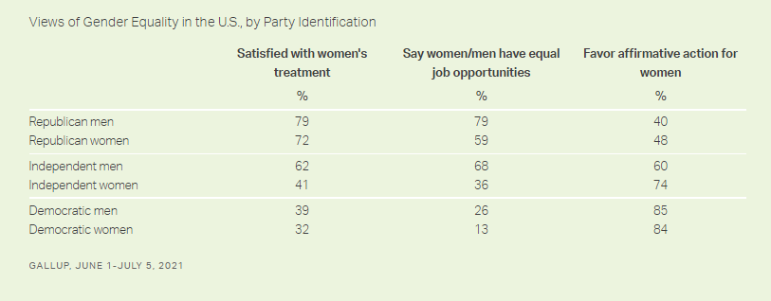

Slide 29
Conclusion
Evidence and Equality
  What works?!

Slide 30


