Slide 1
Immigration Policy

Slide 2
Introduction
Immigration– the big picture
(Animation)
Historical antecedents
Cultural conflict vs. economic conflict
Modern preference system
Illegal immigration– myth and reality
Immigration and federalism
Immigration and the economy
Costs/benefits of immigration

Slide 3
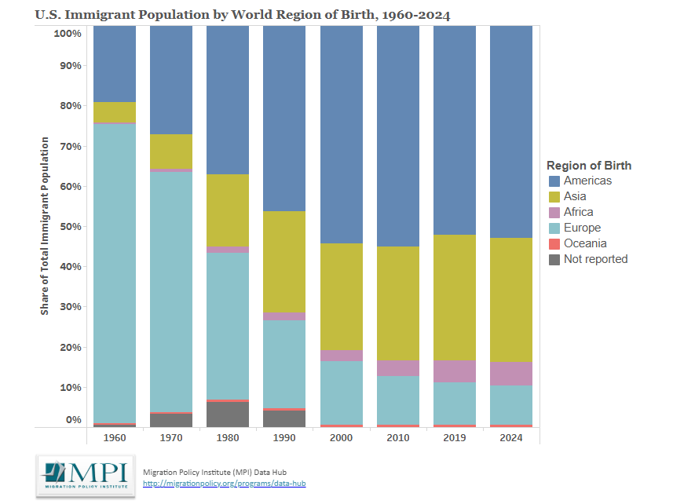

Slide 4
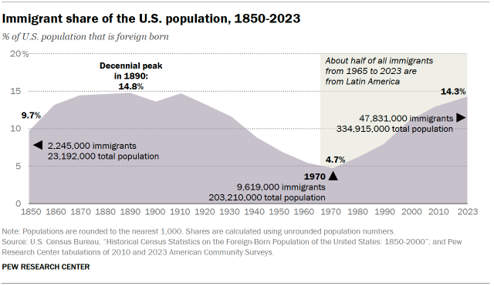

Slide 5
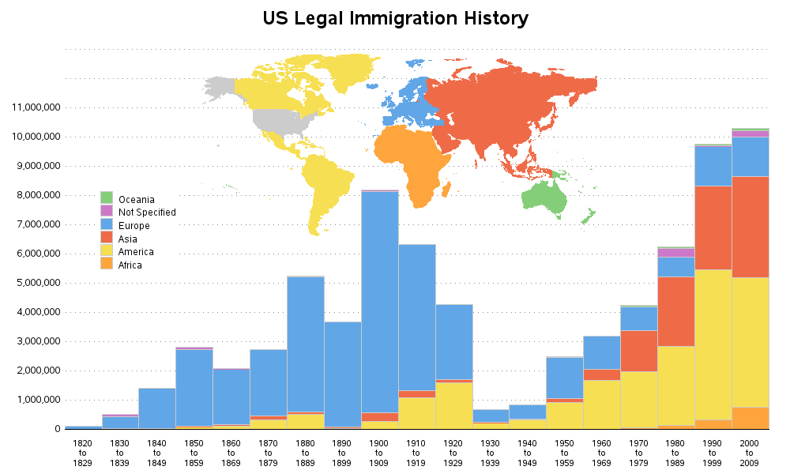

Slide 6
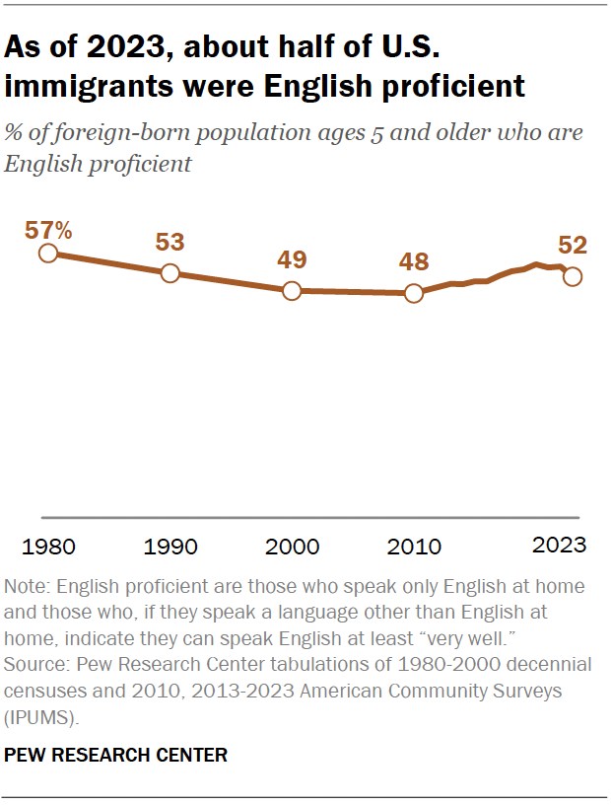

Slide 7
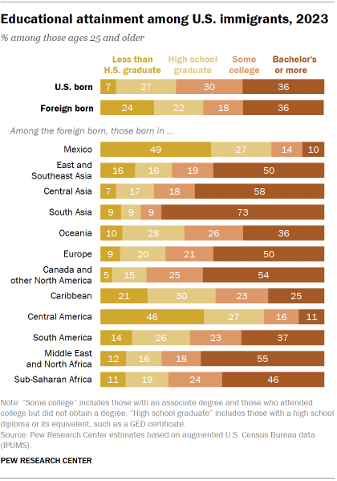

Slide 8
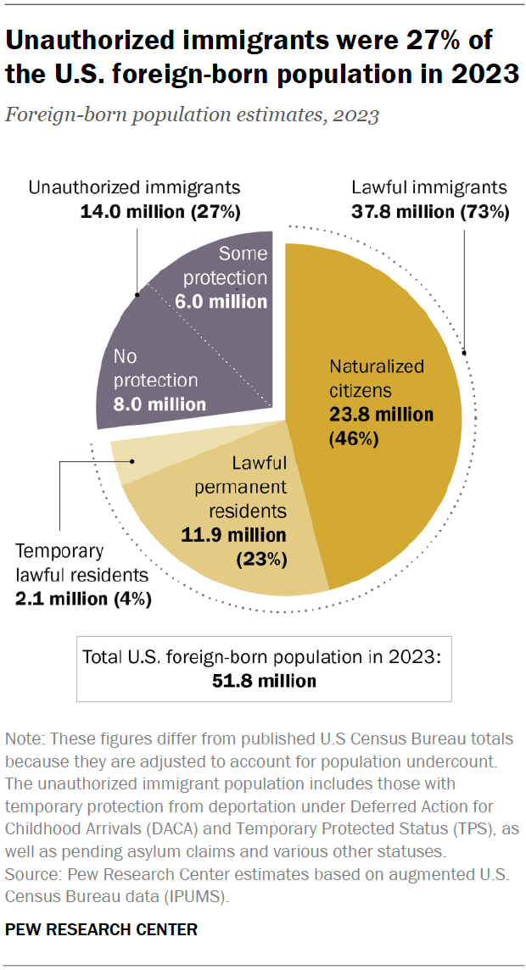

Slide 9
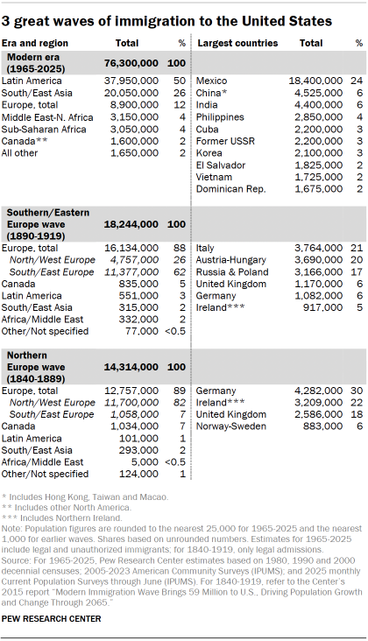

Slide 10
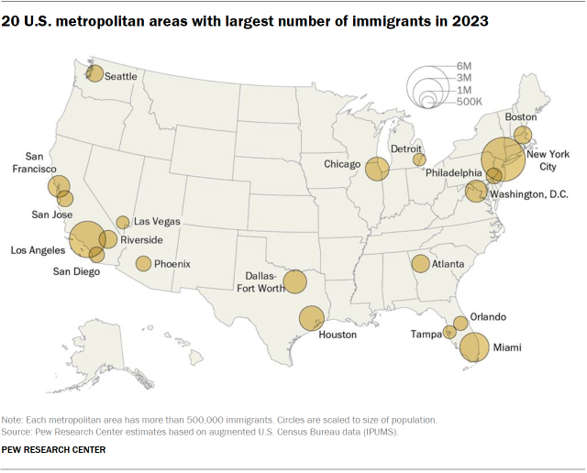

Slide 11
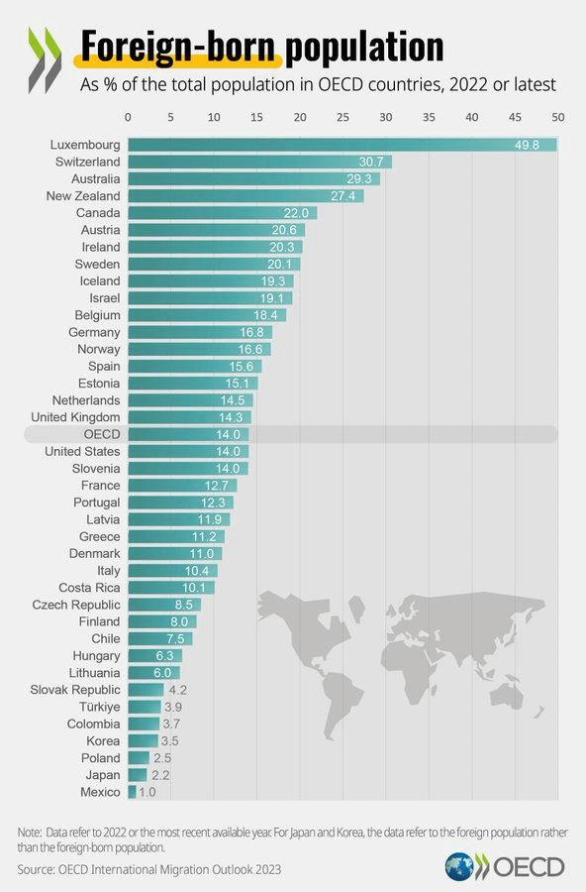

Slide 12
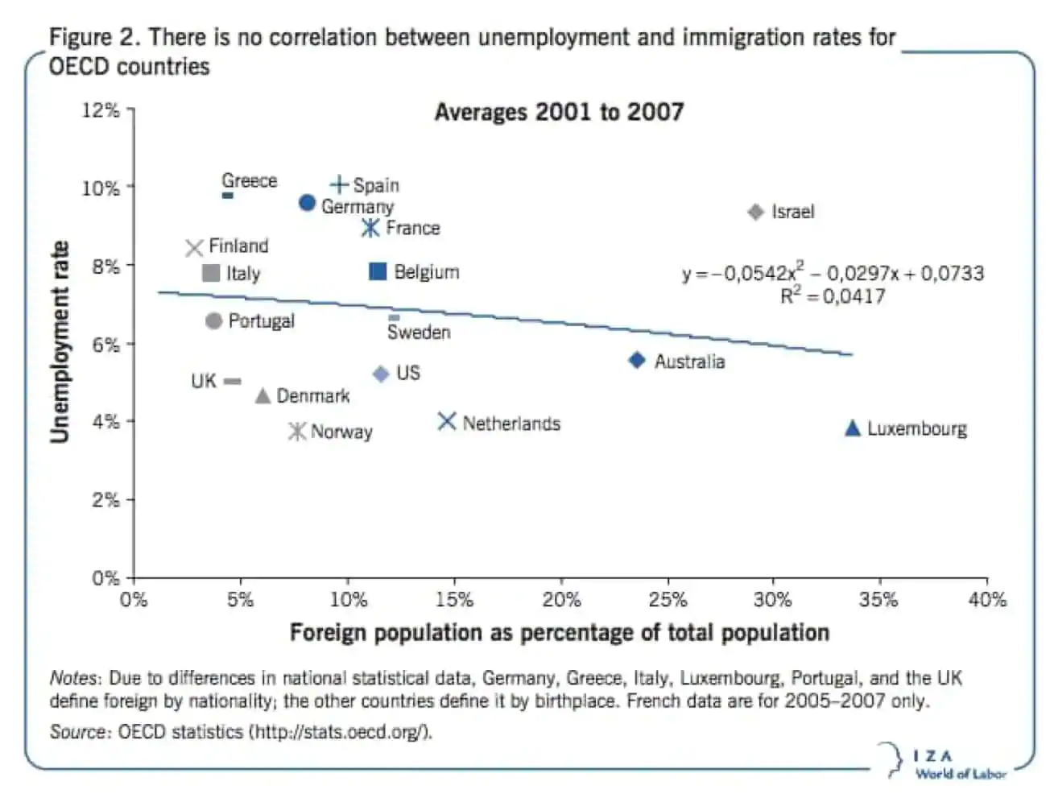

Slide 13
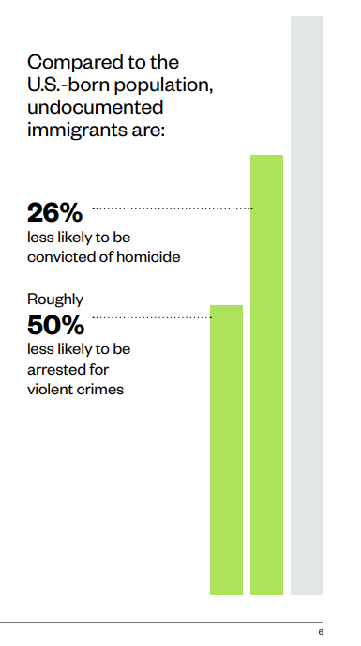

Slide 14
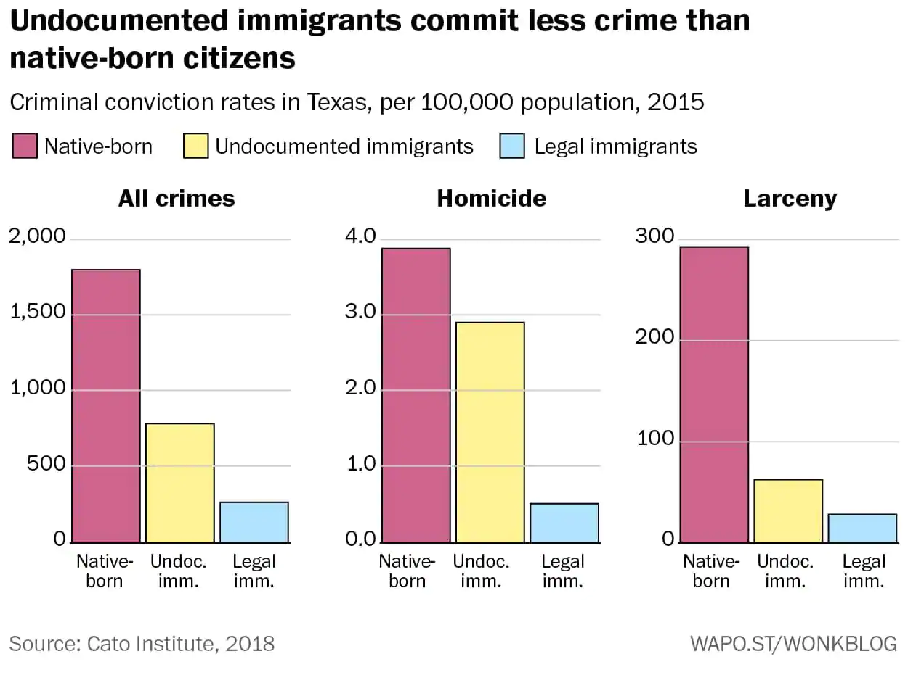

Slide 15
The public opinion and politics of immigration
Thermostatic public opinion– immigration style
A Public (not so) Divided
Polarization
It’s the intensity, stupid
It’s the ethnocentrism(, stupid)
Mass-elite conflict

Slide 16
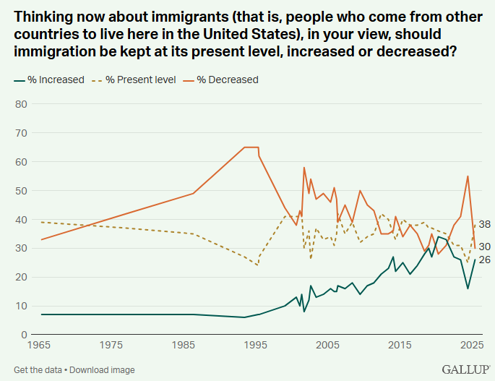

Slide 17
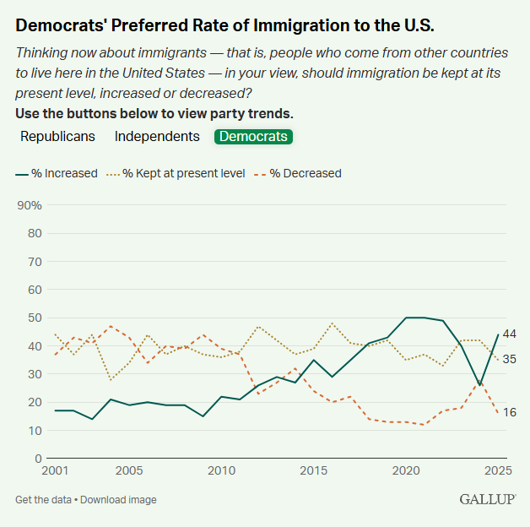
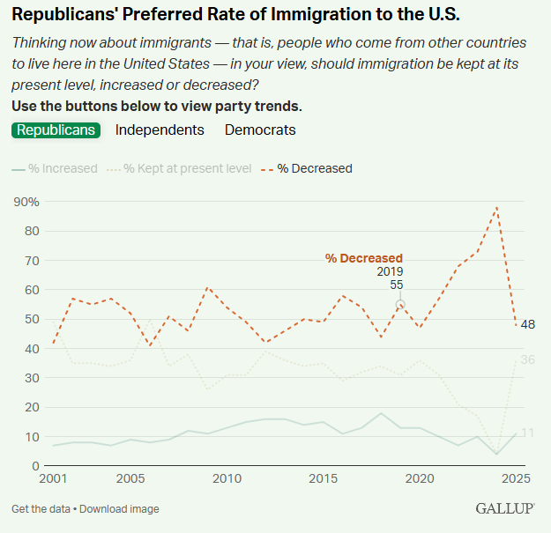

Slide 18
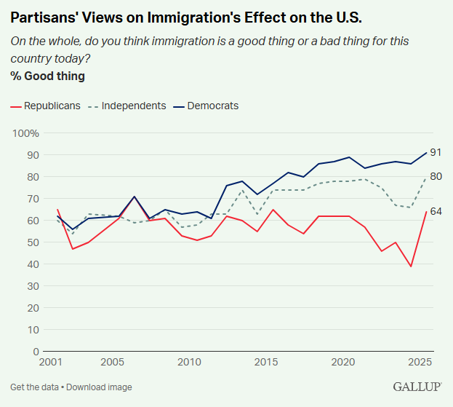

Slide 19
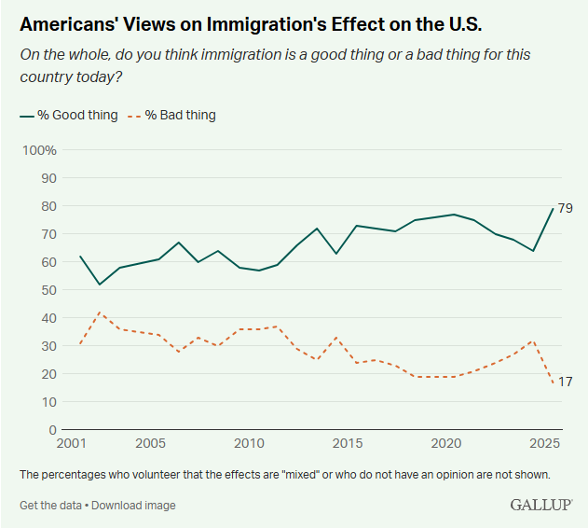

Slide 20
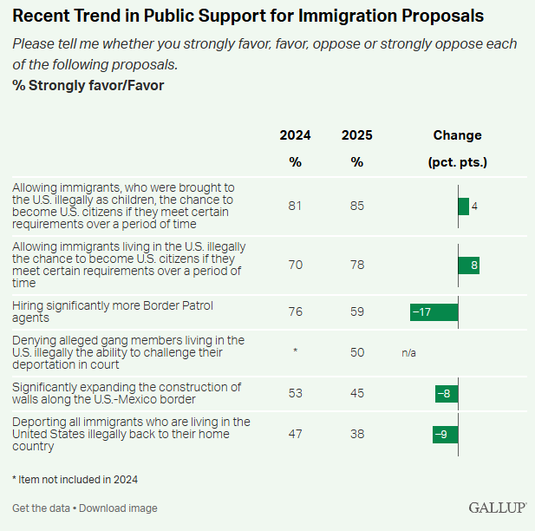

Slide 21
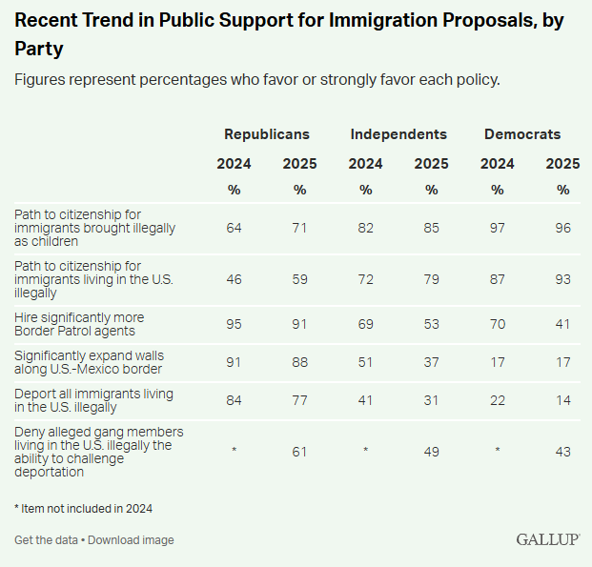

Slide 22
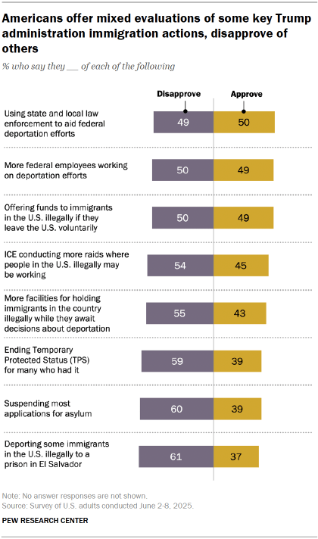

Slide 23
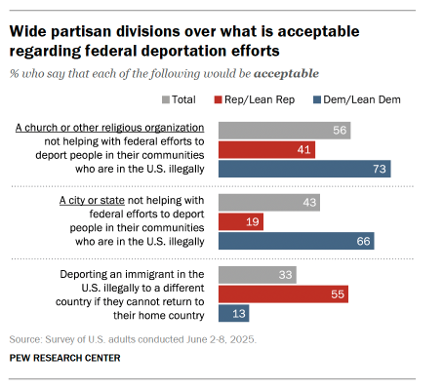

Slide 24
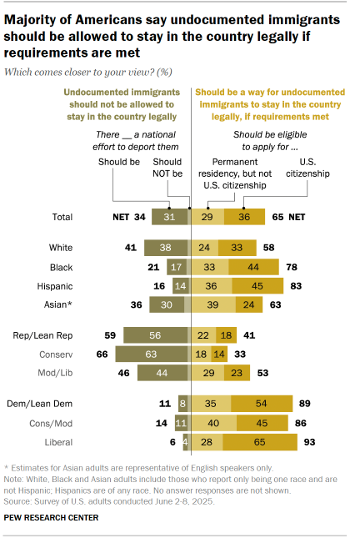

Slide 25
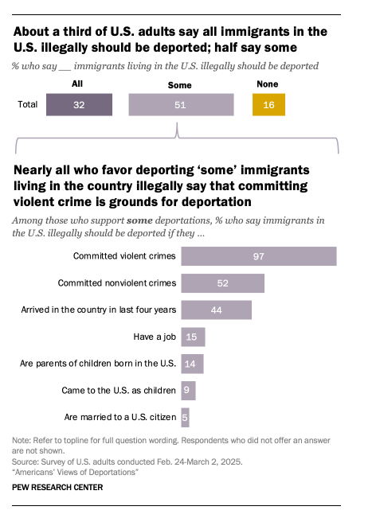
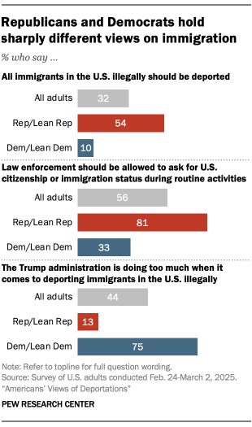

Slide 26
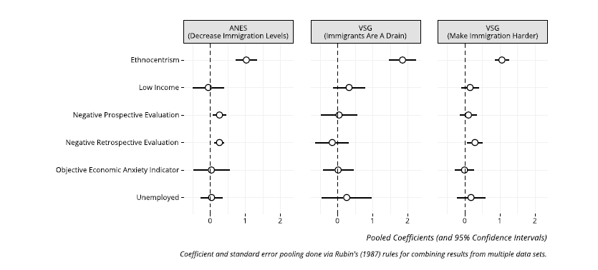
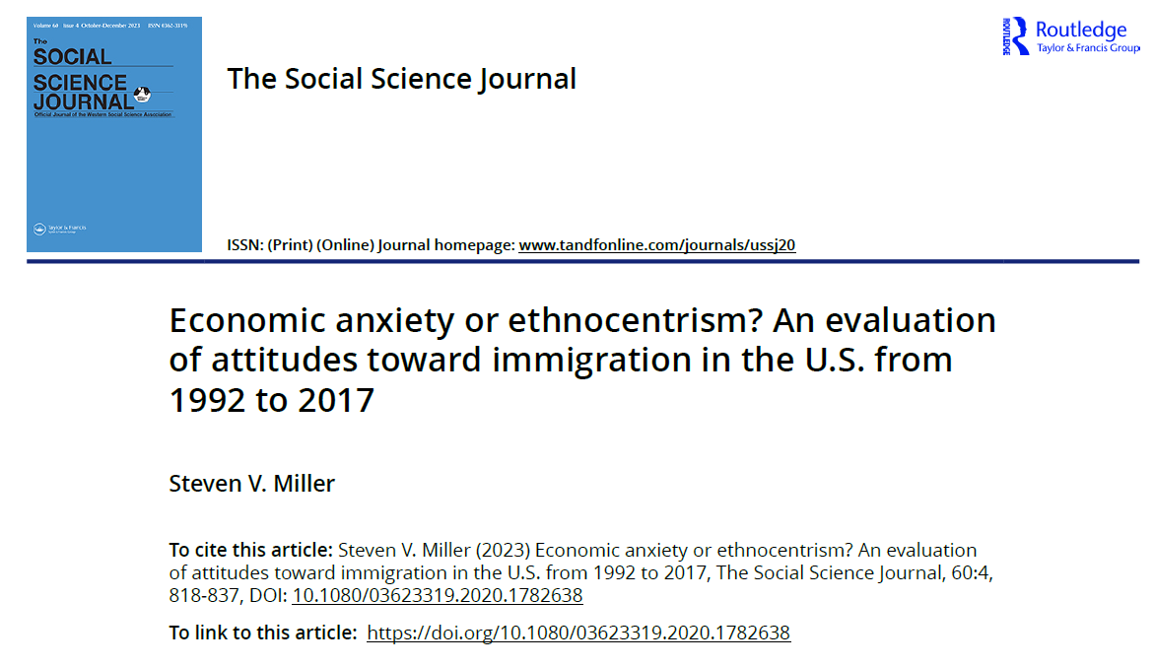

Slide 27
Towards the future
Can the US afford Trump’s approach?
The reform paradox
Economic needs vs political reality
The immigration pendulum

Slide 28
