Slide 1
Criminal Justice Policy
Crime & Punishment

Slide 2
Introduction: Goals of Criminal Justice Policy
Deterrence
Incapacitation
Justice/Retribution
Rehabilitation
Public Order
Efficiency

Slide 3
Crime in the United States
Two Big Stories
Surge and decline in crime rates
American exceptionalism
Crime and rational deterrence
Clearance rate problem

Slide 4
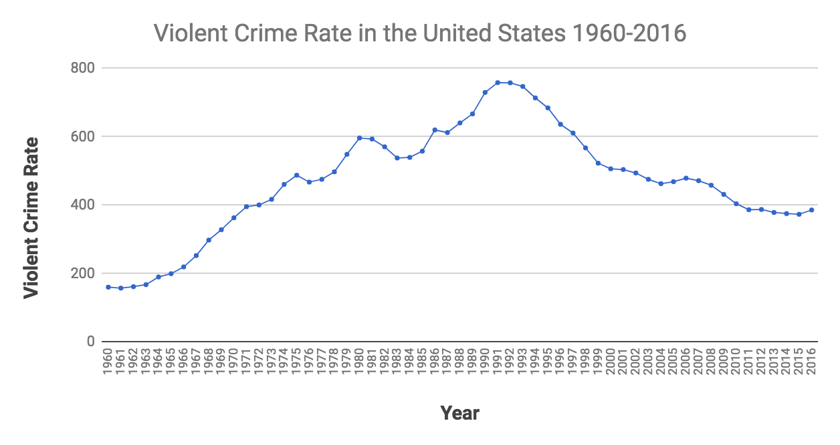

Slide 5
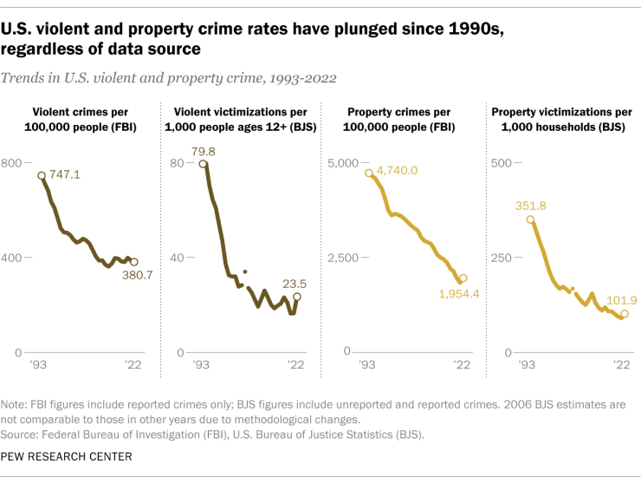
Crime in America
Two stories
Major changes in crime rates
Surge and decline
Recent increase
Cross-national perspective
Crime and deterrence
Certainty, swiftness, and severity

Slide 6
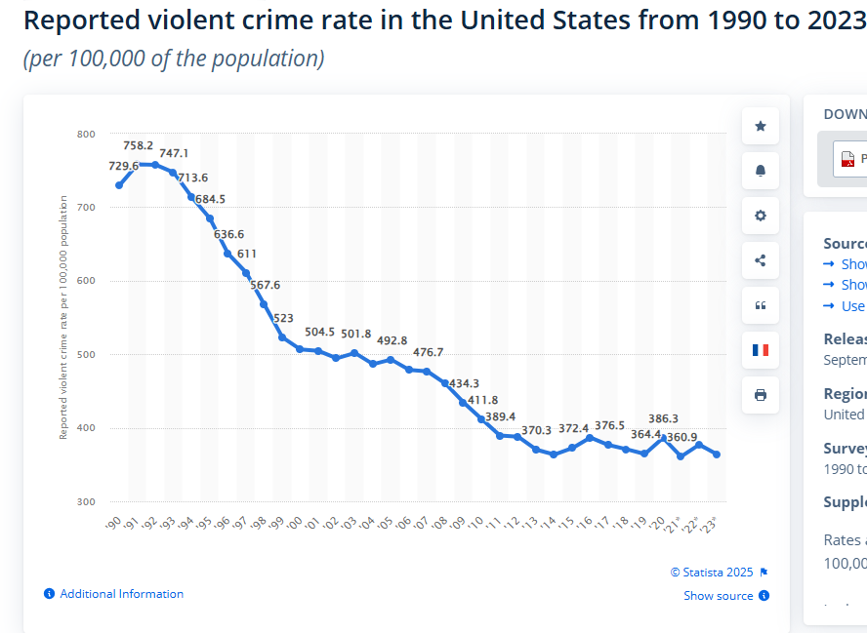

Slide 7
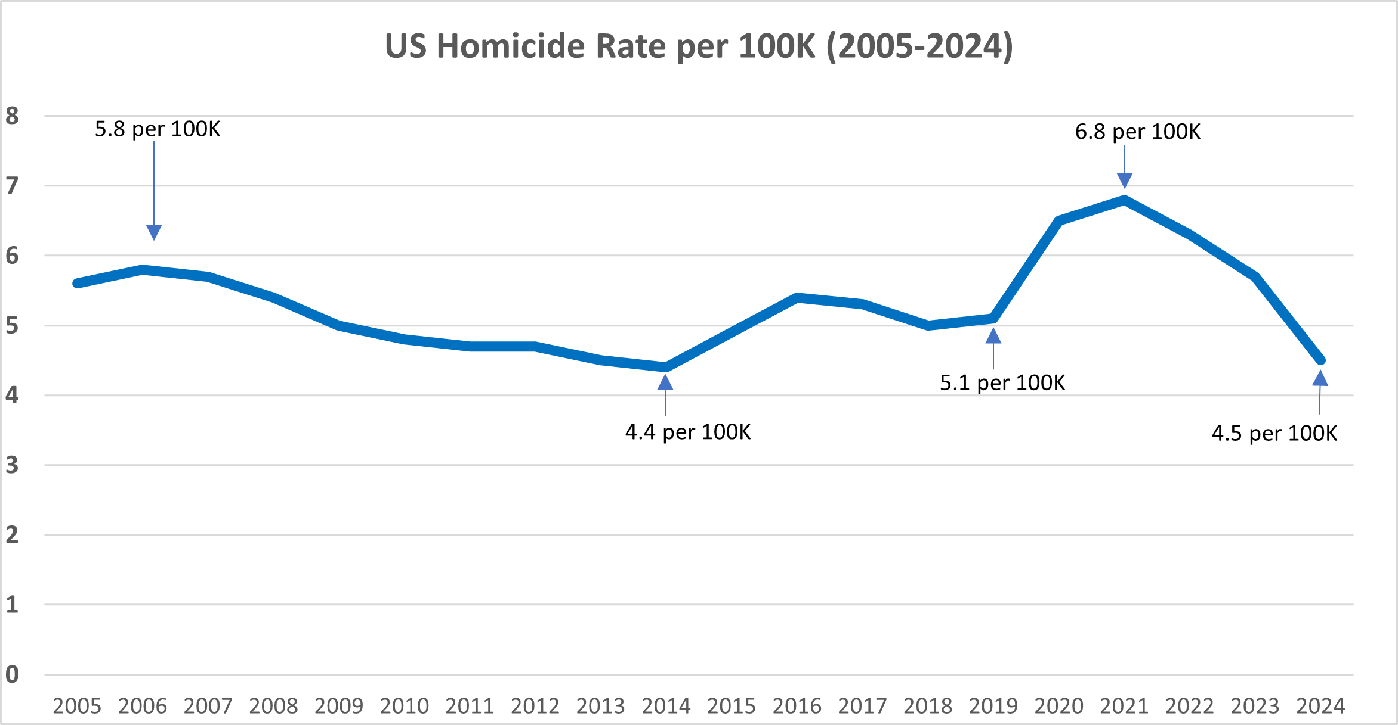
Covid homicide surge

Slide 8
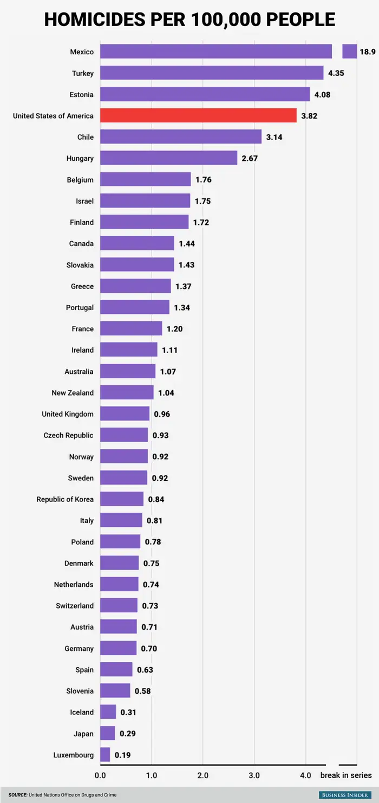
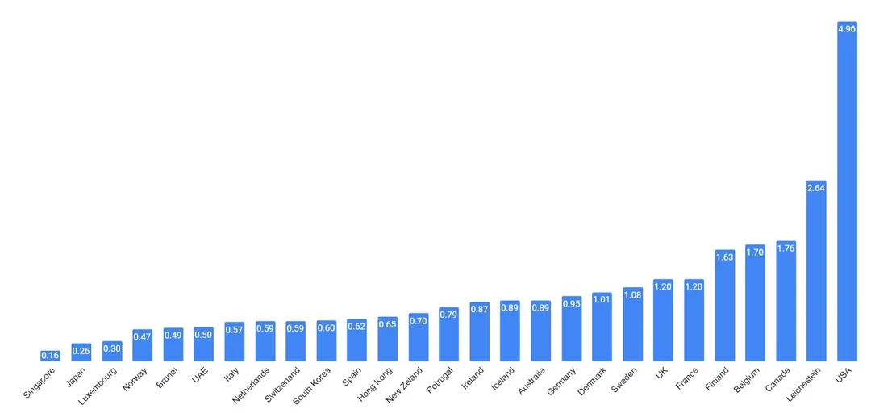

Slide 9
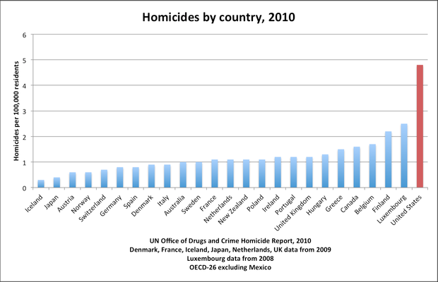
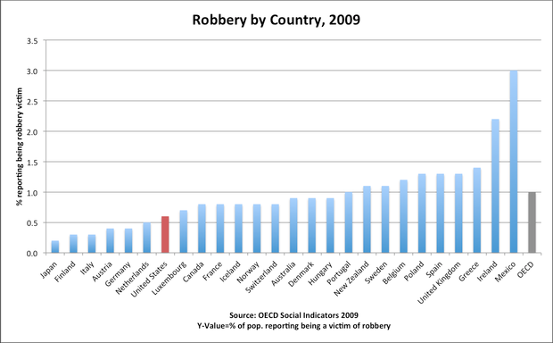
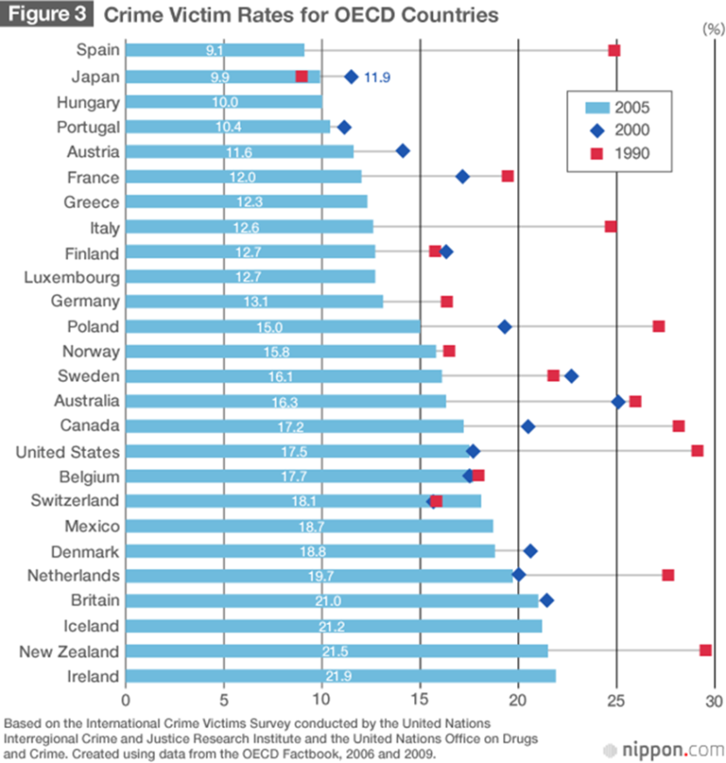
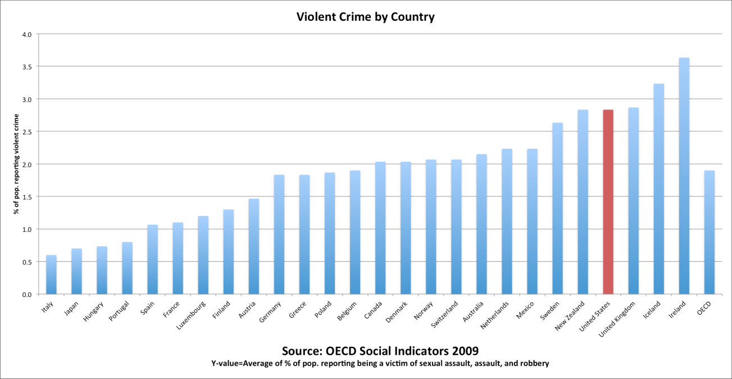

Slide 10
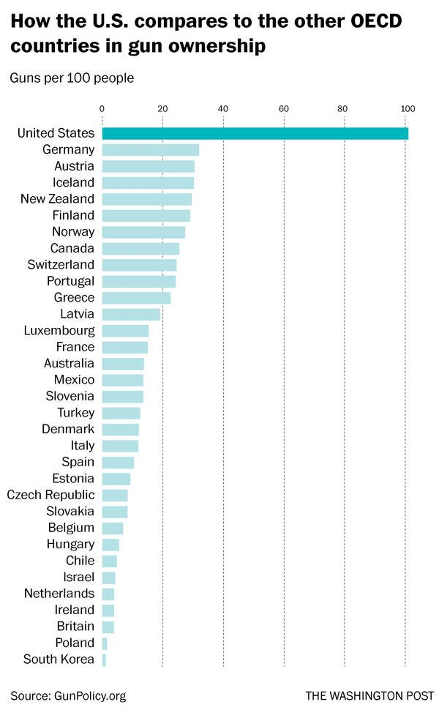
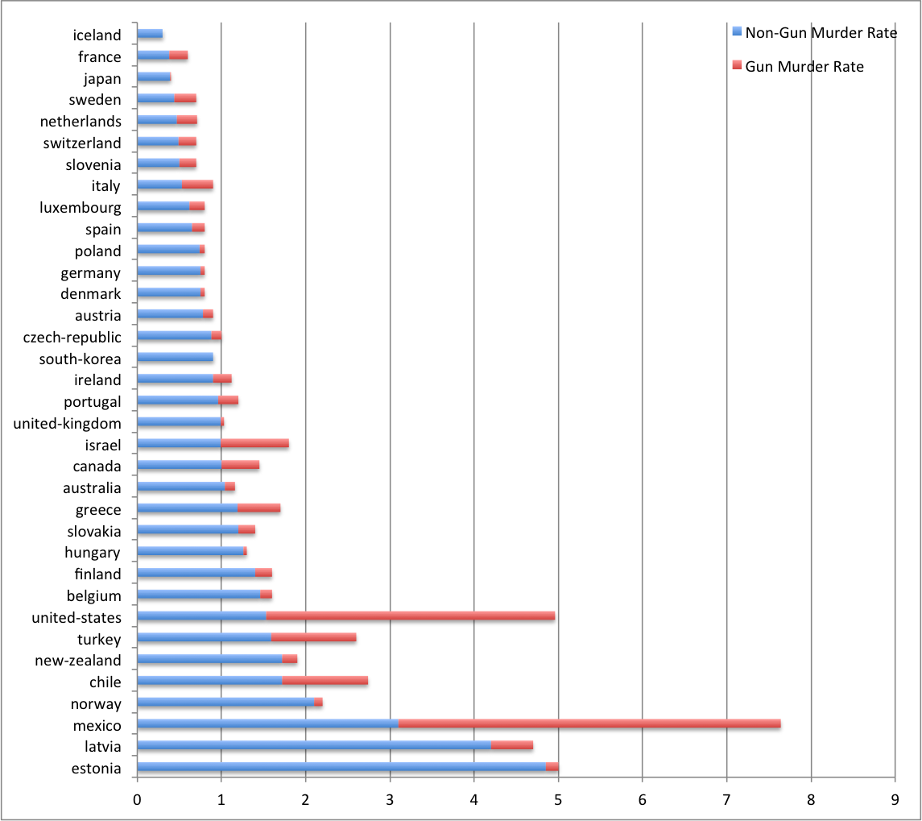

Slide 11
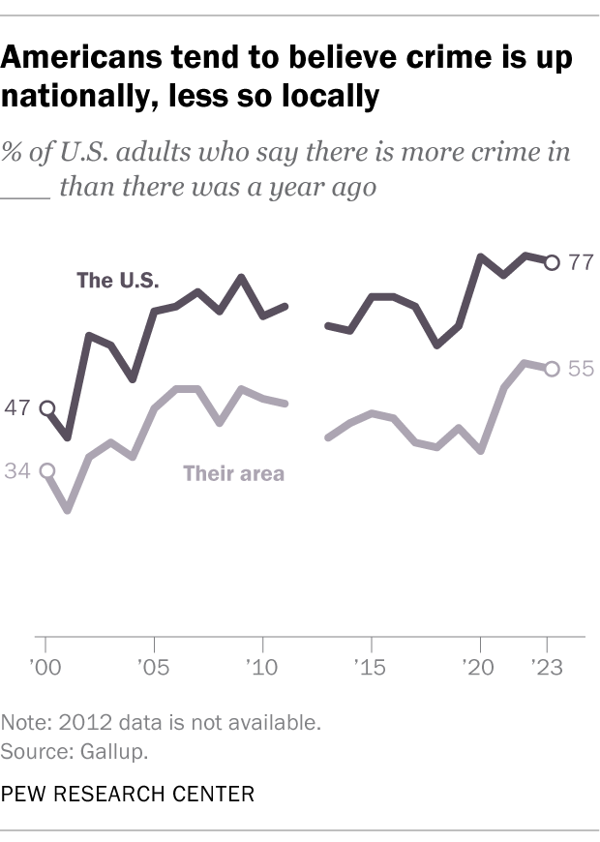

Slide 12
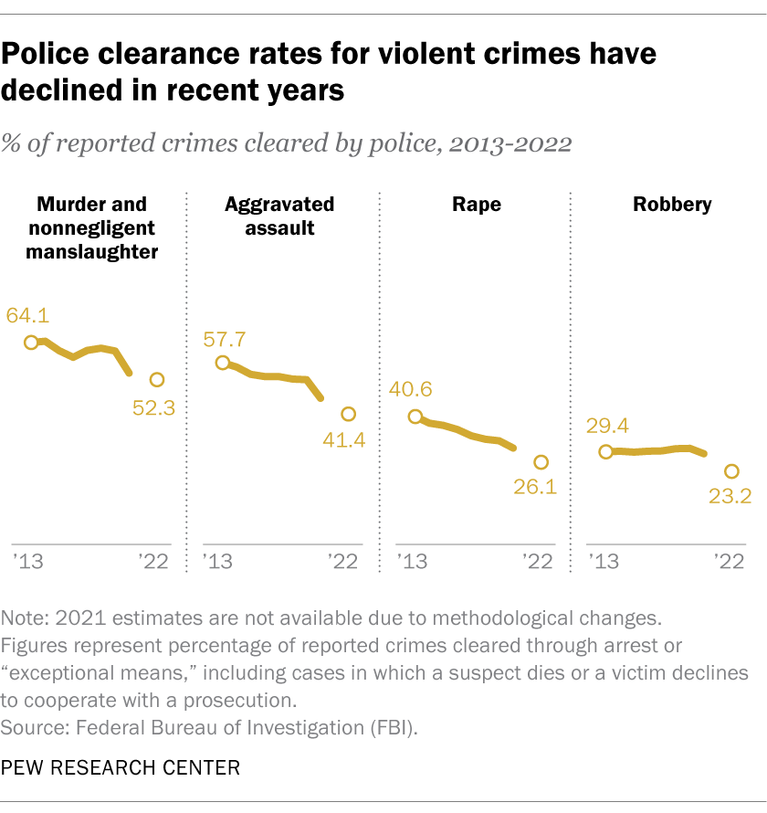

Slide 13
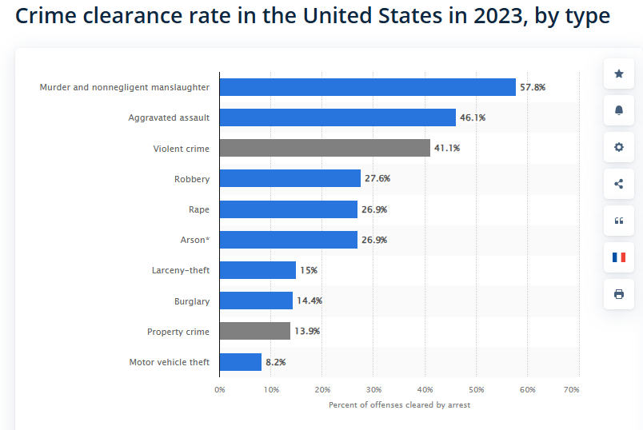

Slide 14
Policing
Key feature of American policing
What works and what doesn’t
Race and policing
Police reform/”defund the police”
Technology and policing

Slide 15
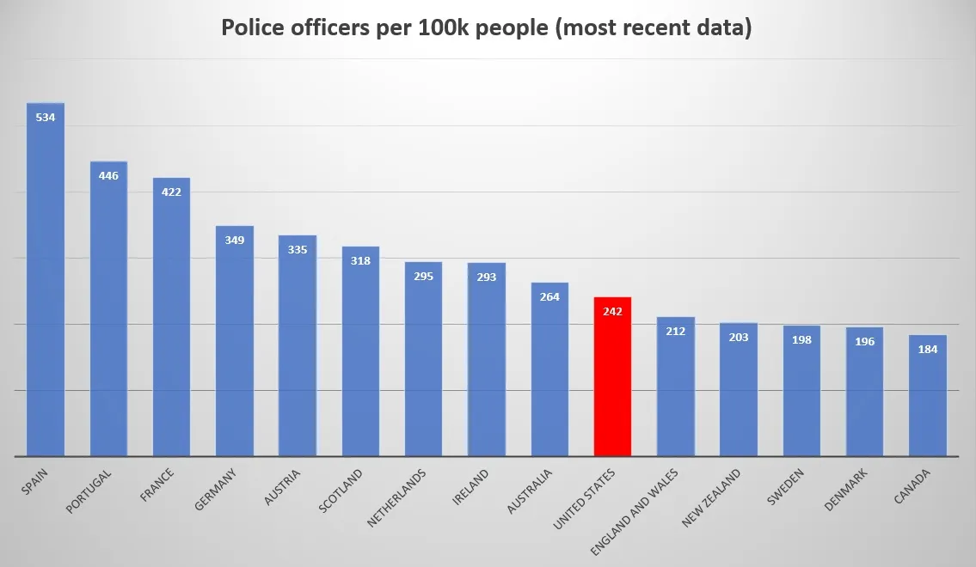

Slide 16
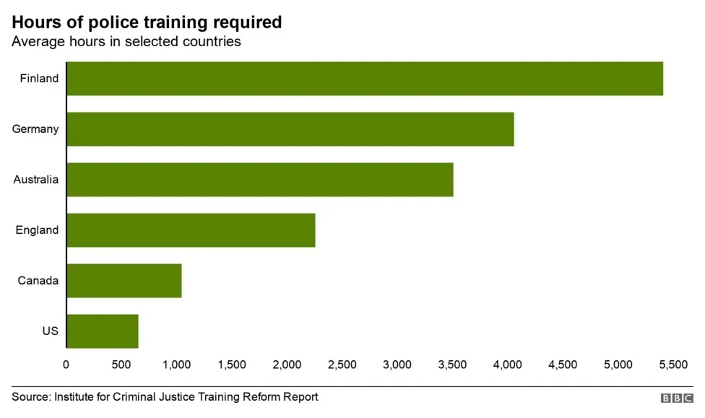

Slide 17
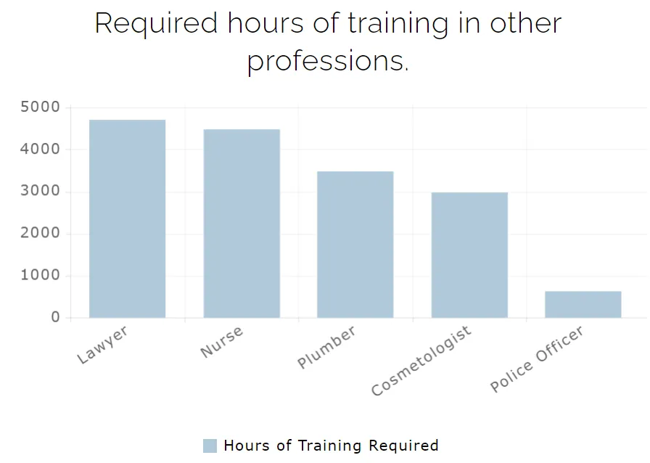

Slide 18
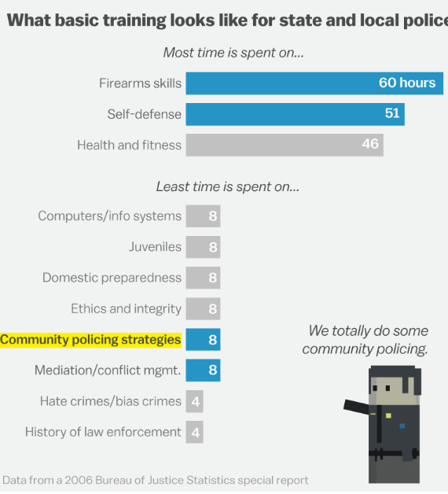

Slide 19
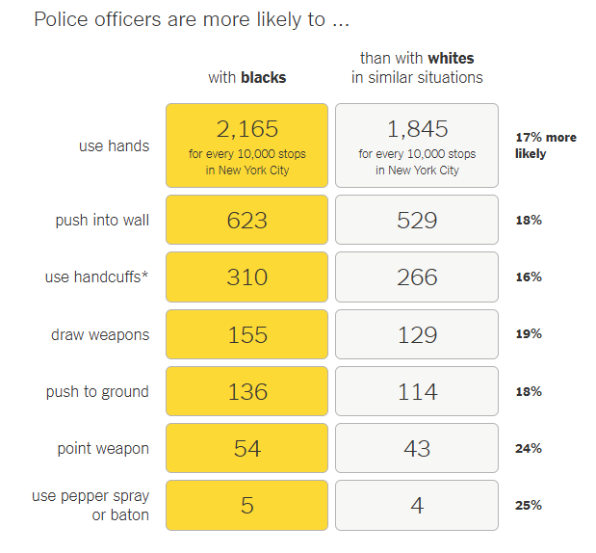
https://www.nytimes.com/2016/07/12/upshot/surprising-new-evidence-shows-bias-in-police-use-of-force-but-not-in-shootings.html

Slide 20
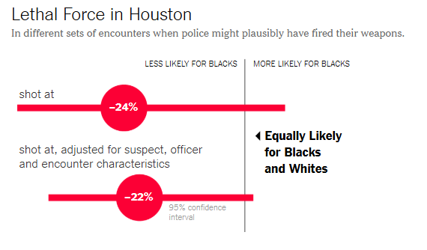

Slide 21
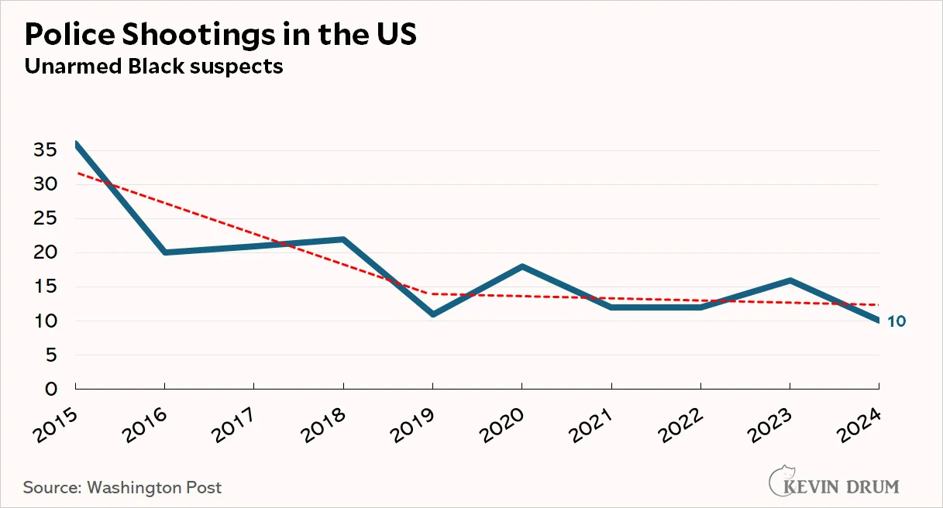

Slide 22
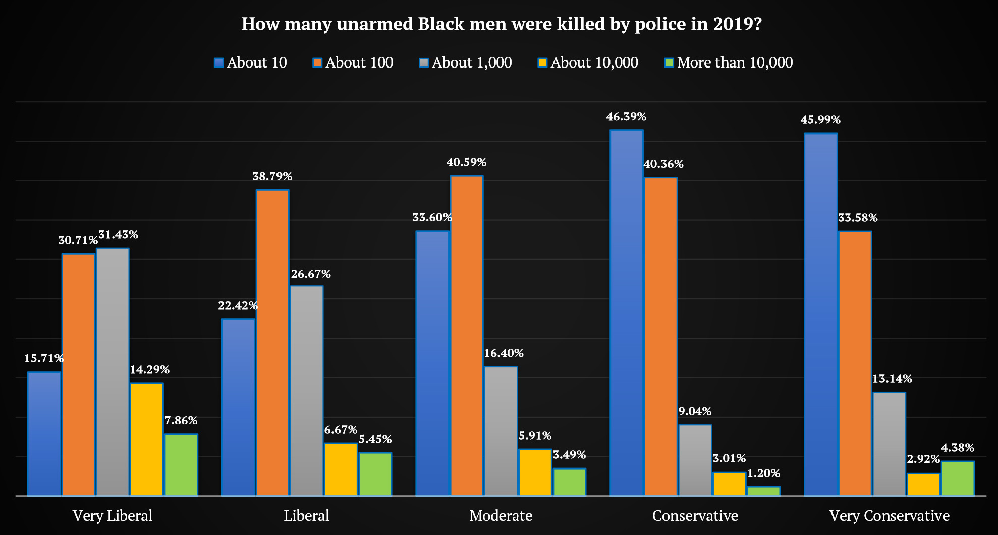
https://www.skeptic.com/research-center/reports/Research-Report-CUPES-007.pdf

Slide 23
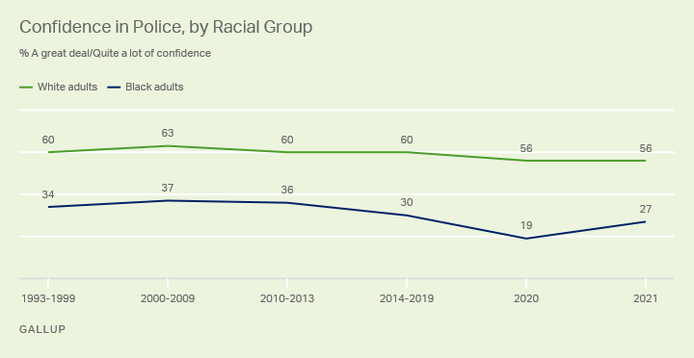
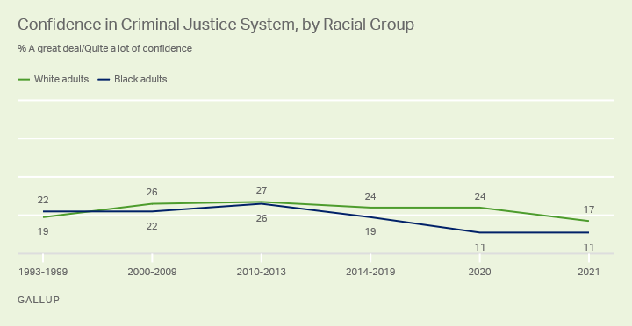

Slide 24
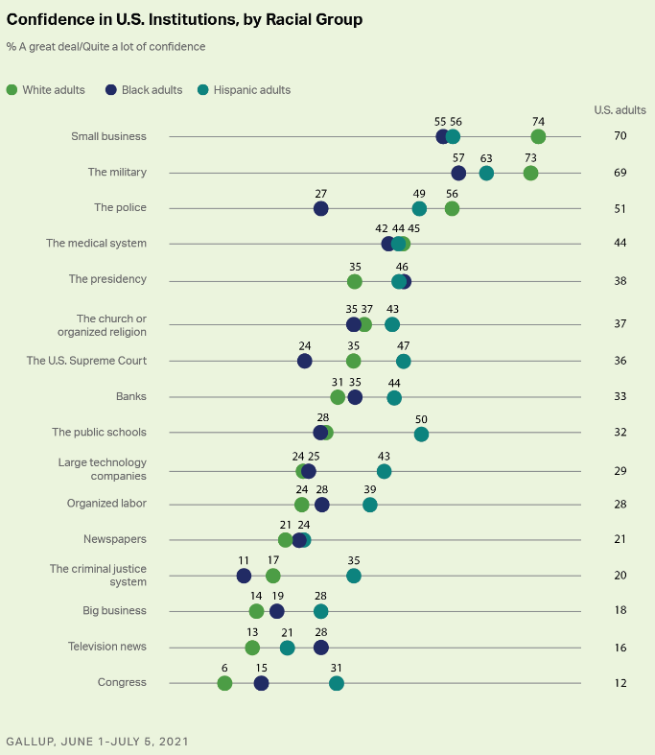

Slide 25
Prisons and Correctional Policy in the age of mass incarceration
Costs and benefits of mass incarceration ?
Too many prisoners?
It’s the prosecutors, (stupid)
Mandatory sentencing
The prison bottleneck
The myth of the “non-violent drug offender "solution
The myth of the “it’s the private prisons” solution
Prison alternatives/Smarter deterrence
What we can learn from other countries
The great prison decline is here

Slide 26
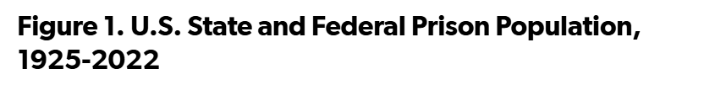
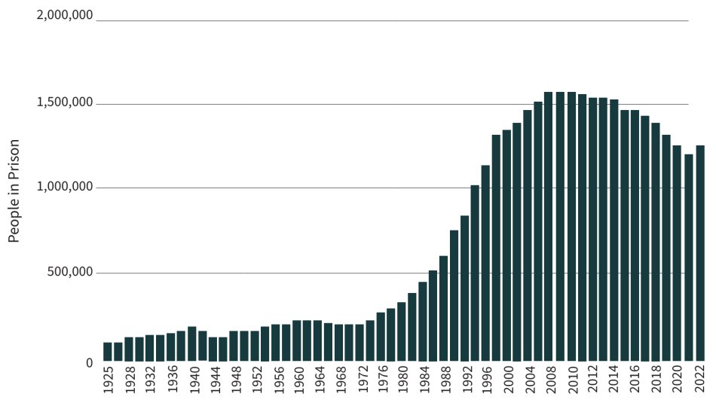

Slide 27
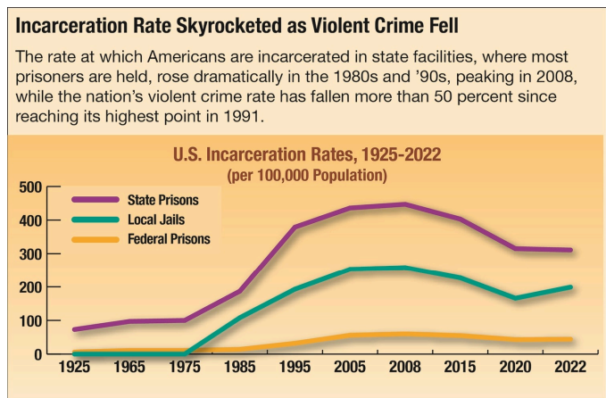

Slide 28
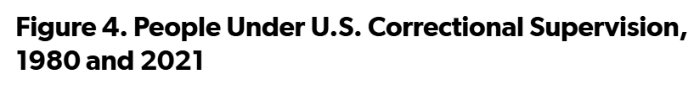
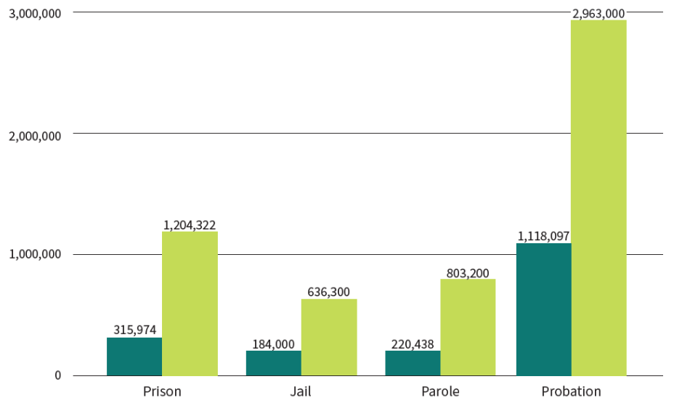
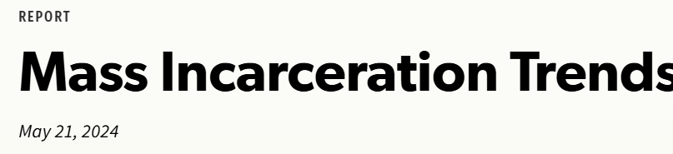


Slide 29
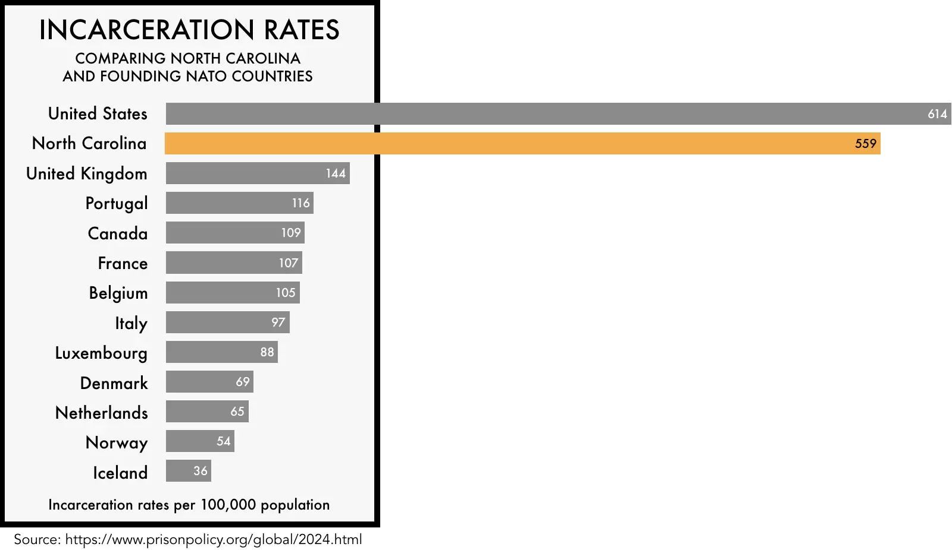

Slide 30
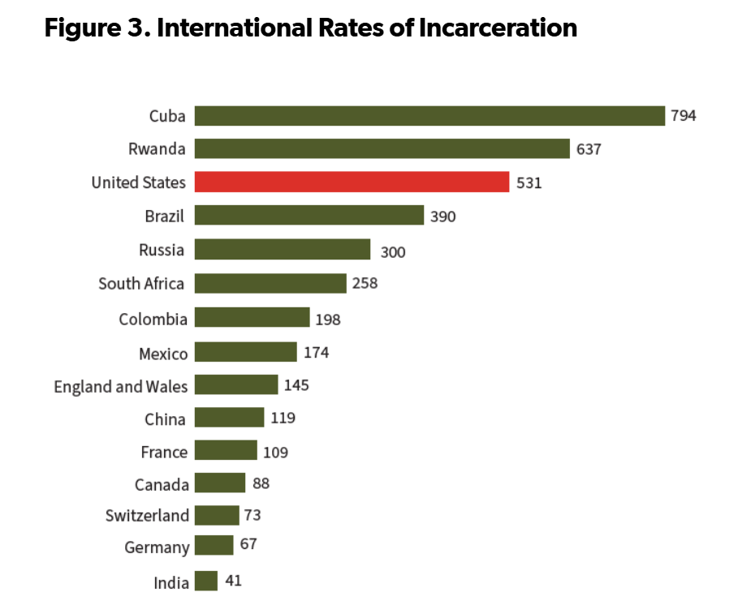

Slide 31
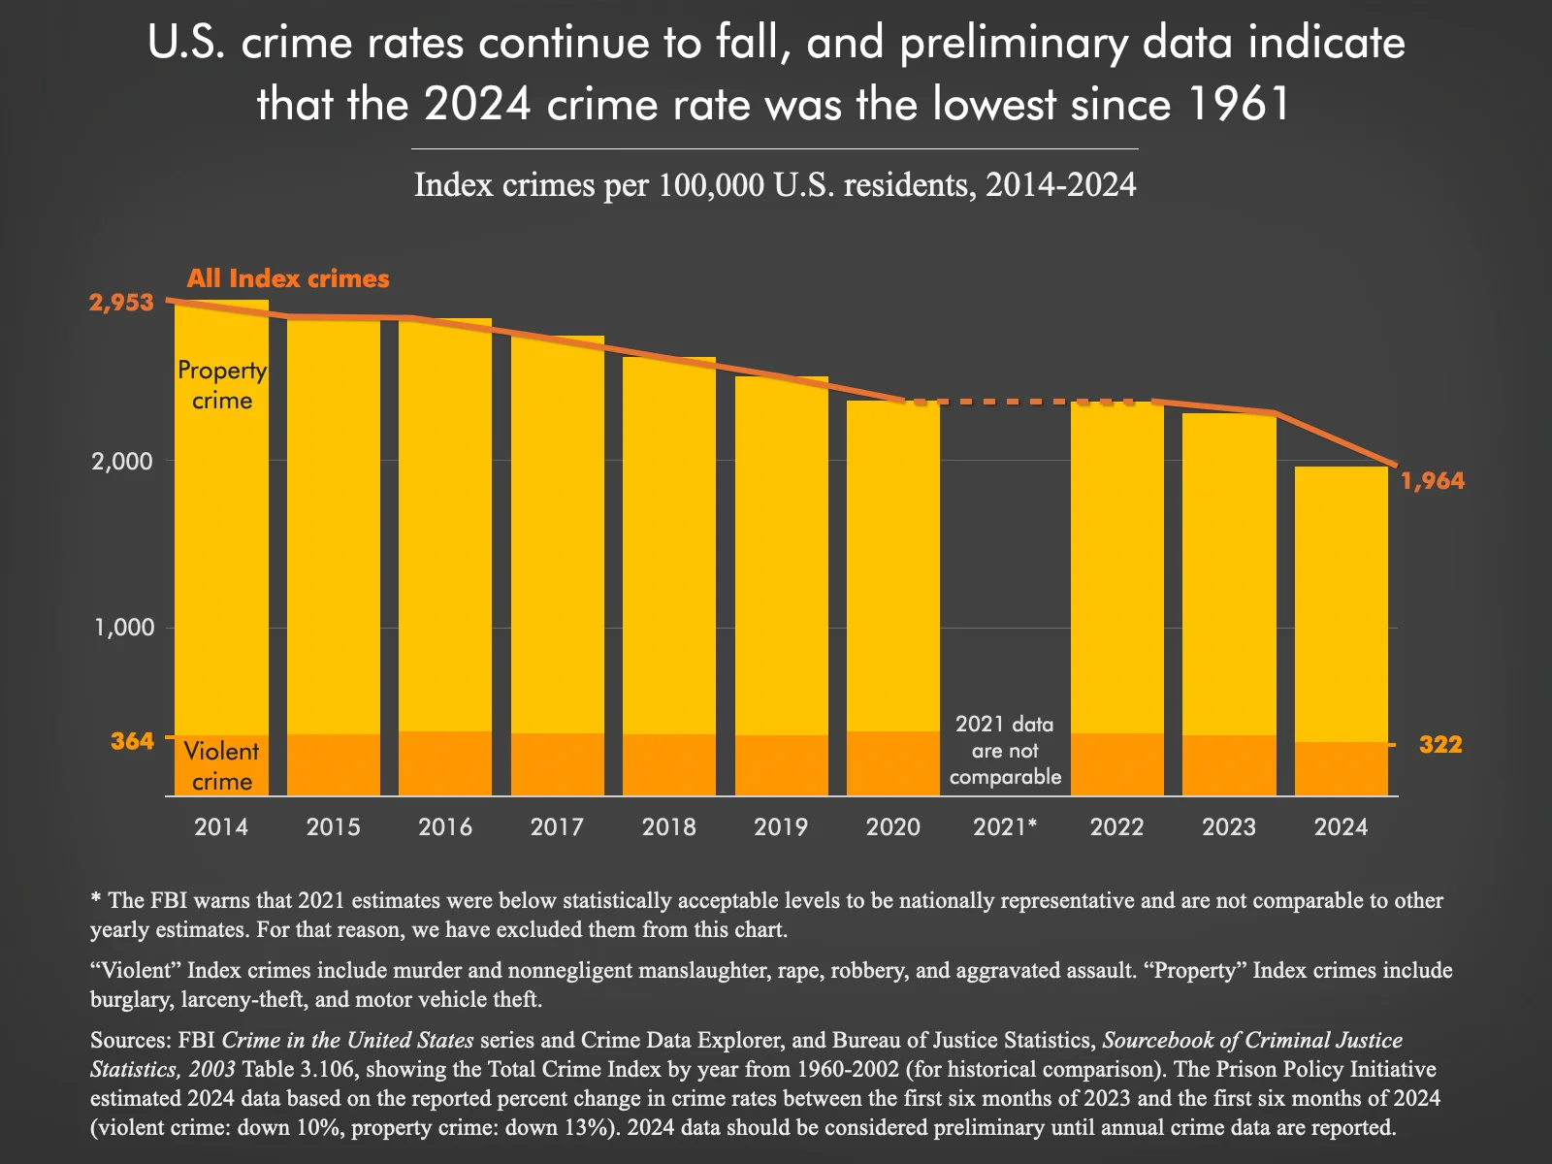

Slide 32
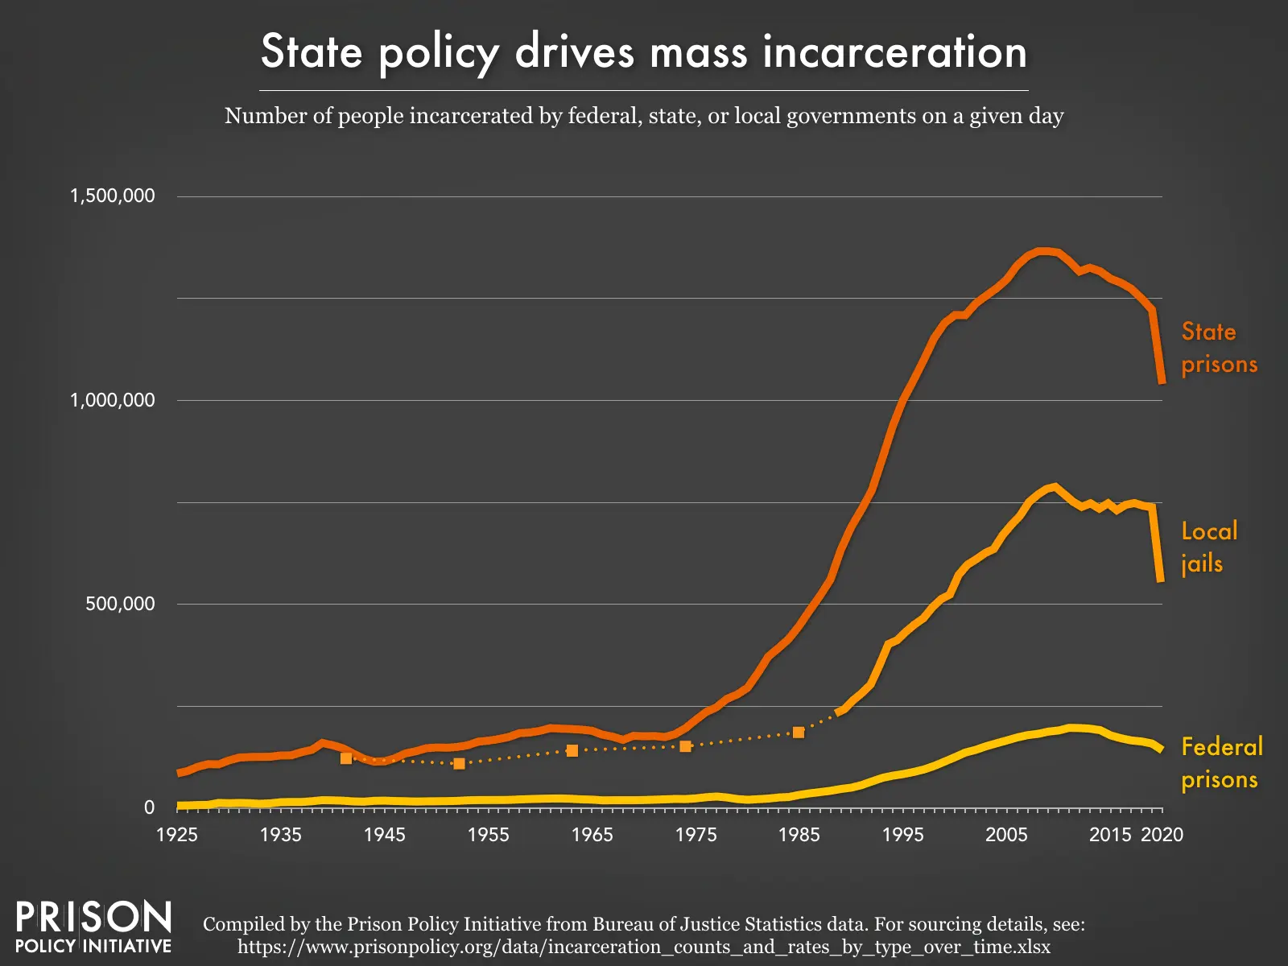

Slide 33
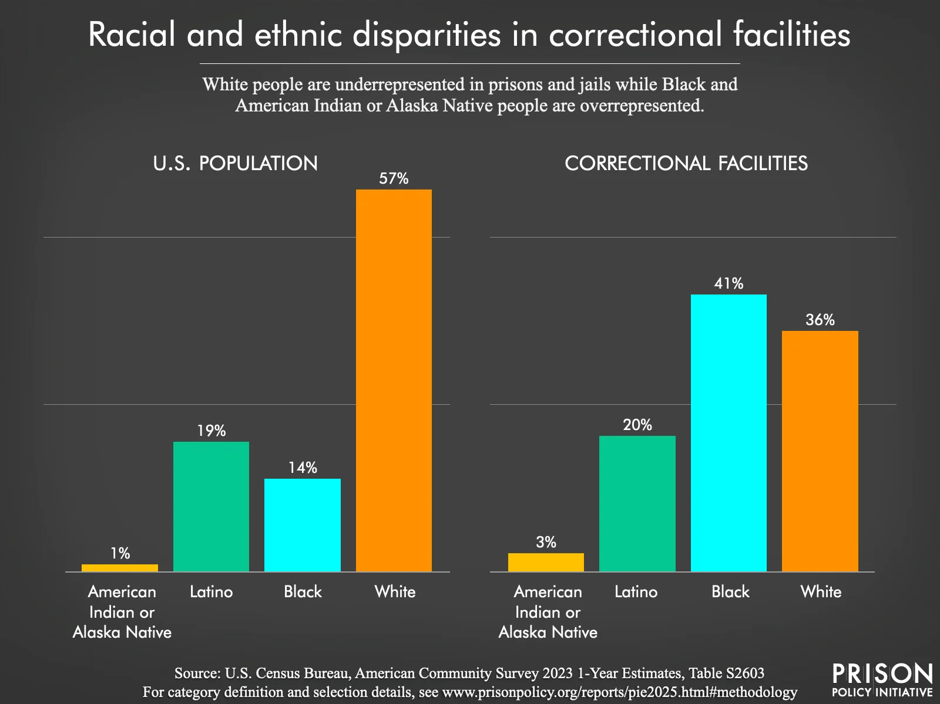

Slide 34
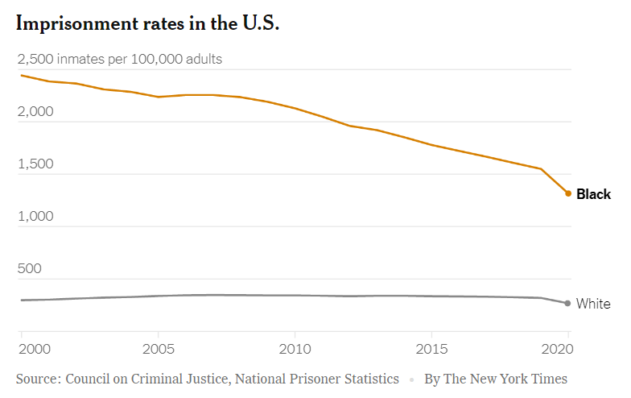

Slide 35
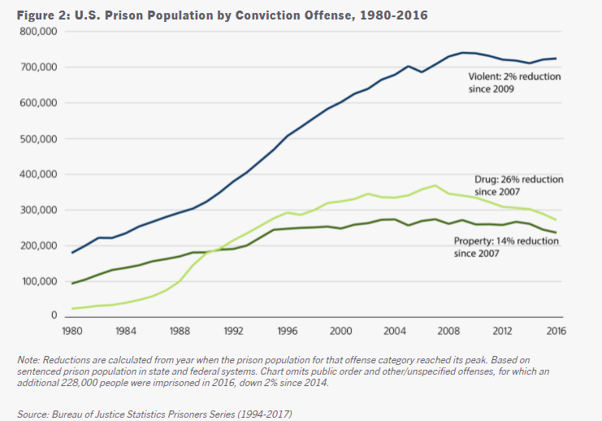

Slide 36
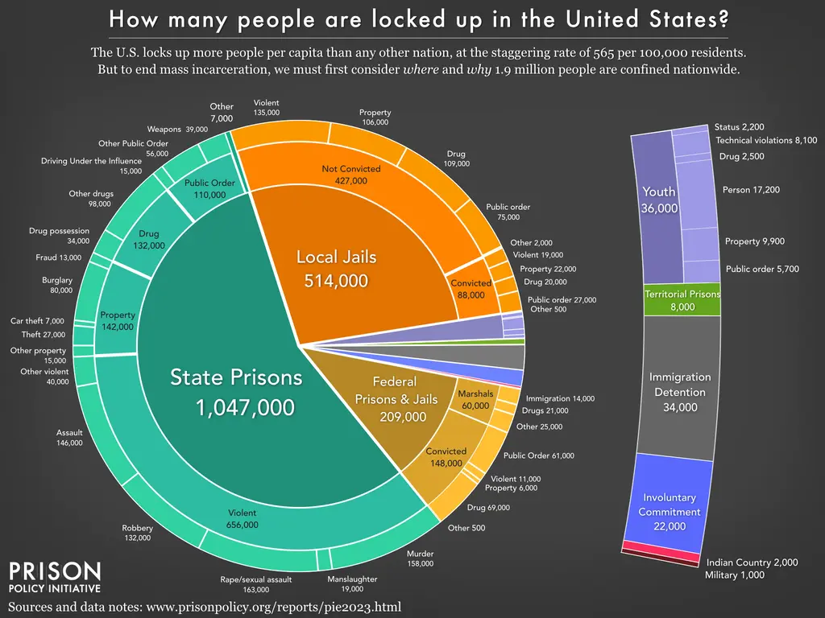

Slide 37
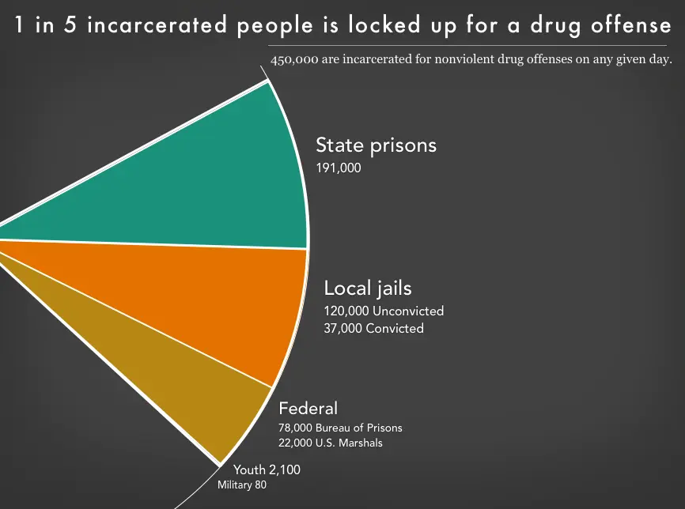

Slide 38
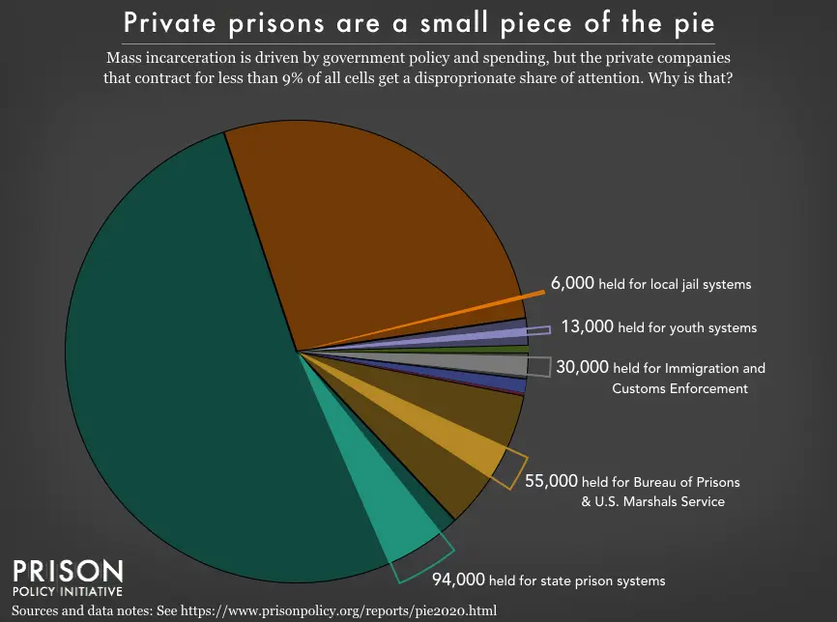

Slide 39
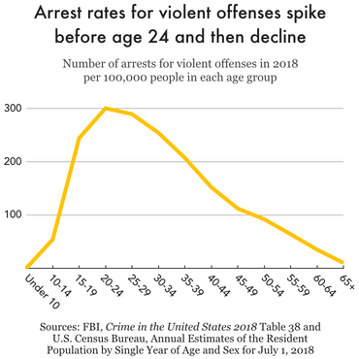

Slide 40
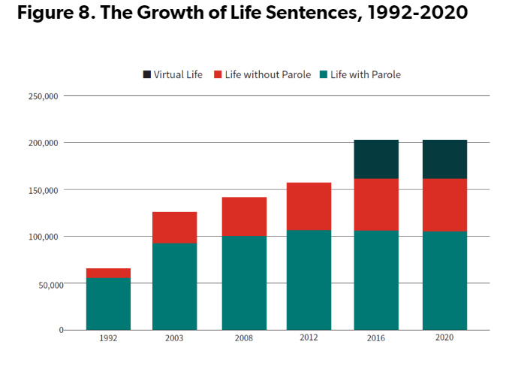

Slide 41
Drugs and Crime
People and drugs
The War on drugs: successes and mostly failures
Transformation of America’s drugs problem

Slide 42
Drug Policy: what works; what doesn’t
Treatment
Medicaid Waivers
Swift, certain, and modest consequences
Smarter enforcement
Real world examples: Portugal vs. San Francisco
Marijuana policy and federalism
Evidence-based path forward
Why this is so hard politically
[The Fentanyl wild card]

Slide 43
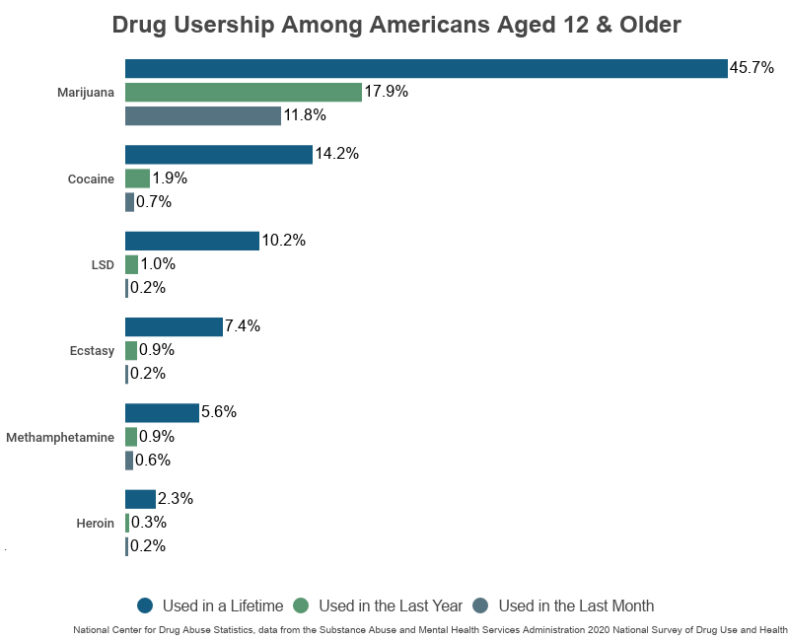

Slide 44
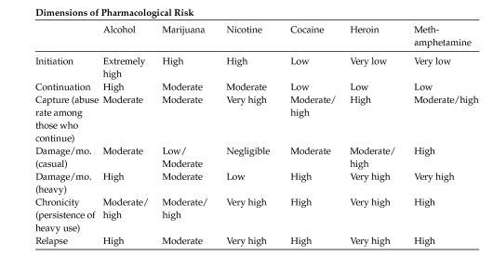

Slide 45
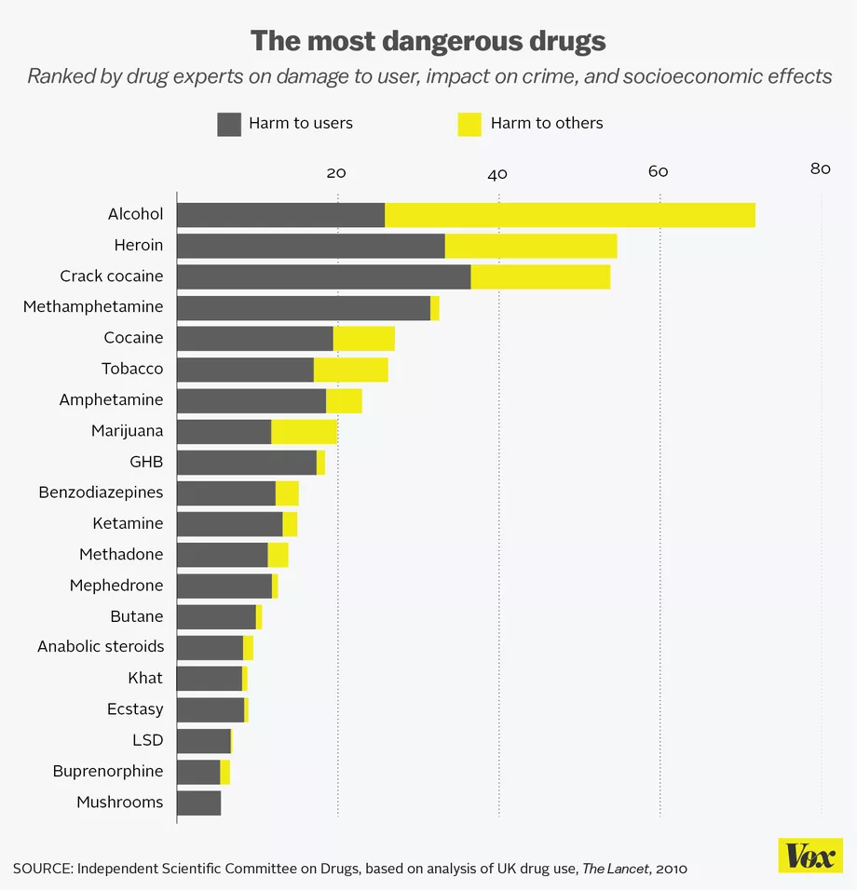

Slide 46
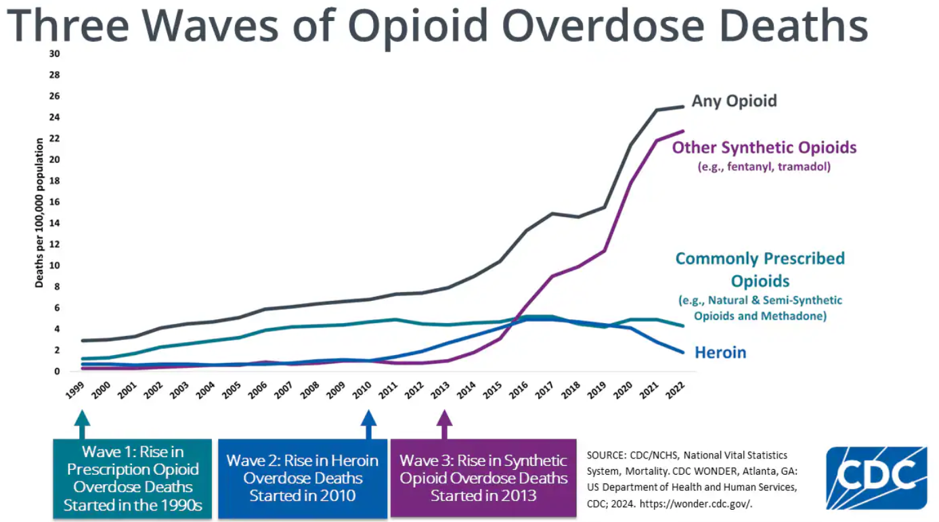

Slide 47
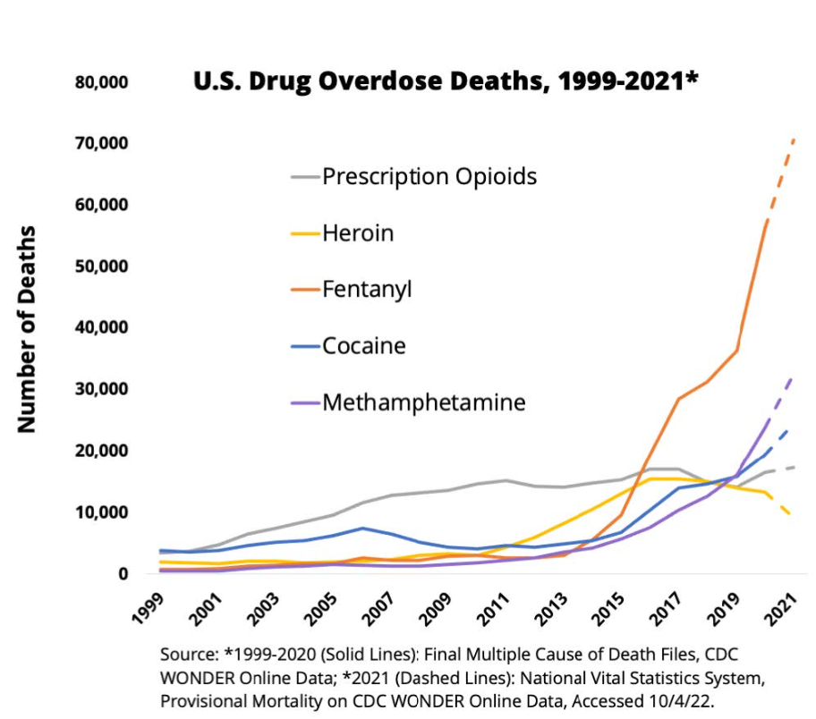

Slide 48
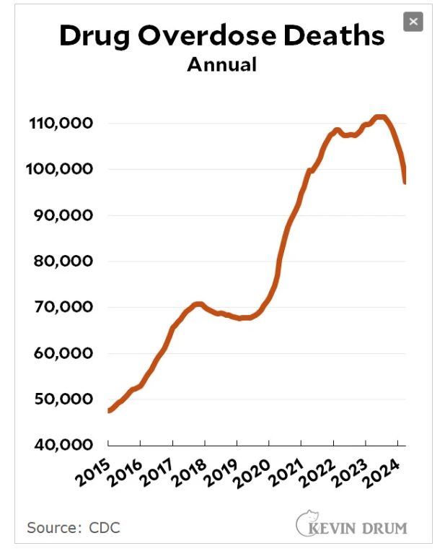

Slide 49


Slide 50


Slide 51


Slide 52
Guns
Guns and Crime
Costs/Benefits of widespread gun ownership
Gun control policies and gun violence
The evolving 2nd amendment
Gun policies that would reduce gun violence (and be Constitutional)
The current politics of guns and policy stalemate

Slide 53


Slide 54


2006 WHO data

Slide 55


Slide 56


Slide 57
Death Penalty (in 5 minutes or less!)
Death penalty as public policy
Death penalty has become incredibly rare
The US is a capital punishment outlier
Death penalty is highly geographically concentrated
Public support is declining
The paradox of death penalty deterrence

Slide 58


Slide 59


Slide 60


Slide 61


Slide 62


Slide 63


Slide 64


Slide 65


Slide 66


Slide 67


Slide 68
Conclusion
Thinking smarter about criminal justice
The politics of reform

Slide 69


