Slide 1
Education Policy

Slide 2
The State of US Education
Cross-national comparison
US Education in crisis?
Local control
Growth of state role
Interstate and intrastate disparities
Racial/socio-economic disparities
From performance/accountability back to values

Slide 3
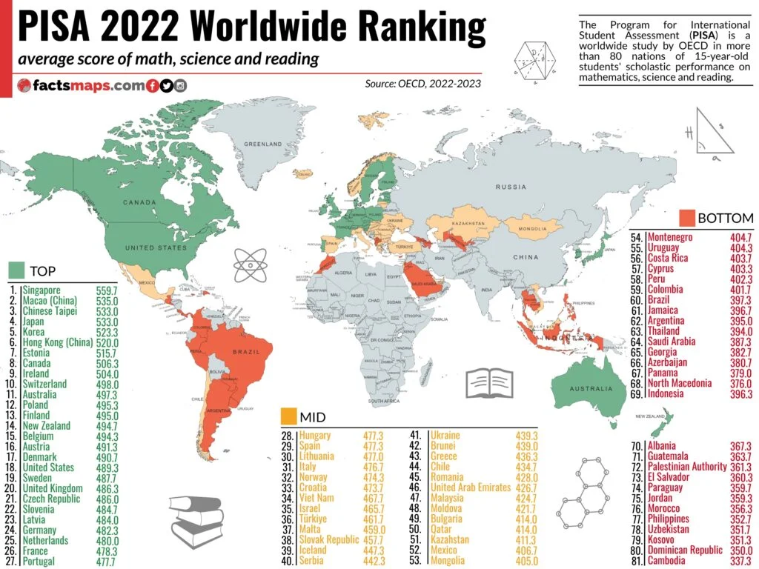

Slide 4
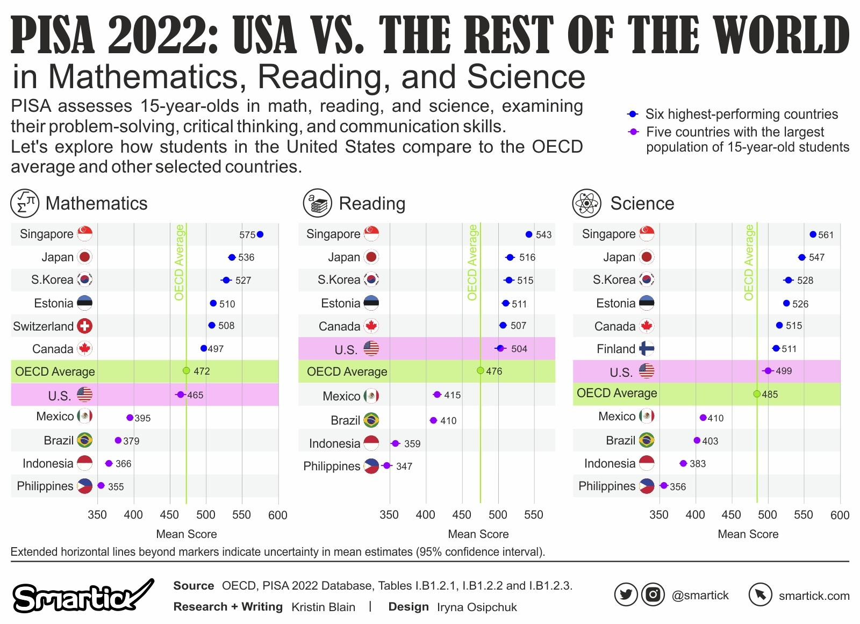

Slide 5
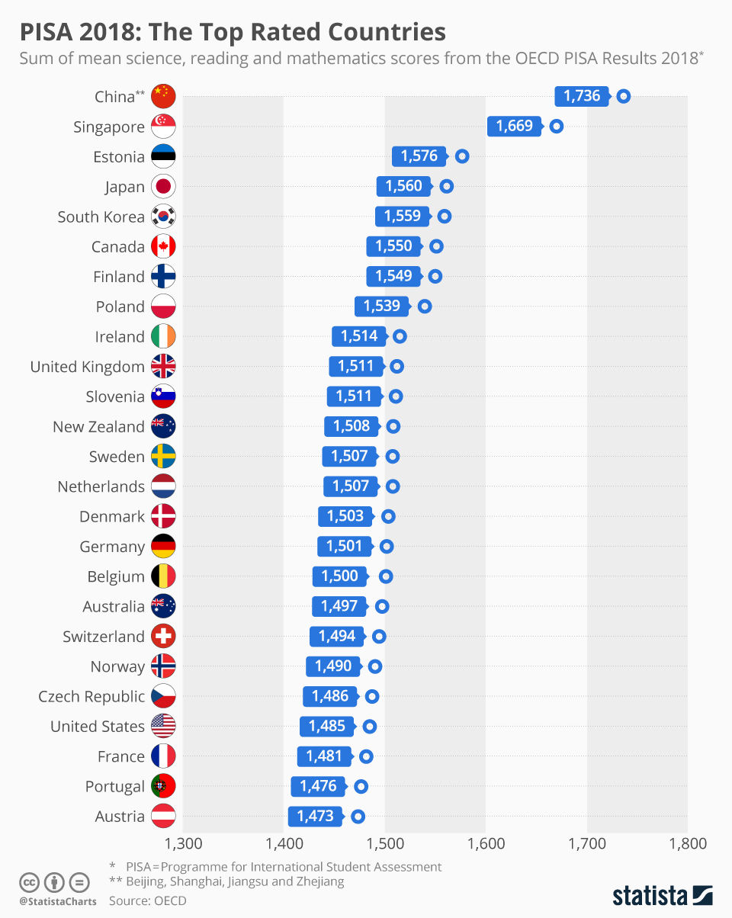

Slide 6
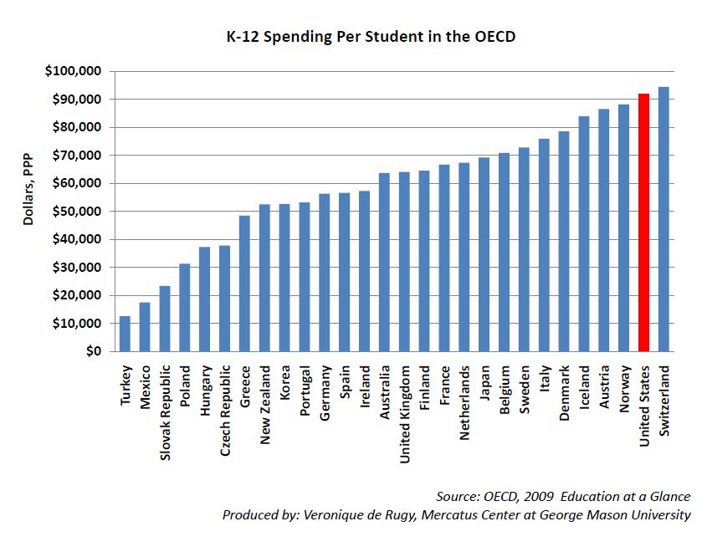

Slide 7
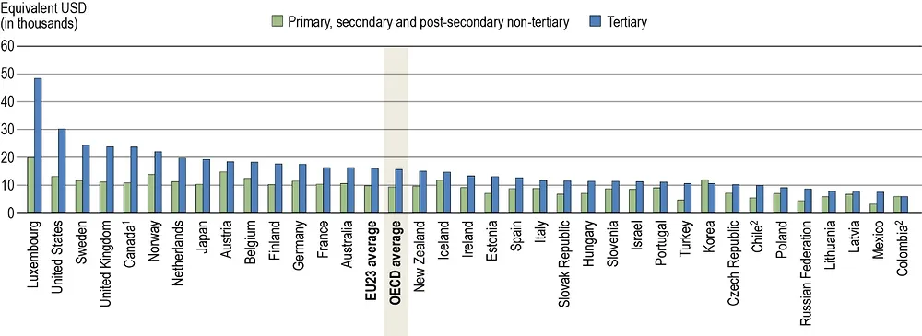

Slide 8
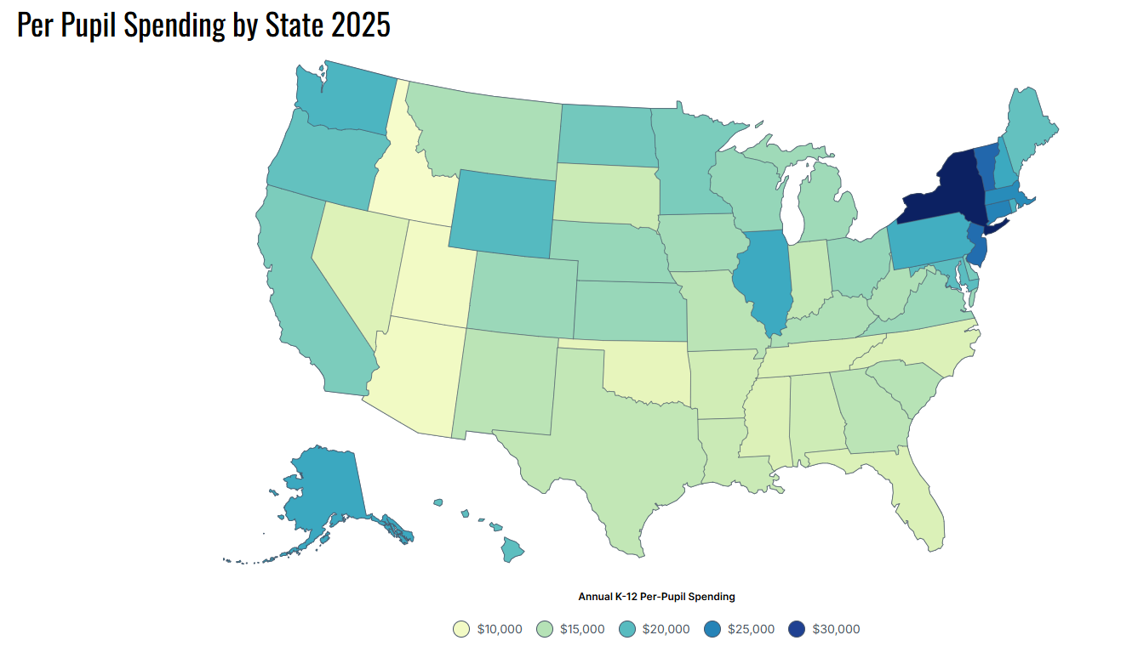

Slide 9
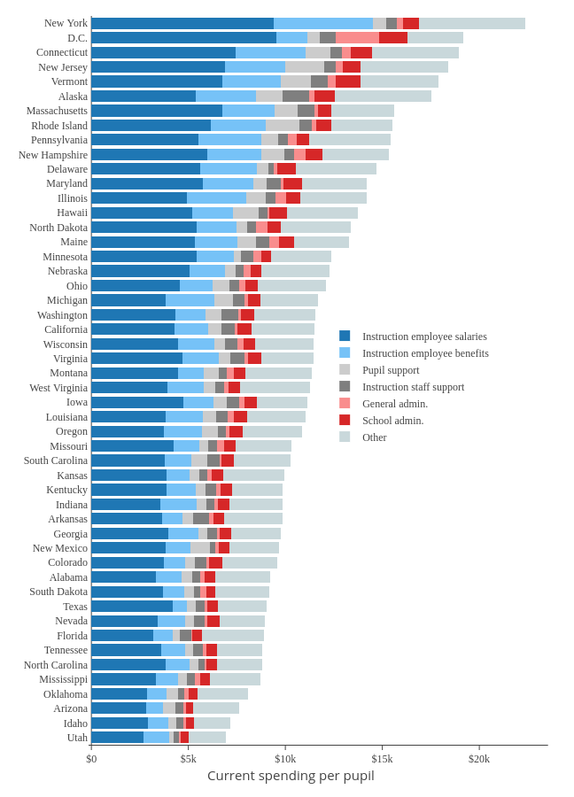

Slide 10
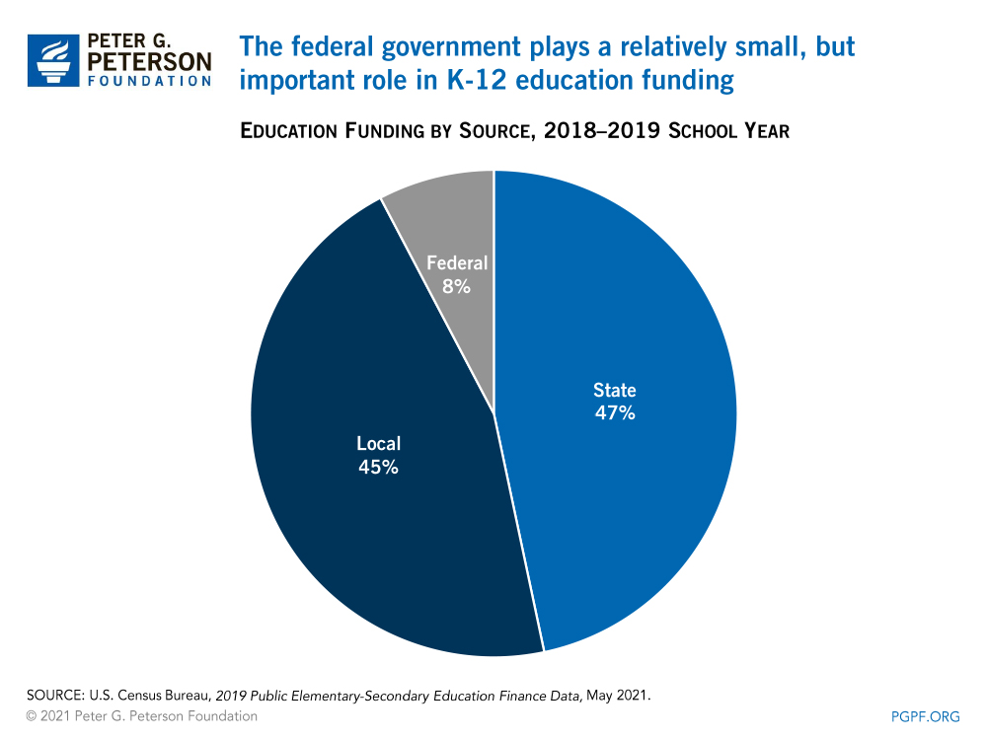

Slide 11
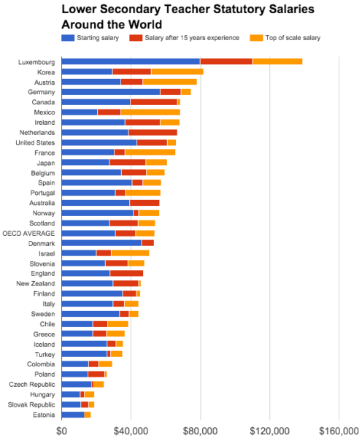

Slide 12
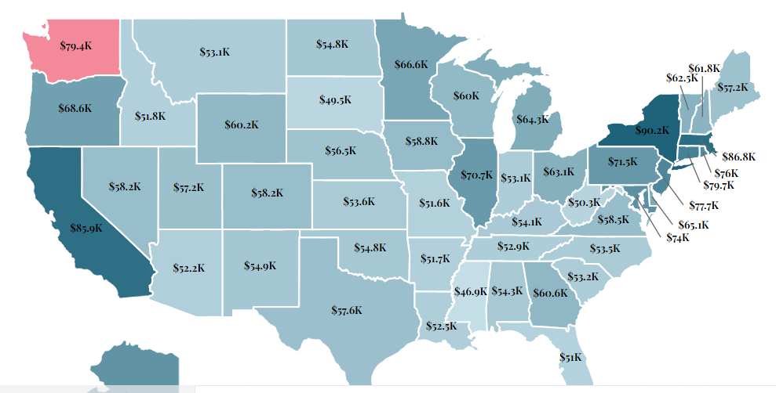

Slide 13
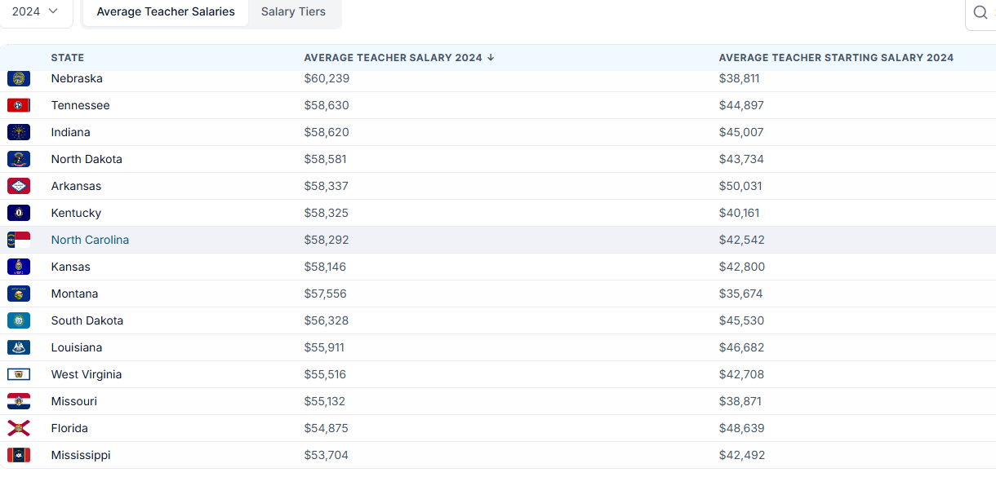

Slide 14
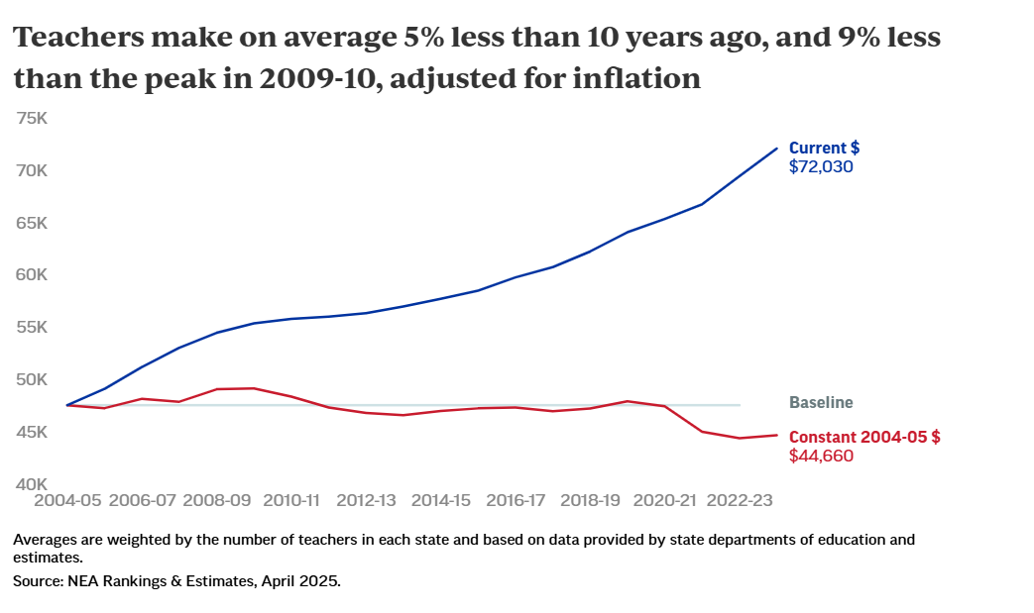

Slide 15
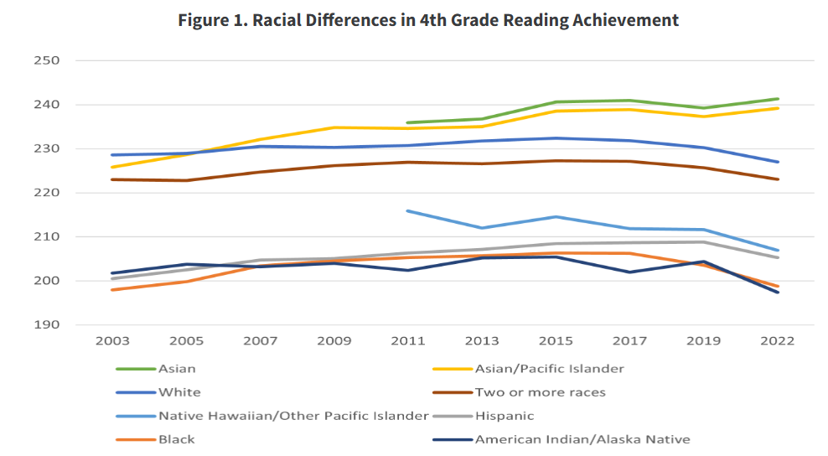

Slide 16
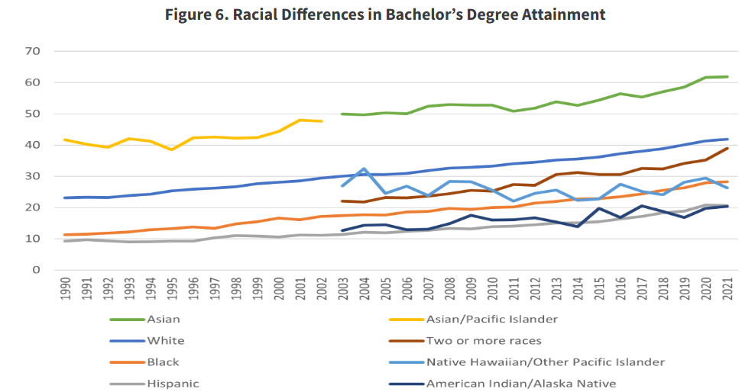

Slide 17
No Child Left Behind (and the rise of standardized testing)
The basics/testing
Student Achievement and school accountability
What worked with NCLB?
What didn’t work with NCLB?
Every Child Succeeds (ESSA) and the legacy of NCLB

Slide 18
Common Core to the rescue?
Common Core basics
About the standards
Criticisms
Assessment

Slide 19
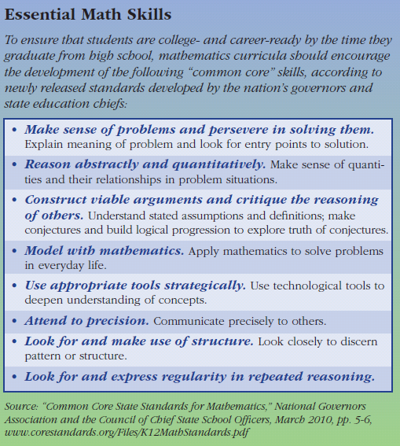
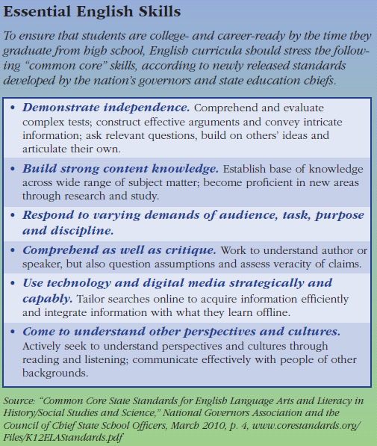
Common Core Standards

Slide 20
Teaching and Education reform
Teachers and educational quality
Teacher assessment and accountability
So, how do we get better teachers
  Lessons from other countries
  (pay them more!!)

Slide 21
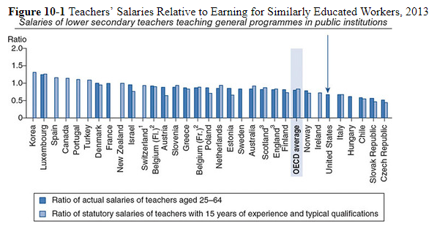

Slide 22
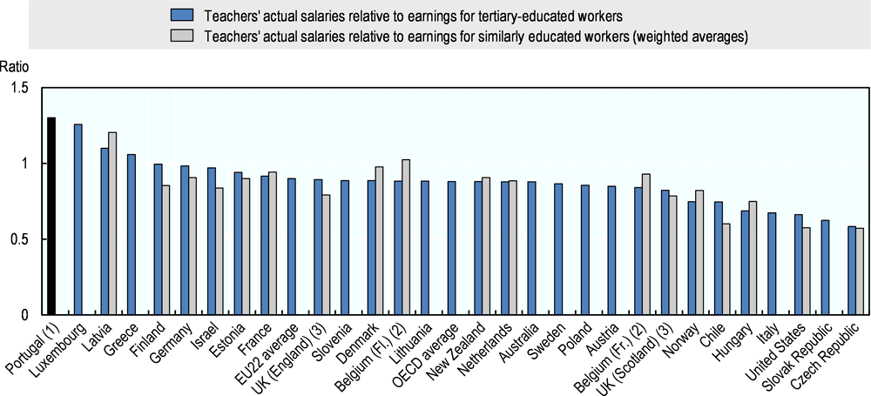

Slide 23
School Choice
Basics
Charter Schools
Vouchers
Religious schools and public funding
NC case study

Slide 24
Schools and Culture war politics
Transformation of politics
Critical Race Theory
LQBTQ+ and Gender issues
Parents Rights!

Slide 25
College and education policy
College costs
Student loans/student debt
Trump versus universities

Slide 26
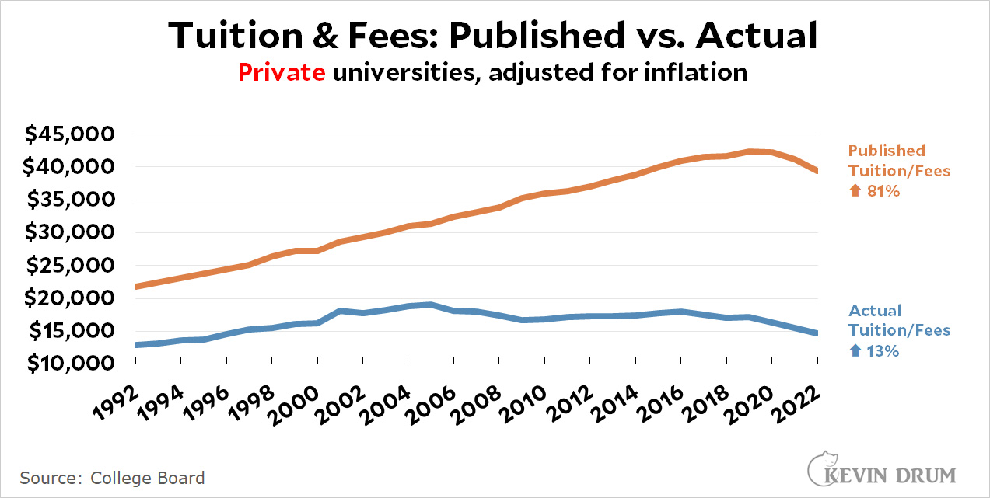
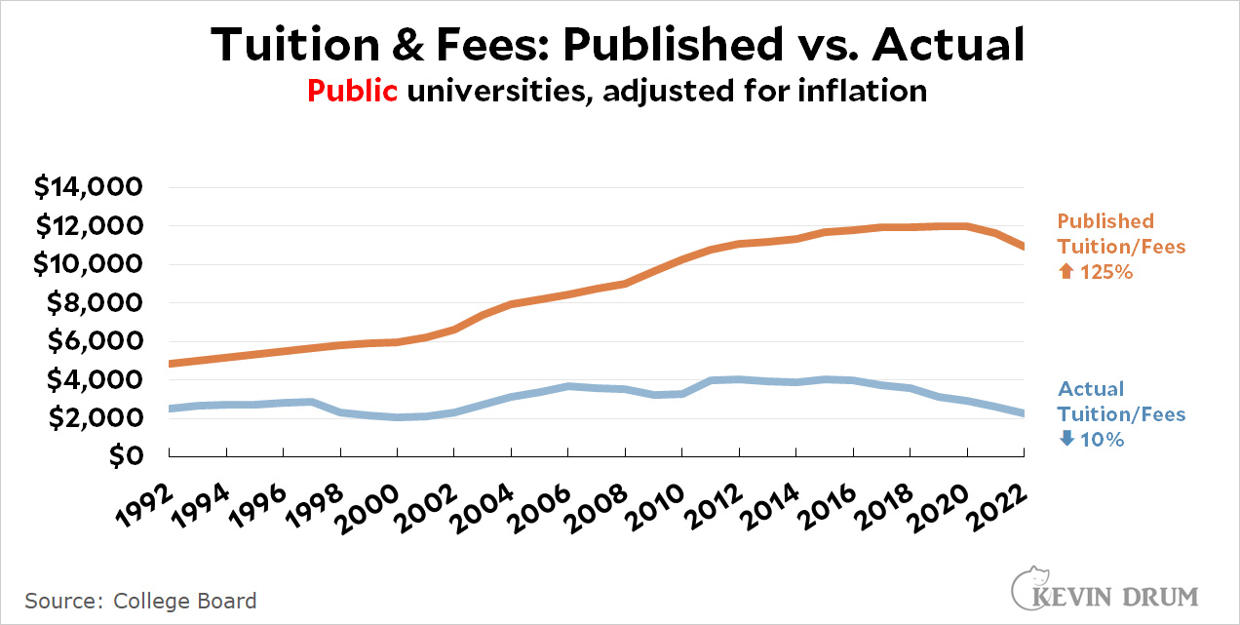

Slide 27
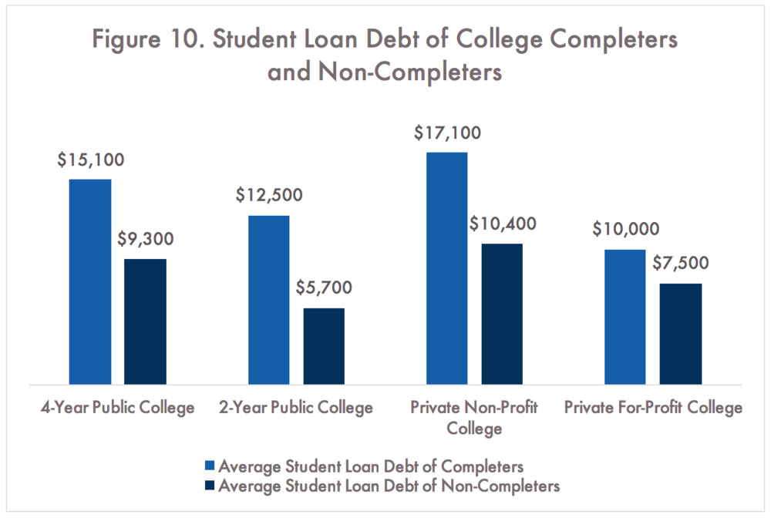
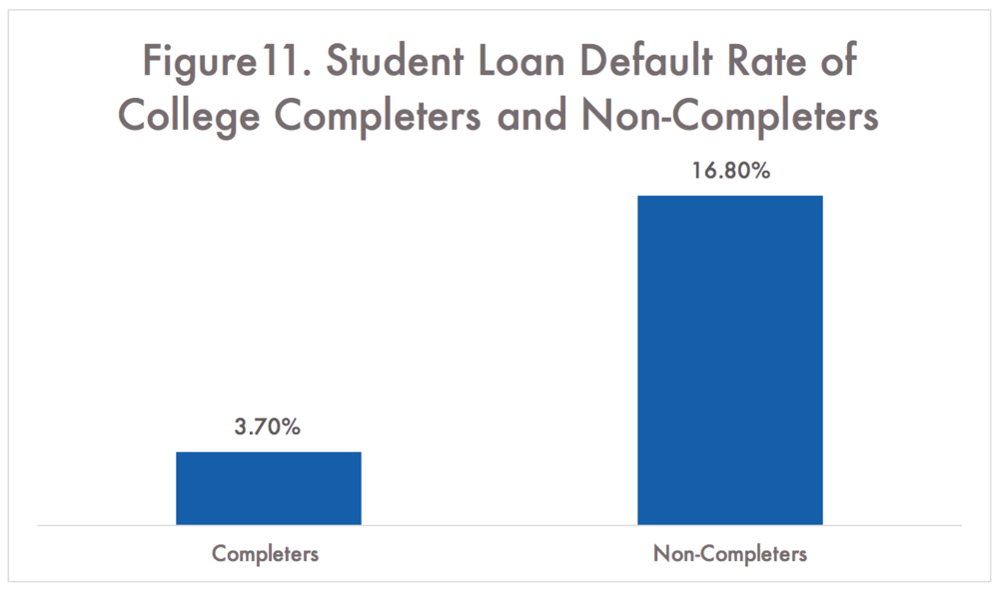

Slide 28
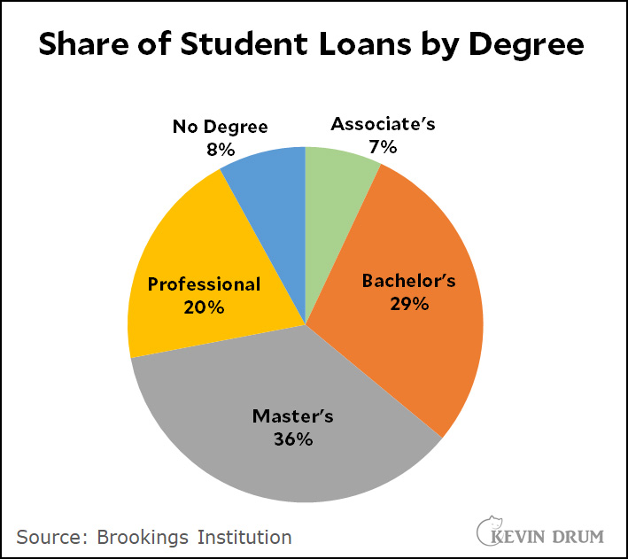
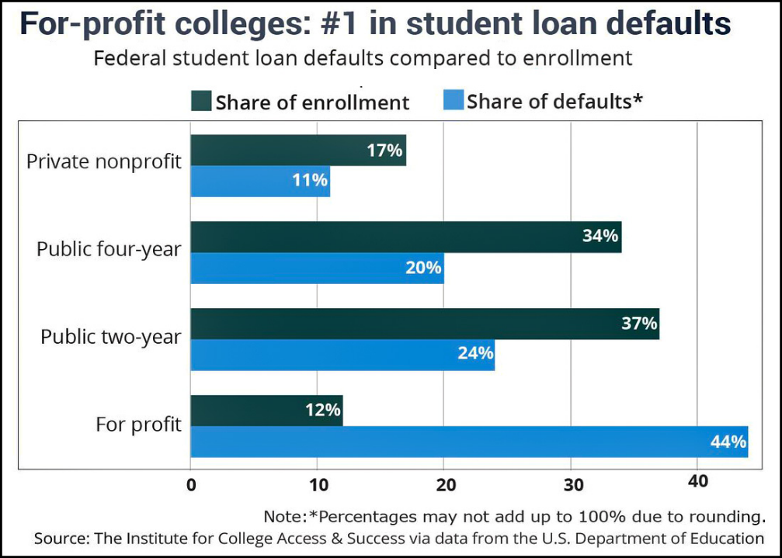

Slide 29
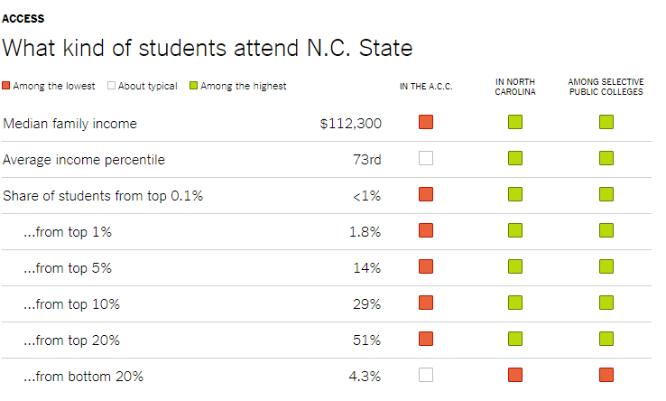

Slide 30
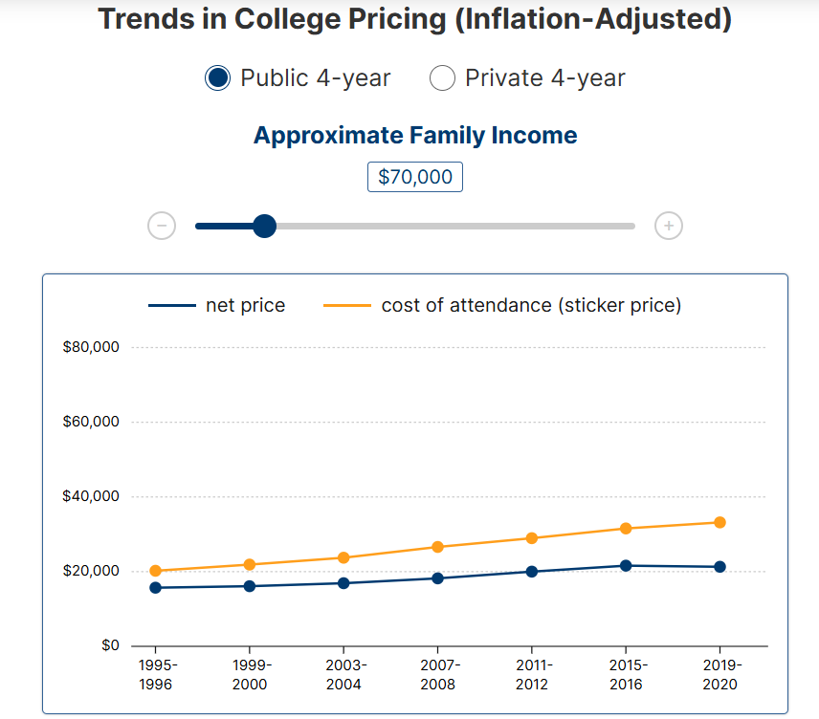

Slide 31
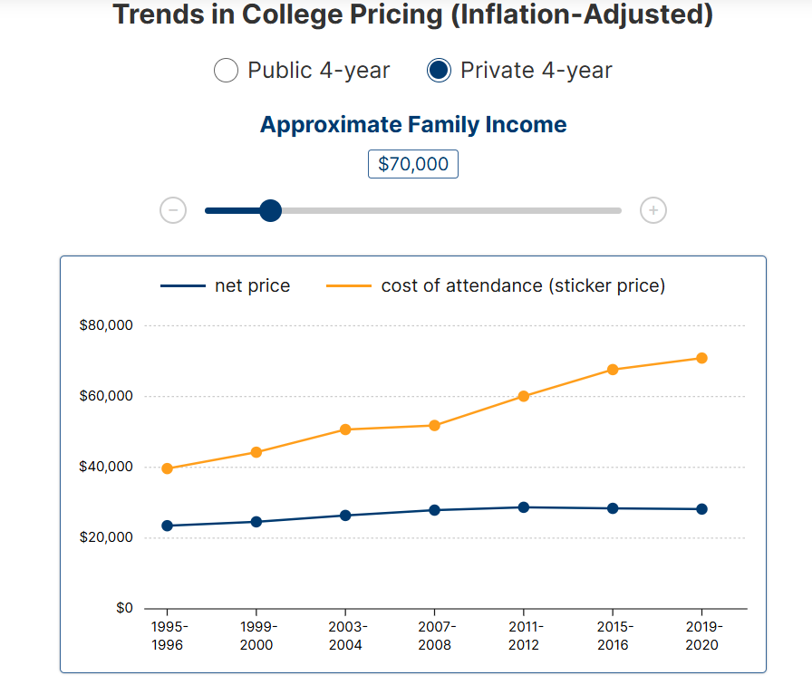

Slide 32
Conclusion
Lessons from the world
It’s not easy, but the good ideas are out there, i.e., we actually know what to do

Slide 33
