Slide 1
Health Care Policy

Slide 2
Introduction
Why health care policy matters
The problem in 3 charts
Political frustration (the Luigi problem)

Slide 3
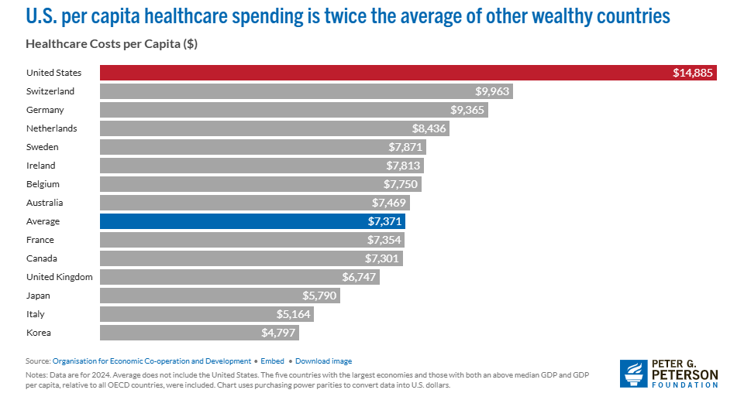

Slide 4
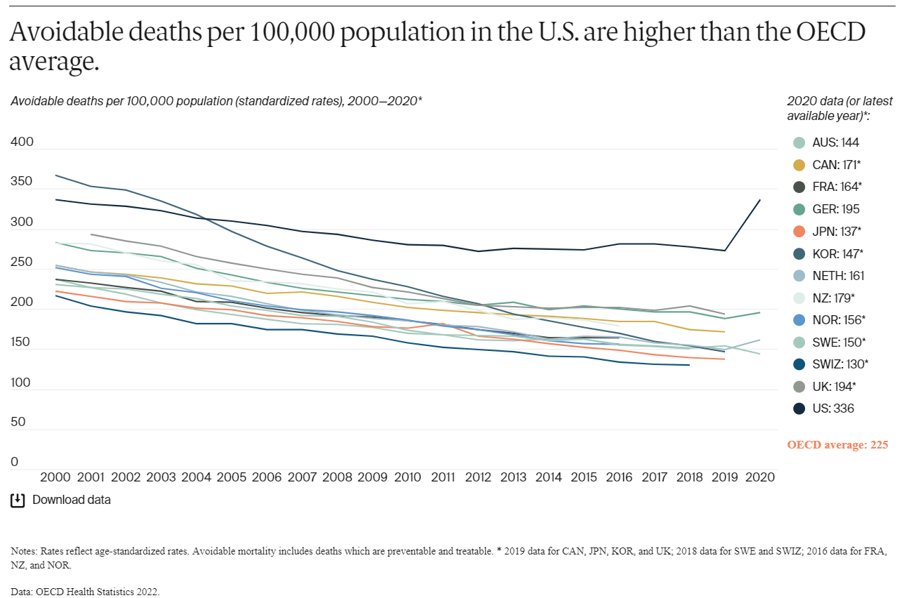

Slide 5
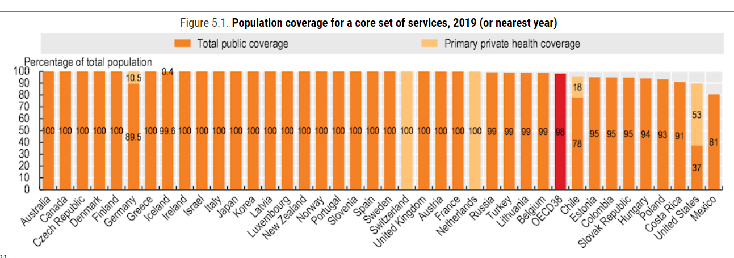

Slide 6
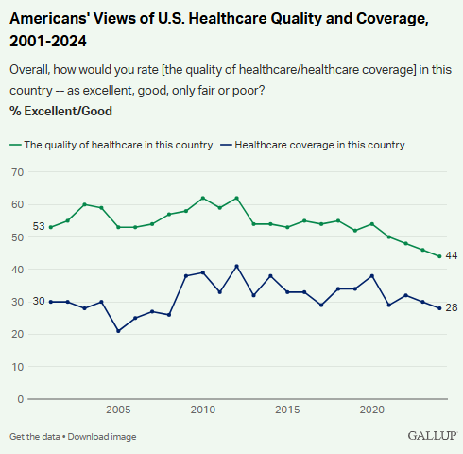
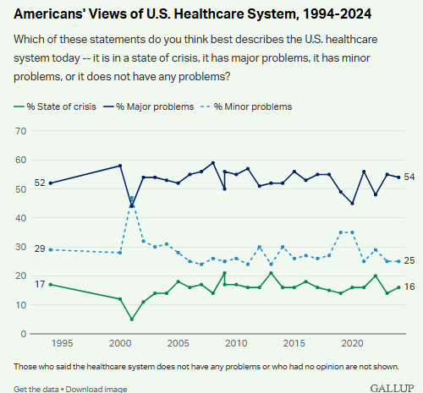

Slide 7
Health in America
US vs. the world

Slide 8
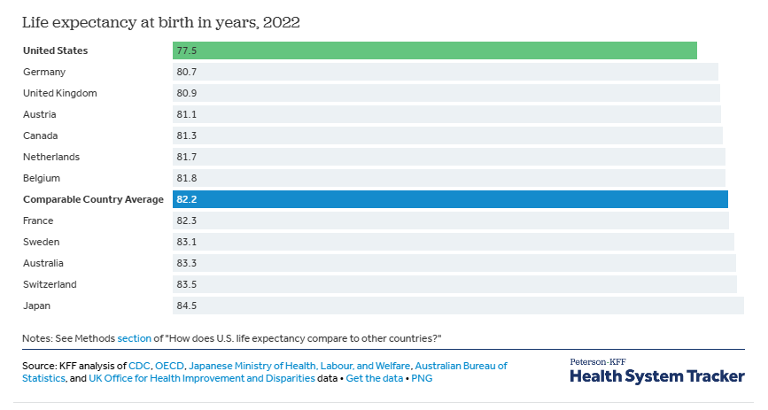

Slide 9
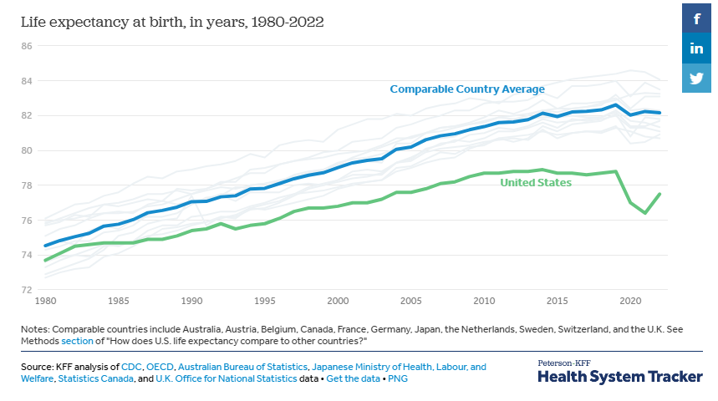

Slide 10
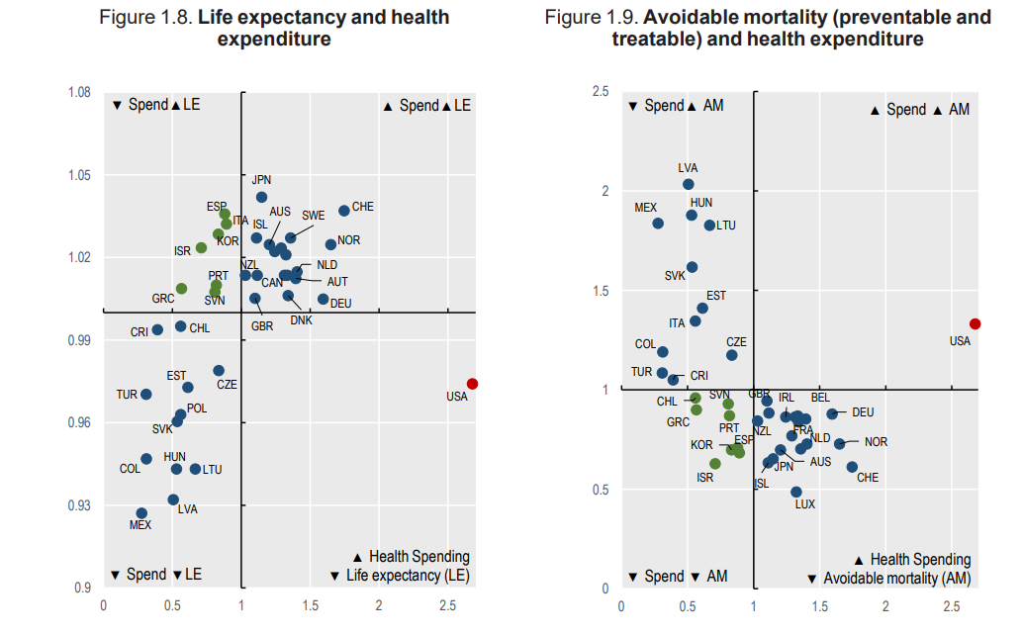

Slide 11
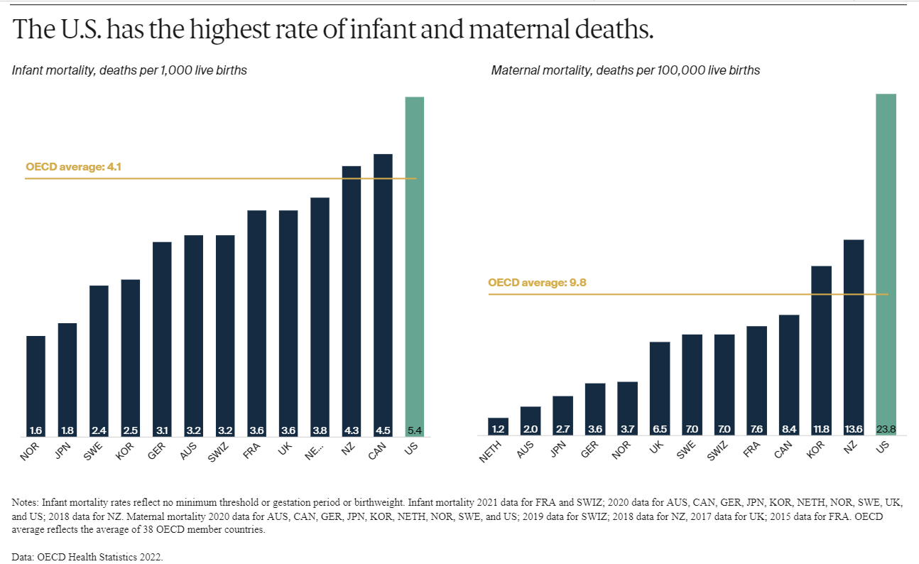
Infant Mortality

Slide 12
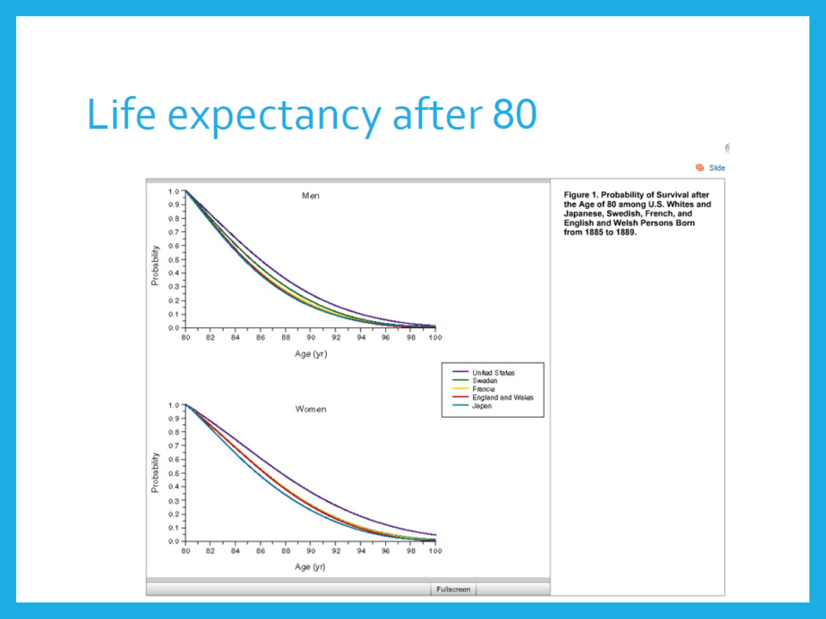
Life expectancy after 80

Slide 13
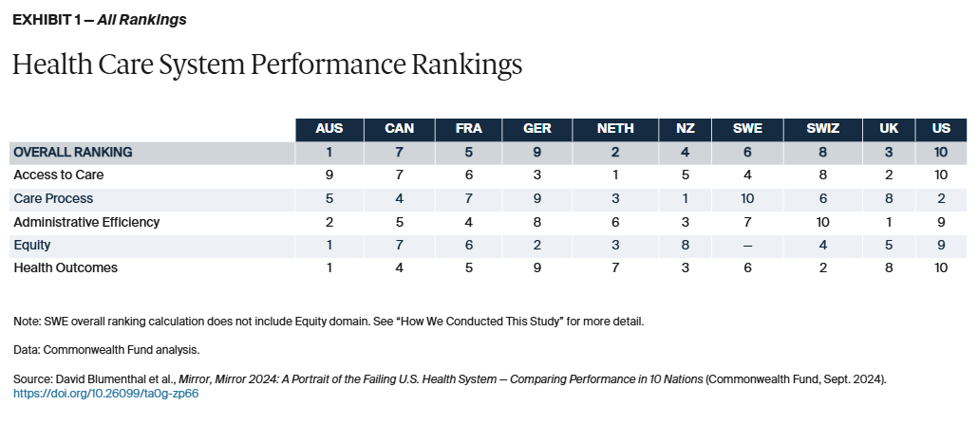

Slide 14
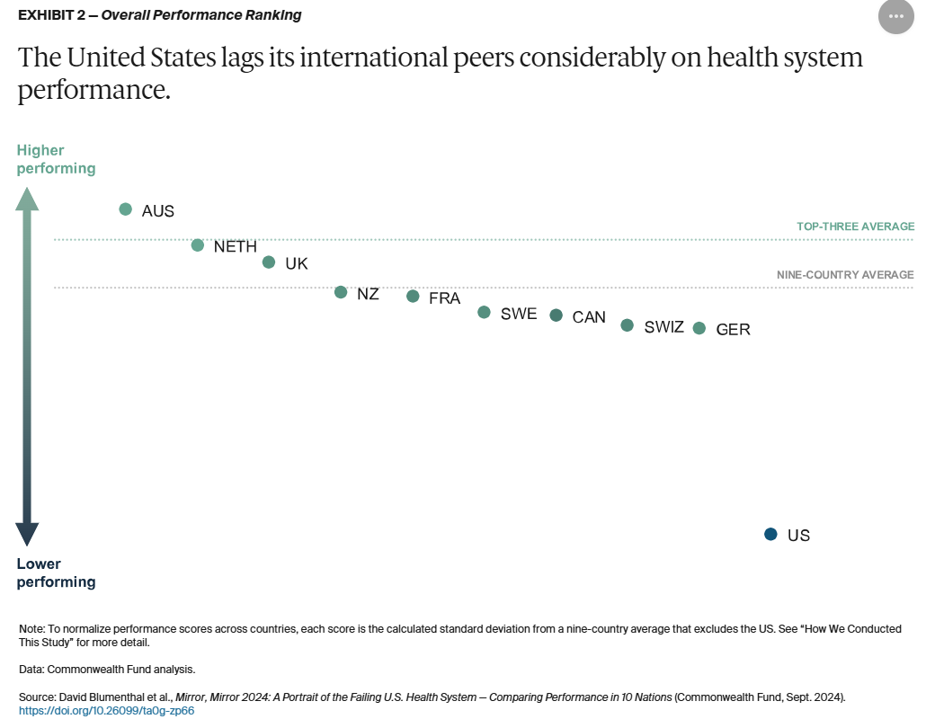

Slide 15
The U.S. Health Care System
Complexity of system

Slide 16
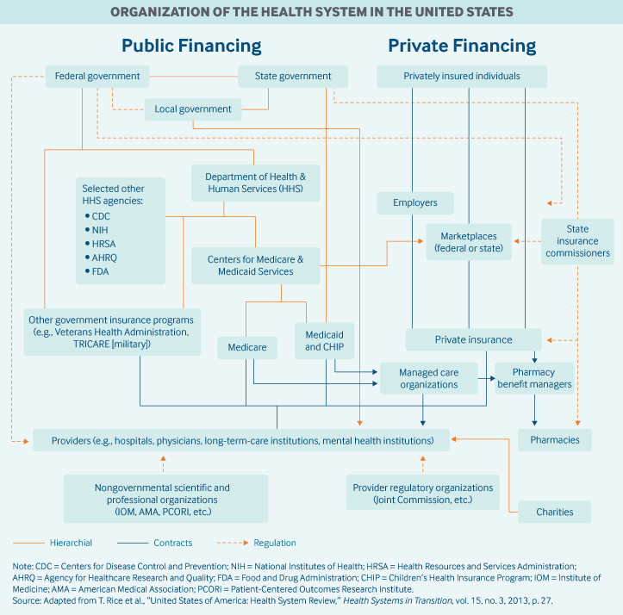

Slide 17
The U.S. Health Care System
Employer-based insurance
Fee for Service
Managed Care
Government subsidized care

Slide 18
Problems with the U.S. System: Cost
High relative cost

Slide 19
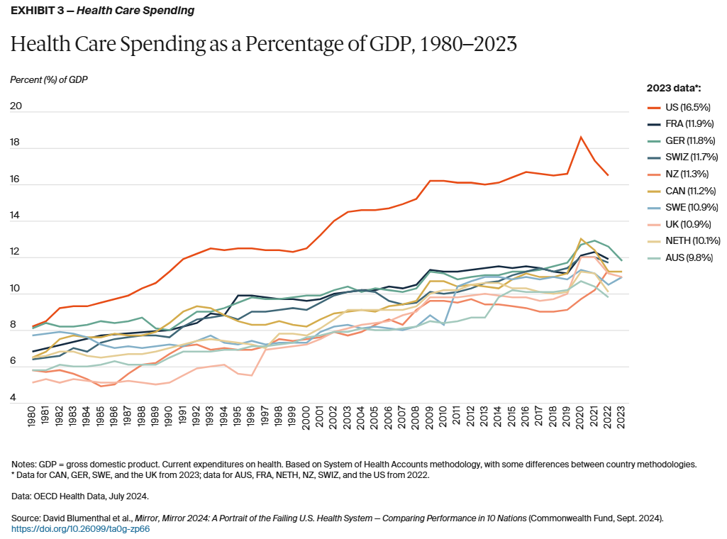

Slide 20
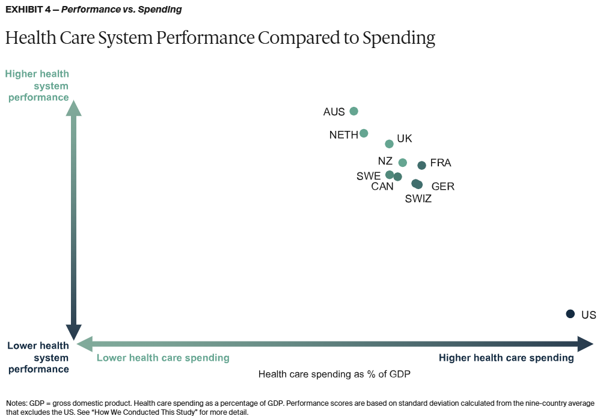

Slide 21
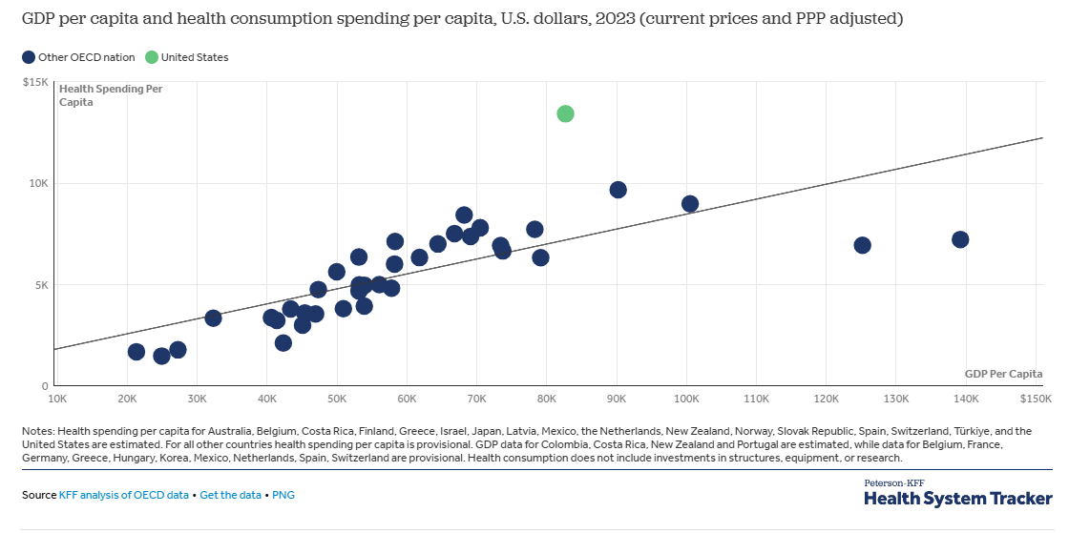

Slide 22
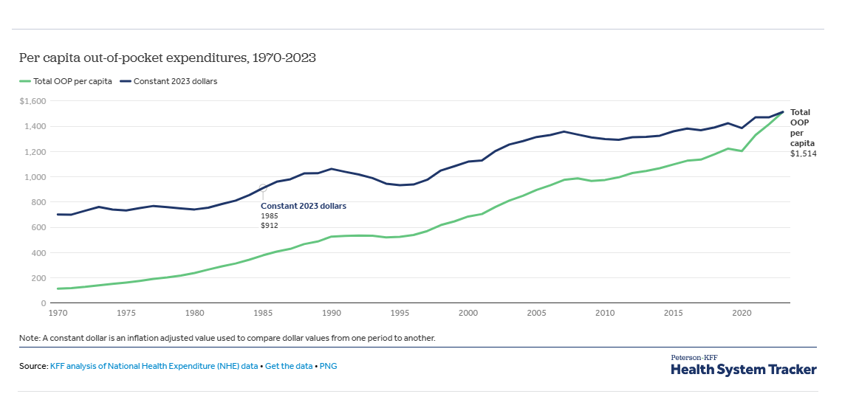

Slide 23
Problems with the U.S. System: Cost
Fee-for-service system (incentives)
Market Failure
Supply constraints
Technology
Aging public
Medical culture
Primary care shortage
Prescription Drugs
Administrative costs
It’s the prices, stupid

Slide 24
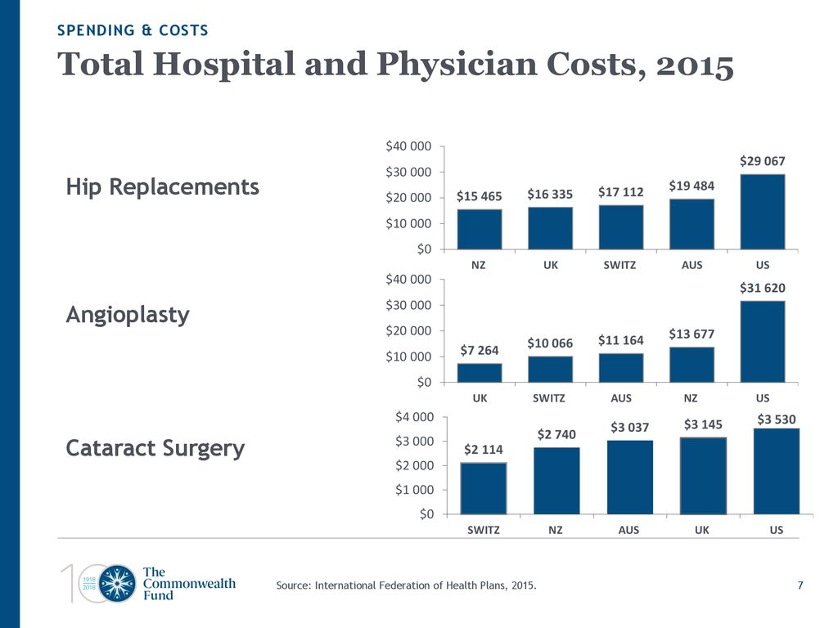

Slide 25
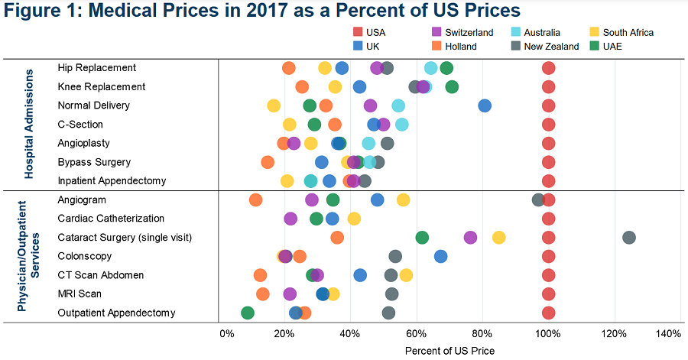

Slide 26
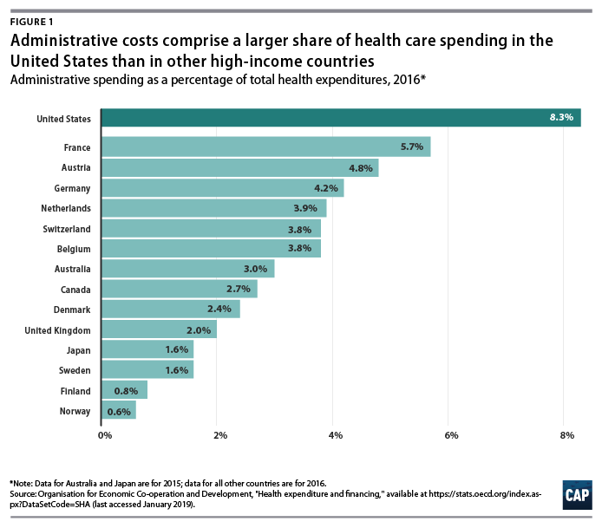

Slide 27
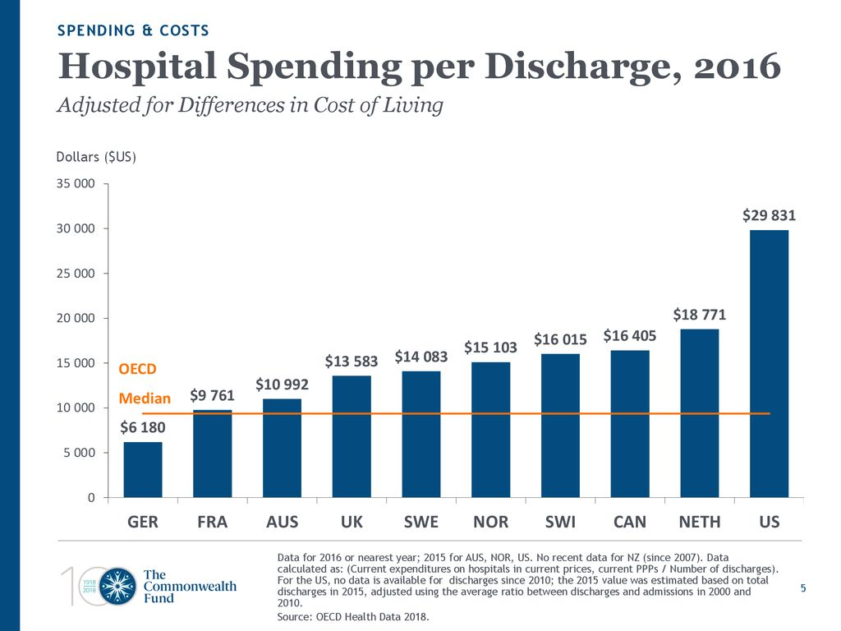

Slide 28
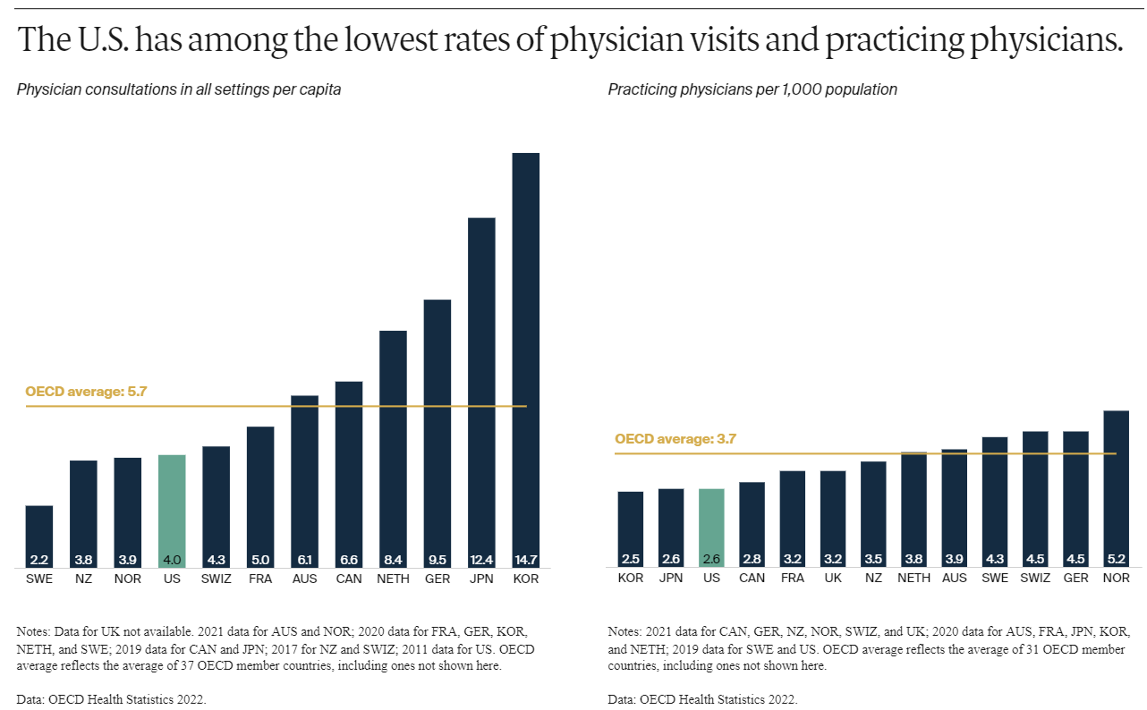

Slide 29
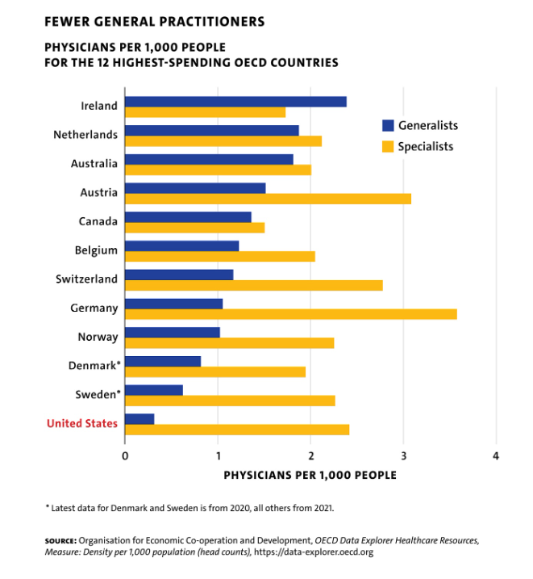

Slide 30
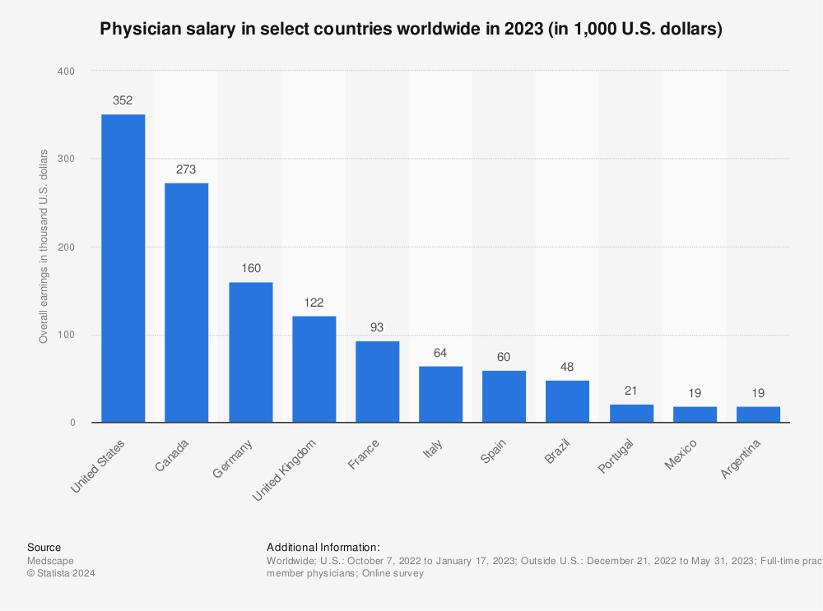

Slide 31
Problems with the U.S. System: Access
Inadequate Access
Rationing
Cost as an access problem
Physician shortage redux
Equity

Slide 32
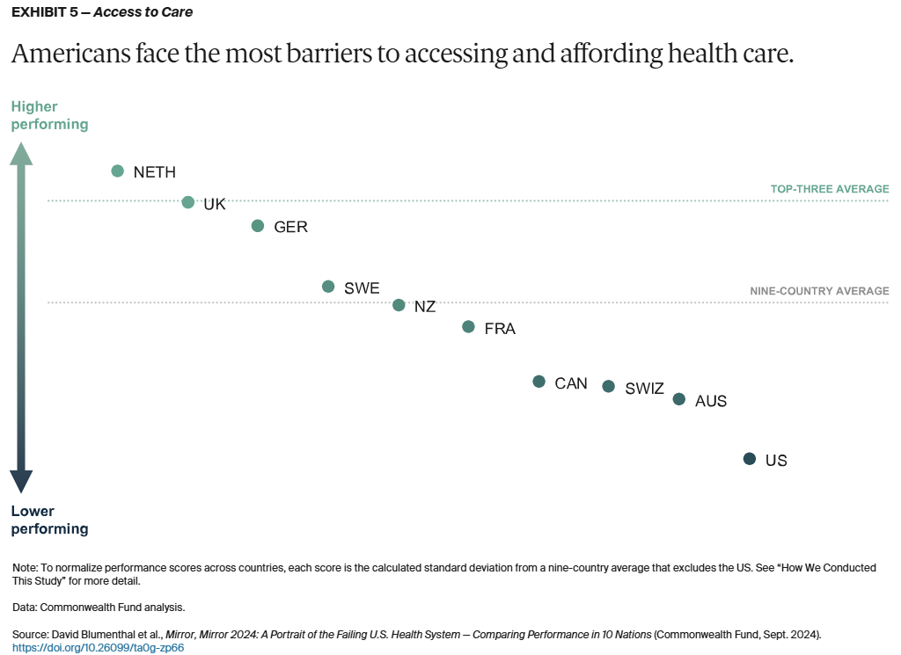

Slide 33
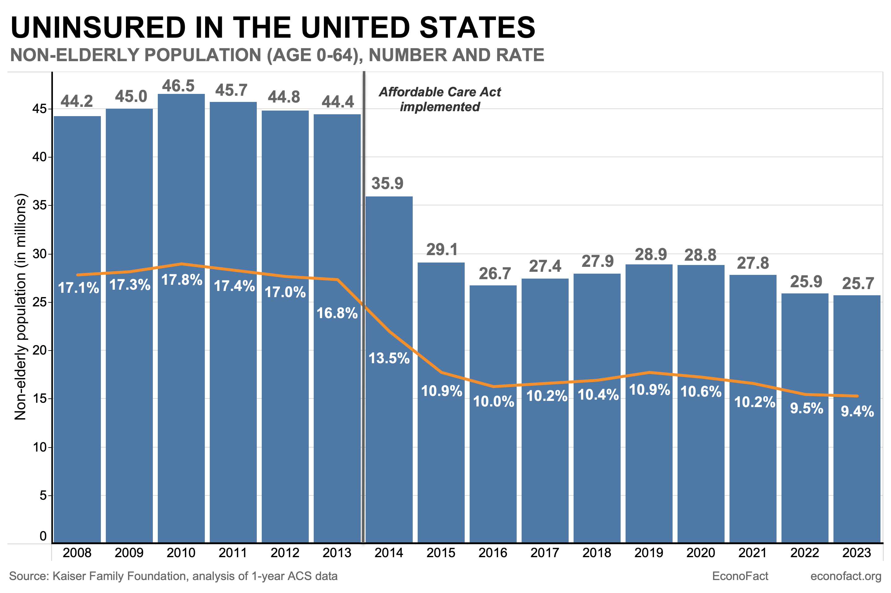

Slide 34
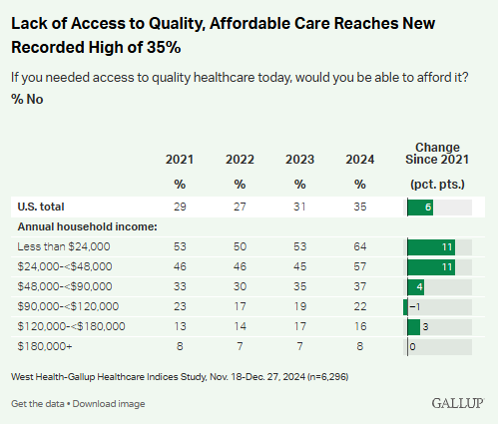
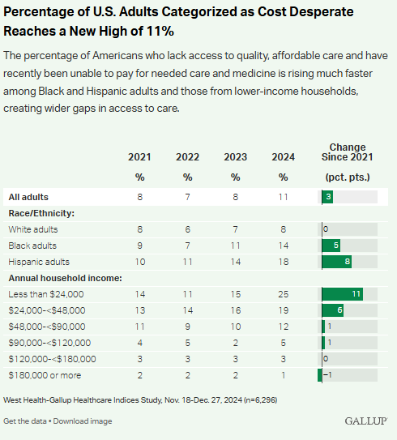

Slide 35
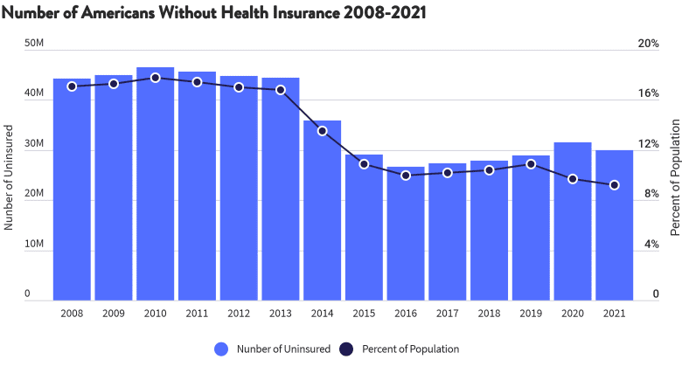

Slide 36
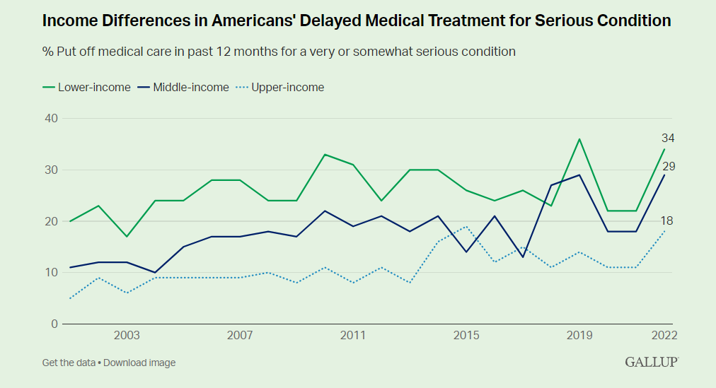

Slide 37
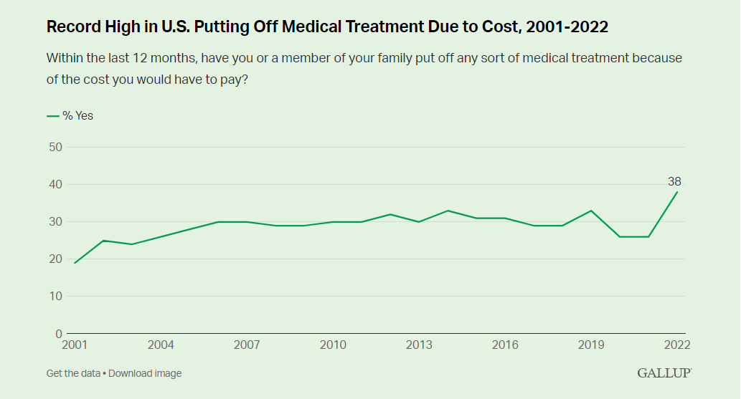

Slide 38
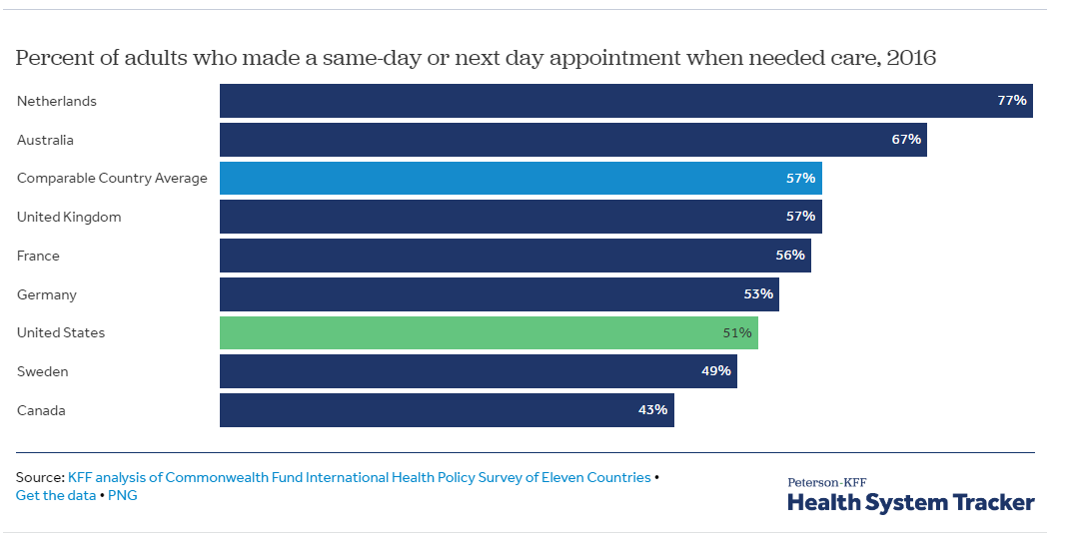

Slide 39
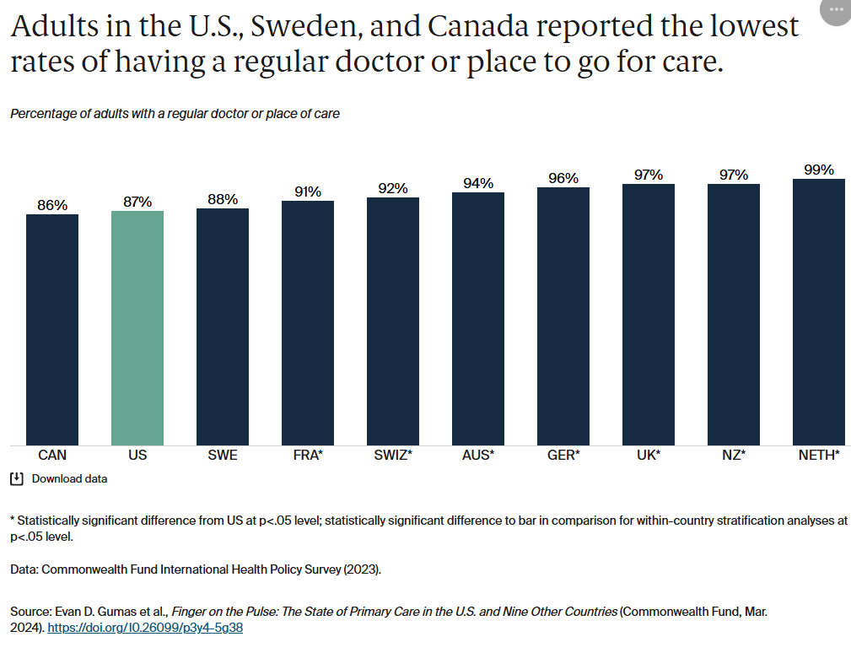

Slide 40
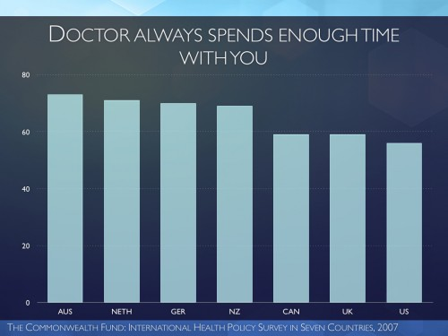

Slide 41
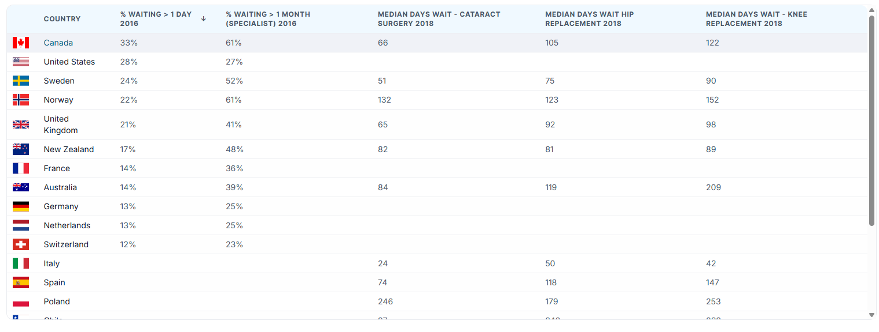
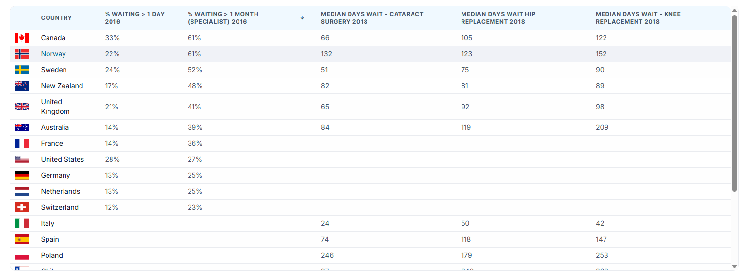

Slide 42
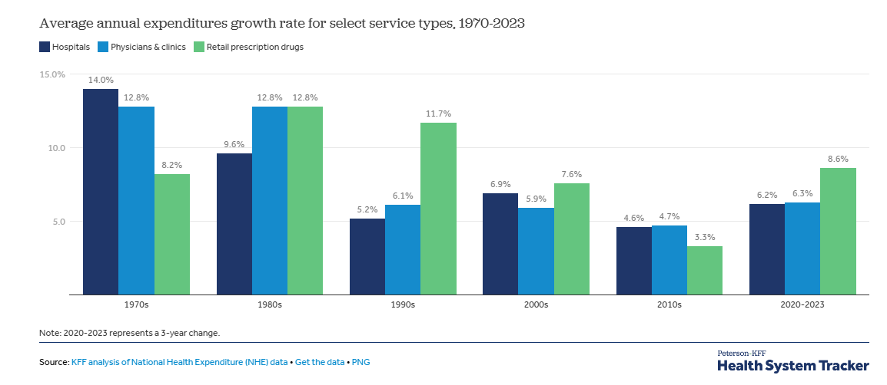

Slide 43
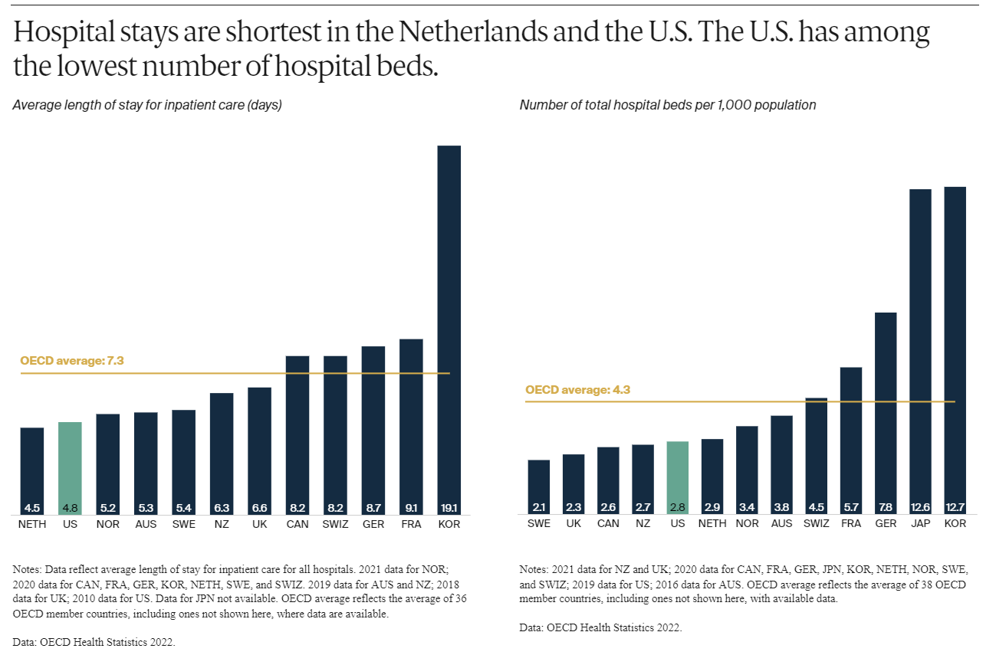

Slide 44
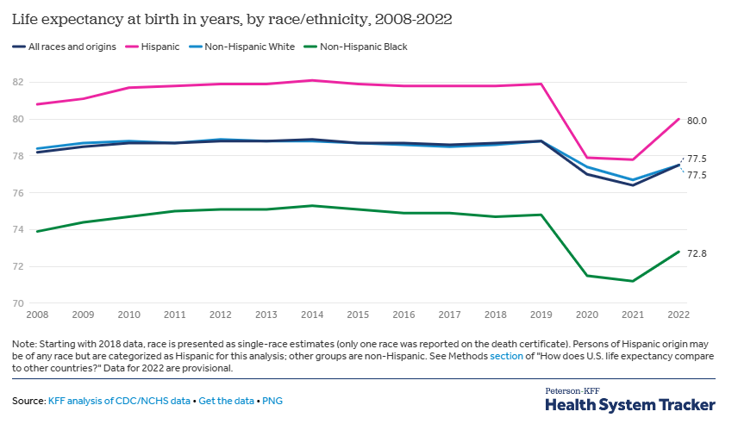

Slide 45
Problems with the U.S. System: Quality
Quality in cross-national perspective

Slide 46
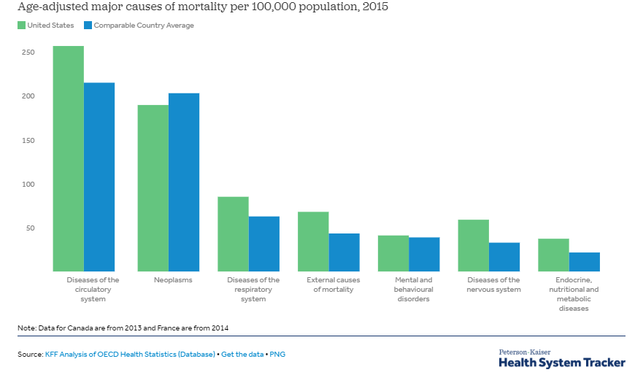

Slide 47
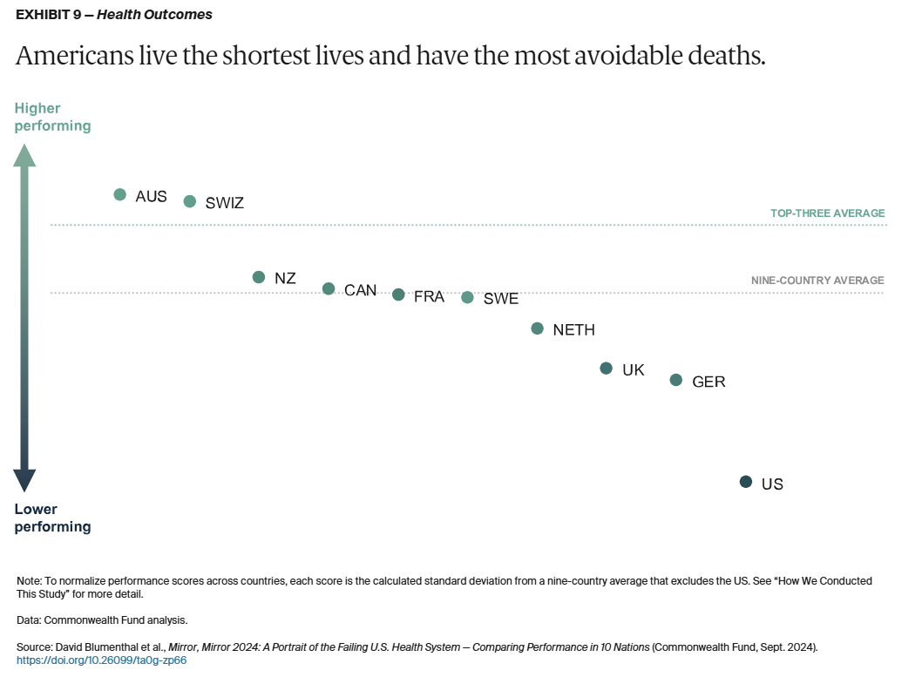

Slide 49
Problems with the U.S. System: Quality
Lack of Access
Focus on sickness instead of health
Overspecialization

Slide 50
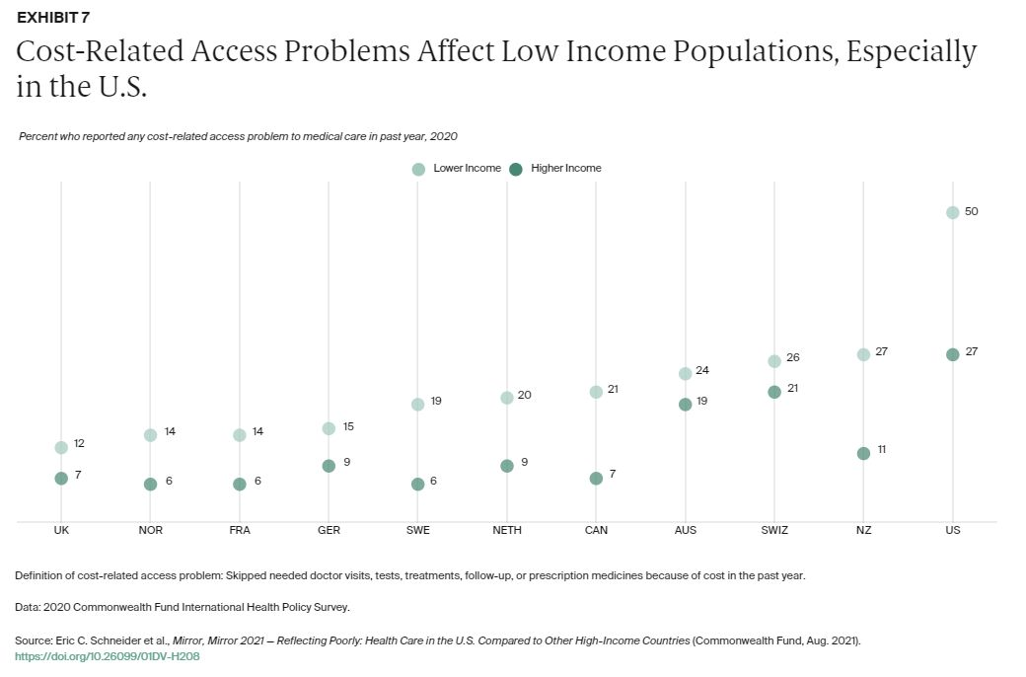

Slide 51
Contemporary Policy
Medicare
Medicaid
Medicaid expansion
Work requirements
OBBB Medicaid cuts
ACA/Obamacare
How it works
Whither the subsidies?

Slide 52
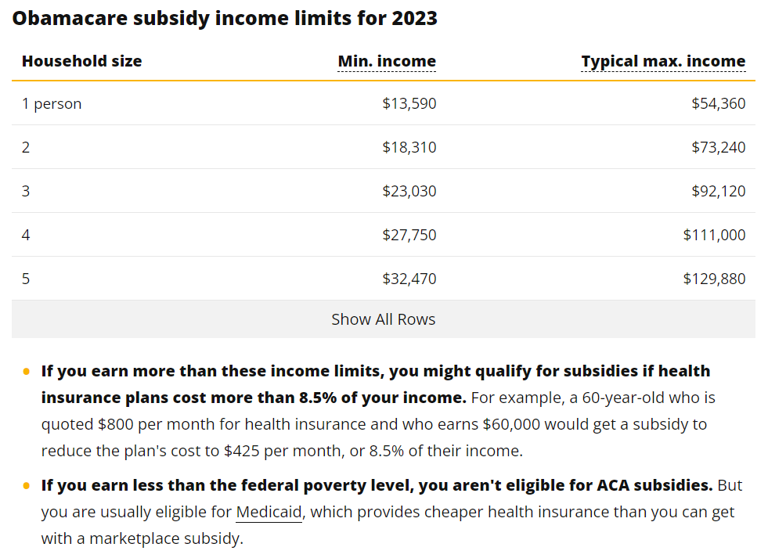

Slide 53
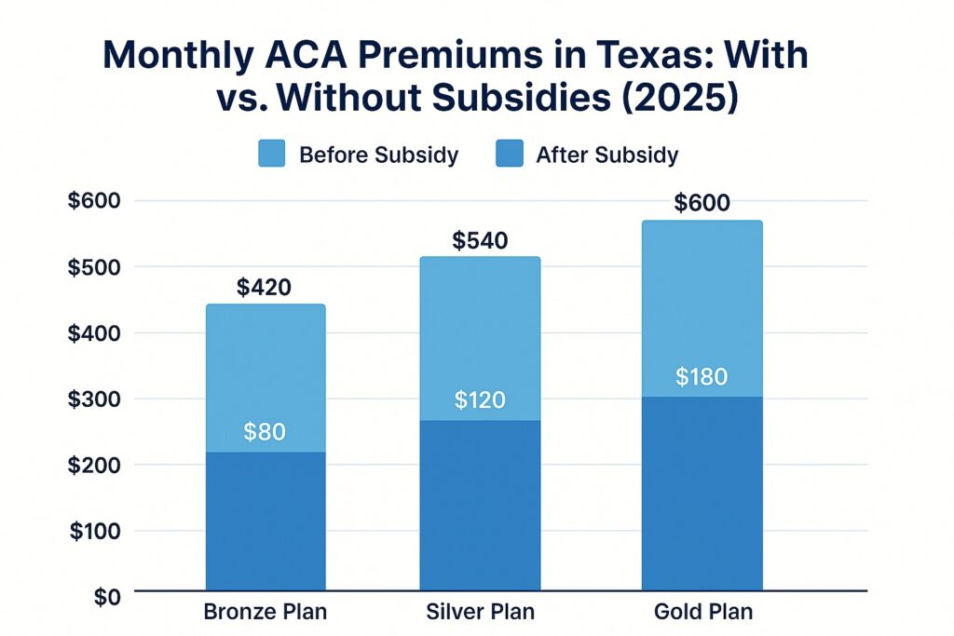

Slide 54
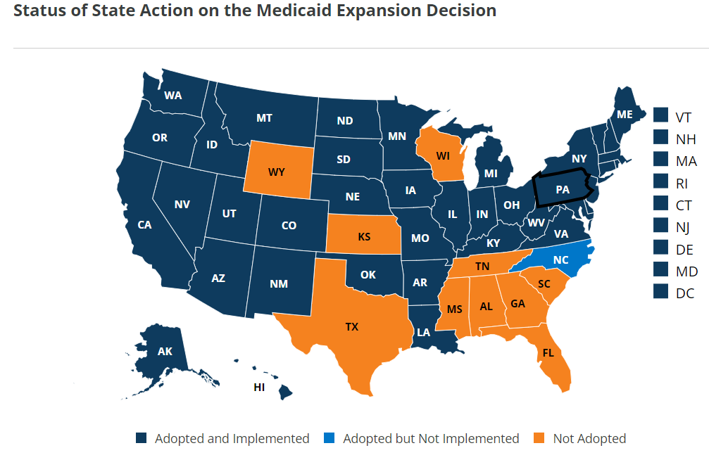

Slide 55
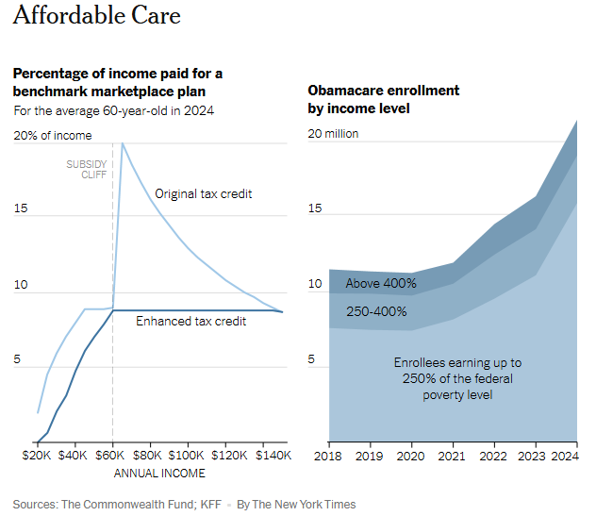

Slide 56
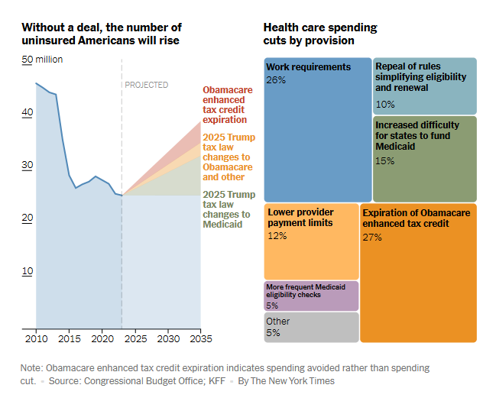

Slide 57
Lessons from abroad
No perfect model
The politics matter– a lot
Health care and markets
Medicare for all/Single payer
Gradual single payer/opt-in
Social insurance/employer mandates
Individual mandates
Single payer+ private option

Slide 58
Concluding thoughts
Three paths forward– something’s gotta be constrained
The Fundamental Challenge

Slide 59
