Slide 1
Social Welfare Policy

Slide 2
Introduction
Who benefits?
Entitlements
Social Insurance vs. Public Assistance

Slide 3
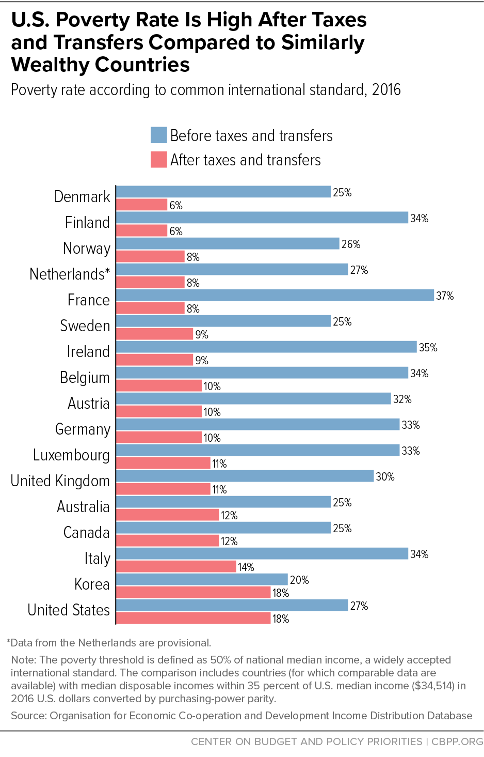

Slide 4
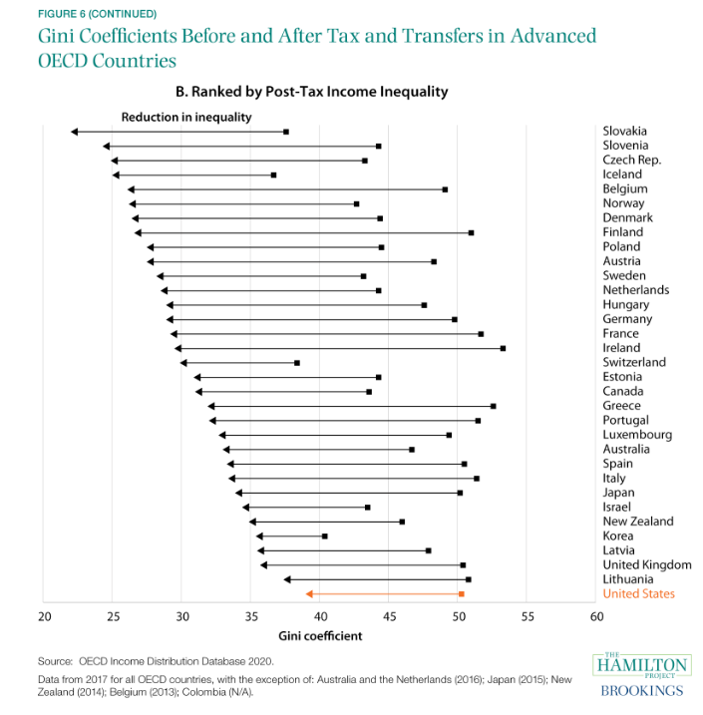

Slide 5
Poverty in America
By the numbers
Family Structure
Race
Age
Temporary vs. persistent poor
Working poor
Underclass and homeless
Concentrated poverty
Culture of poverty/Poverty and causality

Slide 6
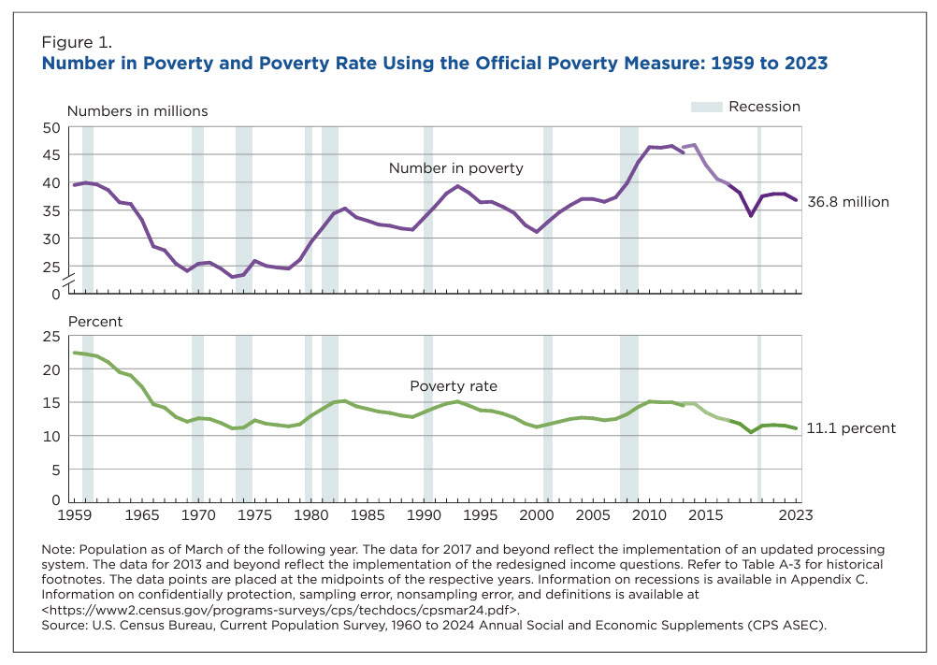

Slide 7
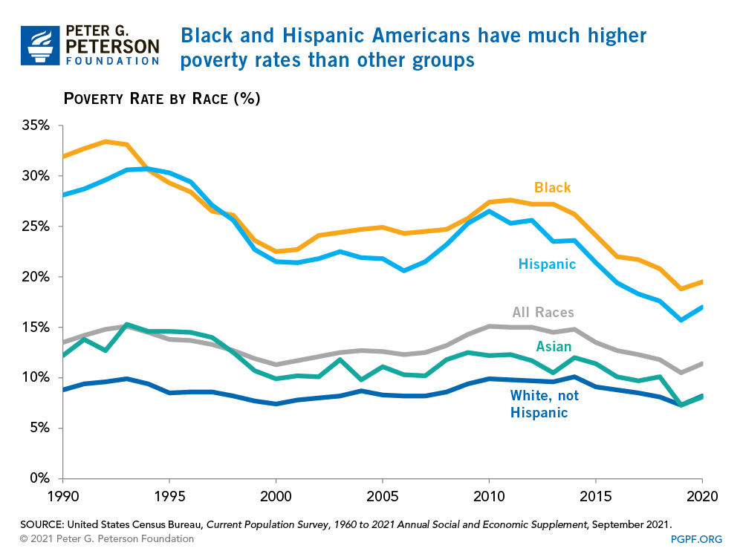

Slide 8
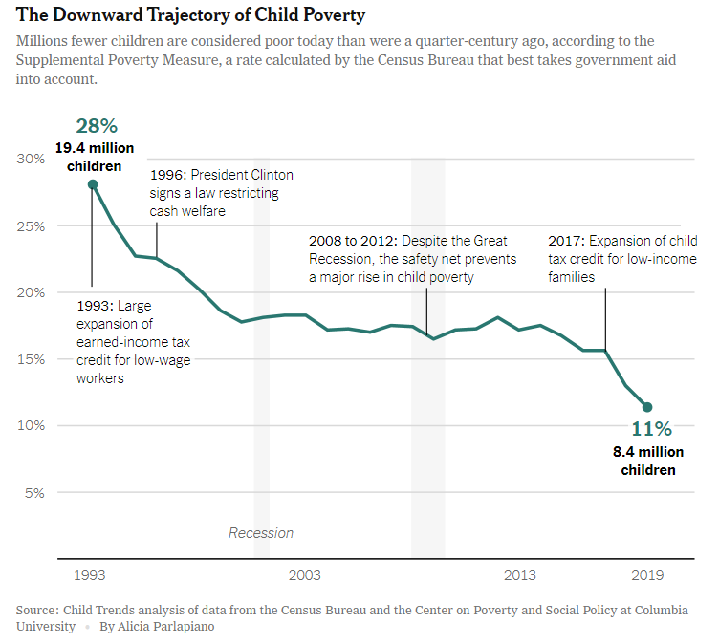

Slide 9
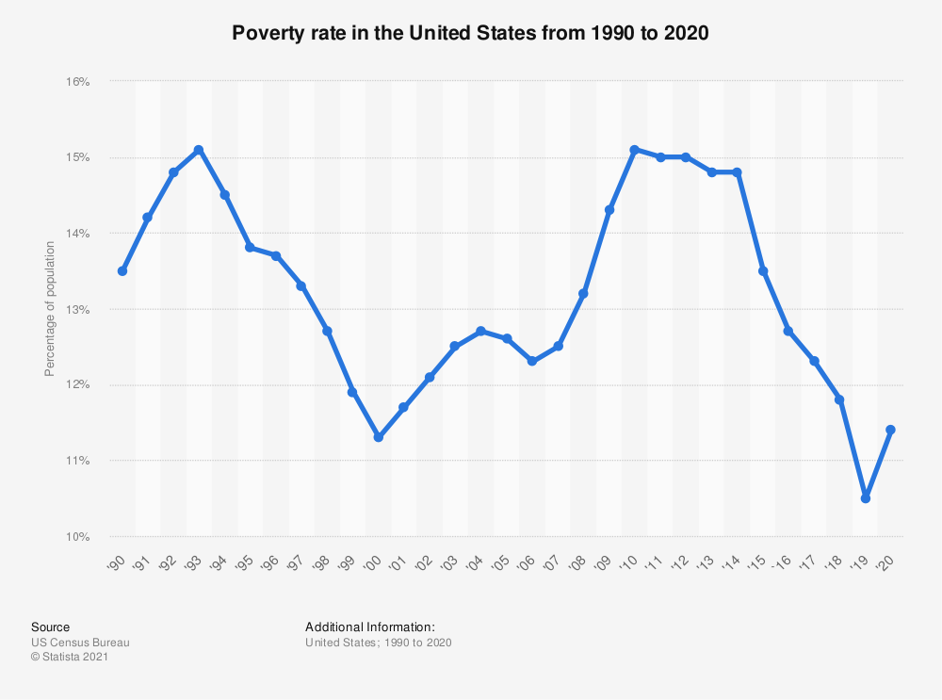

Slide 10
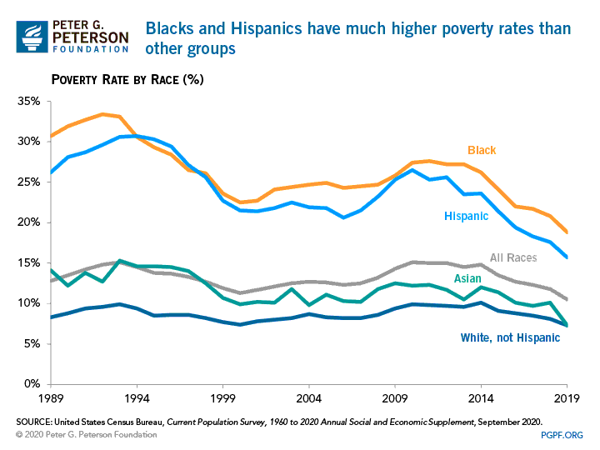

Slide 11
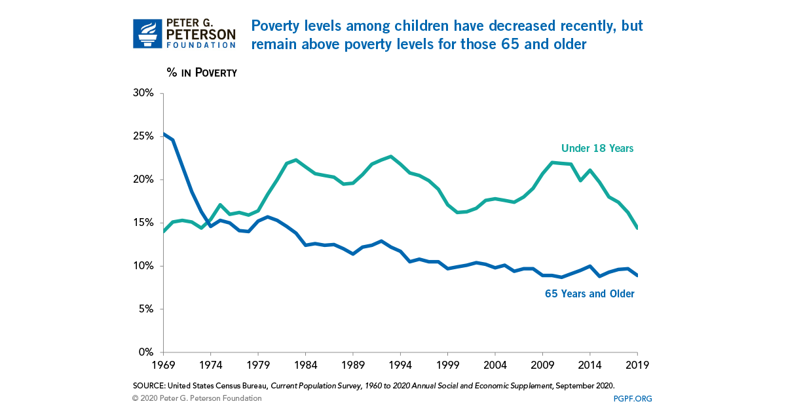

Slide 12
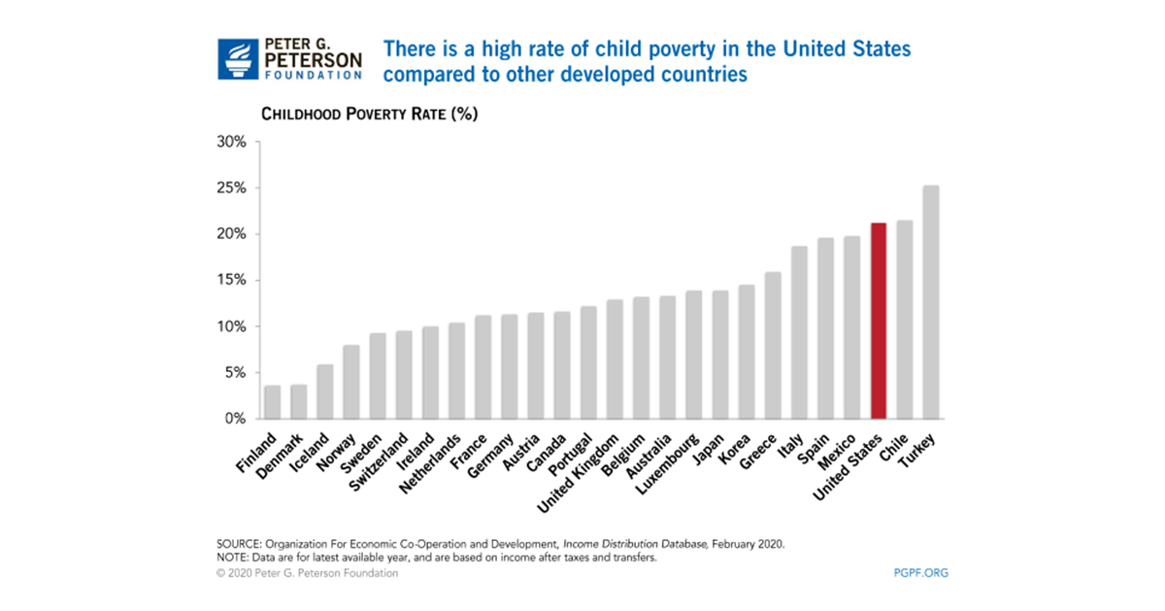

Slide 13
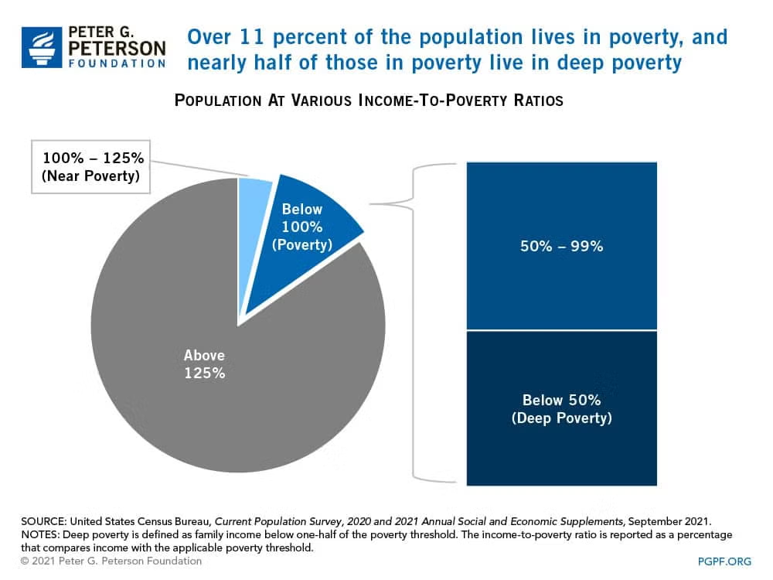

Slide 14
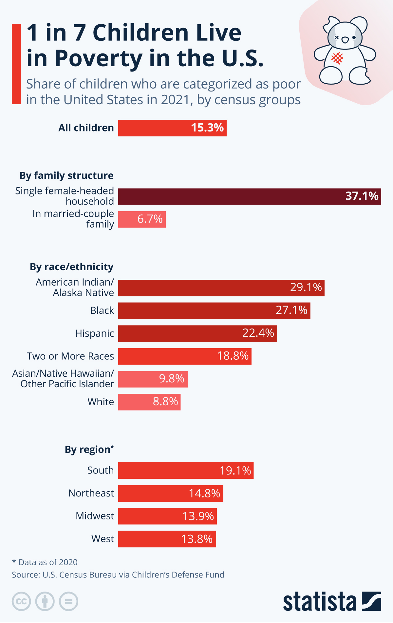

Slide 15
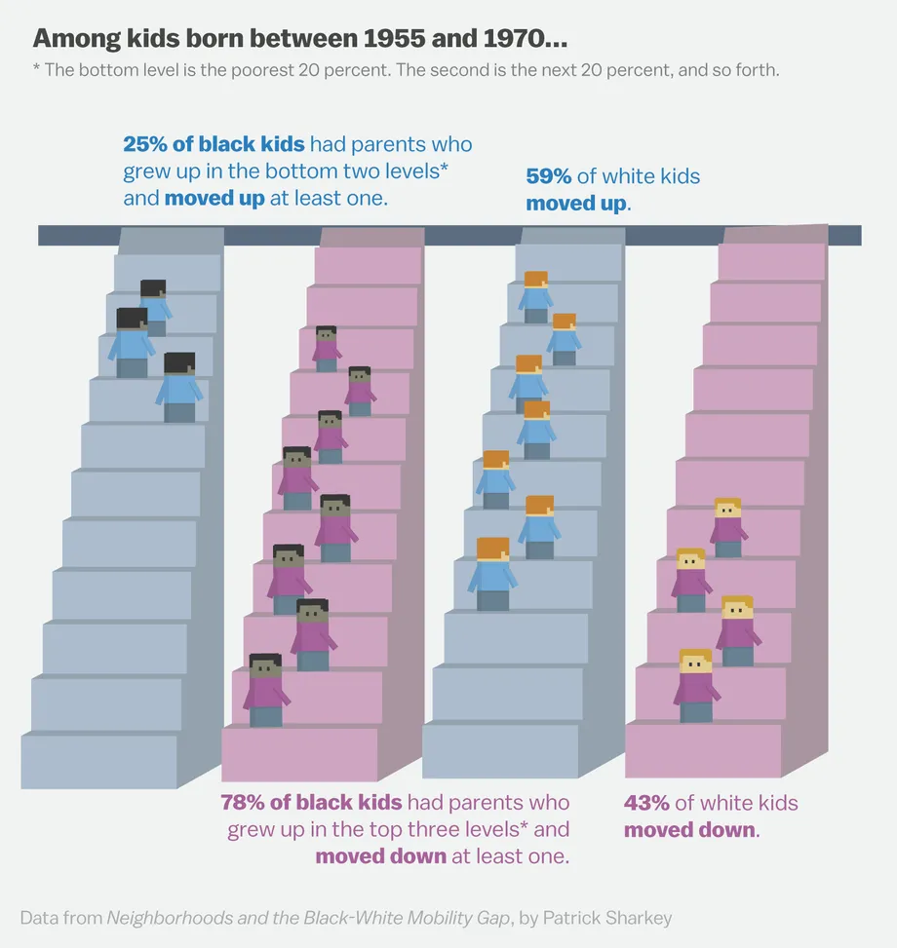

Slide 16
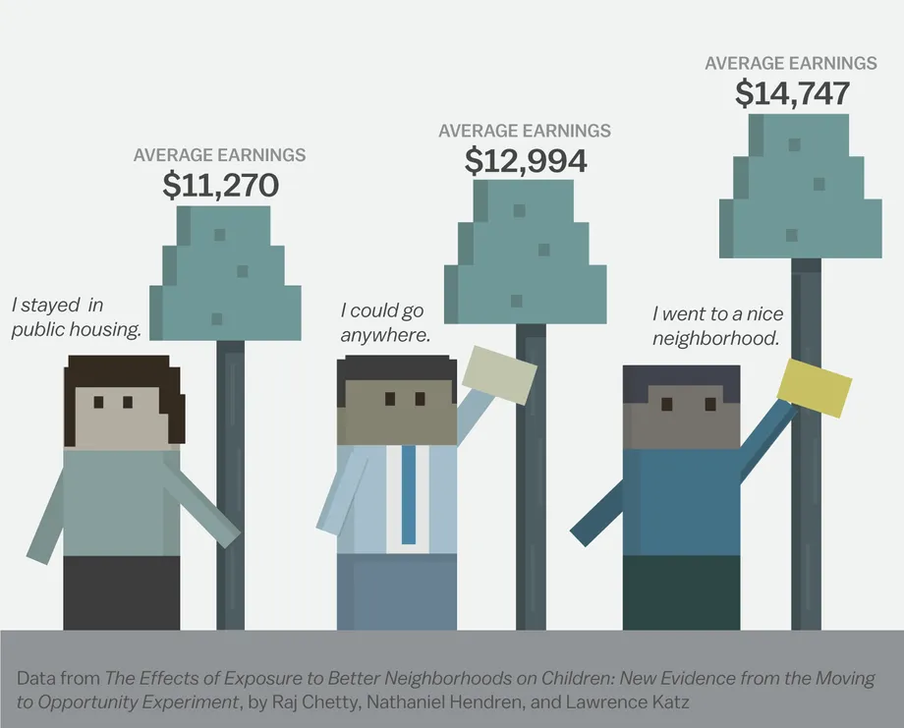

Slide 17
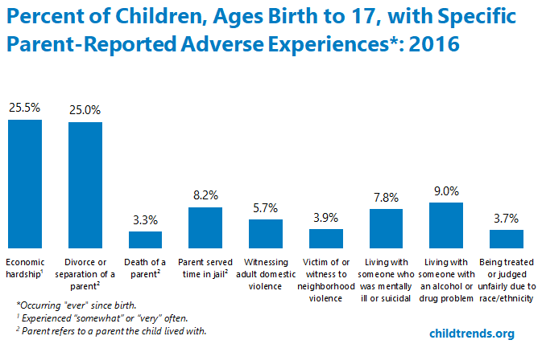

Slide 18
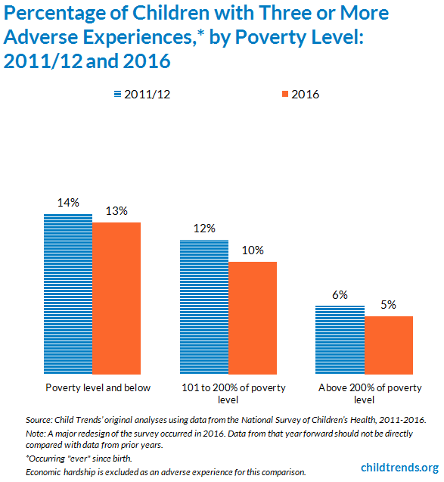

Slide 19
Contemporary Policy: Public Assistance
Welfare
Means testing
Earned Income Tax Credit (EITC)
Child tax credit
Temporary Assistance for Needy Families (TANF)
Food Stamps (SNAP), etc.

Slide 20
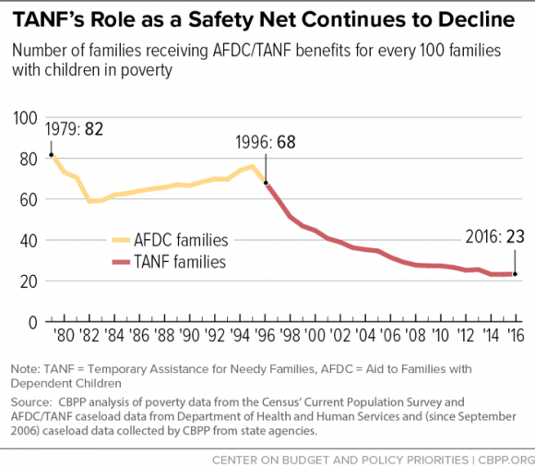

Slide 21
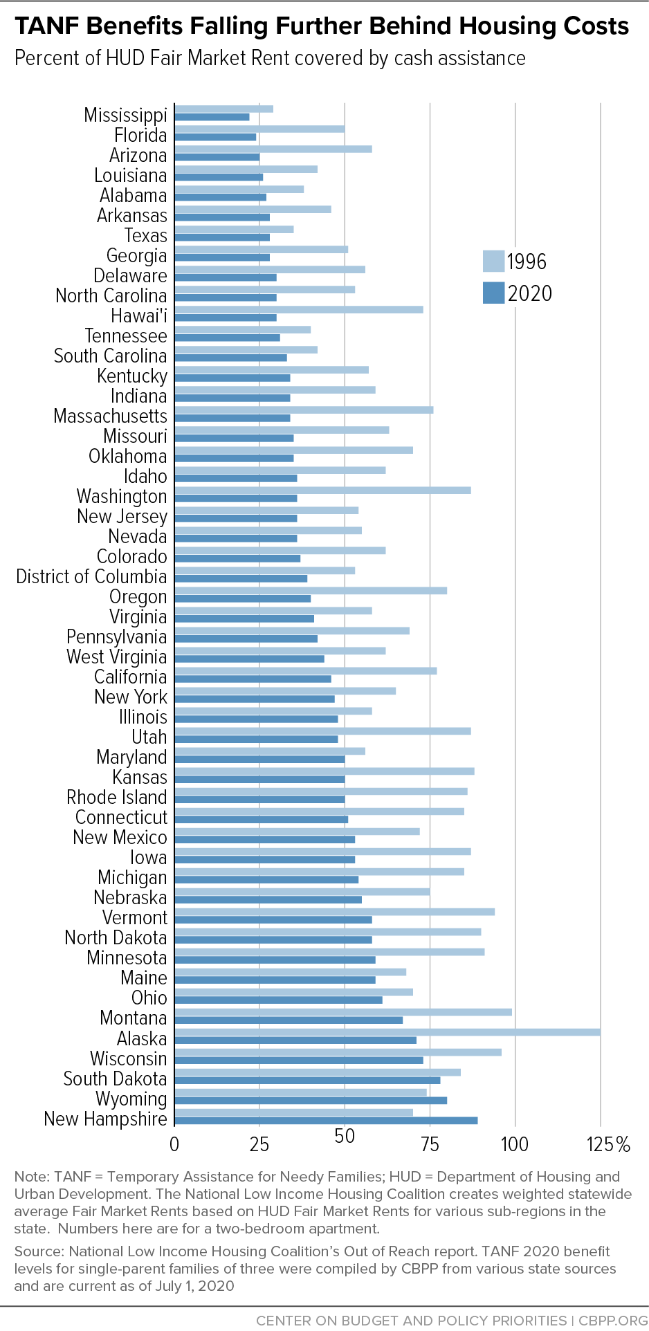

Slide 22
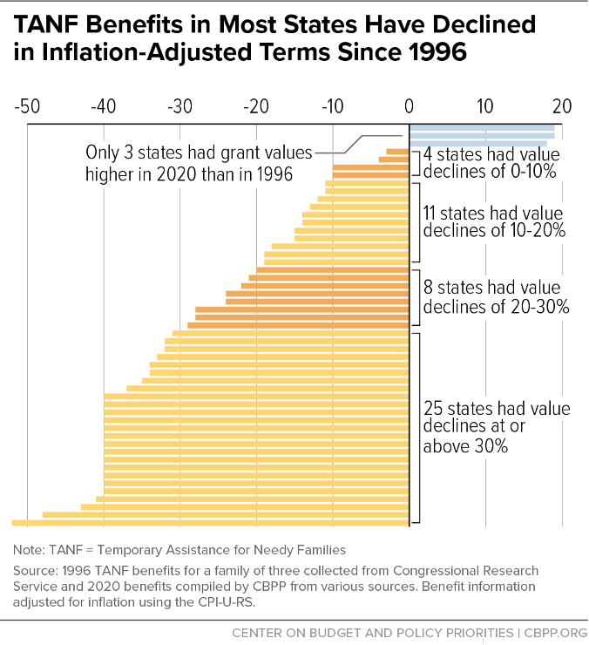

Slide 23
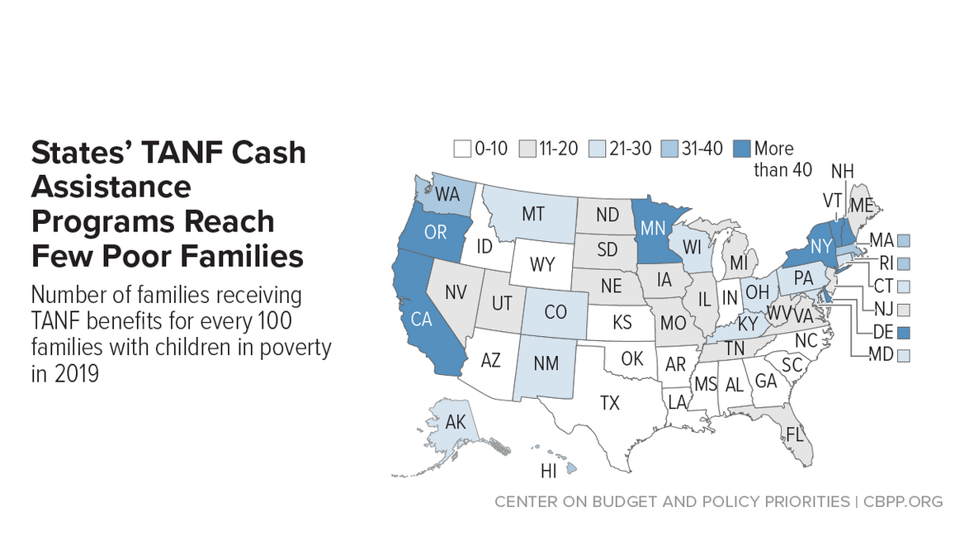

Slide 24
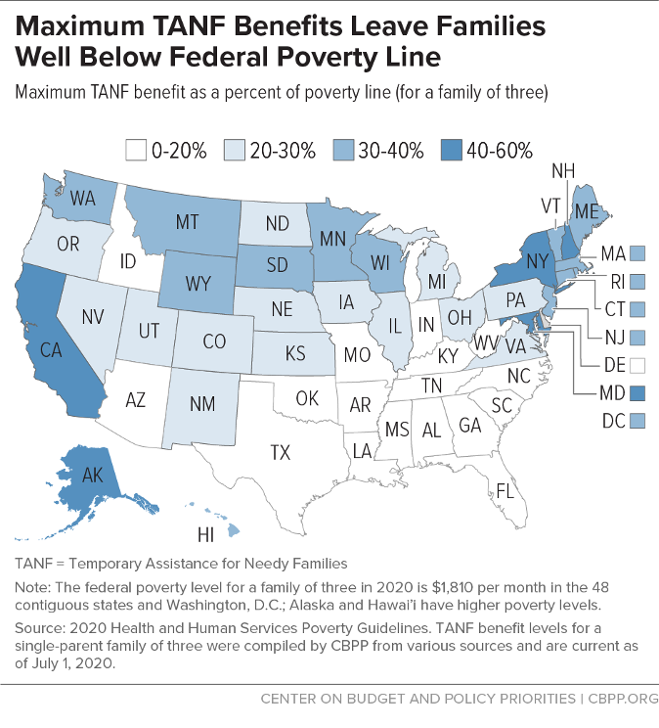

Slide 25
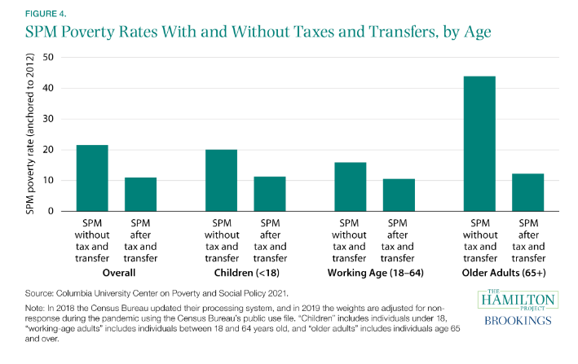

Slide 26
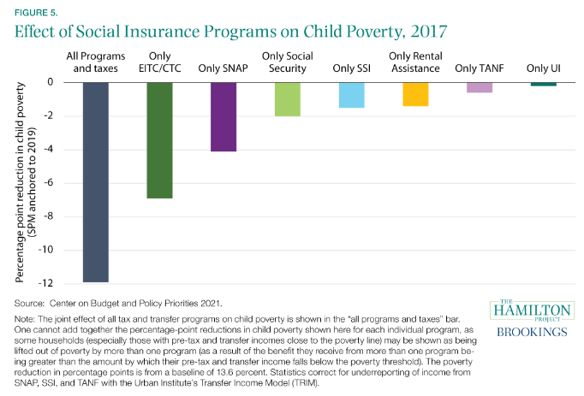

Slide 27
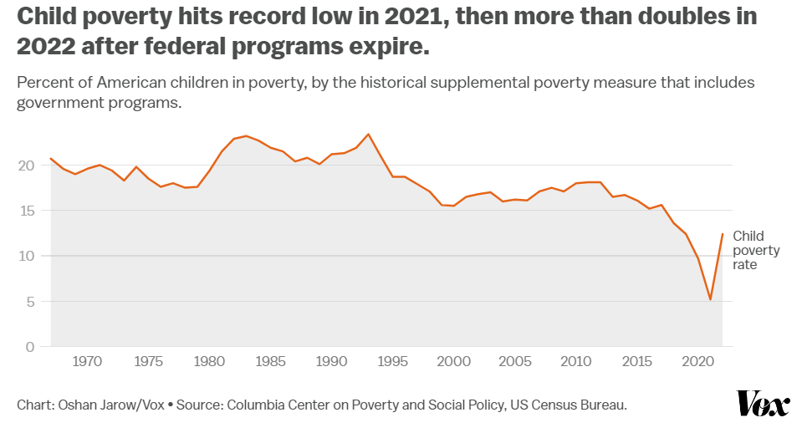

Slide 28
Policy Evaluation: Public Assistance
What’s worked?
Do we need to just spend more?
Work disincentives
Complexity
The Welfare Paradox
Current threats and political dynamics

Slide 29
Contemporary Policy: Social Insurance
Trust Fund
Social Security (OASDI)
Retirement benefits
Survivor and Disability benefits
Rising costs of social insurance

Slide 30
Policy Evaluation: Social Insurance
Social Security Successes
The Trust Fund as inter-generational compact
Social Security “Crisis” Myth

Slide 31
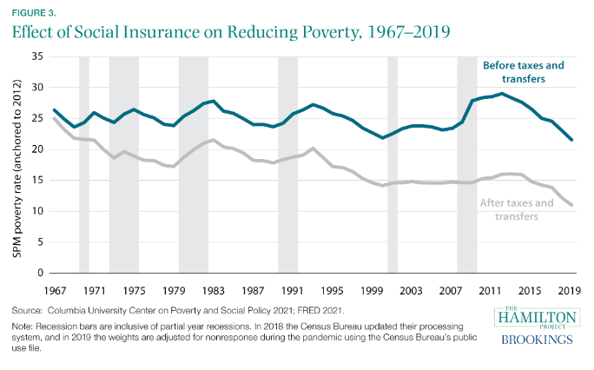

Slide 32
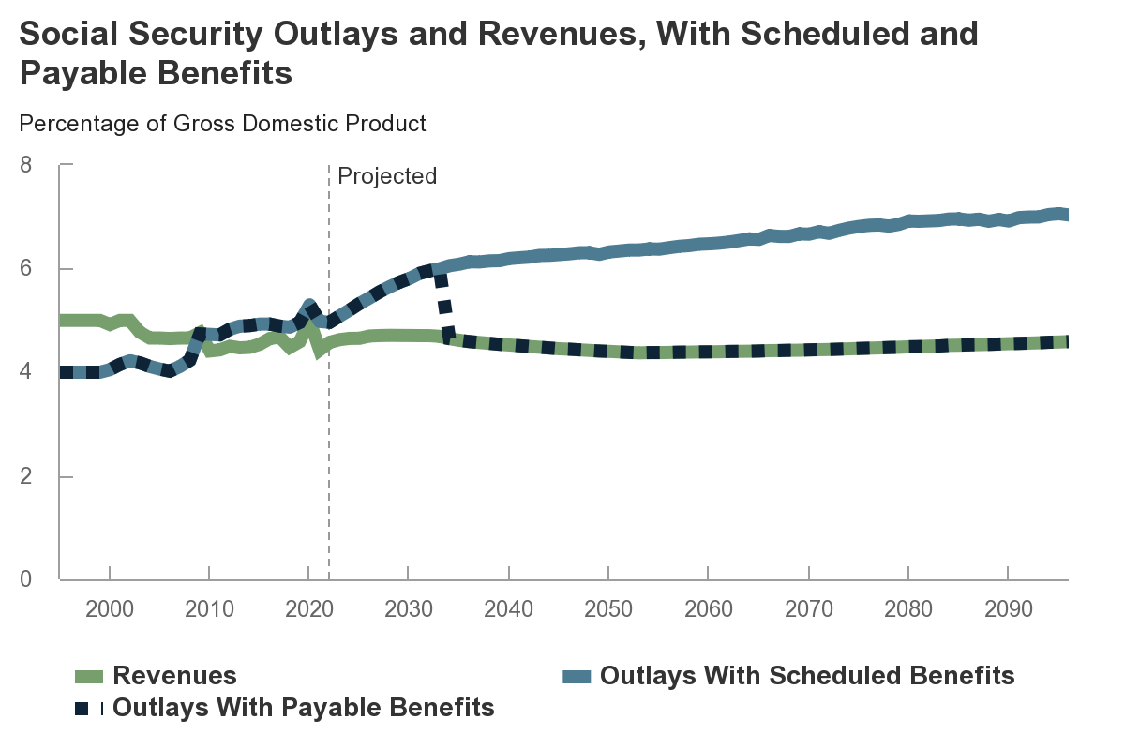

Slide 33
Policy Reform: Social Insurance
Changing Inputs and Outputs
Retirement age
Privatization
Current prospects
Missing policy: Parental leave

Slide 34
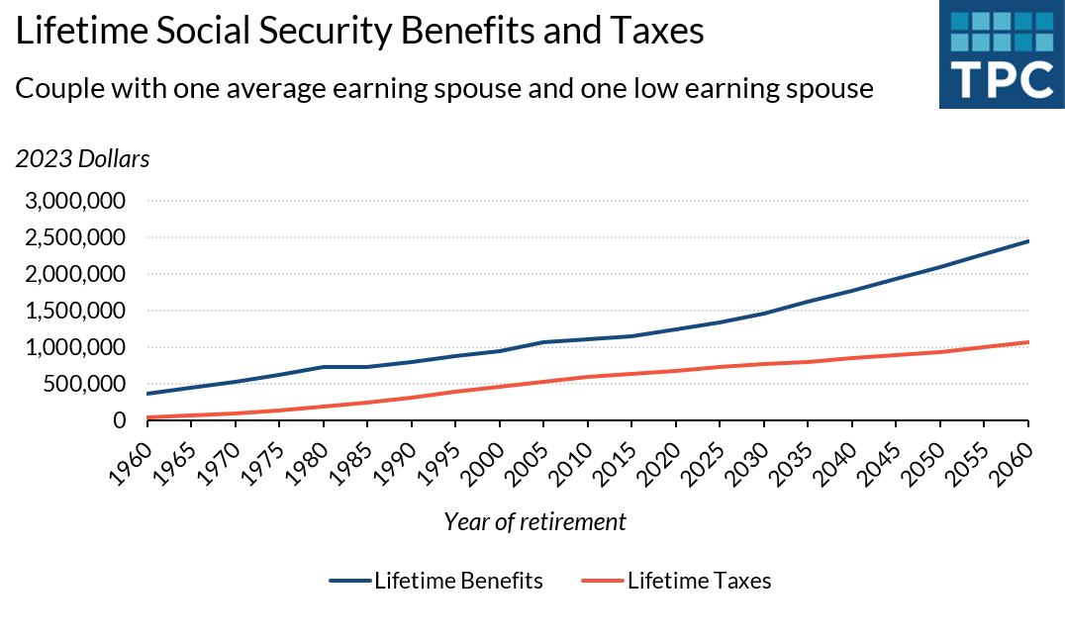

Slide 35
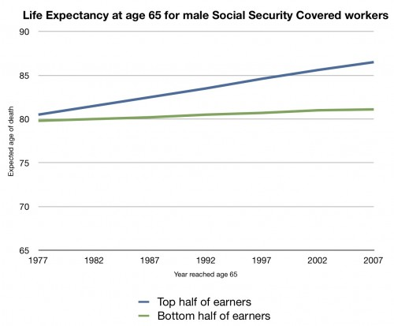

Slide 36
