Slide 1
Economic Policy

Slide 2
Introduction
What is economic policy
Federal government and economic policy
Capitalism/mixed economy
Current economic policy climate

Slide 3
Goals of economic policy
Economic growth
Low unemployment
Low inflation
Long-term sustainability

Slide 4
Tools of economic policy
Fiscal policy
Monetary policy
Regulation

Slide 5
Tax policy
Basic principles
Personal income tax
Progressivity of income tax
Capital Gains
Payroll tax
EITC
Estate Tax
Corporate income tax
Tariffs
Tax policy and economic goals– the disconnect

Slide 6
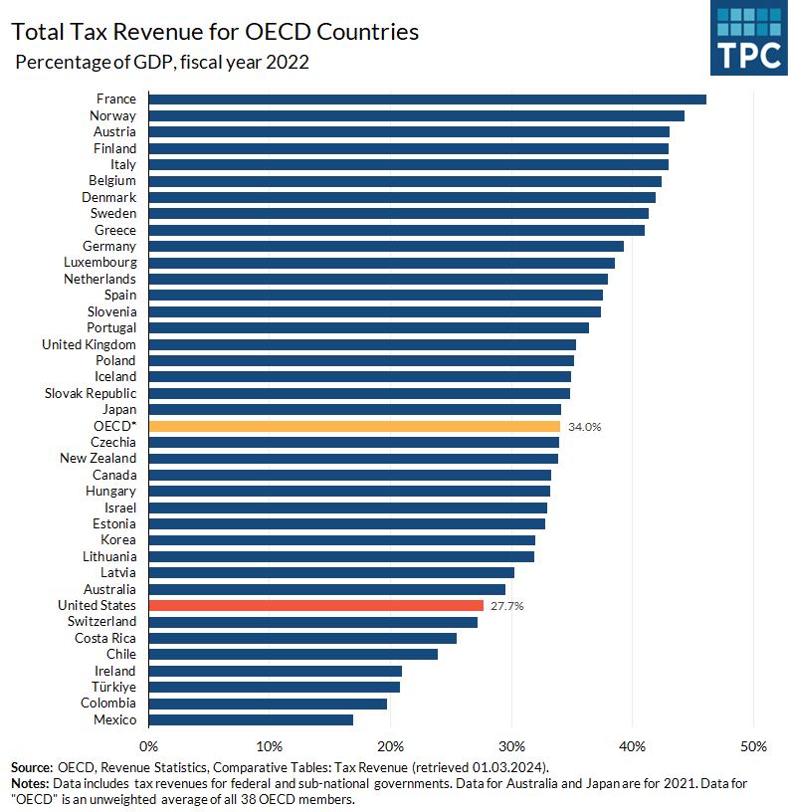

Slide 7
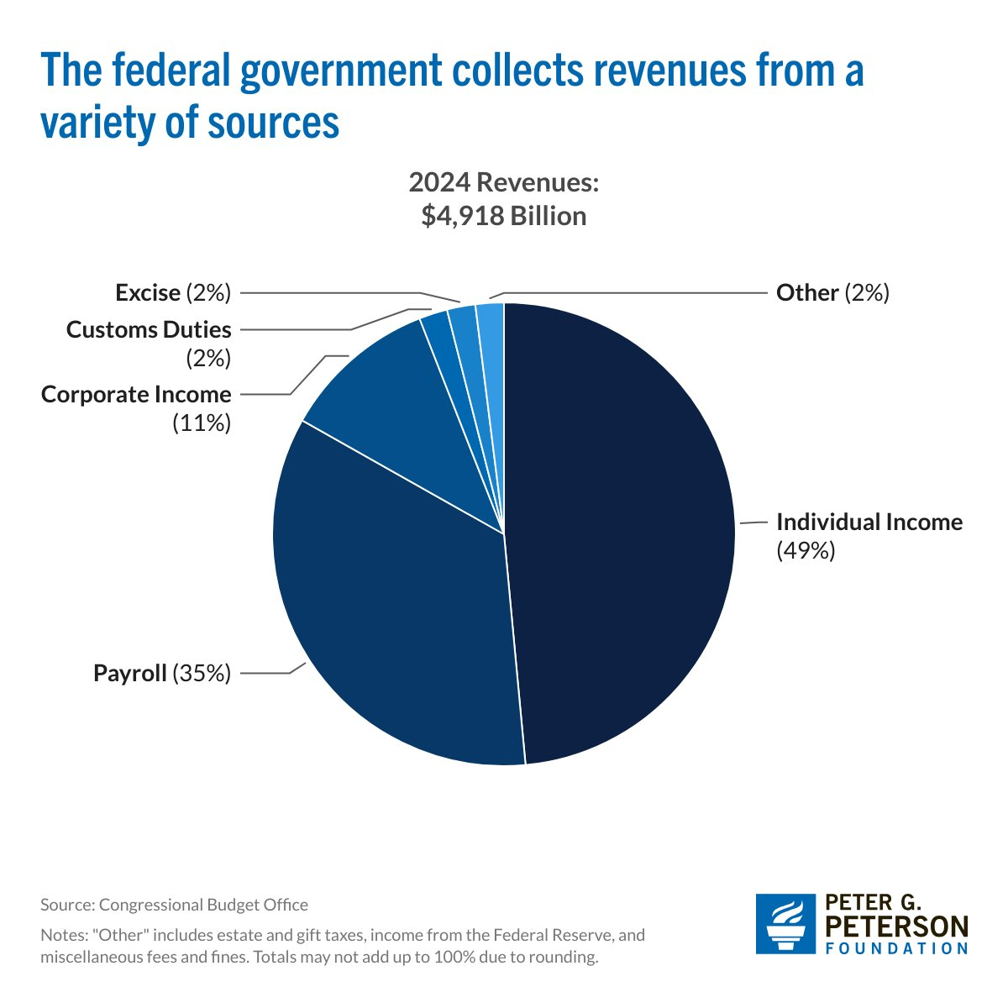

Slide 8
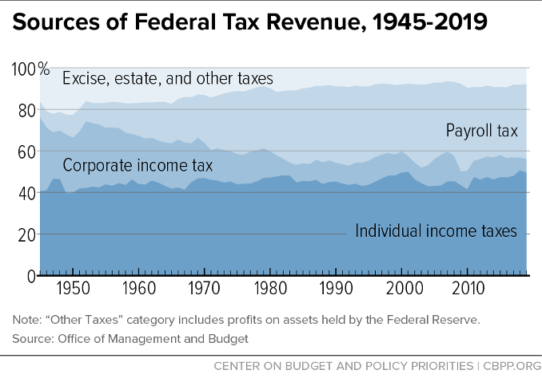

Slide 9
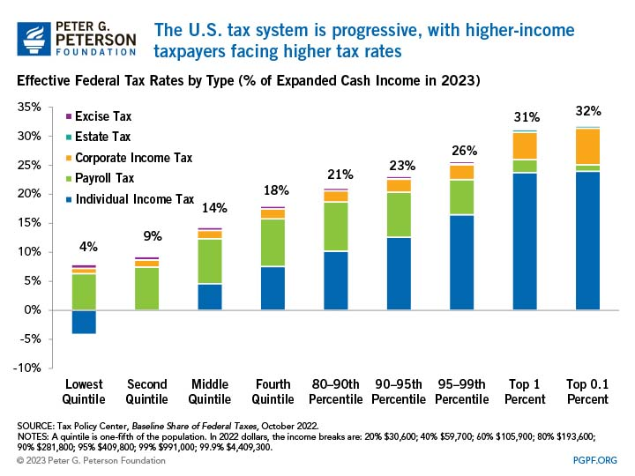

Slide 10
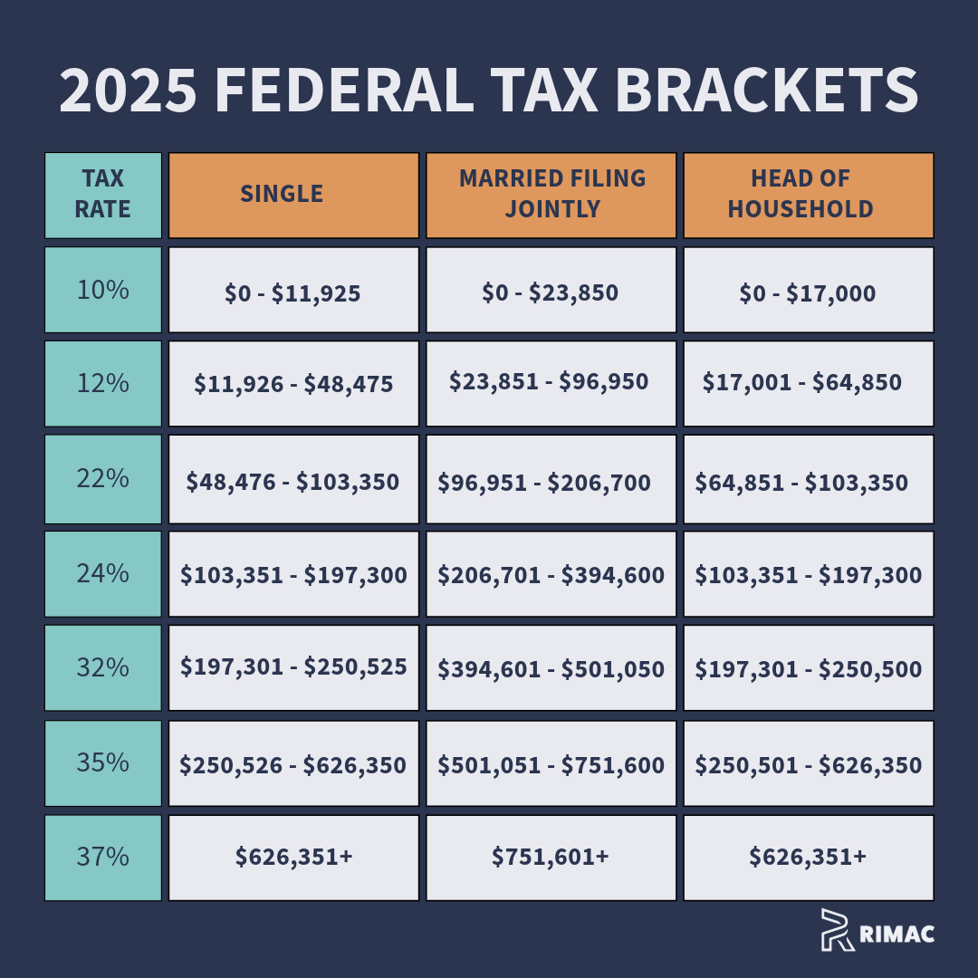
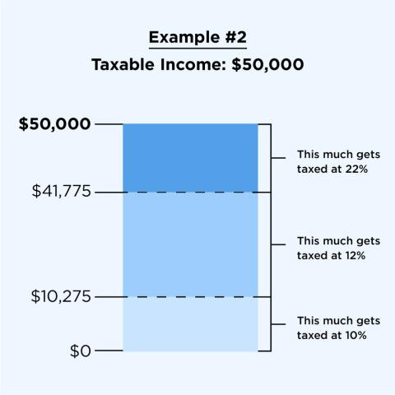
2025 Federal Tax brackets

Slide 11
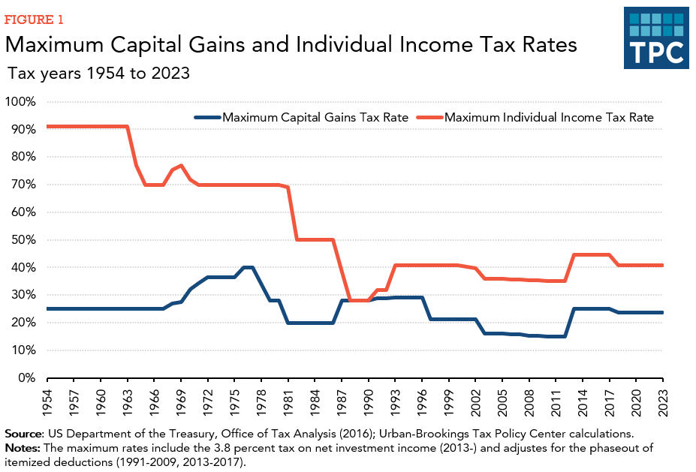

Slide 12
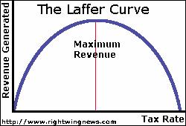

Slide 13
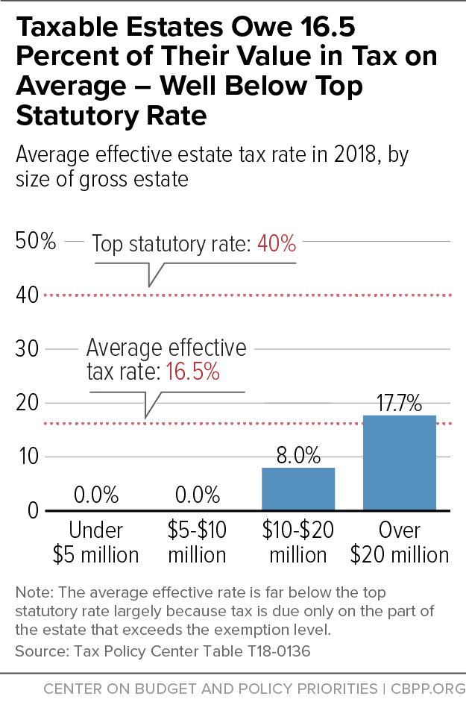
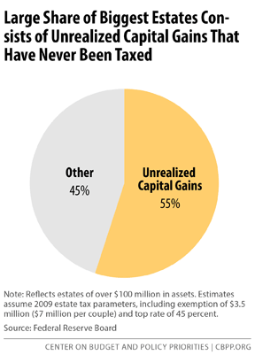
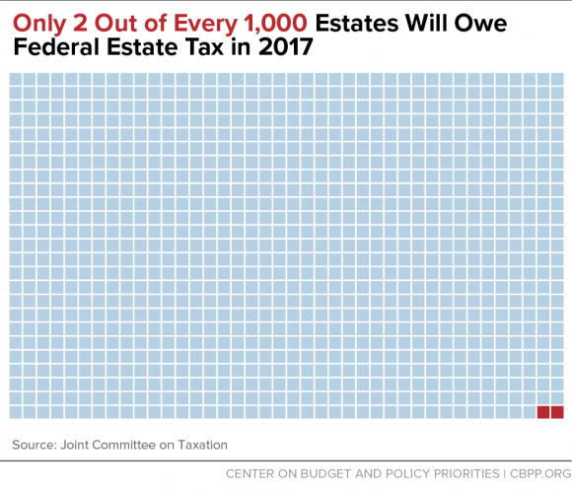
Estate Tax

Slide 14
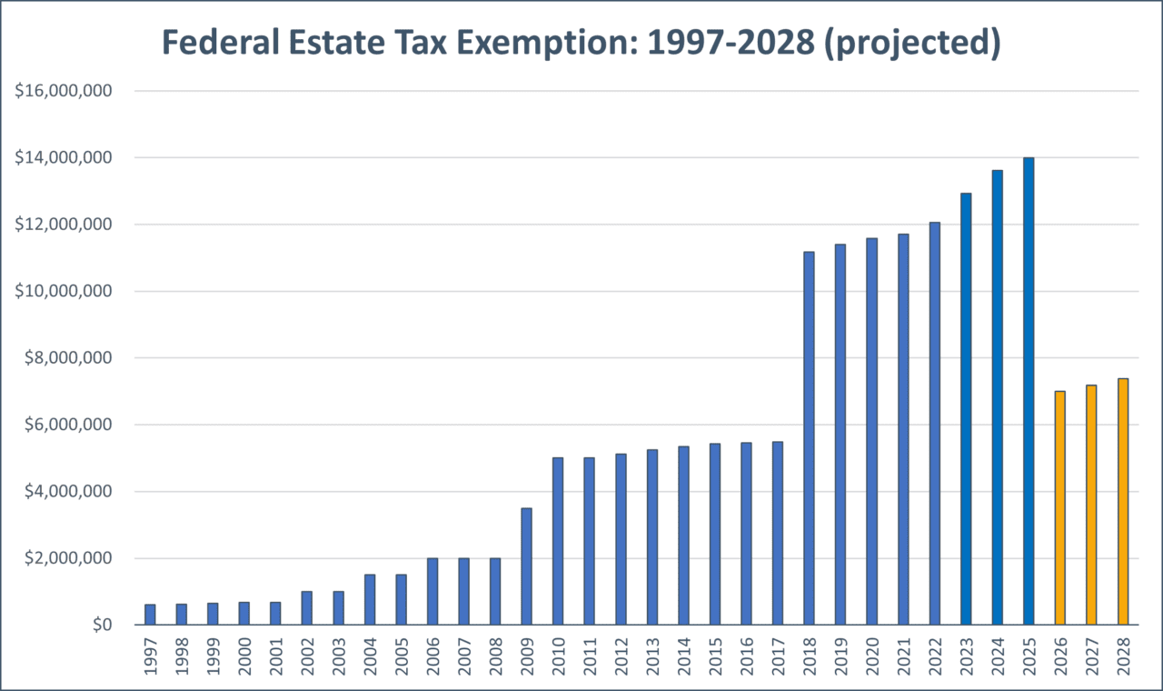
$15 million indexed for inflation starting in 2026

Slide 15
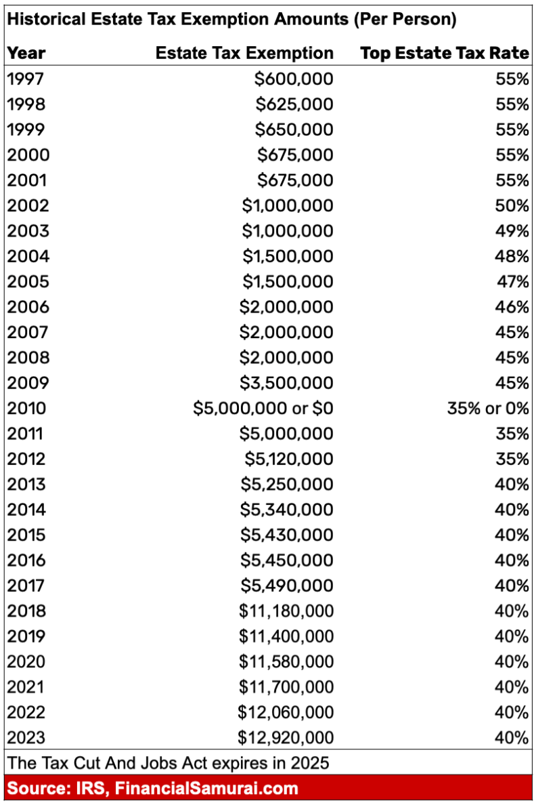

Slide 16
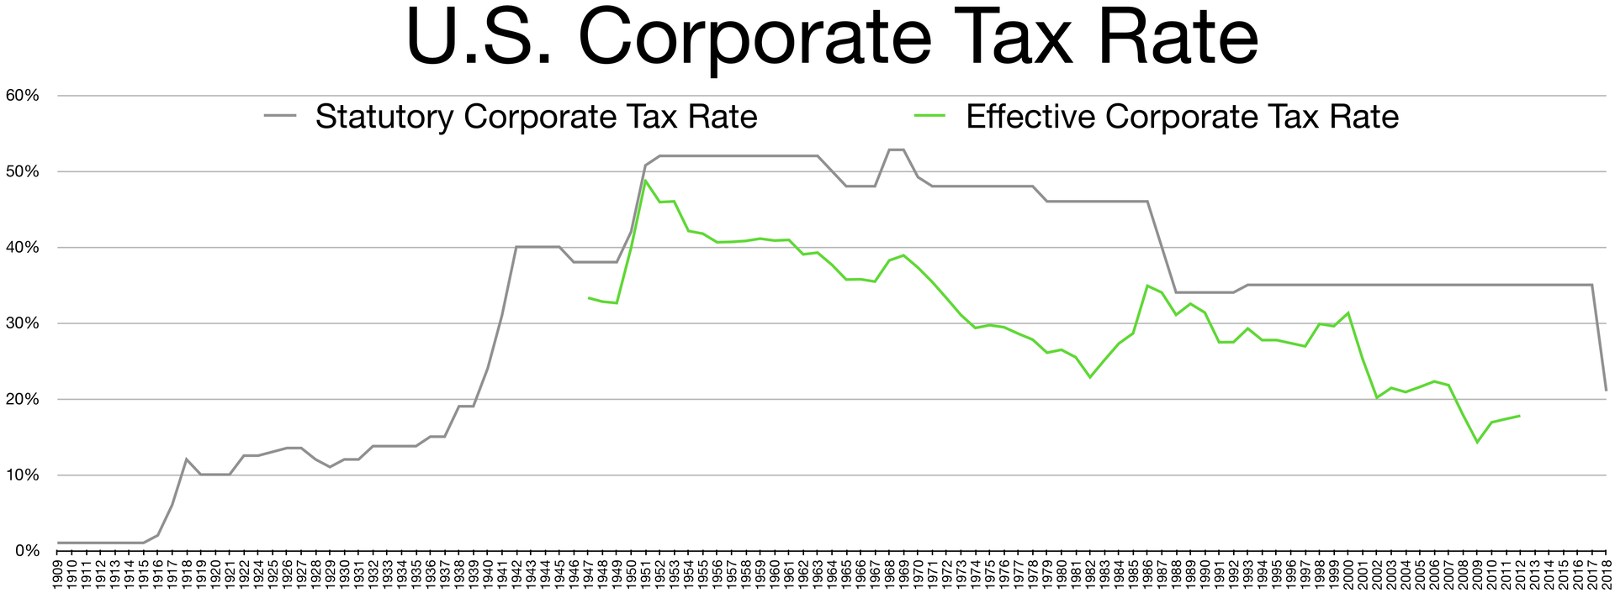

Slide 17
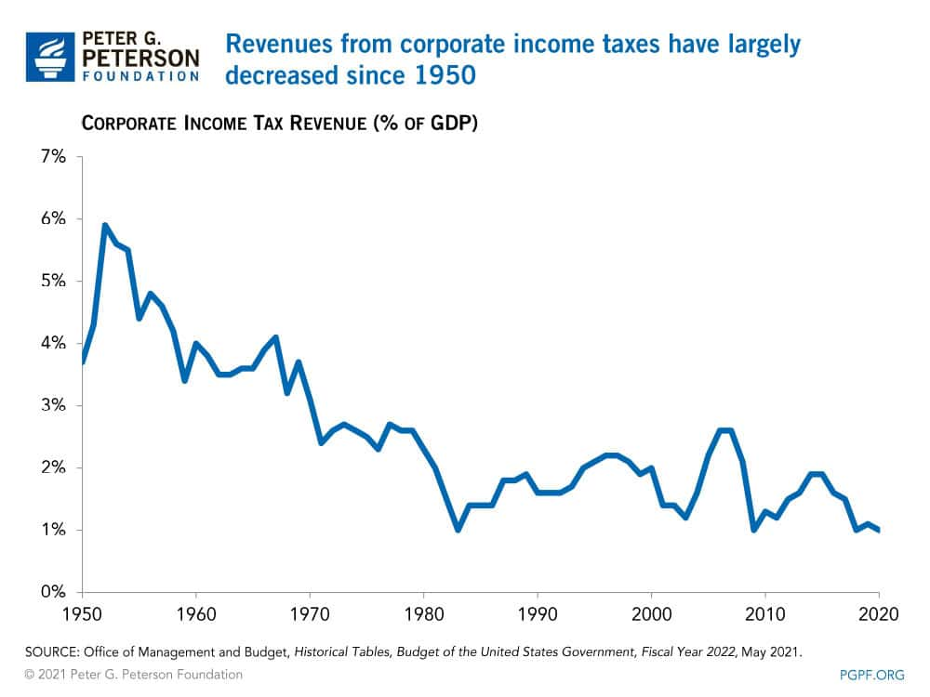

Slide 18
The Budget
National Debt
Debt vs. Deficits
The Deficit Problem
Entitlement Spending
Taxes, spending, and the budget
Debt ceiling

Slide 19
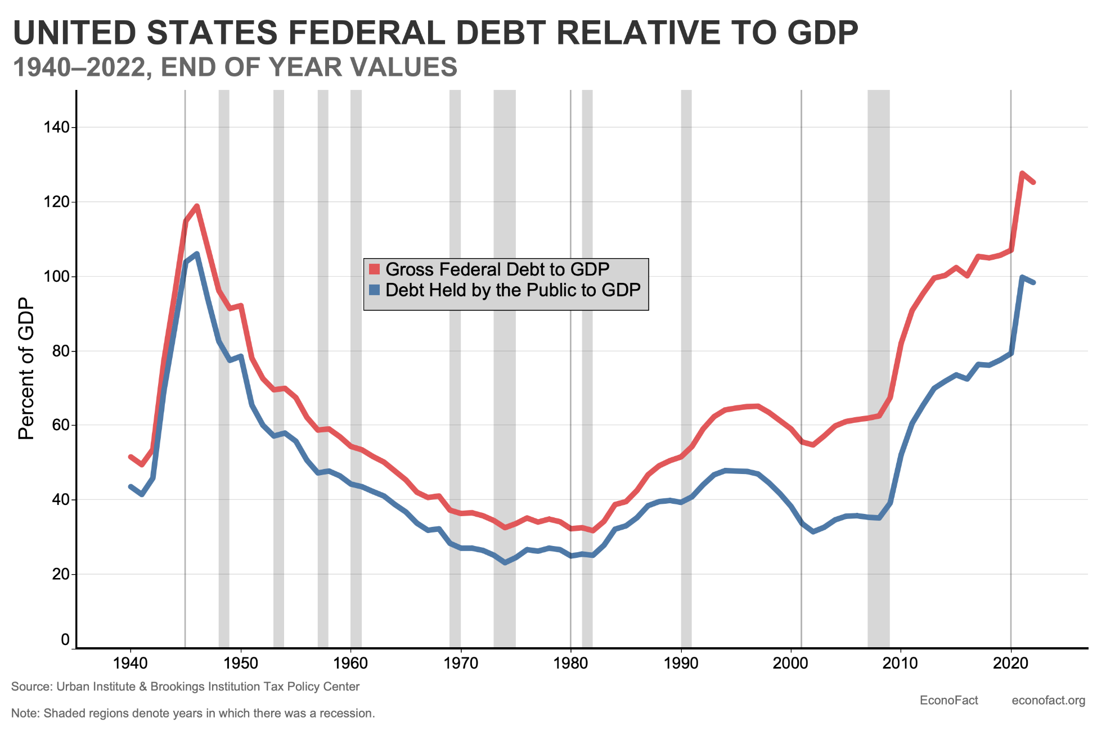

Slide 20
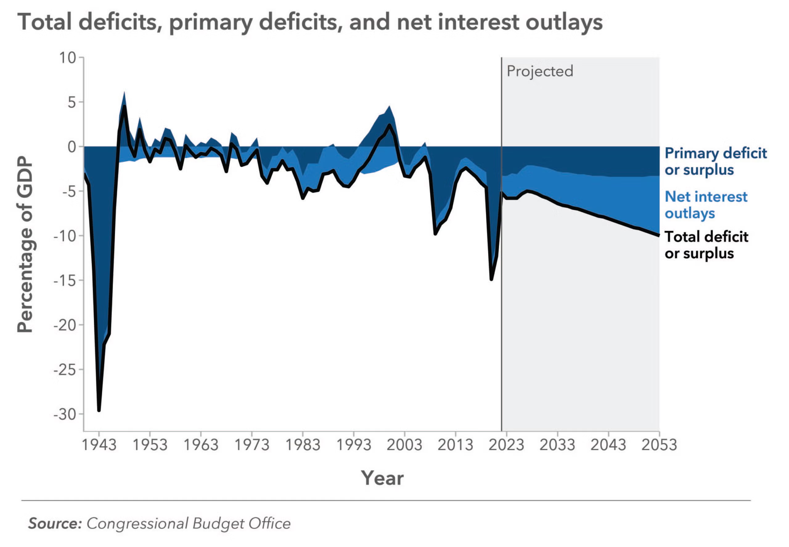

Slide 21
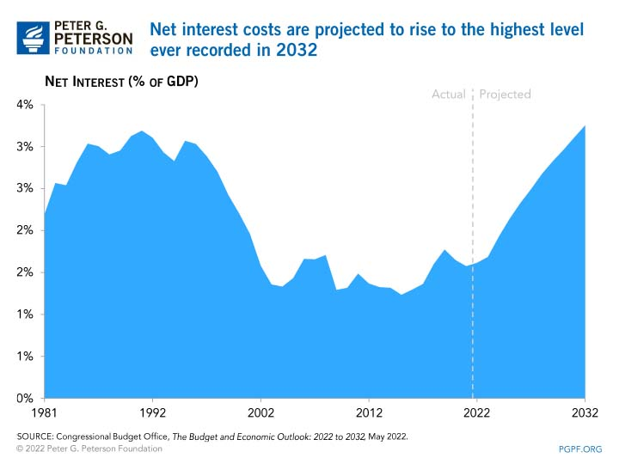

Slide 22
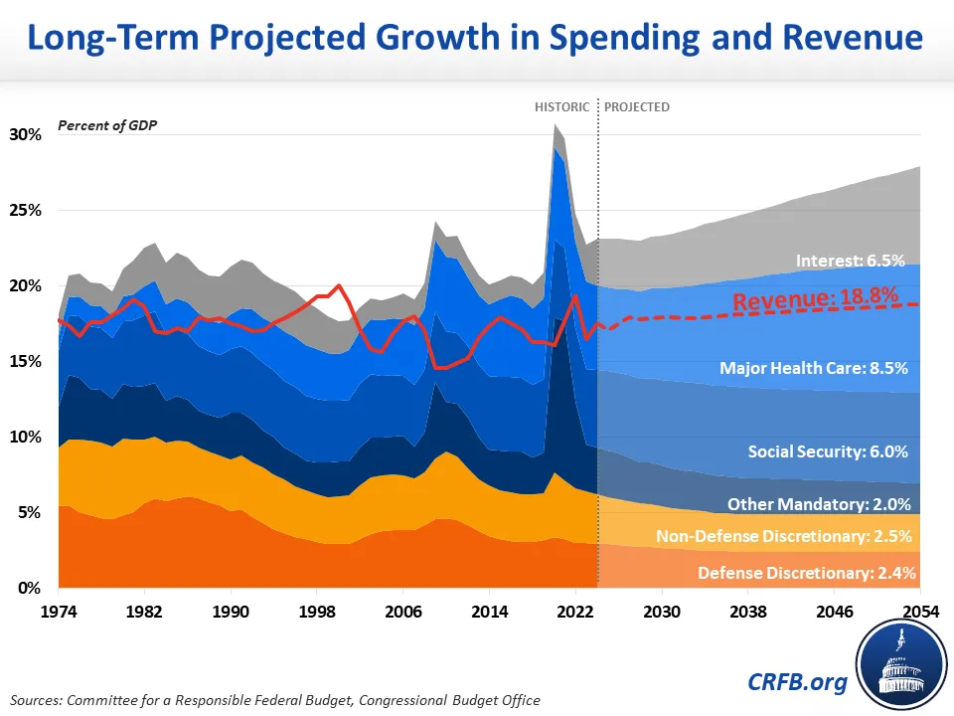
One long-term spending chart to rule them all

Slide 23
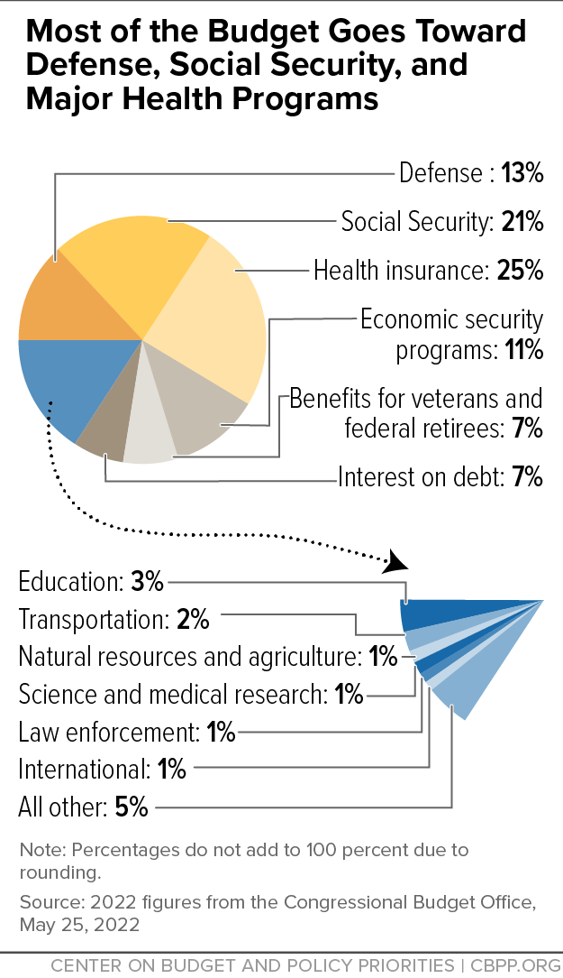

Slide 24
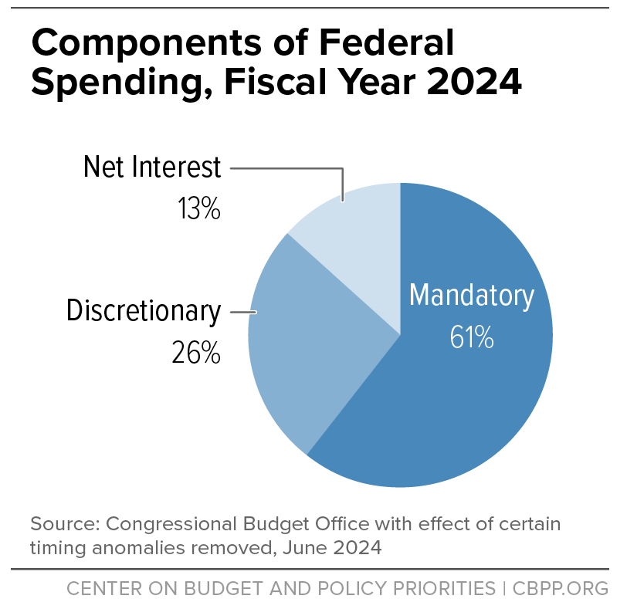
This is the whole fight!

Slide 25
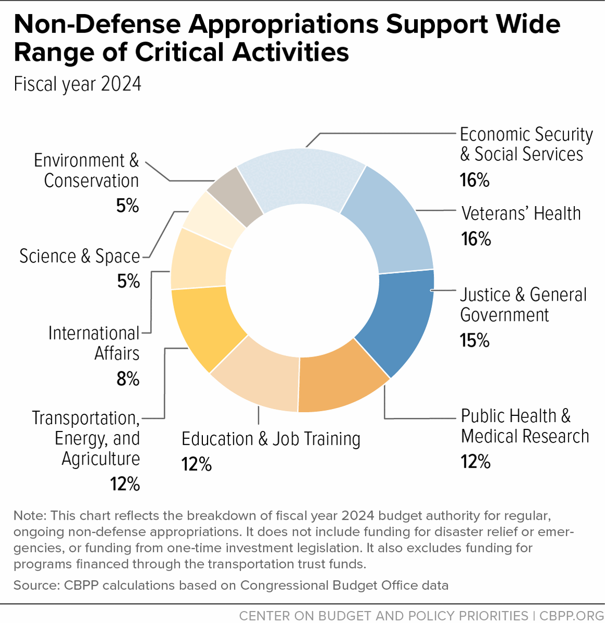

Slide 26
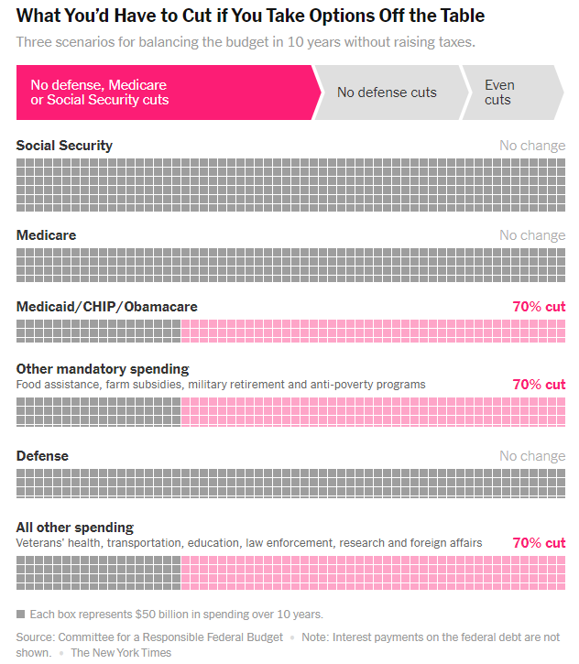

Slide 27
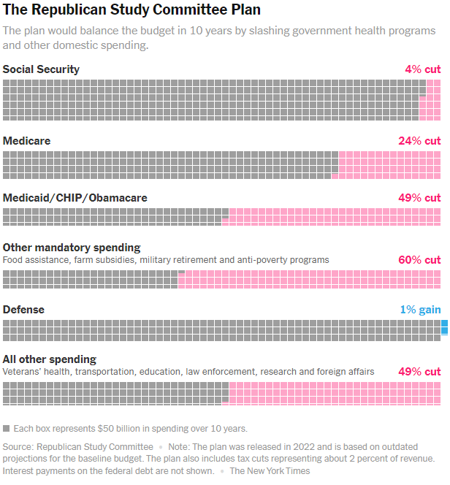

Slide 28
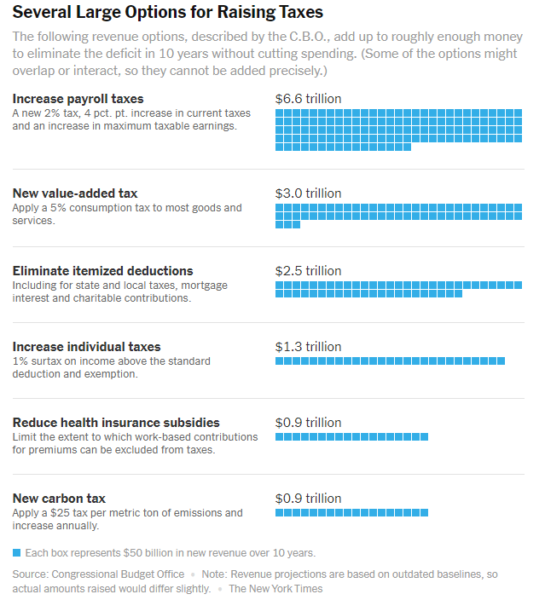

Slide 29
Contemporary Controversies
Income inequality
Long-term debt/deficit challenges
Trump’s OBBB
Return of Tariff policy
The New Realities of Economic Policy

Slide 30
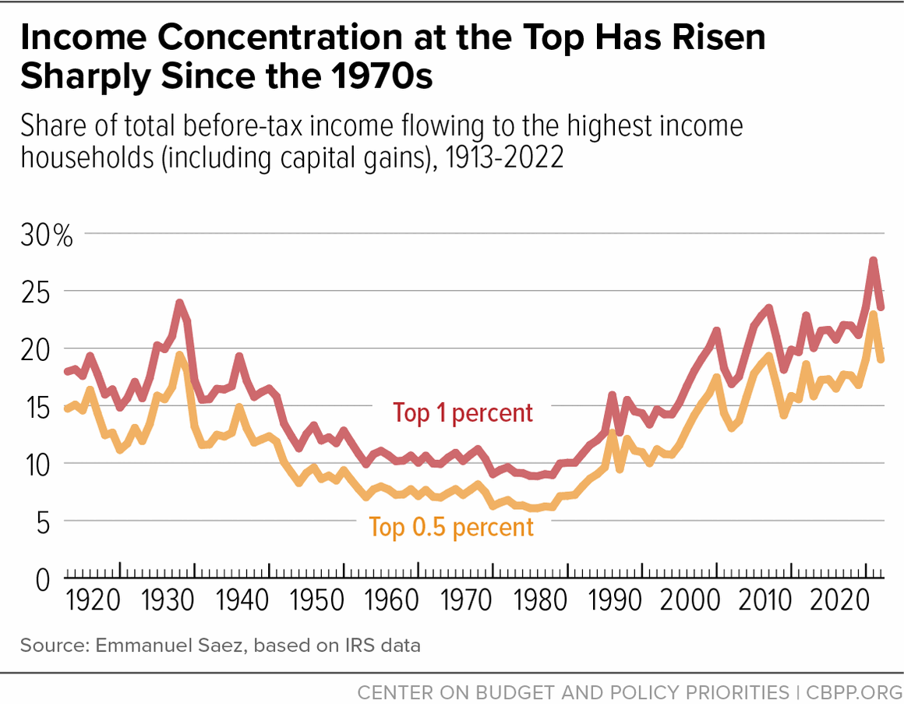

Slide 31
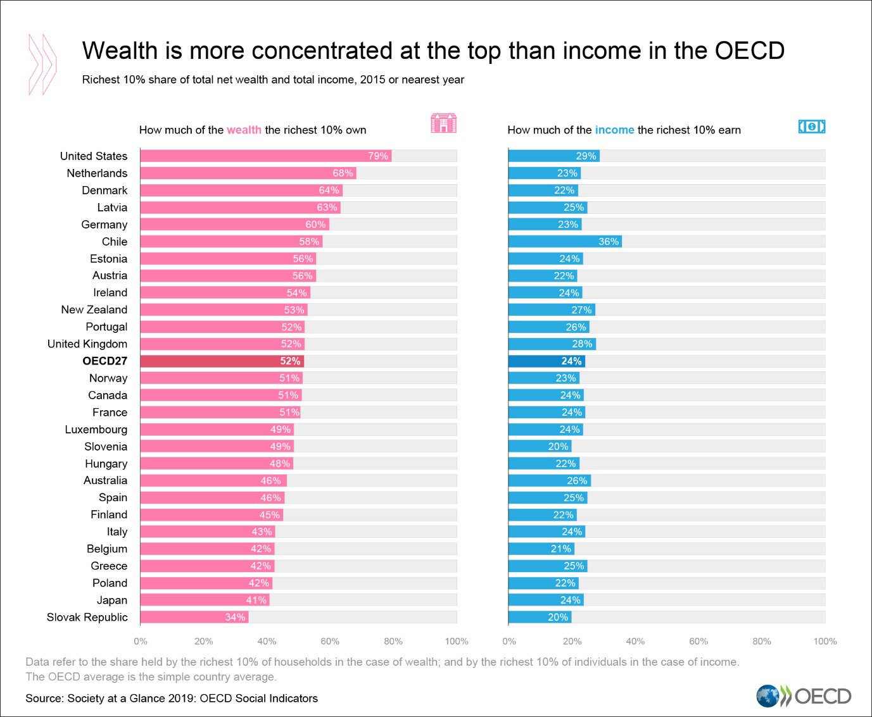

Slide 32
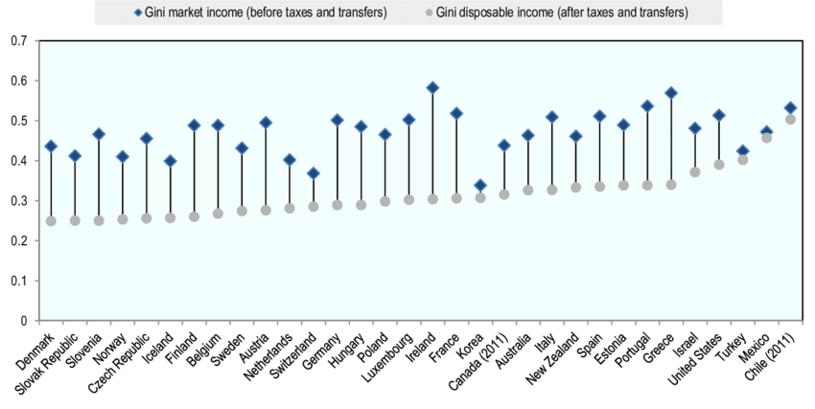

Slide 33
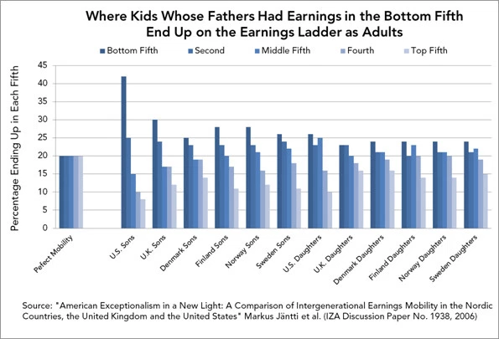
The American Dream: Alive and well in Scandinavia

Slide 34
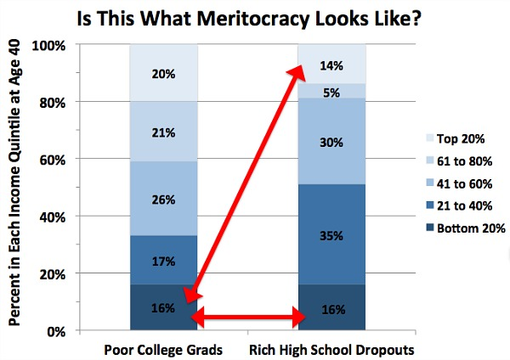

Slide 35
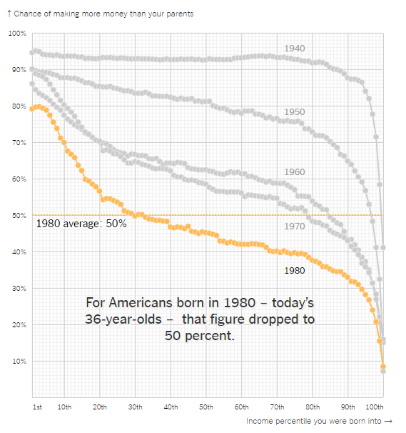
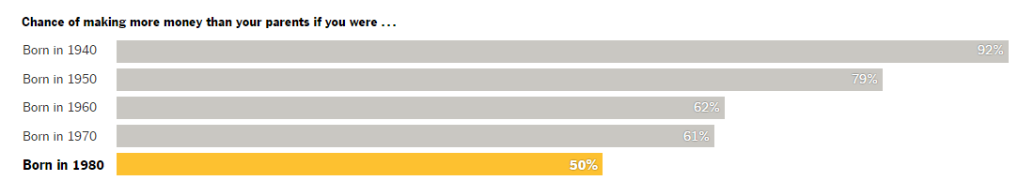

Slide 36
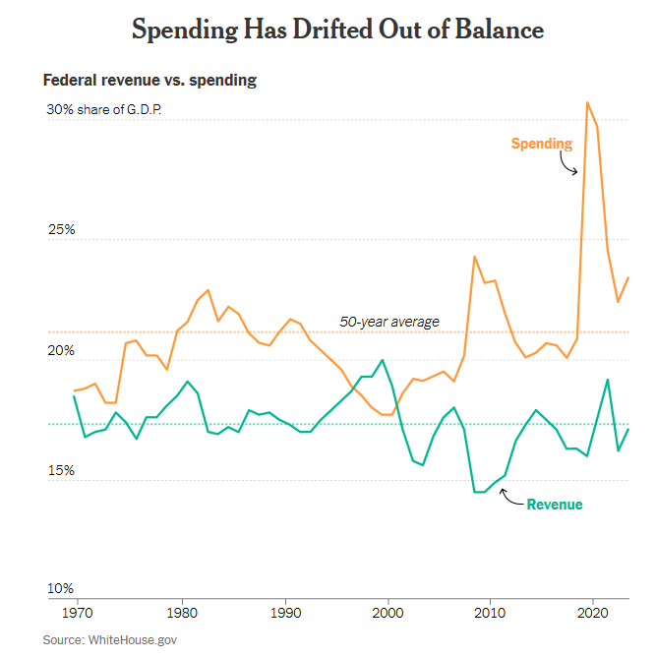

Slide 37
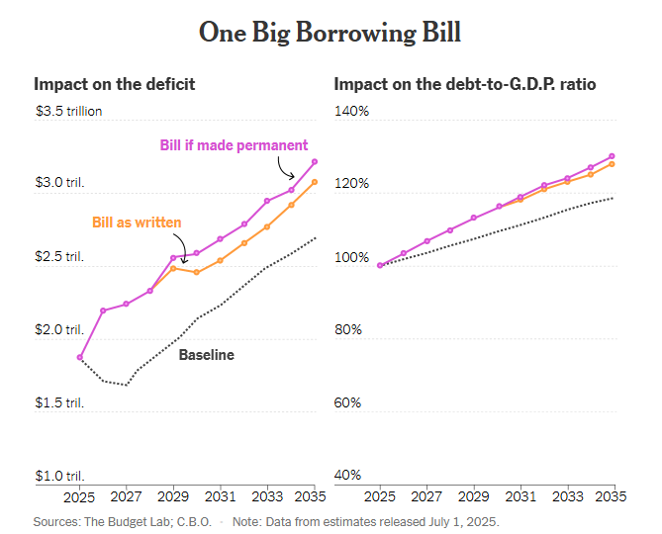

Slide 38
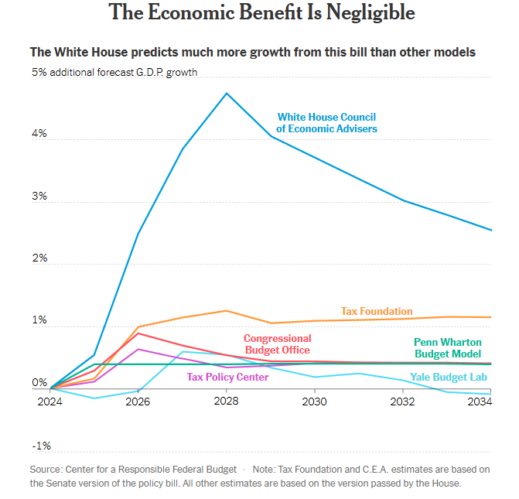

Slide 39


