Slide 1
Institutions and Policy Making: Congress and the President

Slide 2
Congress

Slide 3
The legislative process and policy
How a bill becomes a law

Slide 4
Features of Congressional Policy Making
Central role of Committees
Difficulty in becoming law
Party polarization and policy gridlock
Congressional disempowerment

Slide 5
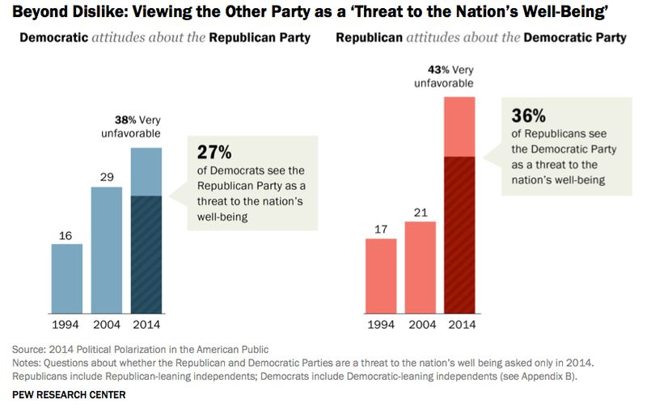
Party tribalism

Slide 6
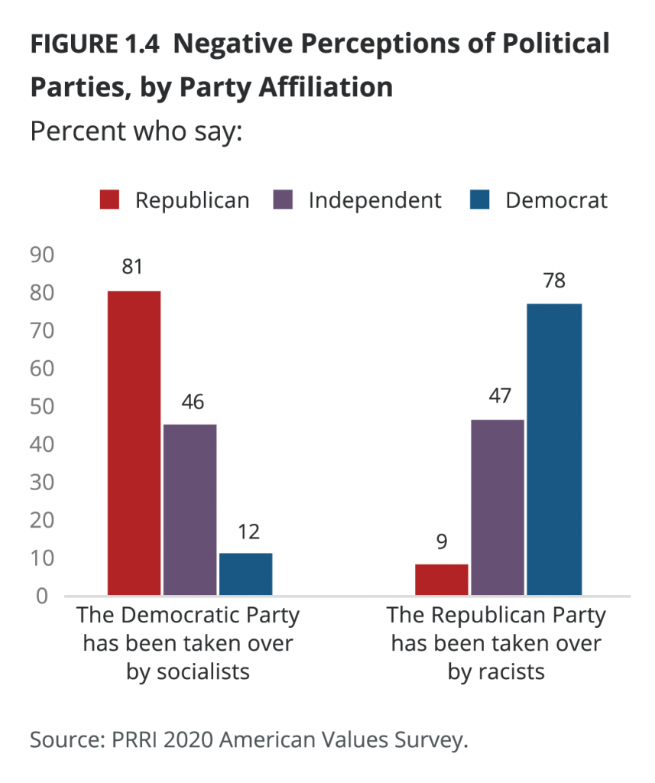

Slide 7
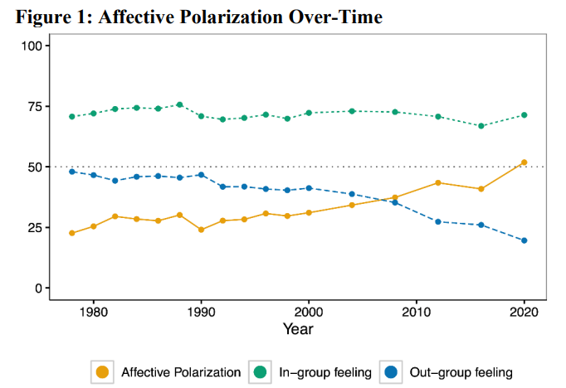

Slide 8
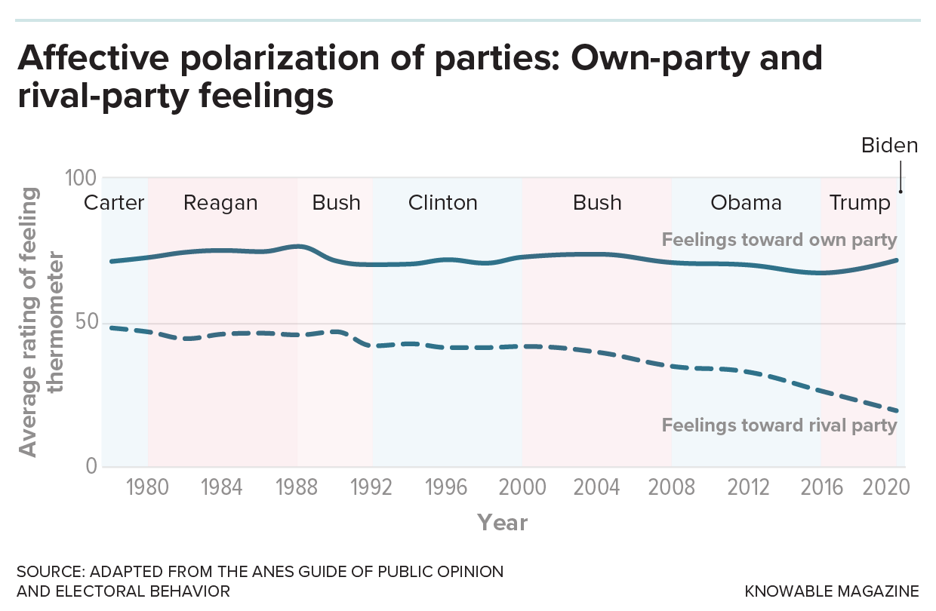

Slide 9
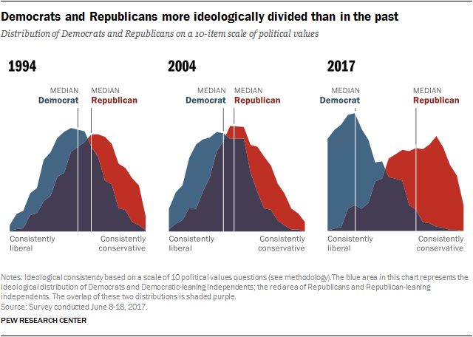

Slide 10
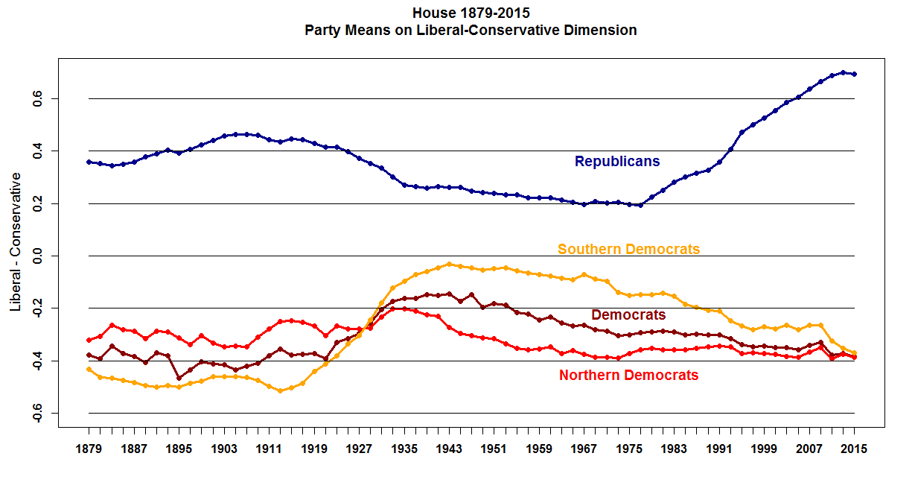
Party polarization in Congress

Slide 11
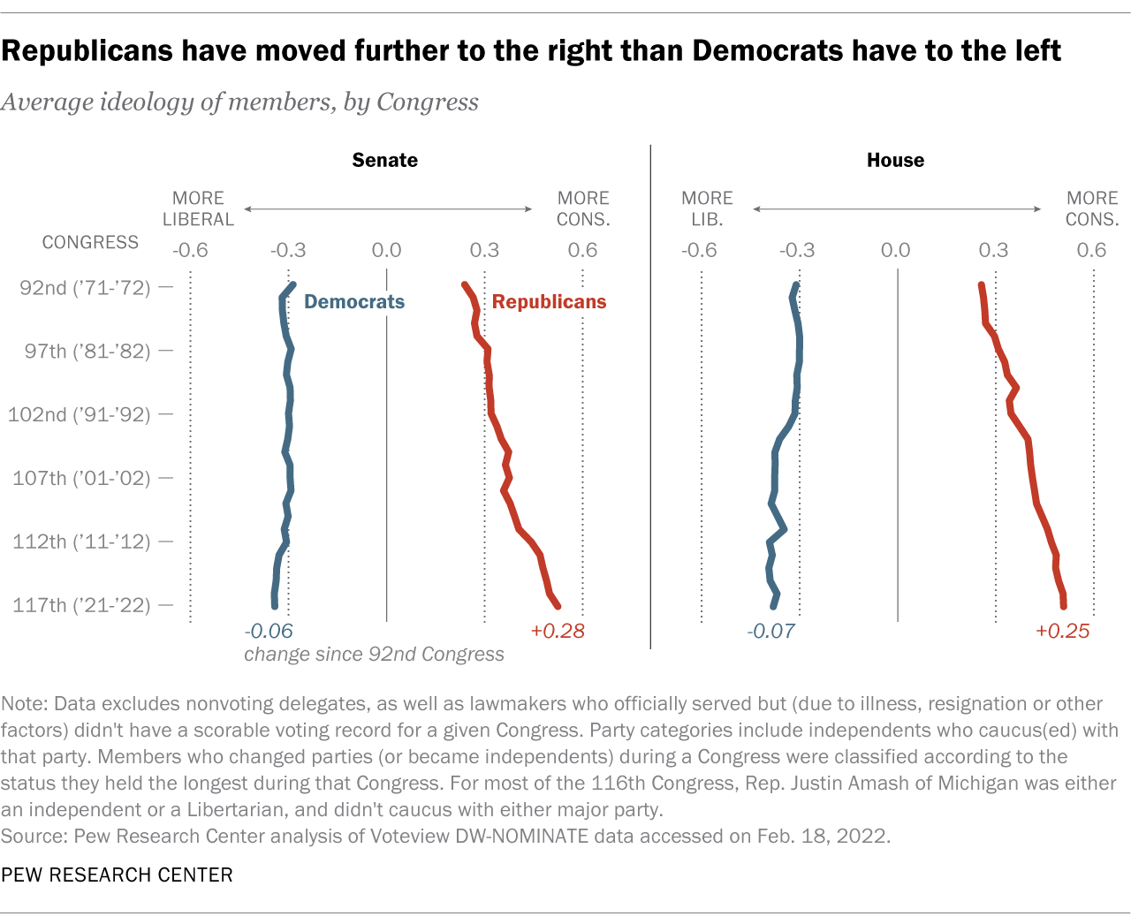

Slide 12
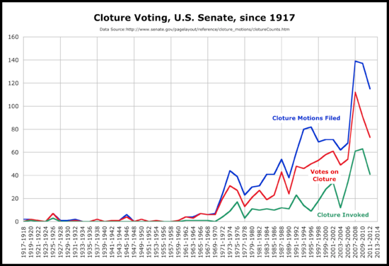
Growth in Filibuster

Slide 13
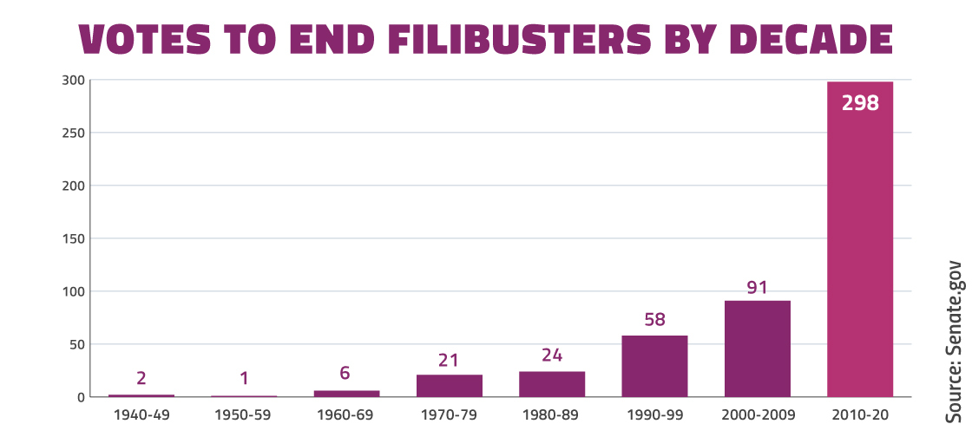

Slide 14
Presidential Power in policy making
Strengthening Presidency
Modern Presidency
Growth in implied powers
National security
Executive orders
Presidency in national security/foreign policy
Veto/veto threat
“Going Public” and the “Green Lantern Presidency”
Presidential popularity
Hardest Job in the world?

Slide 15
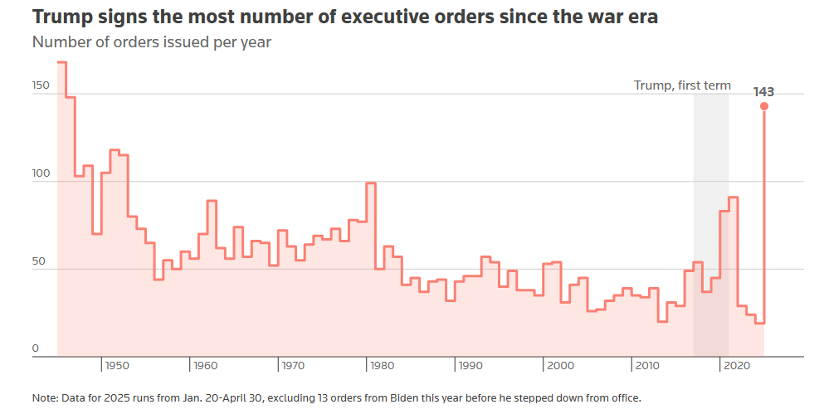

Slide 16
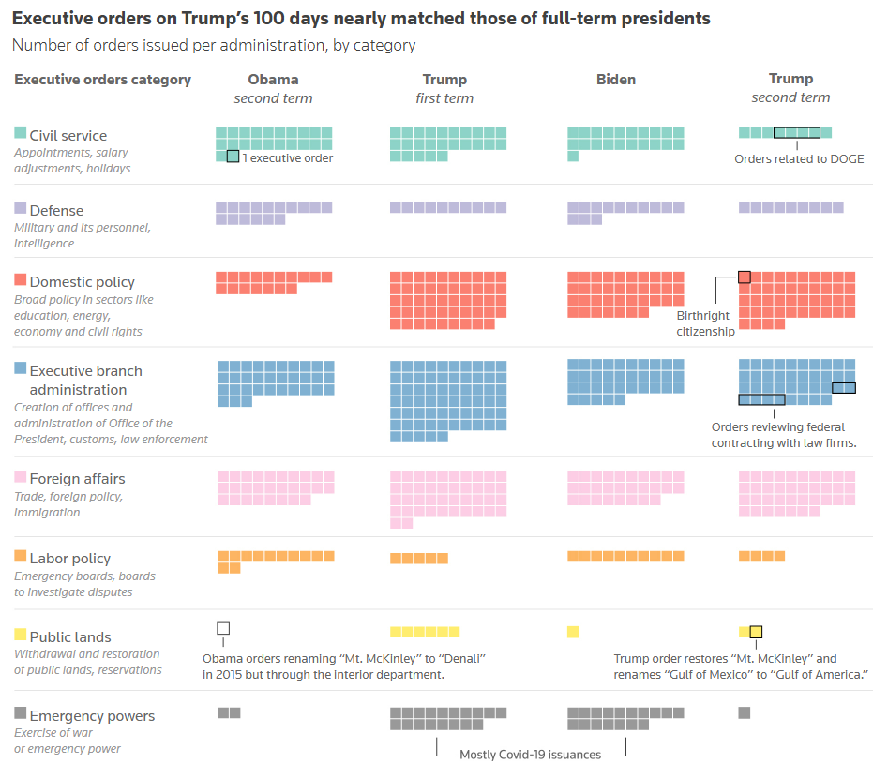

Slide 17
Policy at the State and Federal Level
Federalism in the Constitution
Federal powers
State powers
Pendulum of Federalism
Grants
Categorical vs. Block
Finding a balance

Slide 18
