Slide 1
The Context of
Public Policy

Slide 2
Role(s) of Government
Well?
Security
Membership
Prosperity
Needs

Slide 3
Tragedy of the Commons
What is it?
Policy examples?
What can we do about it?
Mutual coercion mutually agreed upon

Slide 4
Types of Public Policy
What is public policy?
Regulatory
  Self-Regulatory
Distributive/Redistributive

Slide 5
Policy Costs and Benefits
Costs
Benefits
  Perceptions
  Legitimacy
Distribution
Costs and benefits are inherently political
Opportunity costs
Externalities

Slide 6
Policy Contexts
Institutional
Political
Economic
Demographic
Ideological

Slide 7
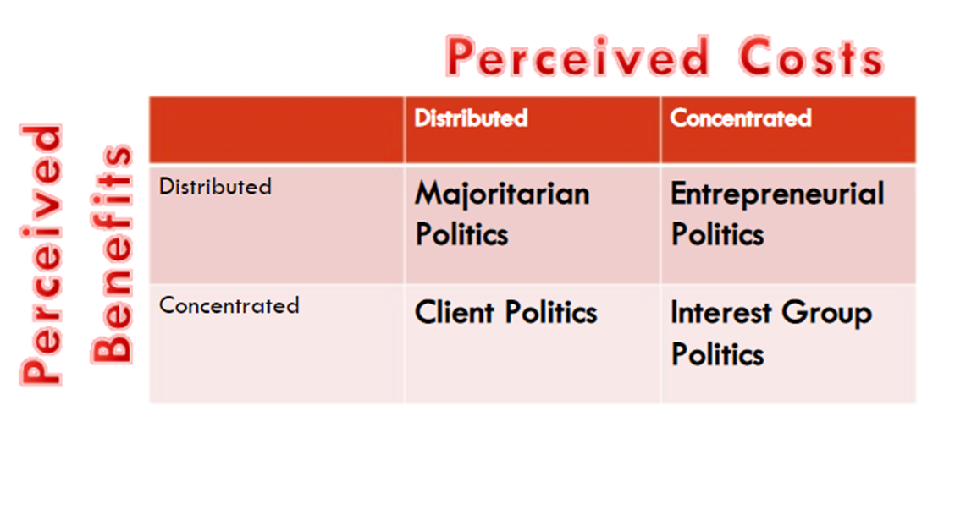
Typology of public policy
Majoritarian politics
Interest group politics
Client politics
Entrepreneurial politics

Slide 8
Stages of Policy Development
Problem Definition
Agenda Setting
Policy Formulation
Policy Adoption
Policy Implementation
Policy Evaluation
  Empirical and Normative

Slide 9
Policy Assessment
Costs and Benefits
Effectiveness
Efficiency
Equity
Political feasibility
Social acceptability
Technical feasibility
Motivated reasoning and policy assessment (how to assess policy like a pro)

Slide 10
