Slide 1
Social Policy Issues

Slide 2
Abortion in the U.S.
Abortion policy before Roe v. Wade
Comparative perspective
Public opinion
Arguments for legal abortion
Arguments against legal abortion

Slide 3
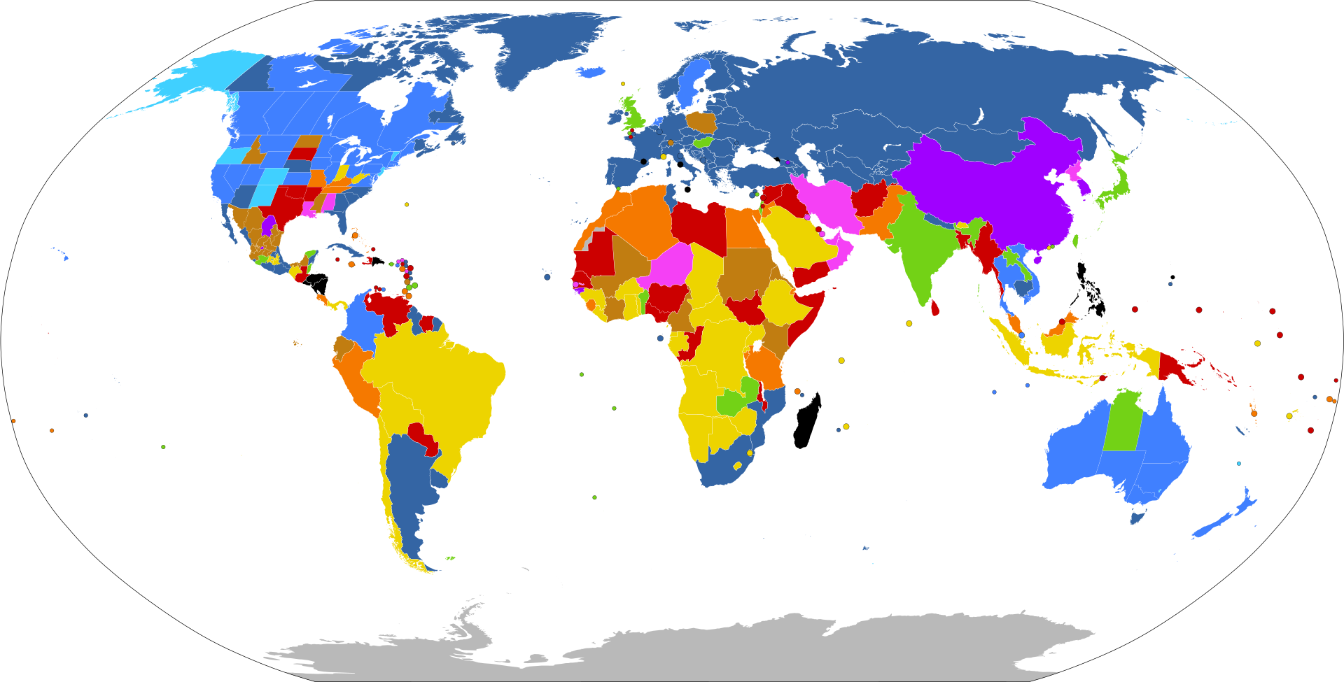
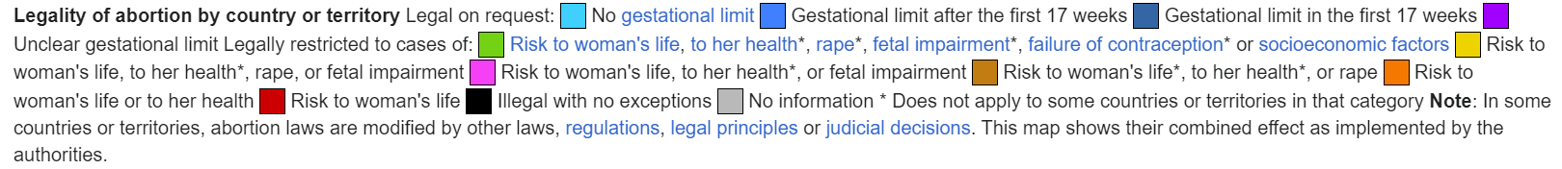

Slide 4
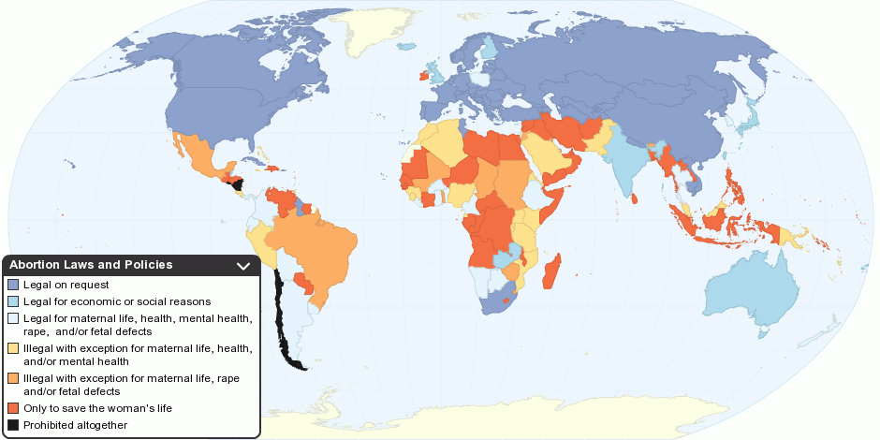

Slide 5
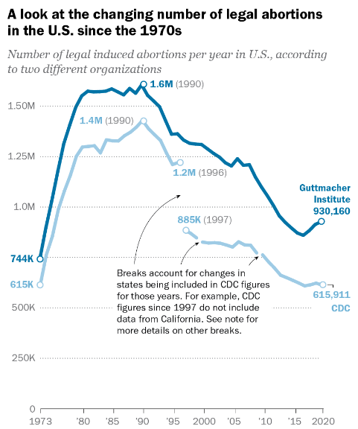

Slide 6
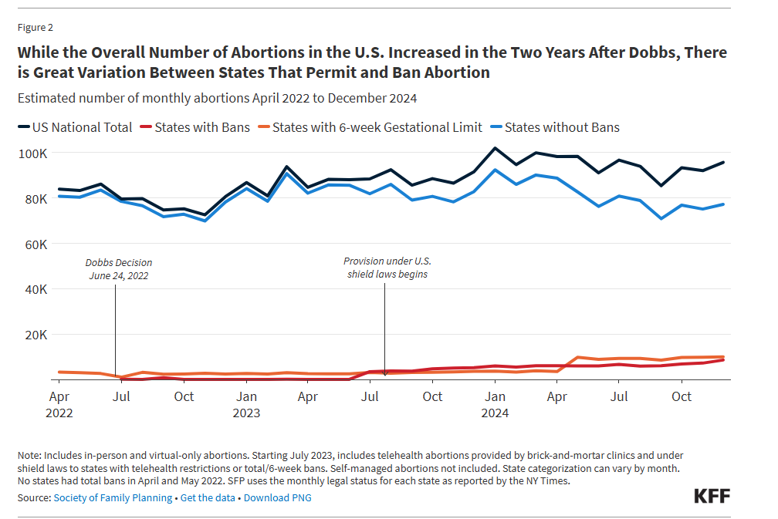

Slide 7
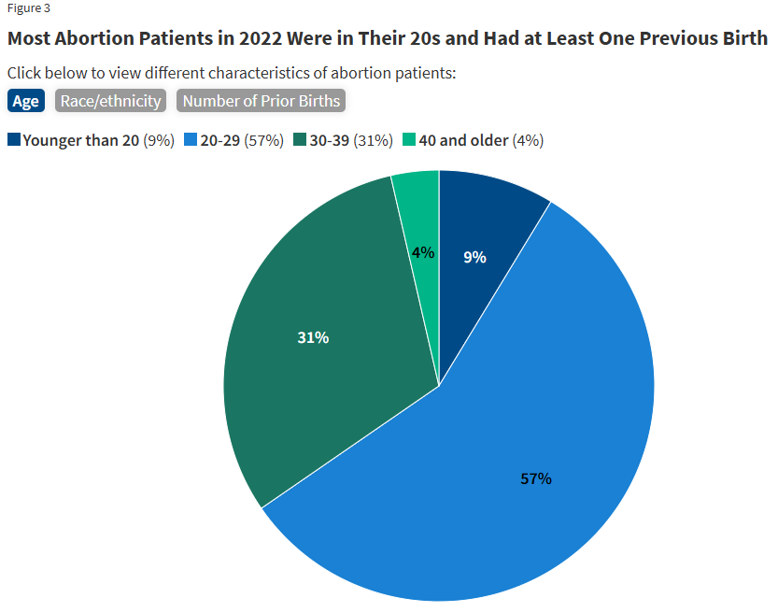
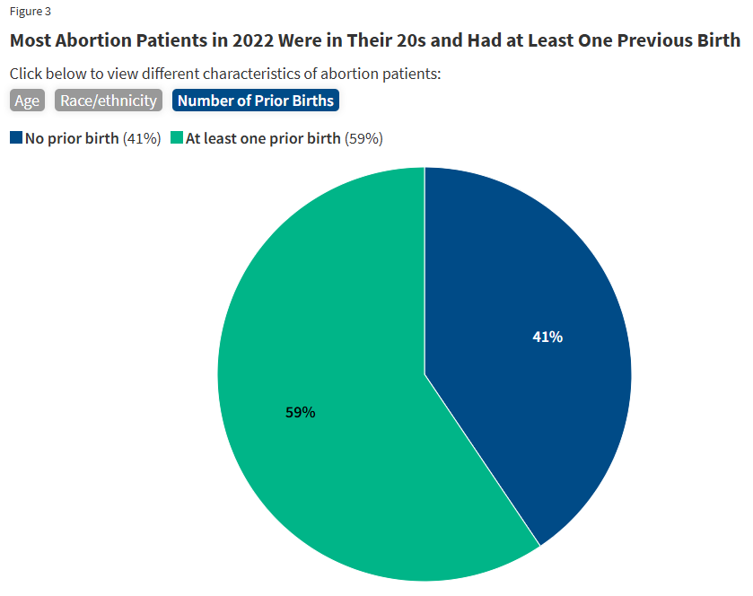

Slide 8
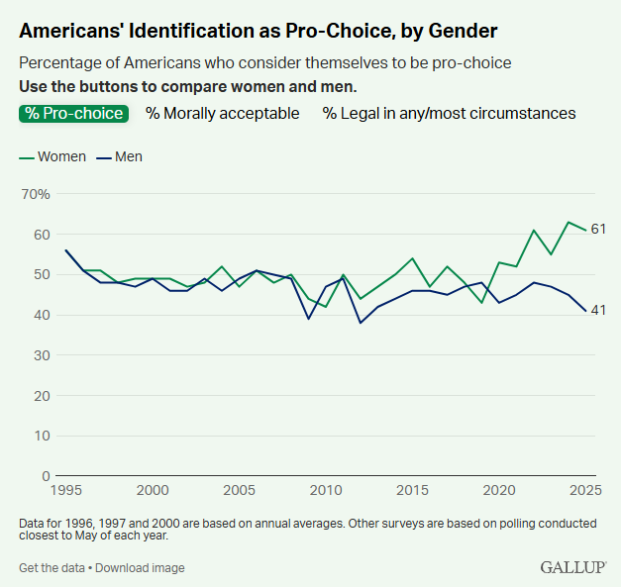

Slide 9
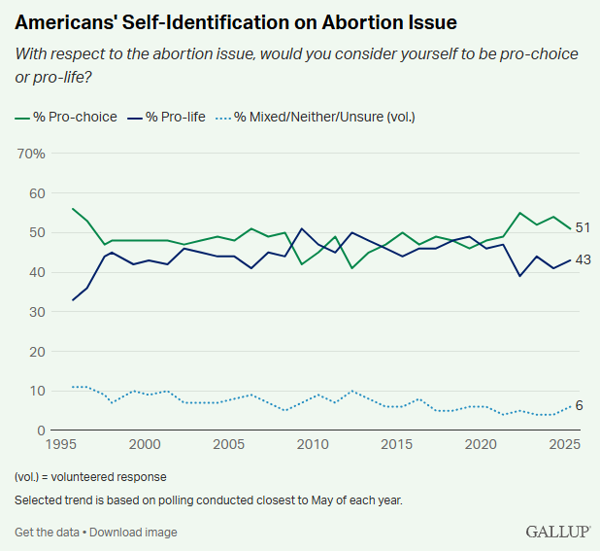

Slide 10
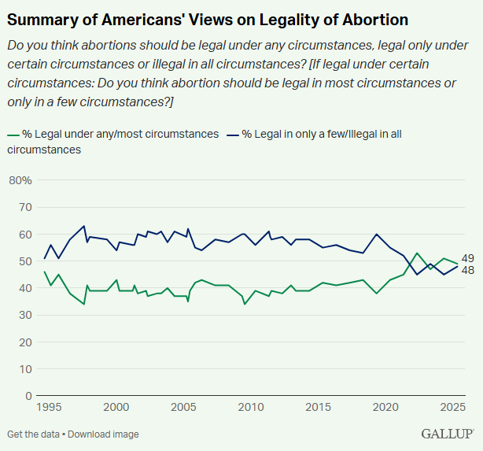

Slide 11
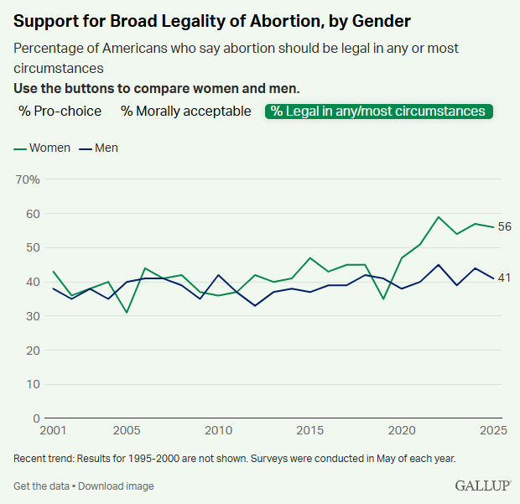

Slide 12
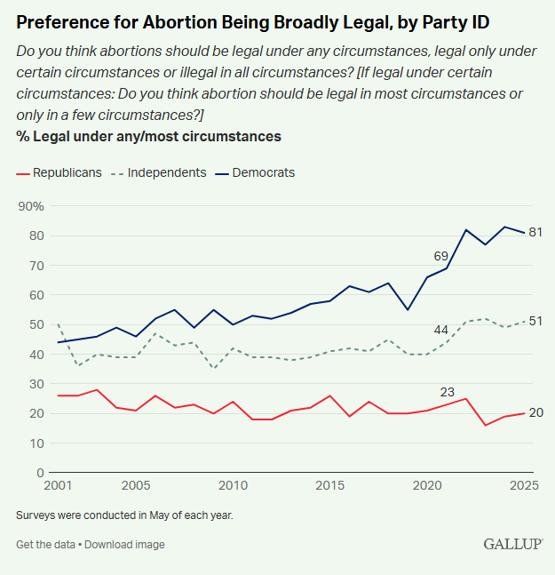

Slide 13
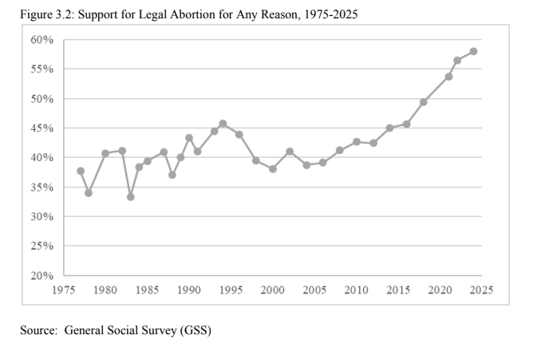

Slide 14
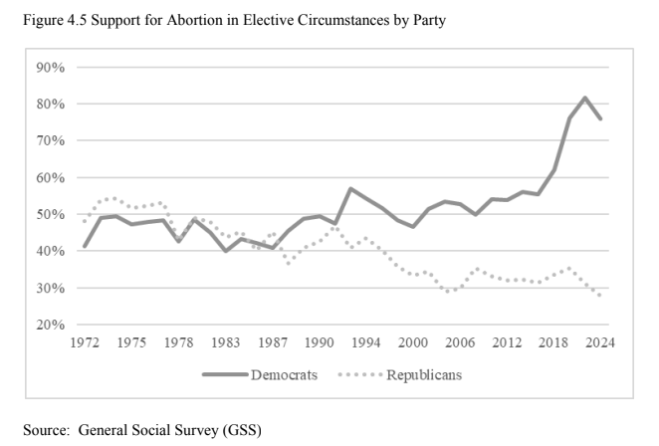

Slide 15
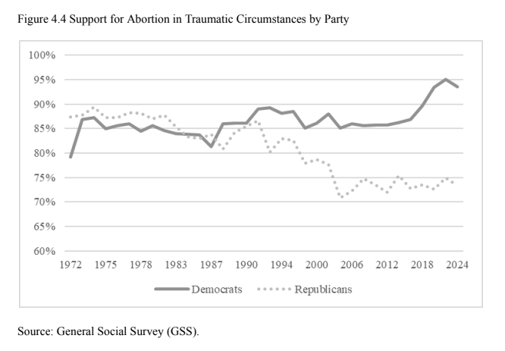

Slide 16
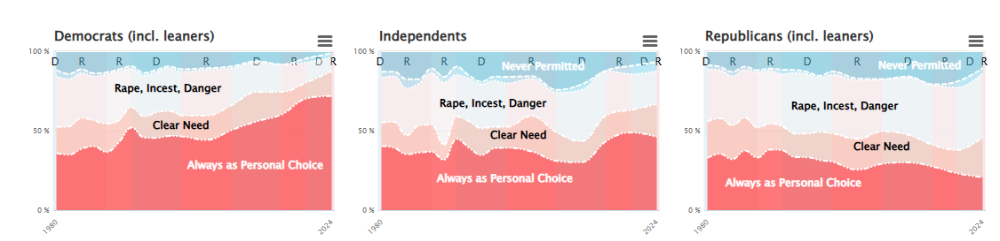

Slide 17
Supreme Court and abortion Policy
Roe v. Wade
Casey v. Planned Parenthood
Whole Women’s Health
Dobbs

Slide 18
Abortion policy in the post-Dobbs world
Massive variation across states
How many weeks?
Exceptions (life vs health of mother)
The inherent tradeoffs of abortion limits versus pregnant women’s health
Rise in medication abortion and telemedicine abortion
Interstate conflicts– shield laws, bounty laws

Slide 19
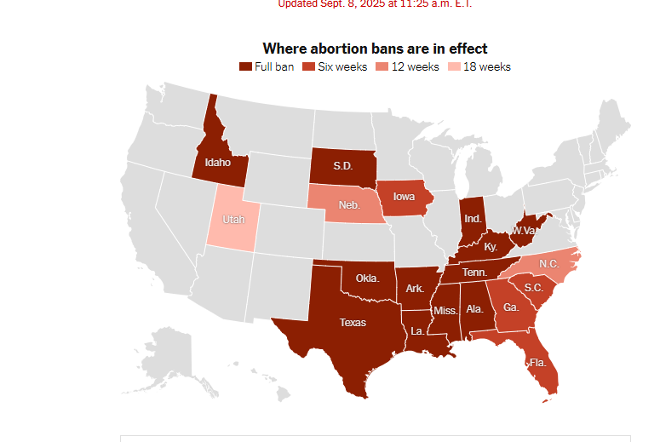

Slide 20
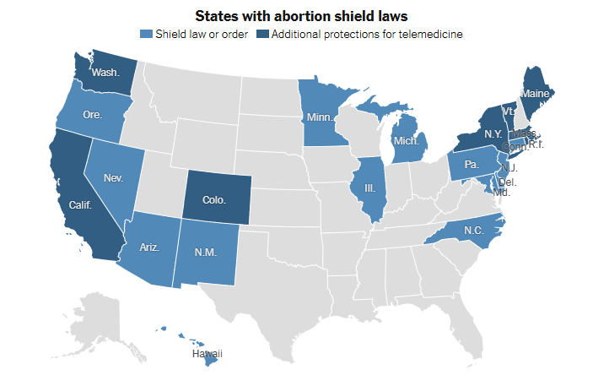

Slide 21
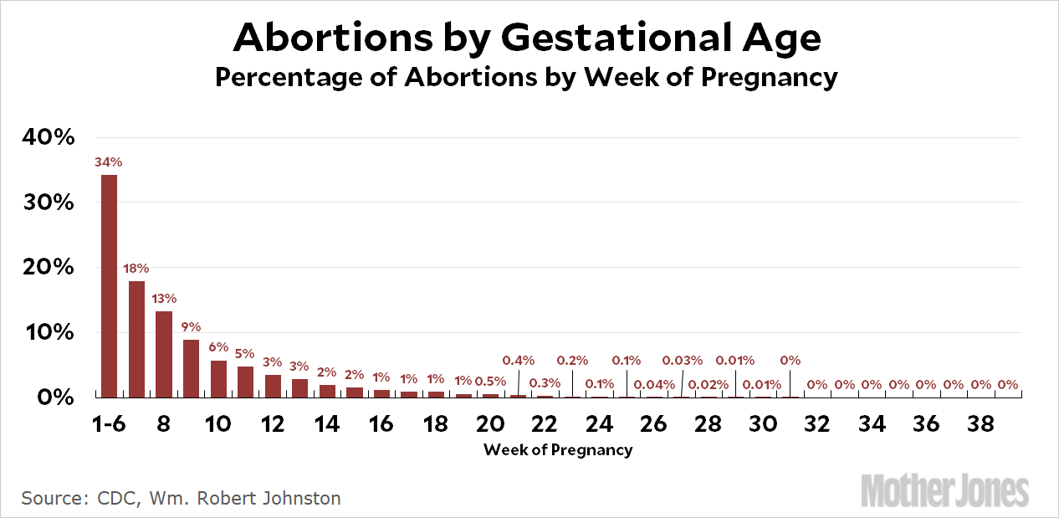

Slide 22
LGBT Rights
Homosexuality and right to privacy
The gay marriage debate
Obergefell v Hodges
Workplace discrimination/Bostock
Gay rights vs. religious liberty
The growing transgender conflict

Slide 23
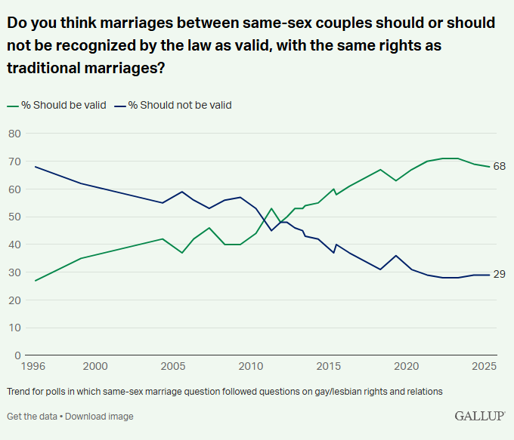

Slide 24
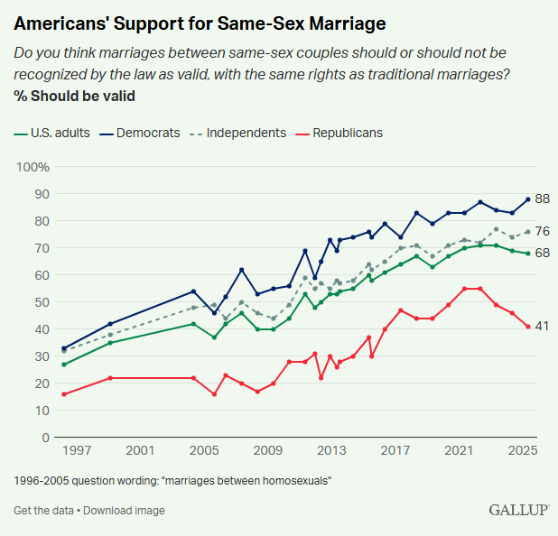

Slide 25
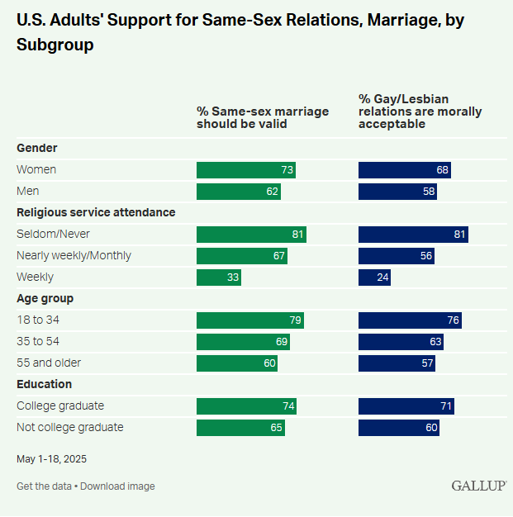

Slide 26
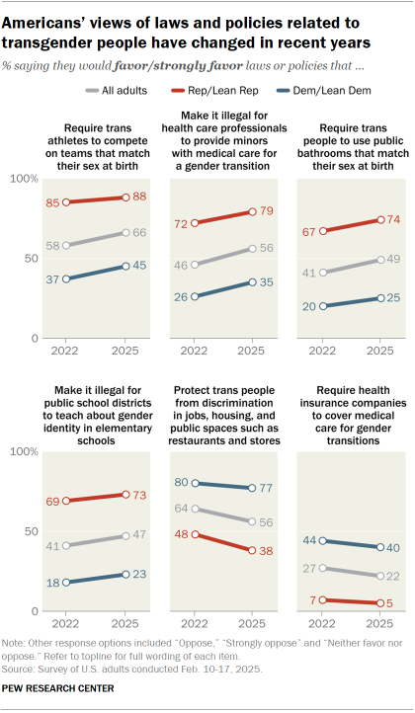

Slide 27
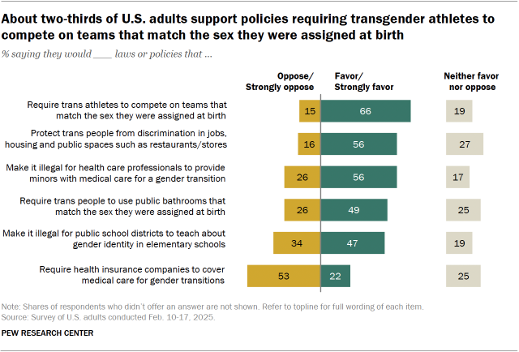

Slide 28
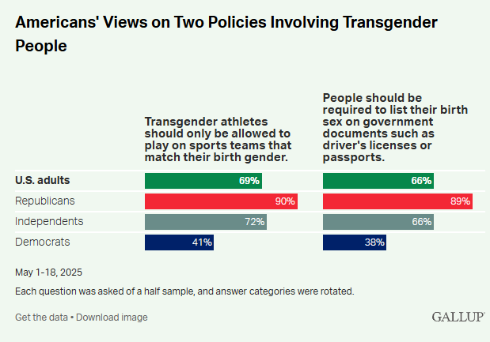

Slide 29
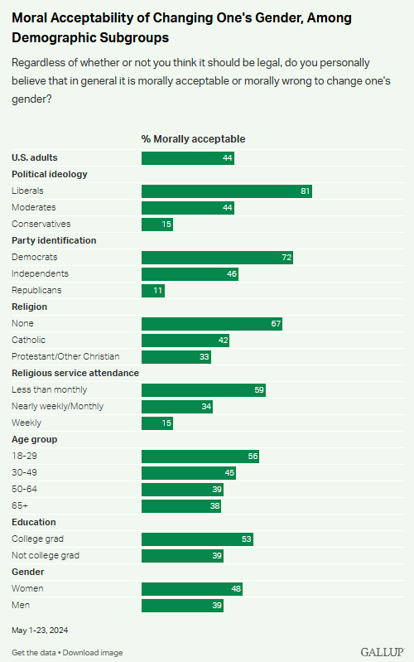

Slide 30
