Slide 1
Environmental & Energy Policy

Slide 2
Introduction
Pollution
Current climate reality
Interdependence of Environment and Energy
US Energy Production and Consumption

Slide 3
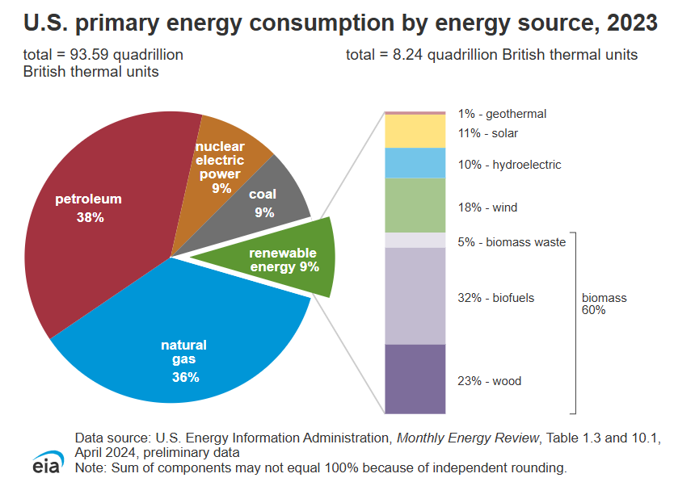

Slide 4
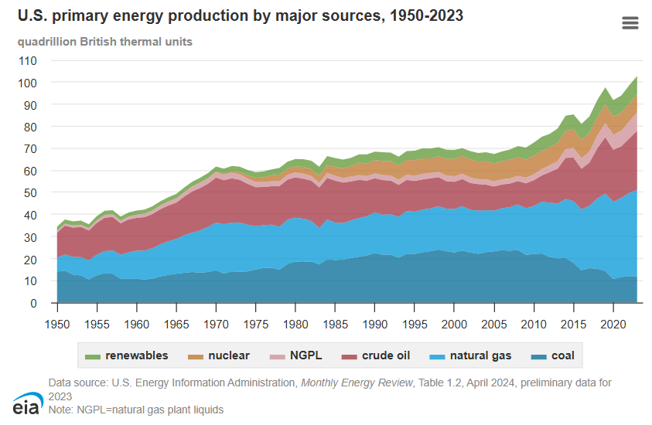

Slide 5
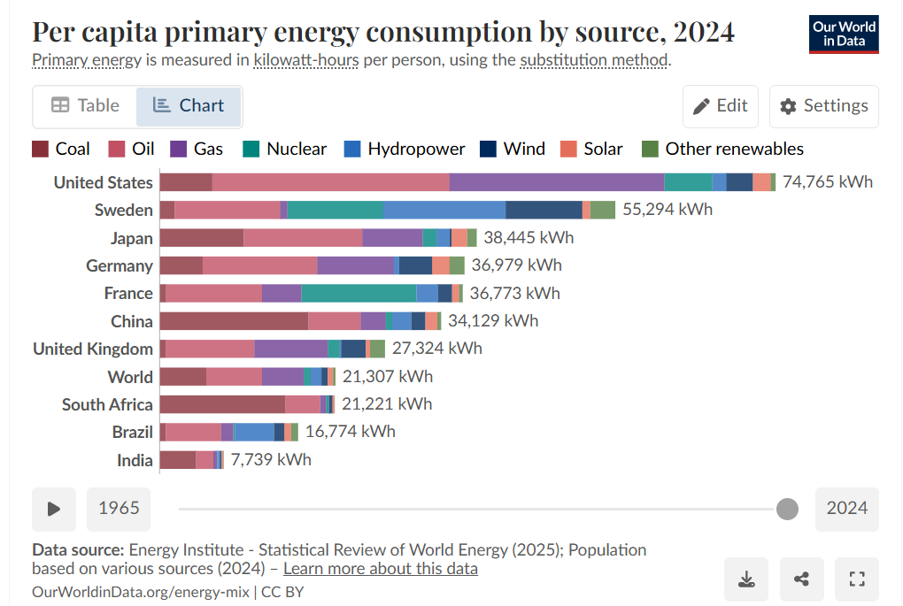

Slide 6
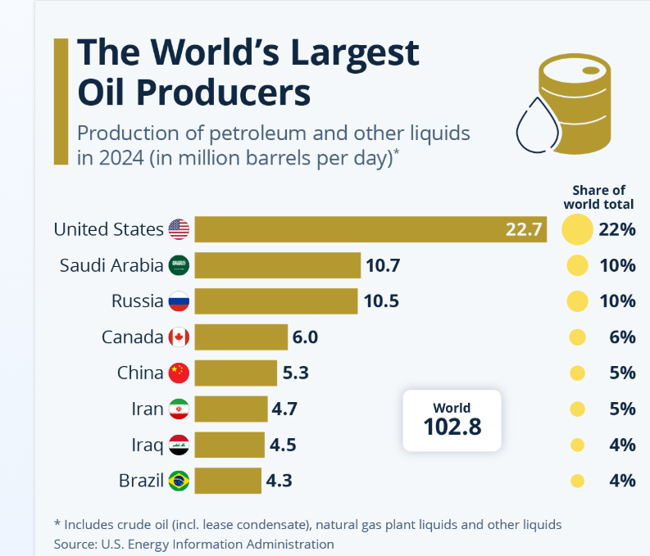

Slide 7
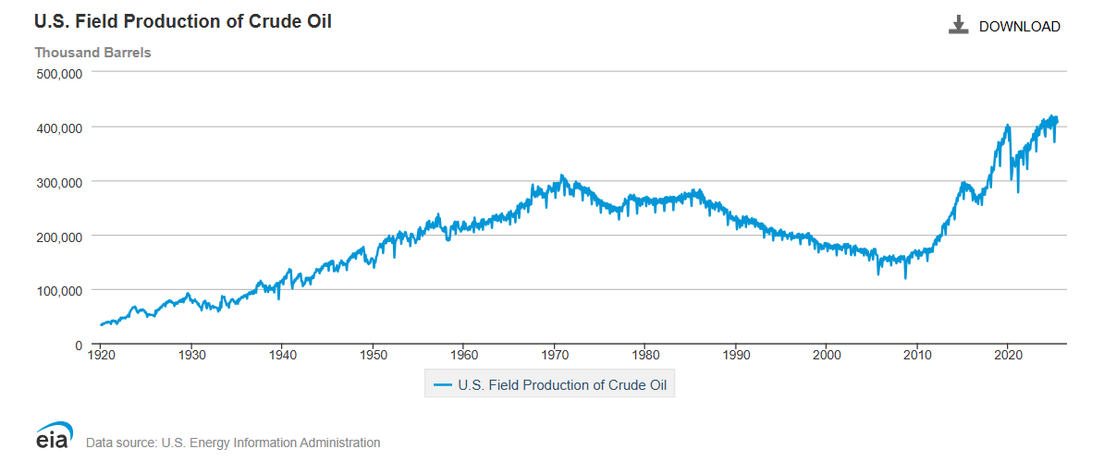

Slide 8
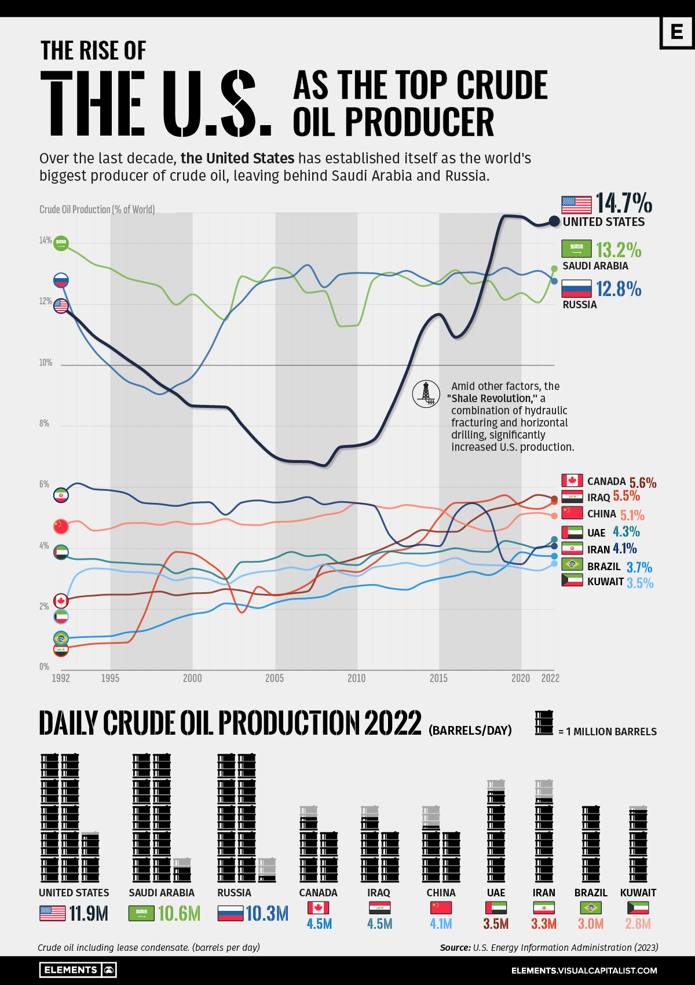

Slide 9
Politics of Environmental Policy: Conflicts and Principles
Costs and Benefits
Short-term vs. long-term benefit
Externalities
Regulation
Risk Assessment
The case of air pollution
Economic Growth
Compromise
Enforcement
Supply vs. Demand
Agriculture Policy
Successes

Slide 10
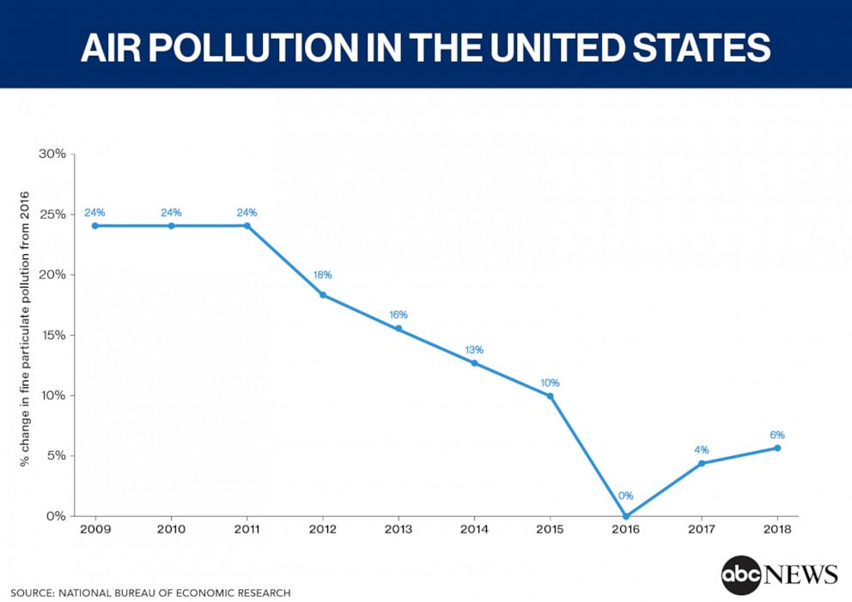

Slide 11
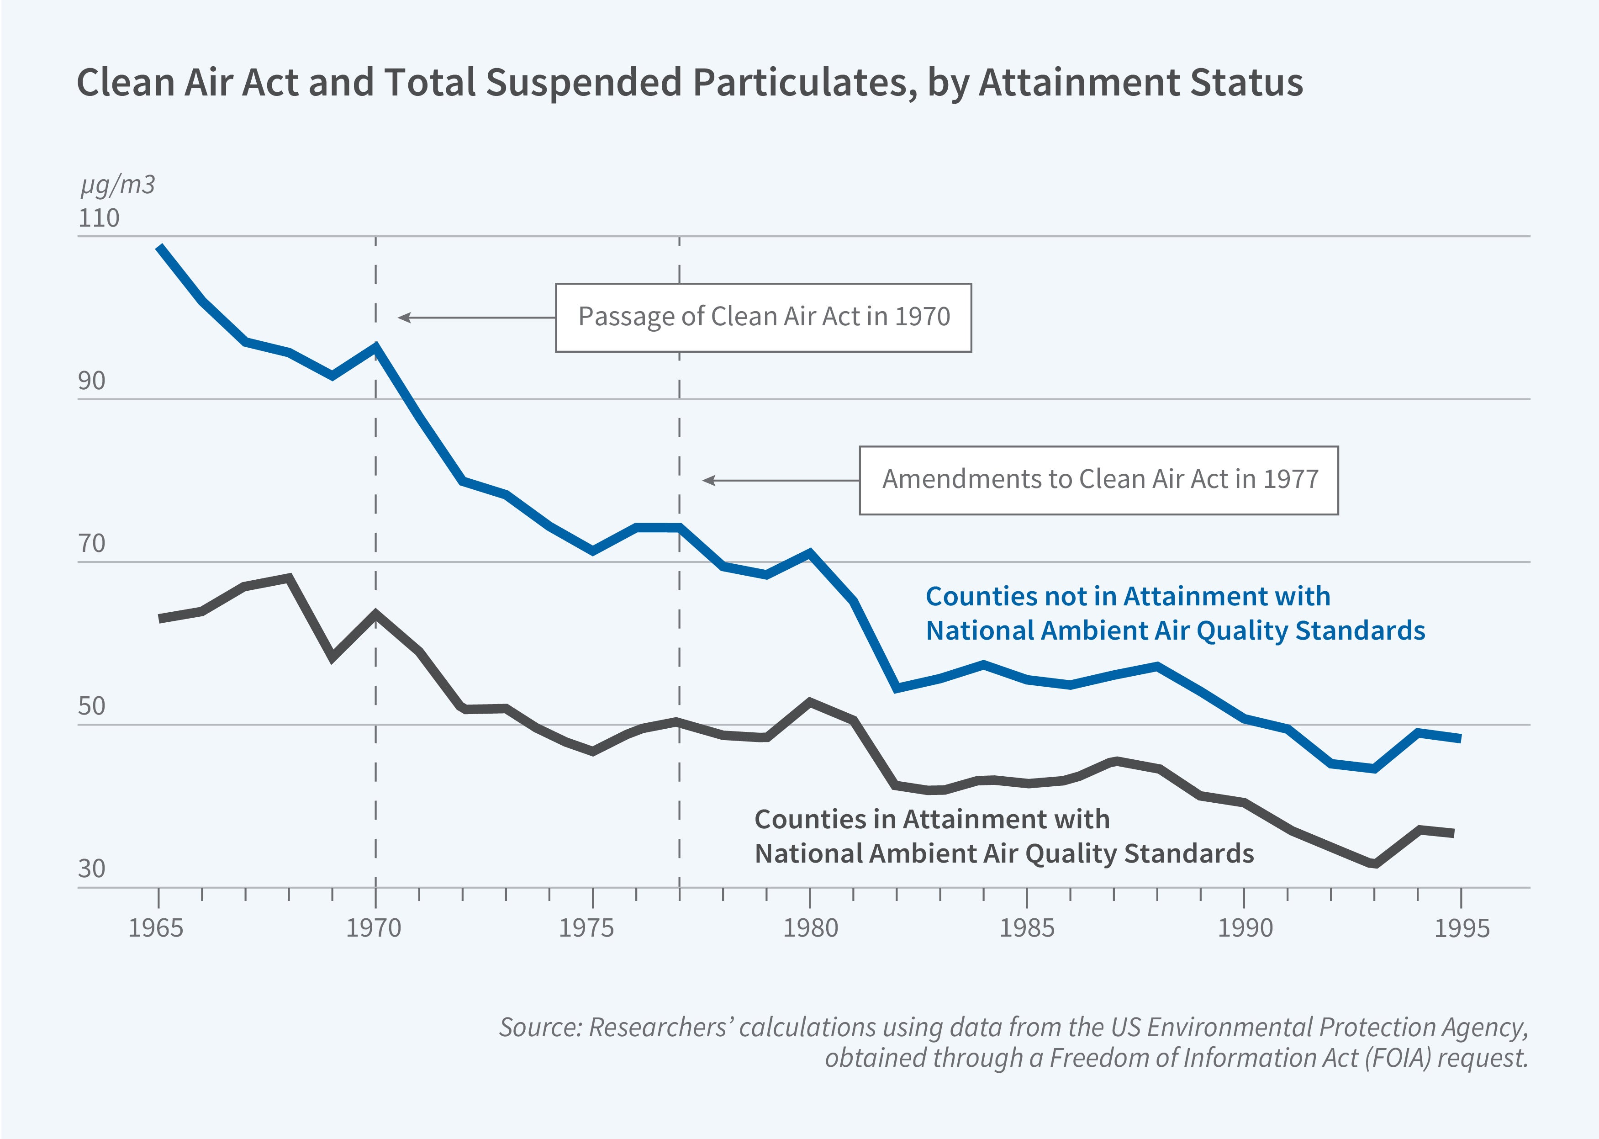

Slide 12
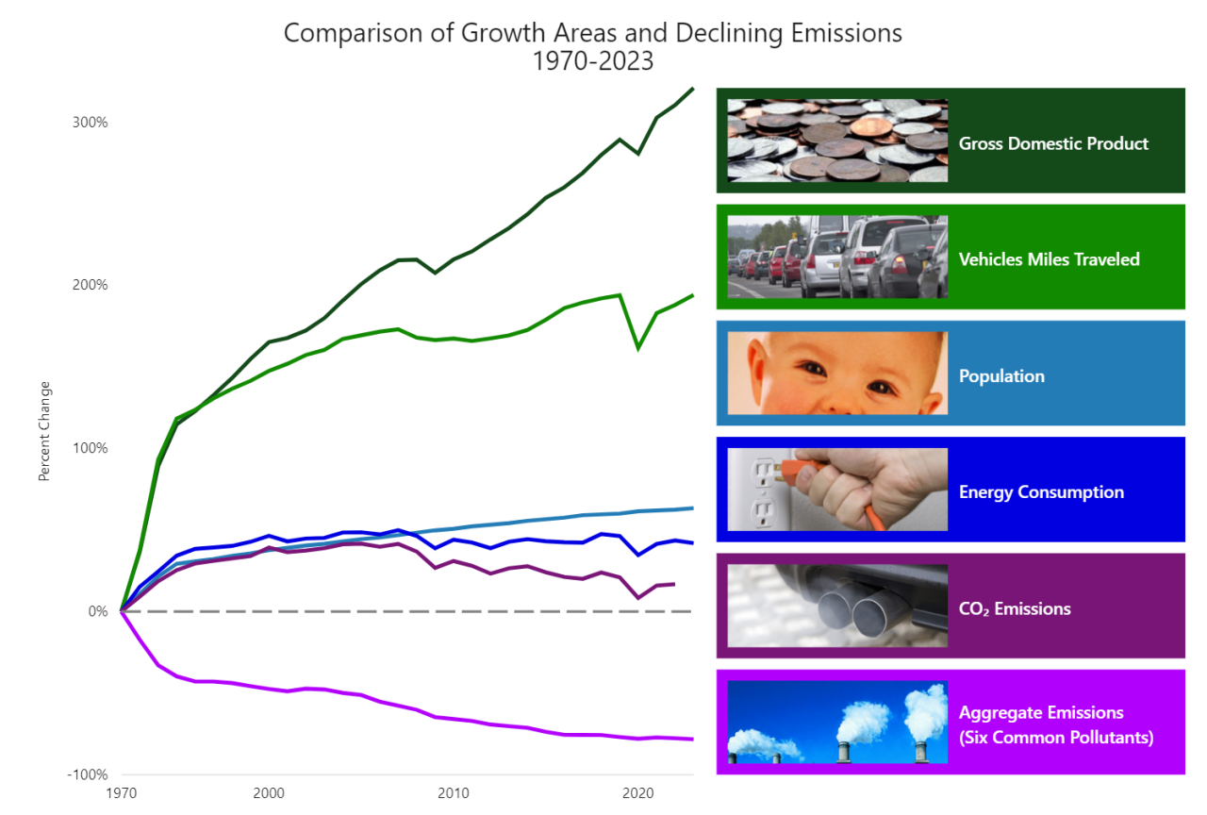

Slide 13
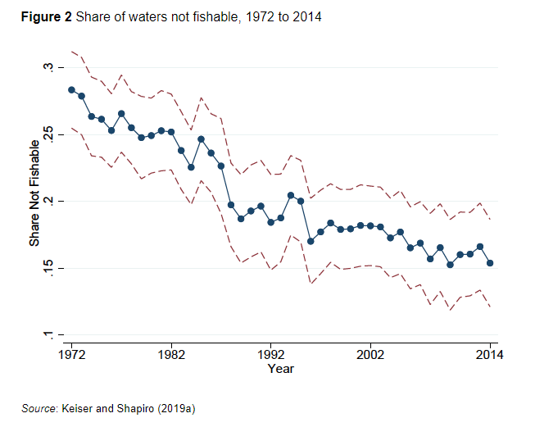

Slide 14
Climate Change
What’s the deal?
The politics of global warming
Public opinion
Global politics vs. national interests
Inflation Reduction Act
Renewables/Electrification

Slide 15
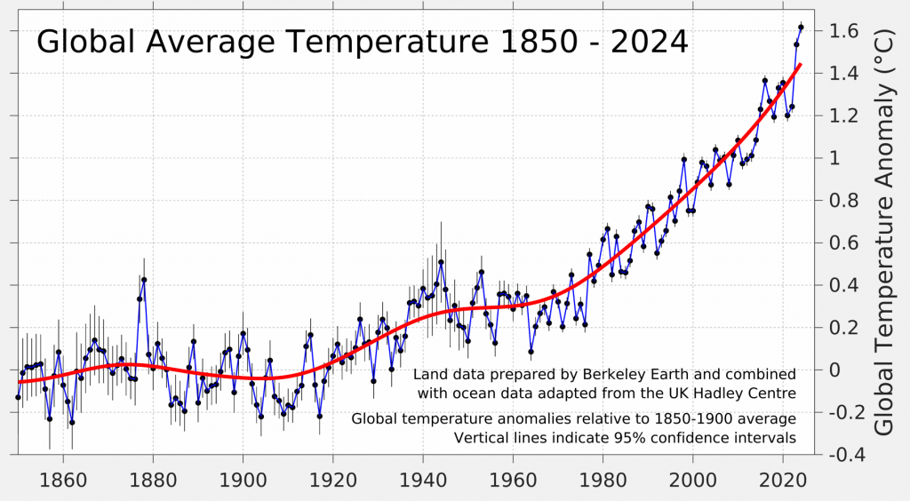
It’s getting hot in here

Slide 16
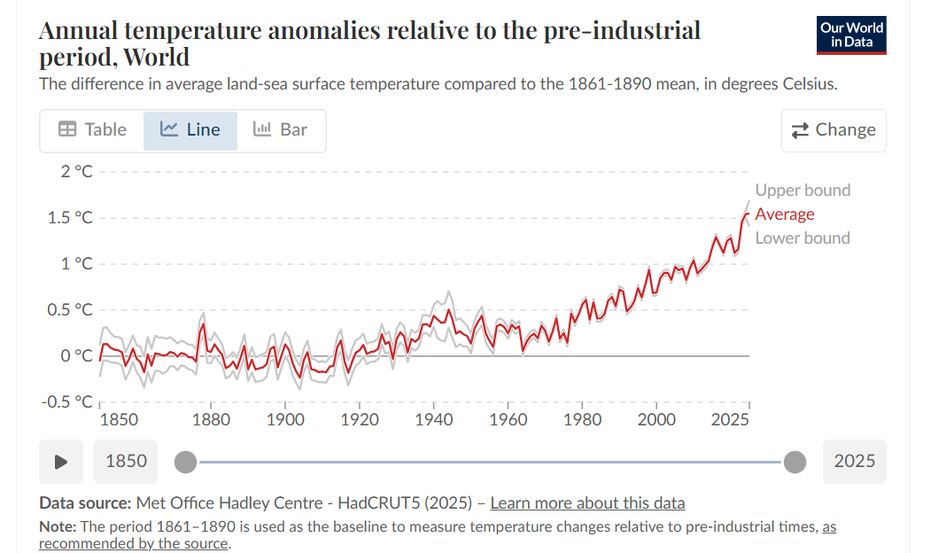

Slide 17
Climate change public opinion

Slide 18
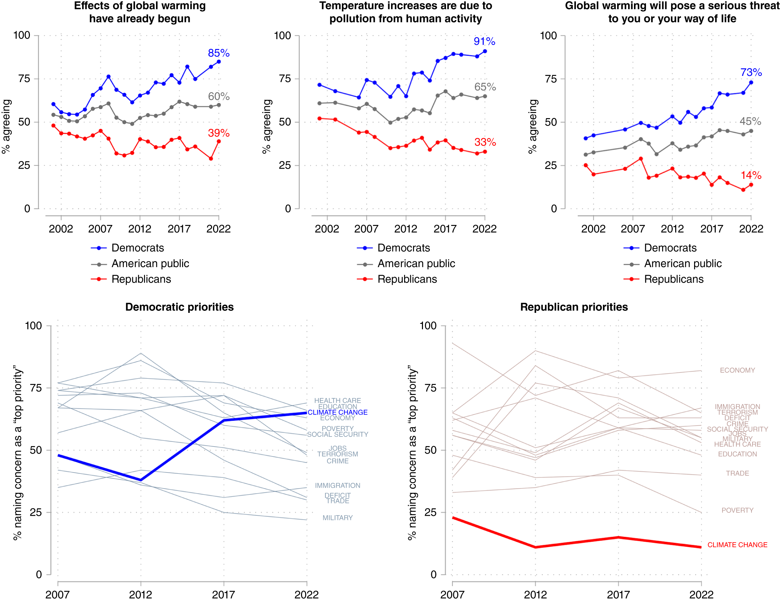
Politics of climate in chart form

Slide 19
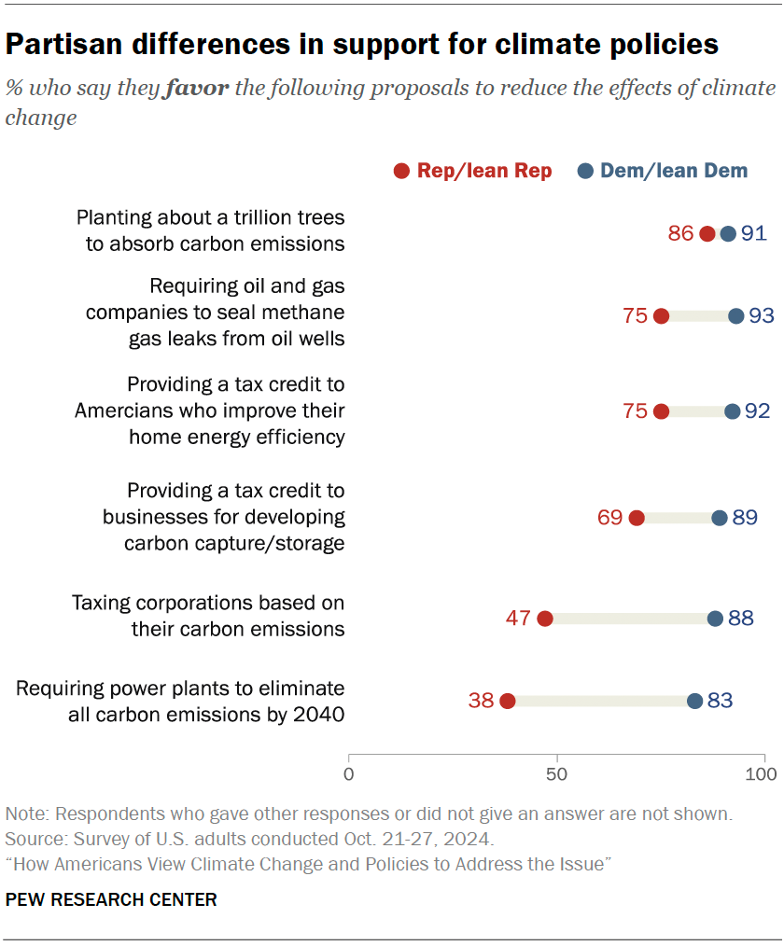
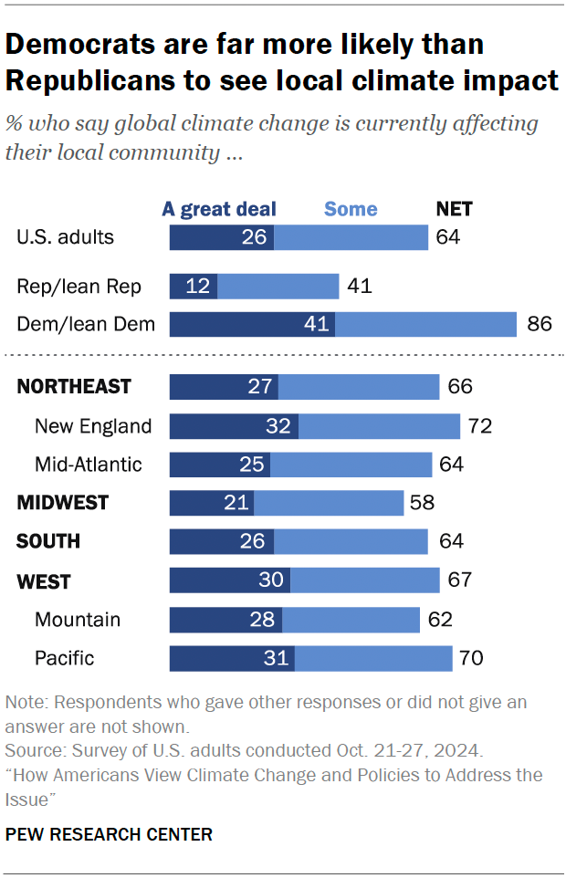
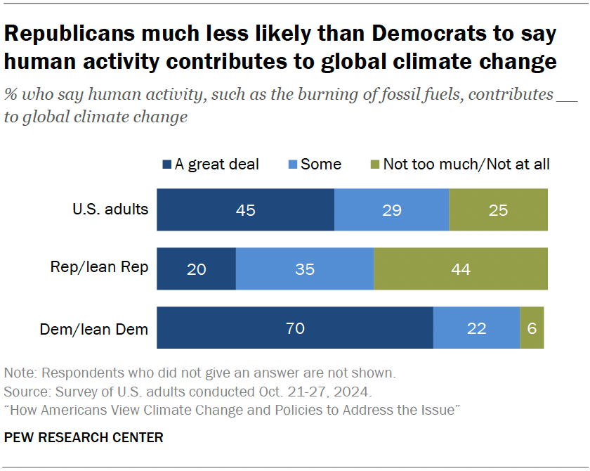

Slide 20
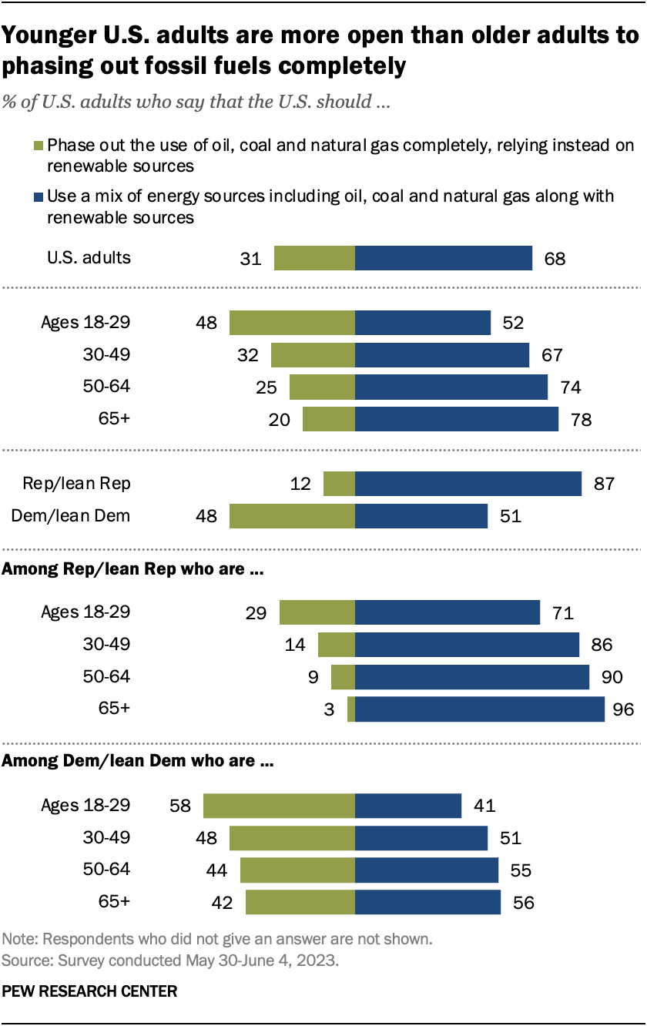

Slide 21
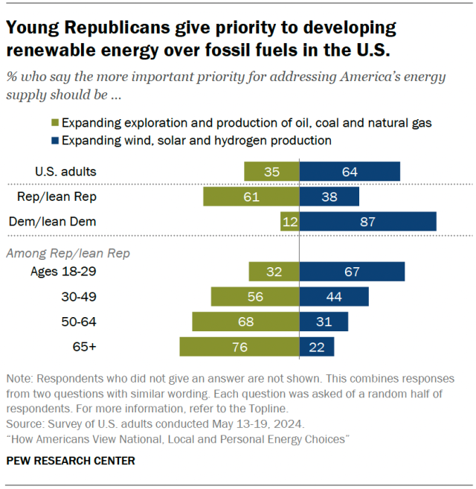

Slide 22
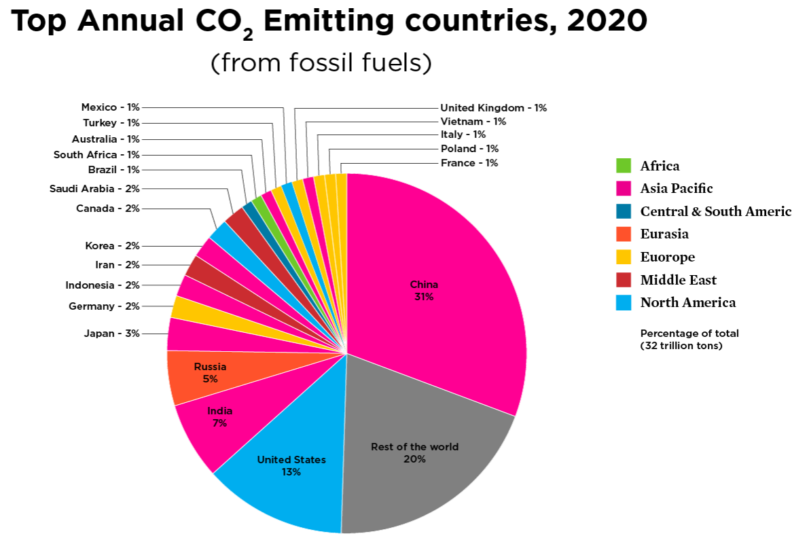
Global CO2 production

Slide 23
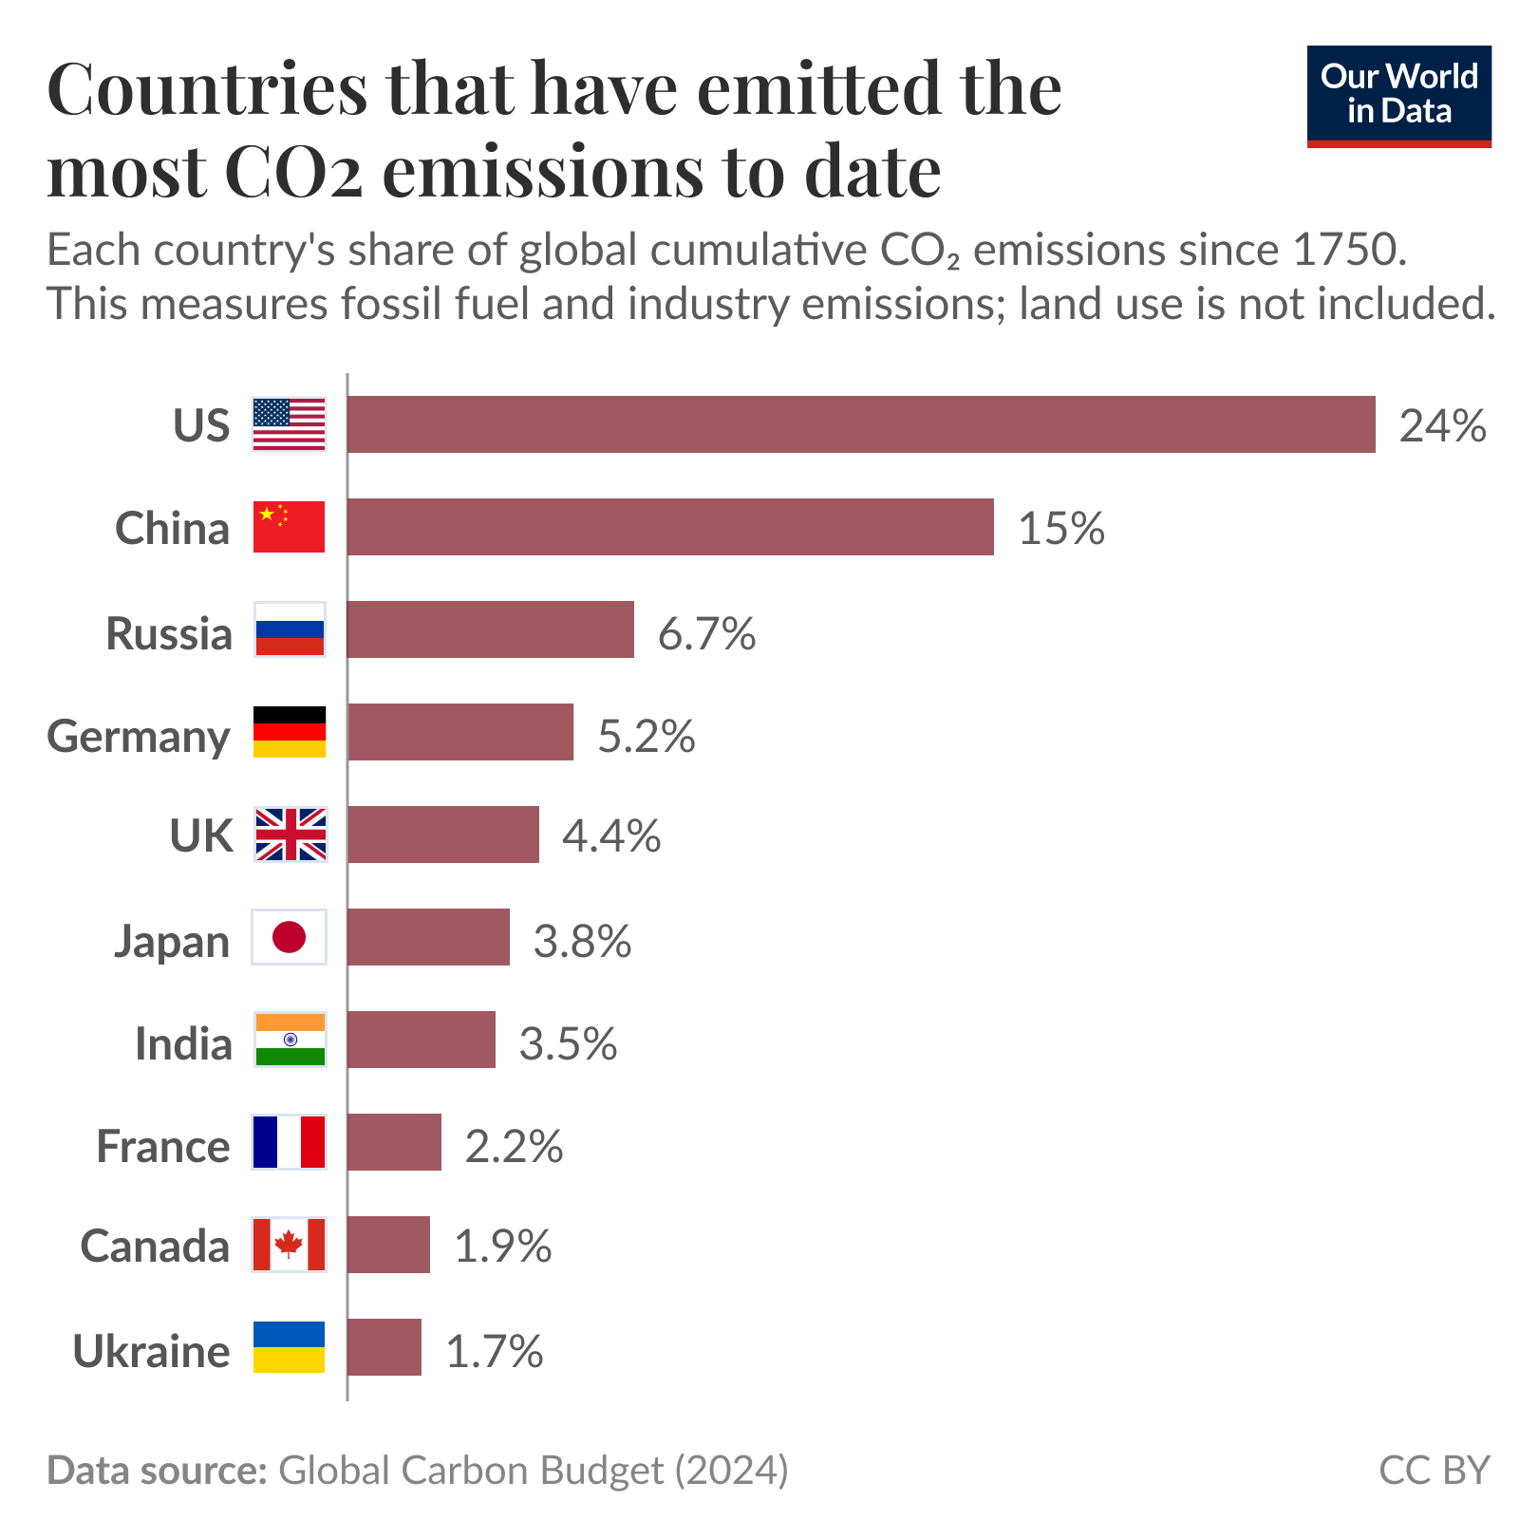

Slide 24
Technology, Energy, and The Future
Renewables/electrification
Grid challenges
Nuclear
Climate change technological mitigation

Slide 25
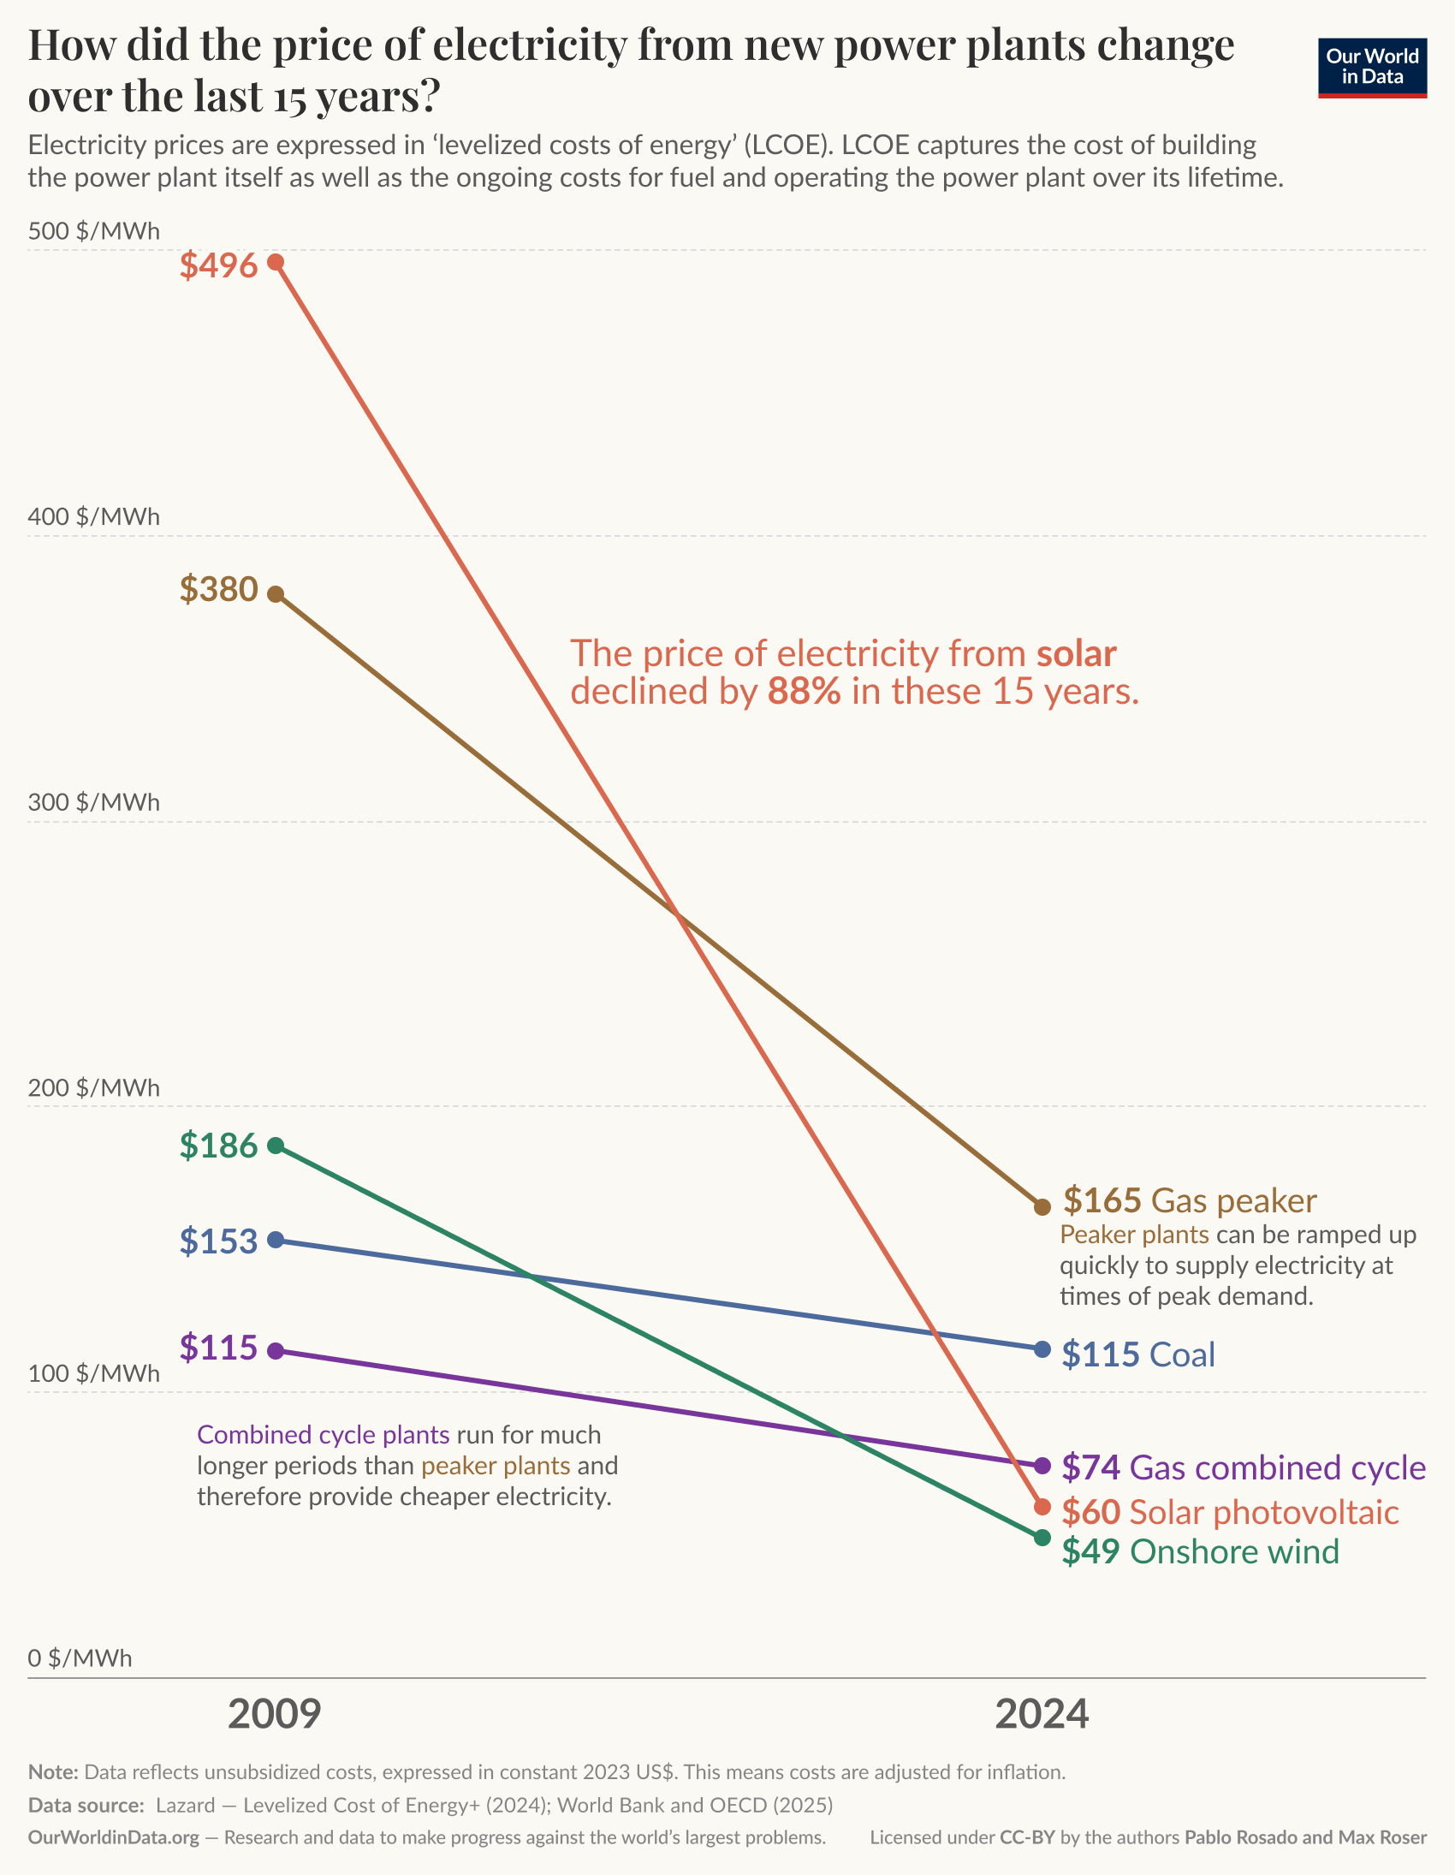
One Chart to Rule Them All

Slide 26
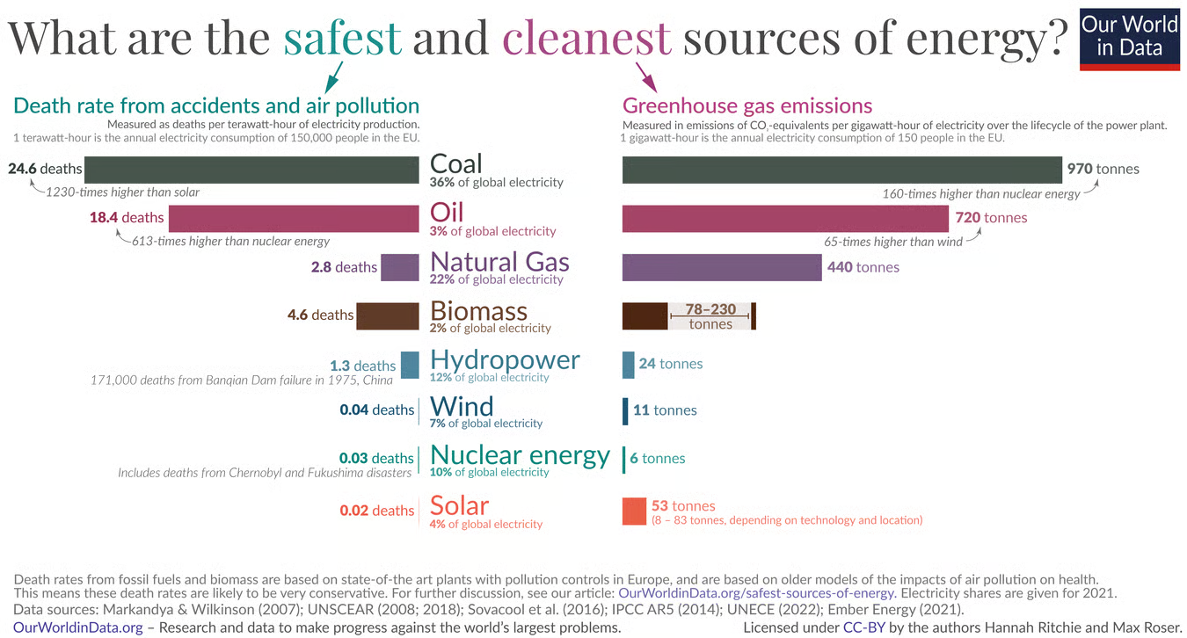

Slide 27
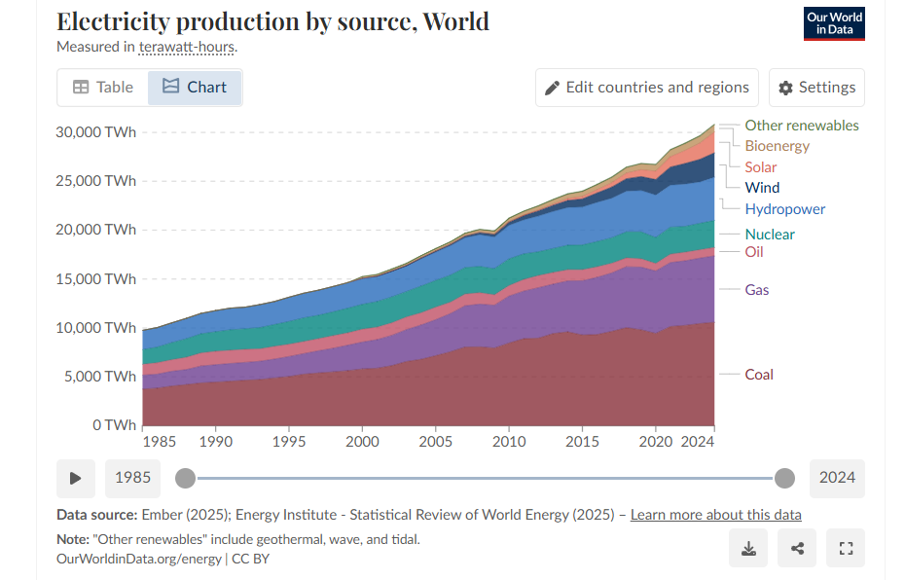
link

Slide 28
Contemporary Policy Challenges
Culture war economics
Interest Group challenges
Self-inflicted competitive damage
AI/Data Centers
The Future?

Slide 29
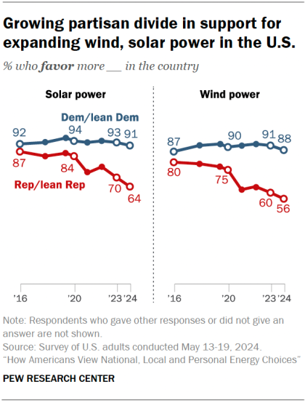
Culture war meets energy policy

Slide 30
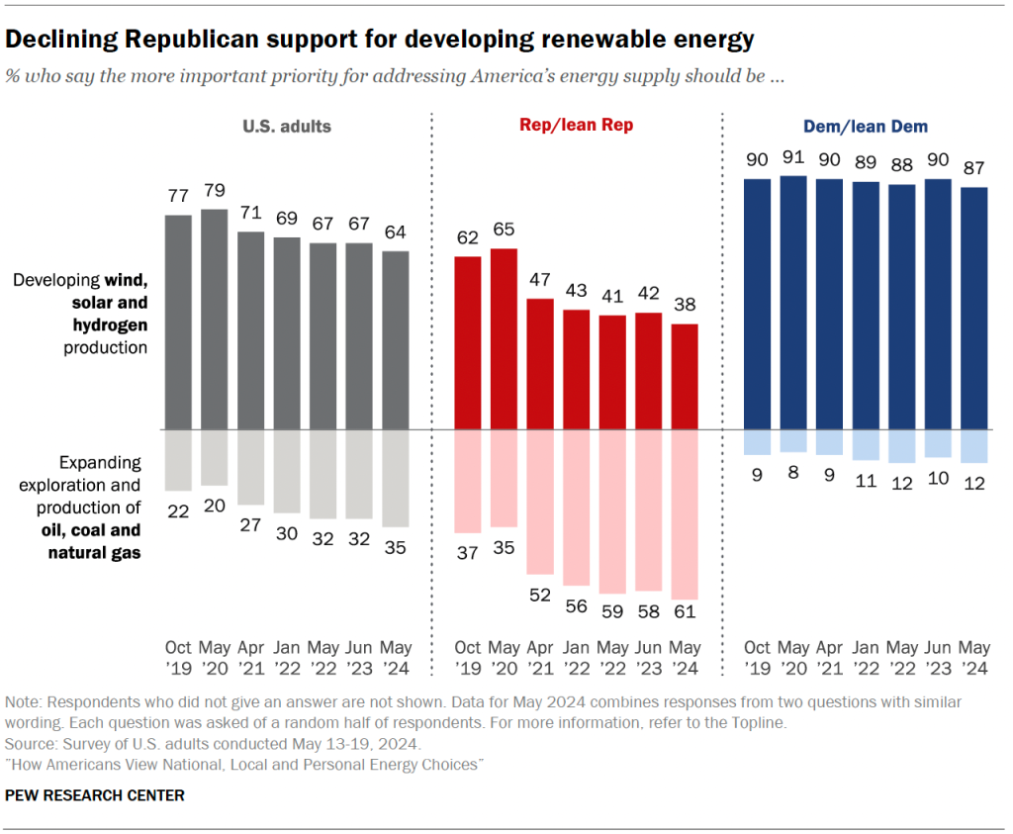

Slide 31
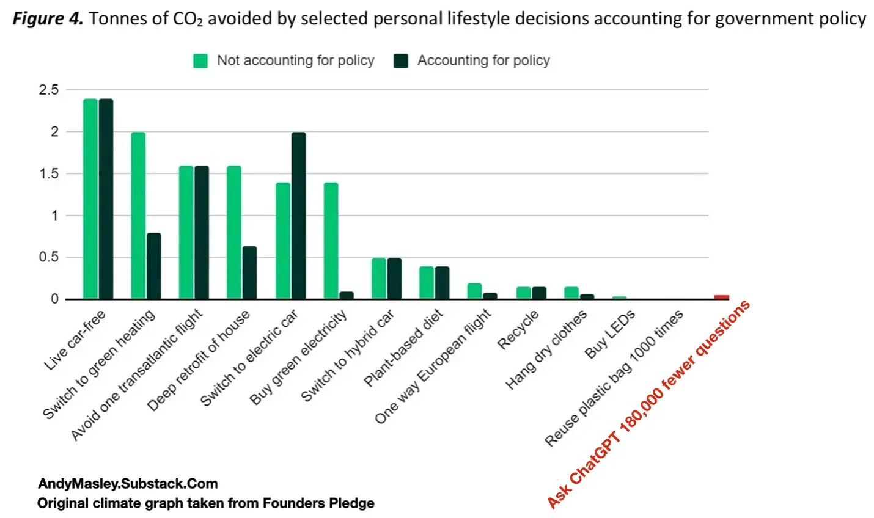
Did Claude make these two slides?

Slide 32
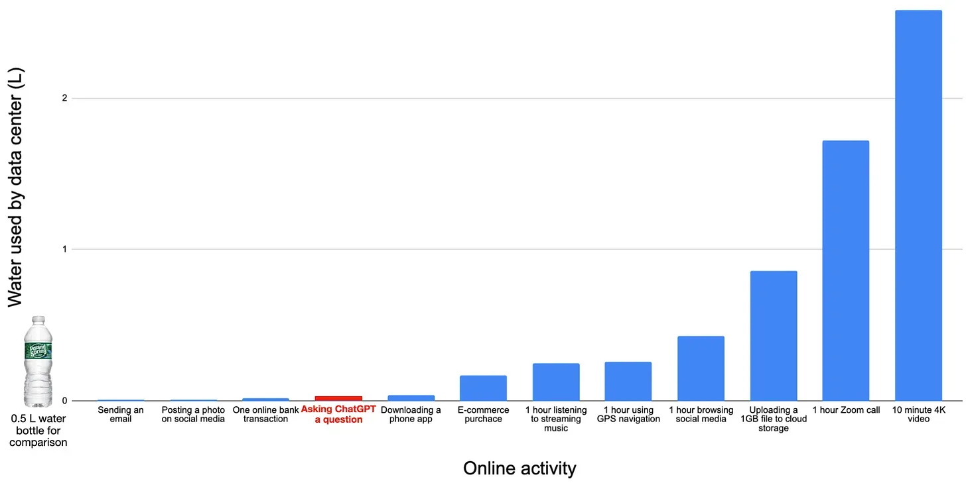

Slide 33
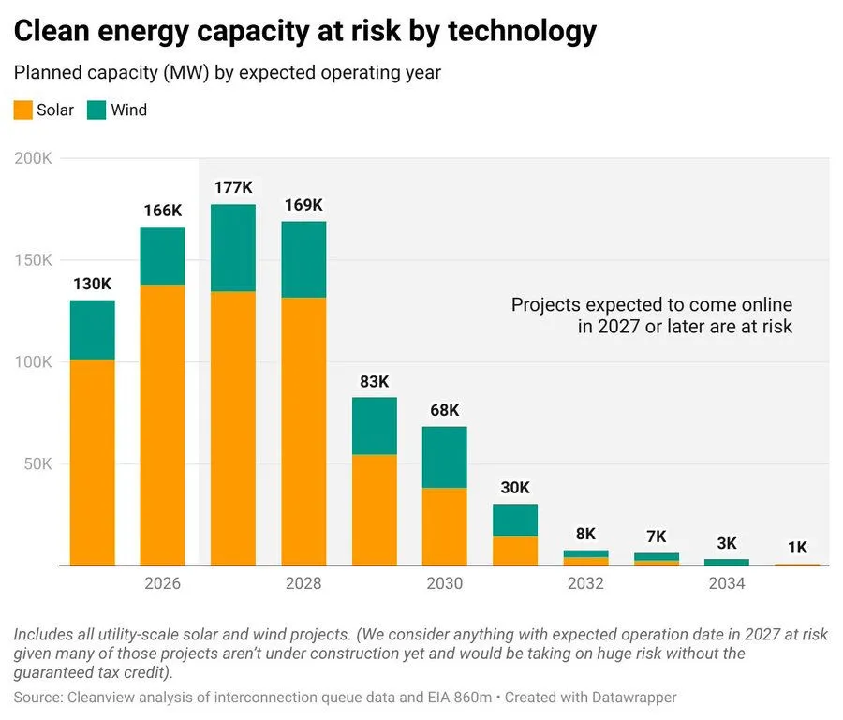

Slide 34


