Slide 1
Institutions and Policy Making: Bureaucracy, Courts, and Interest Groups

Slide 2
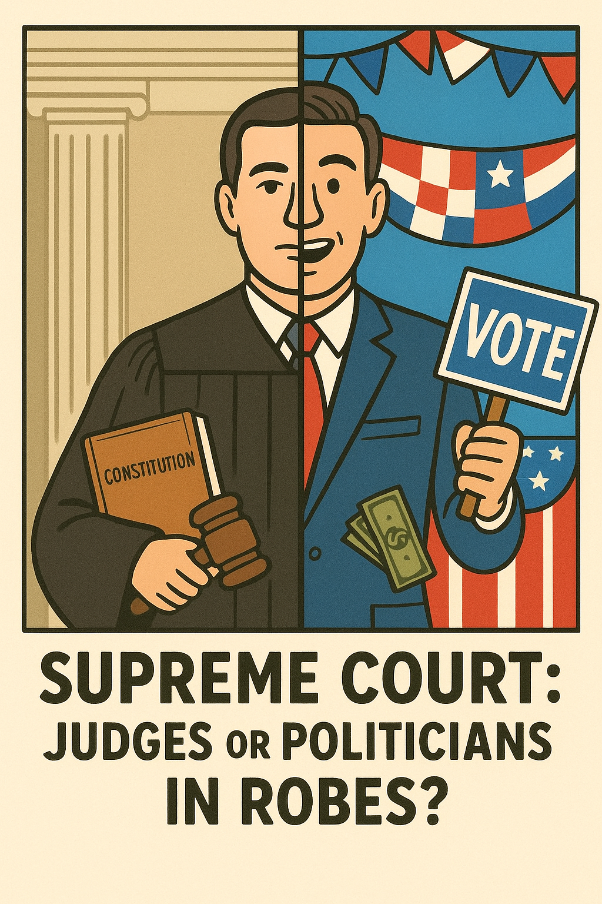
Courts and Policy Making
Courts of Appeals (Circuit Courts)
Supreme Court
Judicial Review
Interpretation
Precedent
Judicial restraint and judicial activism
  “Activist judges”
Shadow docket
Politicians in robes?

Slide 3
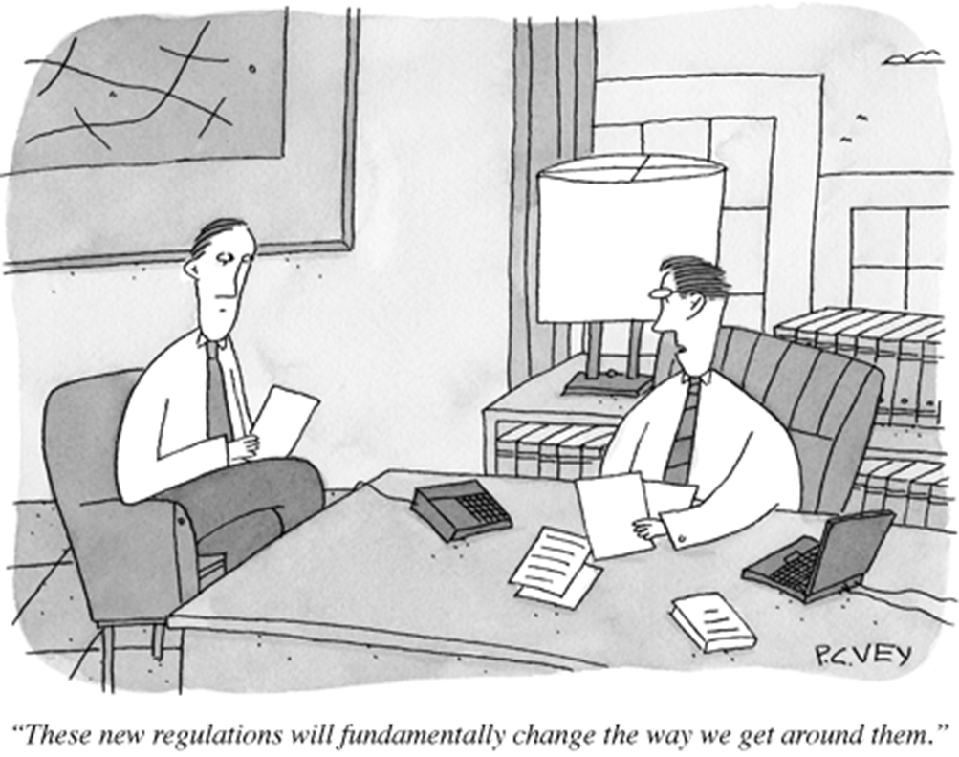
Bureaucratic Policy Making
Modern Bureaucracy
Bureaucratic Authority
Regulations
The bureaucratic burden/The Time tax

Slide 4
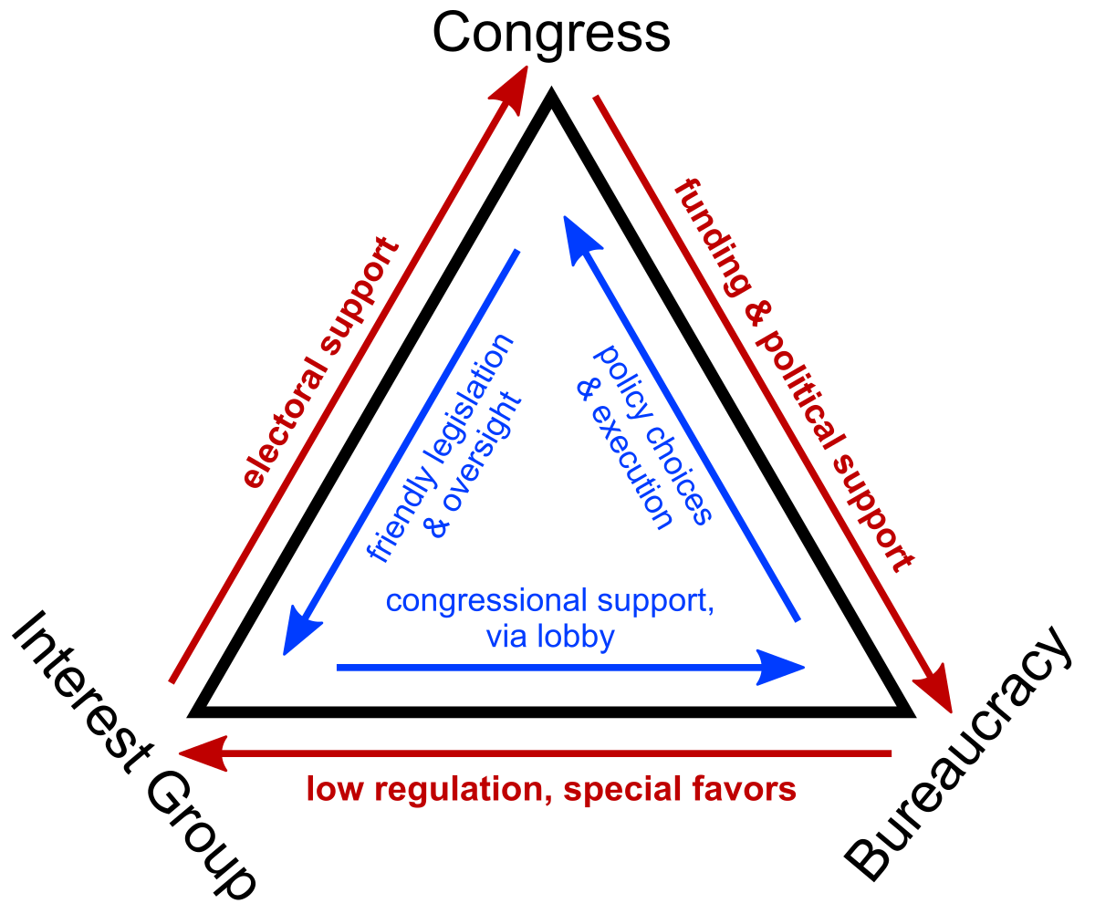
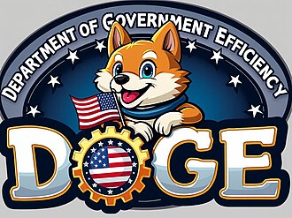
Influences on Bureaucratic Policy Making
President
Congress
Interest Groups
  Regulatory Capture
Iron Triangles
Issue networks
Courts
The case of DOGE

Slide 5
Interest Groups and Policymaking
Defining Interest Groups
Lobbying
Who do Interest Groups represent?

Slide 6
Interest Group Influence: Insider Strategies
Political Contributions
Lobbying Congress
Lobbying the Bureaucracy

Slide 7
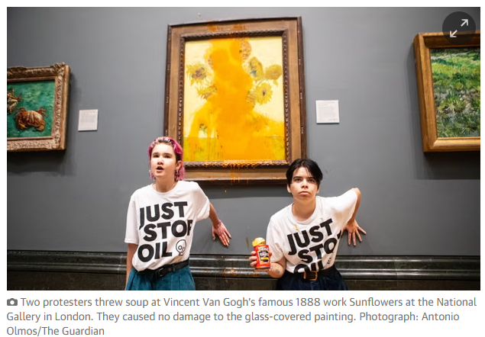
Interest Group Influence: Outsider Strategies
Why outsider strategies?
Courts
Grassroots Lobbying
Protest

Slide 8
Factors affecting success in influencing policy
Group resources
Group intensity
Group competition
Group goals
Status quo

Slide 9
