Slide 1
Political Science 310
American Public Policy
Professor Steven Greene

Slide 2
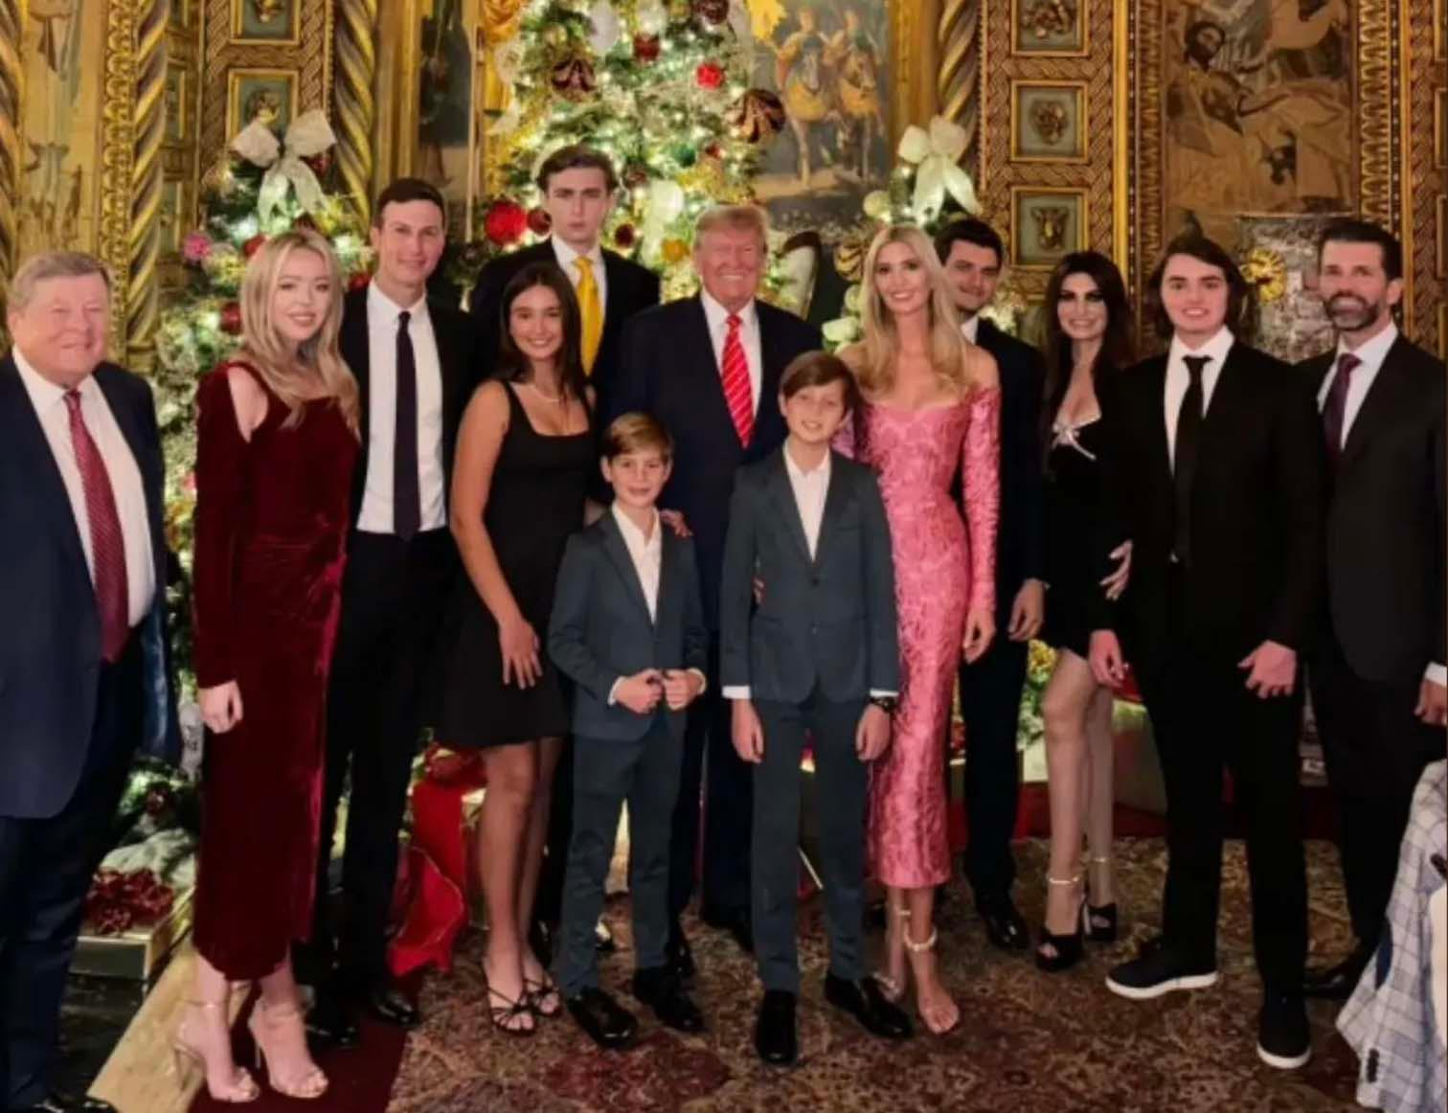

Slide 3
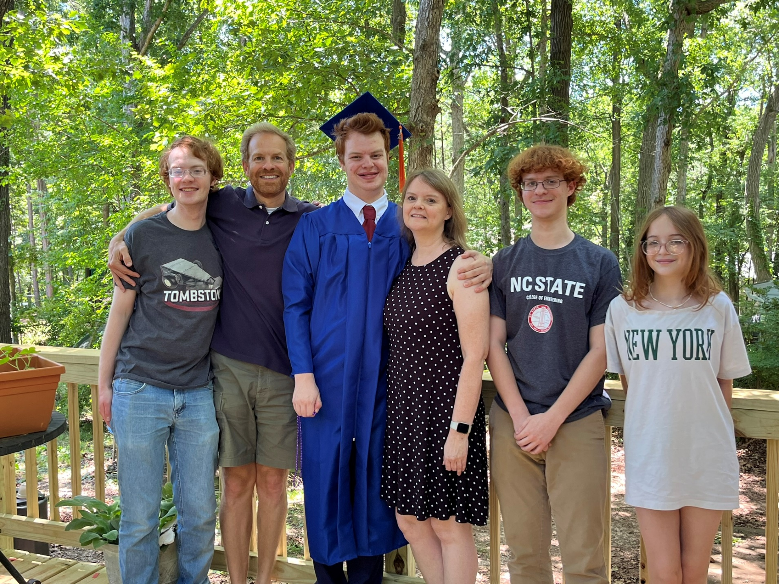

Slide 4
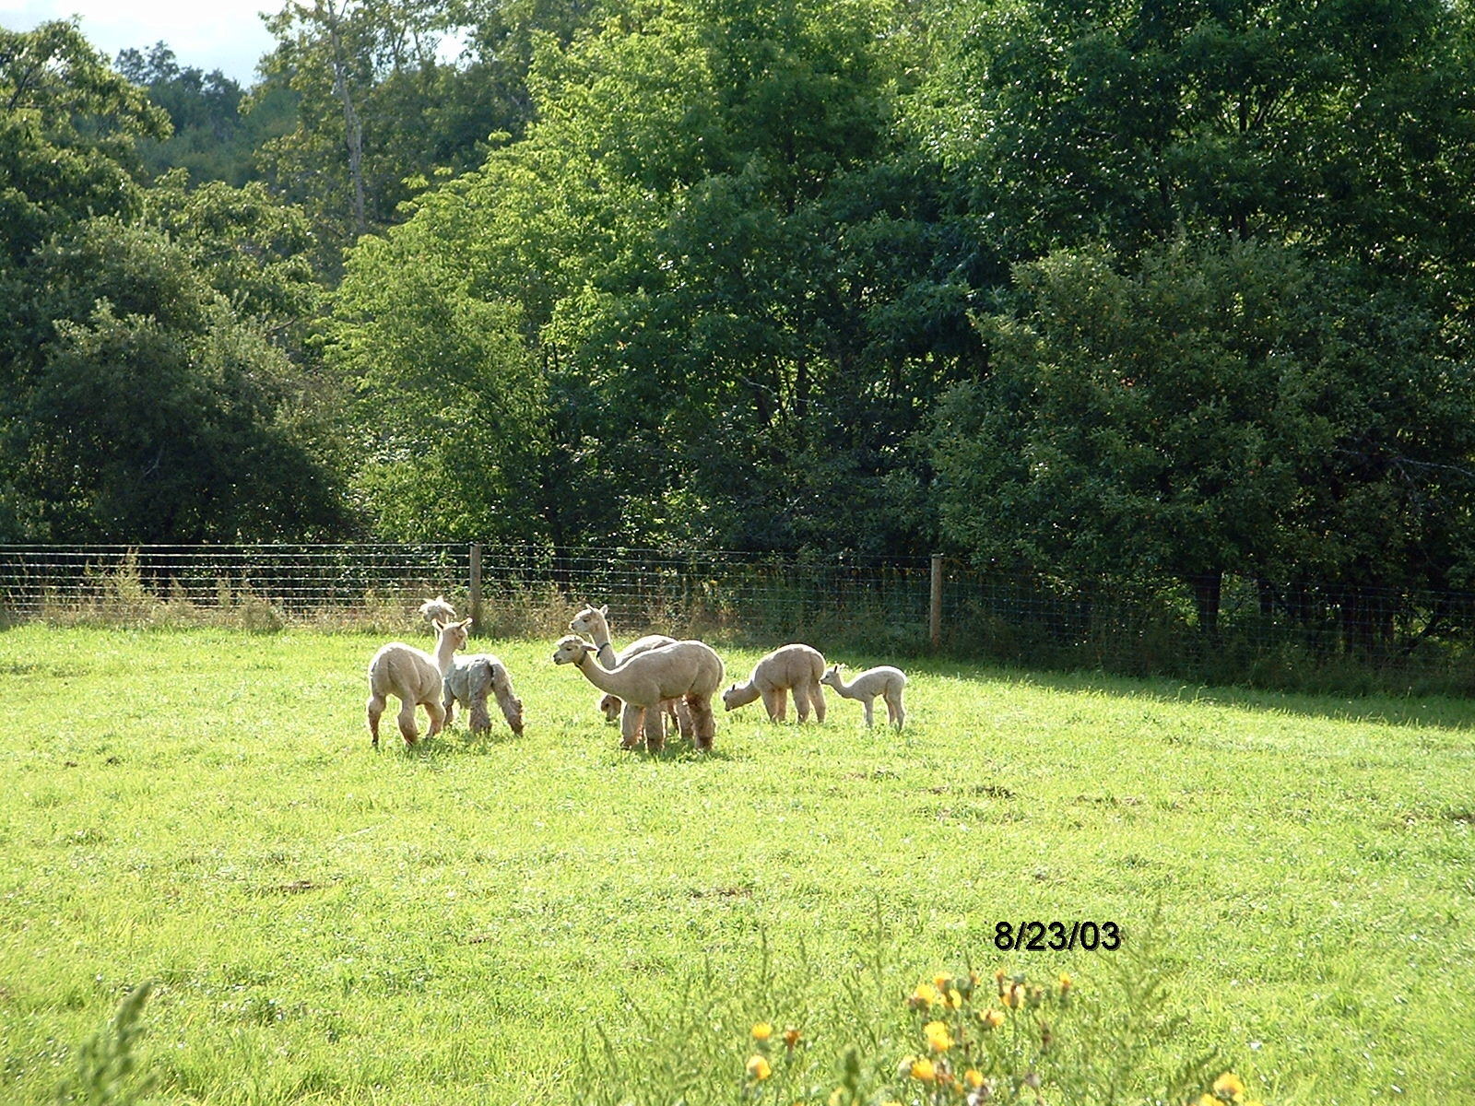

Slide 5
About You
Name
Year
Major
Hometown
Favorite Book

Slide 6
Important Syllabus Stuff
Office Hours
ATTENDANCE AND PARTICIPATION
Reading, Requirements, etc…

Slide 7
About the Video Classroom
No food or drink
Please try and be on time
Remember, you’re being recorded for posterity

Slide 8
General Course Policies
Show Up
Look alive
Cell phones/laptops, etc.
Read
  Be prepared for quick writes
ASK QUESTIONS
Be Wrong

Slide 9
Discussion policies
Civility
Charity
Humility

Slide 10
Political Science 310
American Public Policy
Professor Steven Greene

Slide 14
If you are taking the Distance Education version of this course
About current events
About participation
About tests and papers

Slide 15
Why Study Public Policy
It’s easier than Math
Class is taught at a good time
It actually is important stuff
  Such as?
Learning to think like a social scientist about public policy and political problems

Slide 16
Public Policy Quiz
TopHat

