Slide 1
Thinking like a political scientist about Campaigns and elections

Slide 2
Thinking about politics
Motivated reasoning
Identity protective cognition
The “double standard”
  Third person effect
Scout vs. Soldier mindset
Political science vs. political punditry
Partisanship and Ideology in PS 302

Slide 3
Thinking like a political scientist
Check your ideology at the door
Scrutinize facts equally
  Beware the pundit’s fallacy
Consider nature of evidence
Correlations does not equal causation
Formulate testable hypotheses
2026 Midterms edition

Slide 4
What political scientists know that you don’t
It’s the fundamentals, (stupid)
Independents and “swing voters” really aren’t all that
The “Will of the people” is neither will nor people. Or something.
  Weak attitudes, lack of ideology, contradictory attitudes, top-down influence
Parties and conflict are inevitable
The grass does not grow on its own
All interests are special, therefore none are
We don’t know what you think we do

Slide 5
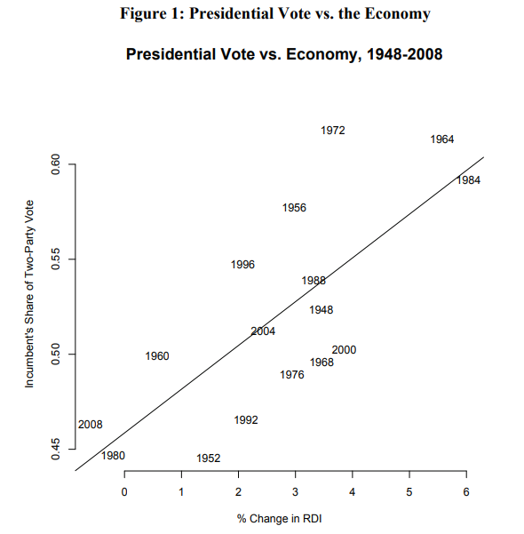

Slide 6
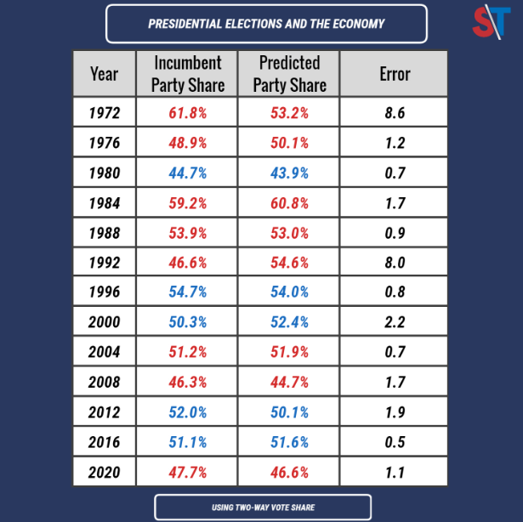

Slide 7
