Slide 1
Myths and Realities of American Public Policy

Slide 2
Policy Costs and Benefits
Costs
Benefits
Distribution

Slide 3
Policy Assessment
Costs and Benefits
Effectiveness
Efficiency
Equity
Political feasibility
Technical feasibility

Slide 4
Myths of Economic Policy
Cutting taxes increases government revenue
Half of Americans don’t pay taxes
Tariffs are mostly paid by foreign countries
We can significantly cut the budget deficit by reducing fraud and waste
We can significantly cut the budget deficit by reducing foreign aid

Slide 5
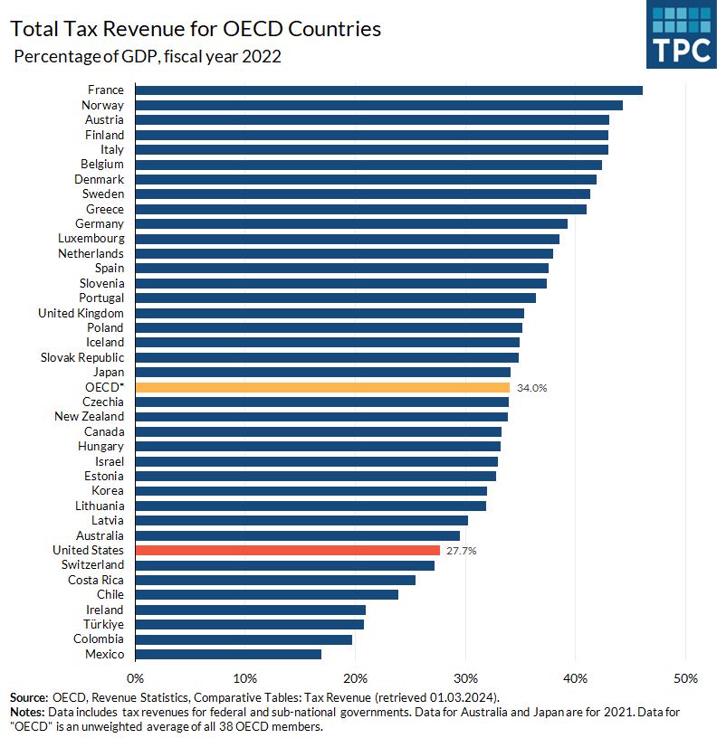

Slide 6
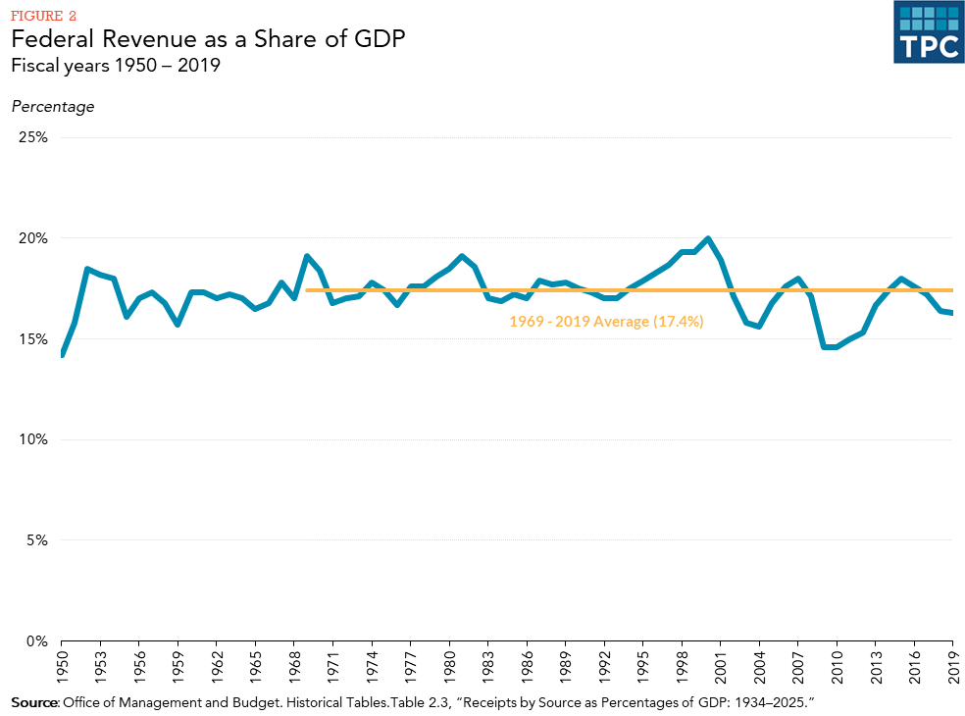

Slide 7
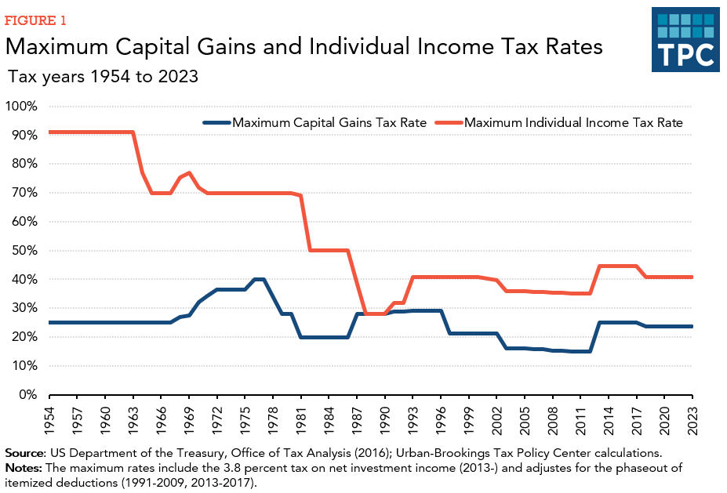

Slide 8
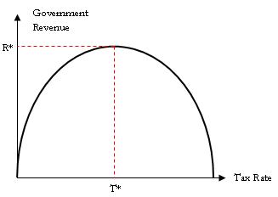

Slide 9
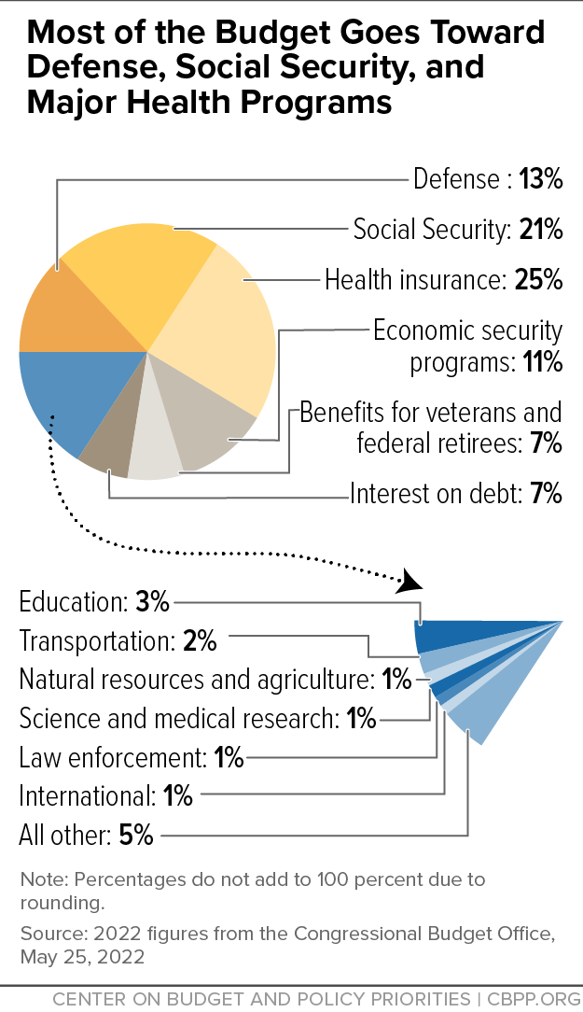

Slide 10
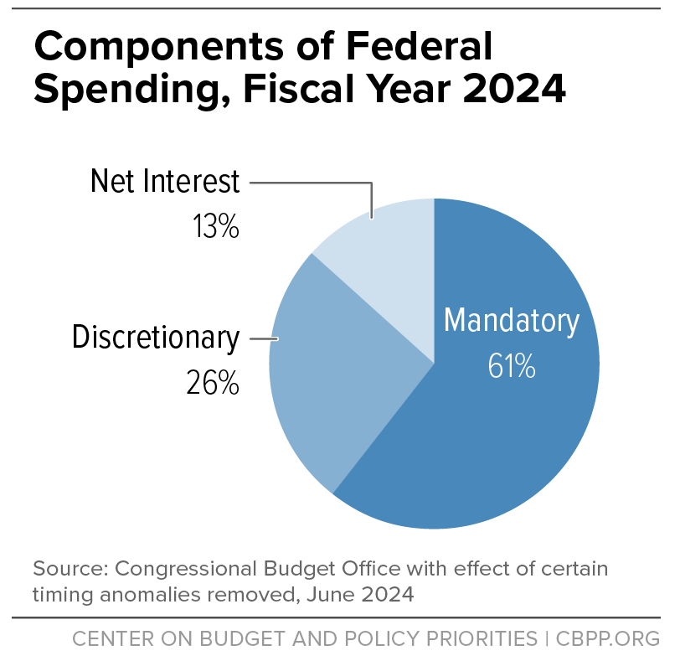
This is the whole fight!

Slide 11
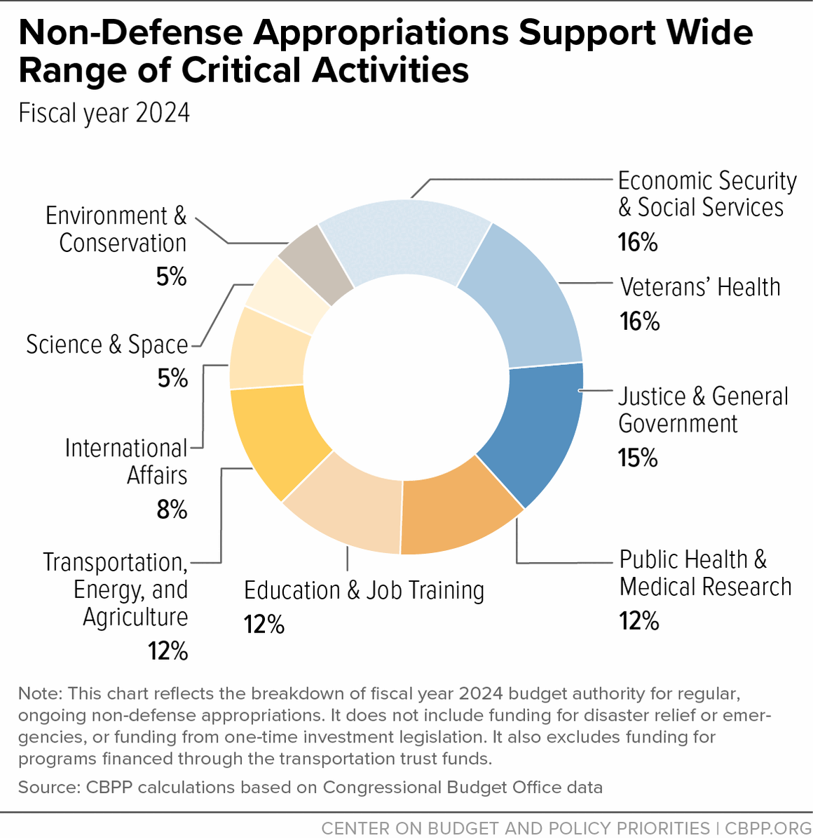

Slide 12
Myths of Health Care Policy
The U.S. has the best health care in the world
Universal care is too expensive
Universal coverage means socialized medicine
Free Luigi! (insurance companies are the problem)
Medicare for All will solve all of our problems

Slide 13
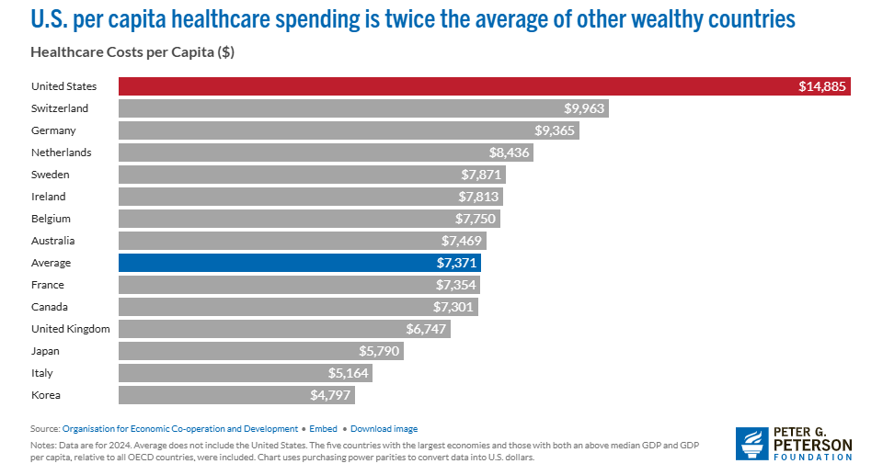

Slide 14
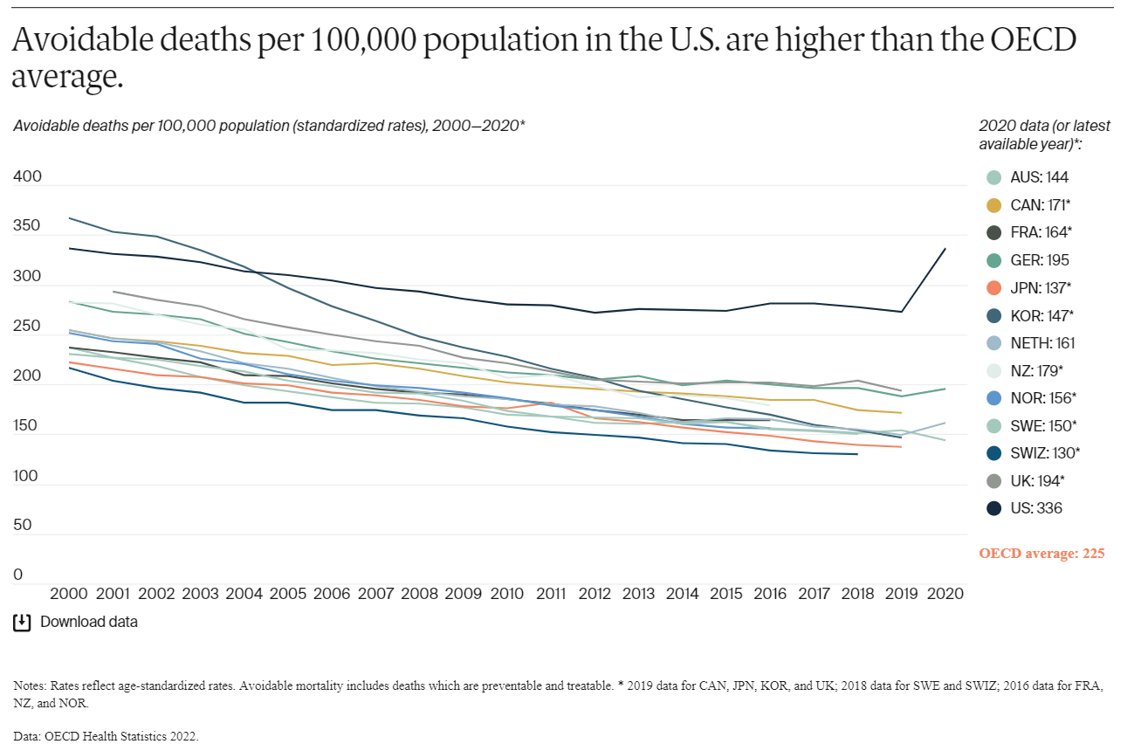

Slide 15
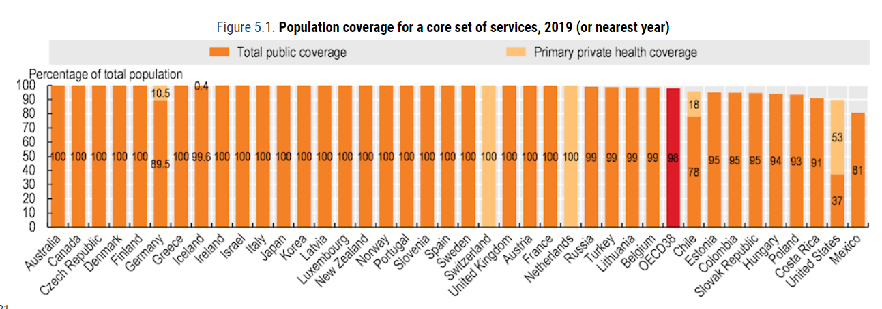

Slide 16
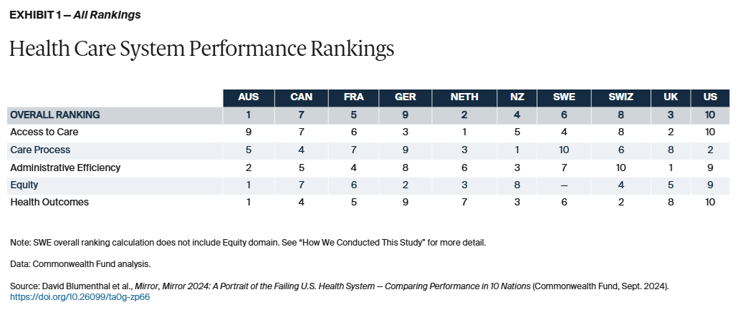

Slide 17
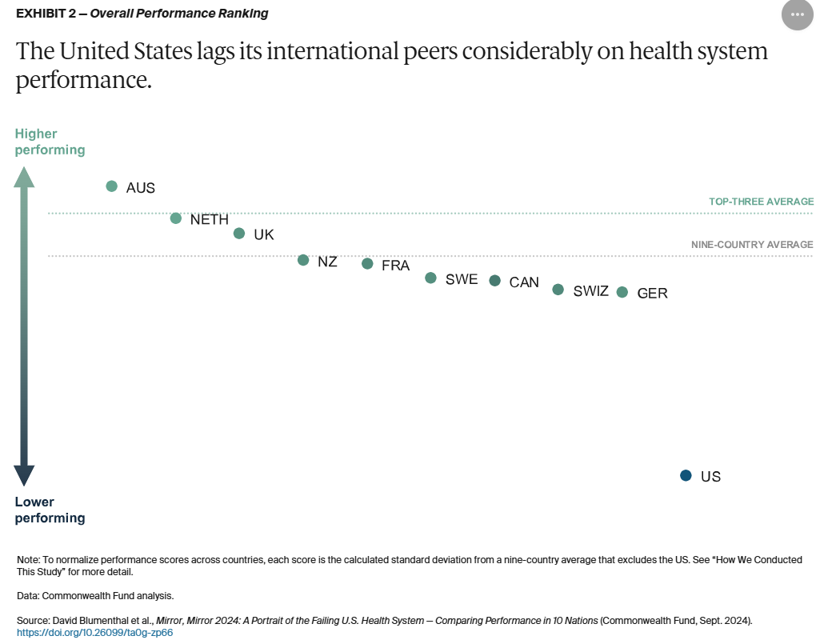

Slide 18
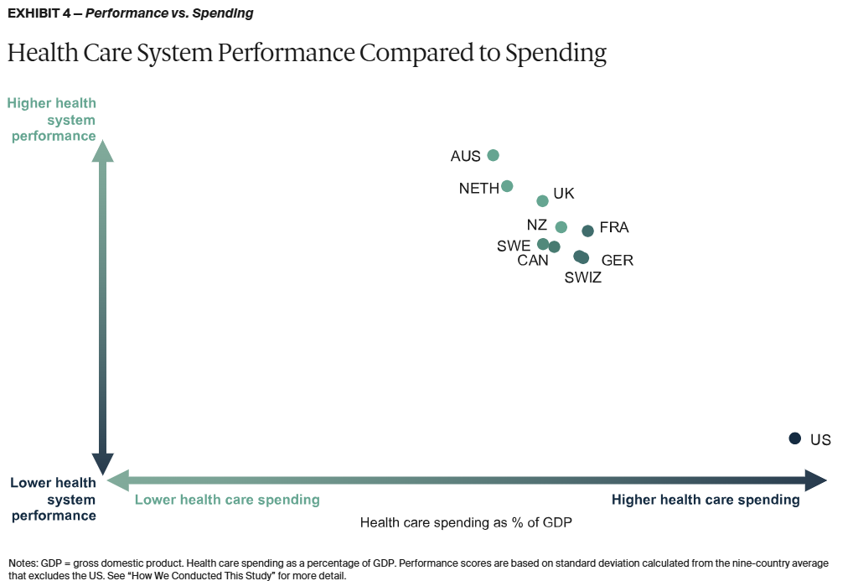

Slide 19
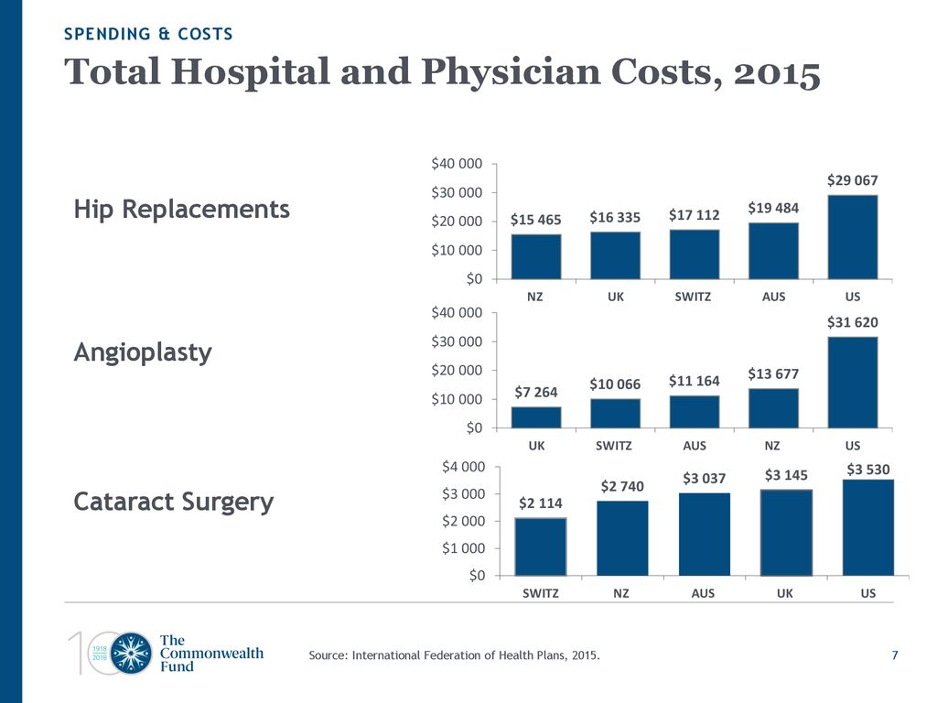

Slide 20
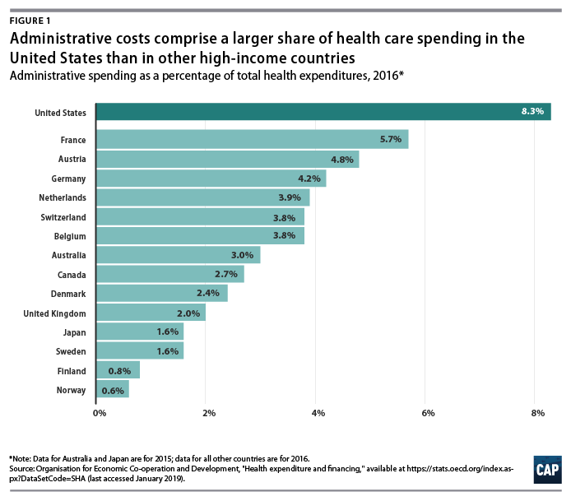

Slide 21
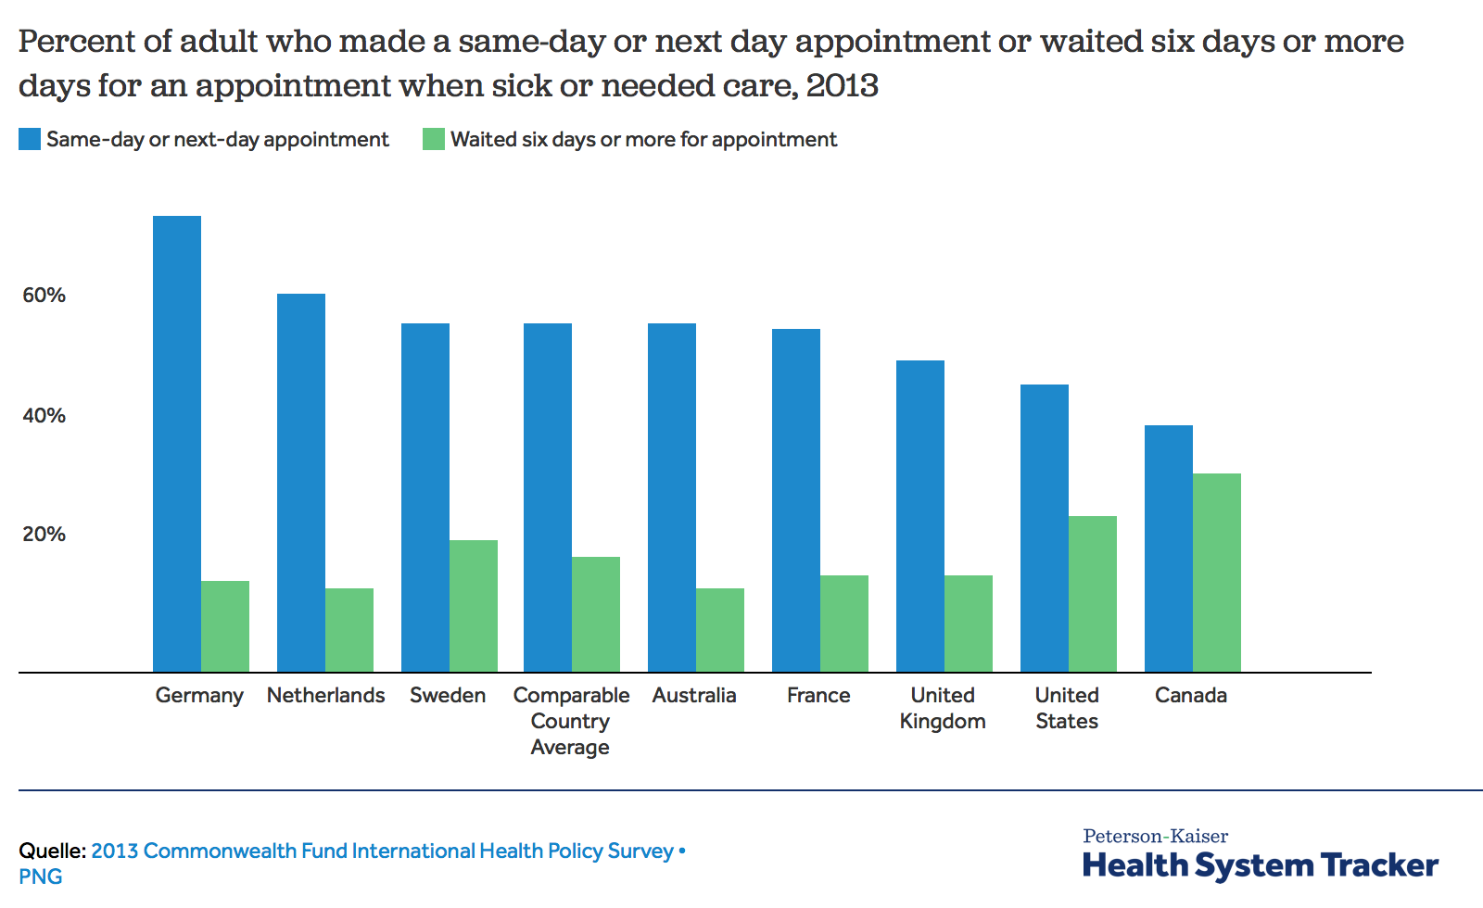
And you still have to wait!

Slide 22
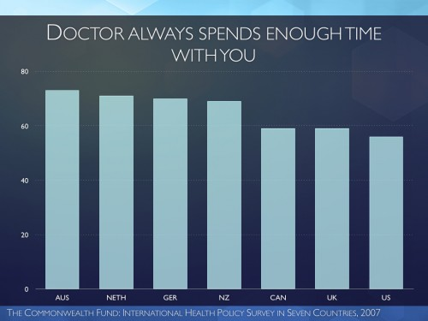

Slide 23
Myths of Criminal Justice Policy
“Tough on crime” keeps us safer
We can solve our mass incarceration problem by cutting penalties on non-violent drug offenders
Defunding the policy will work/Police misconduct is not a real problem
Gun control can't work in America because of the Second Amendment / More guns = more safety
  America has a violent crime problem and mental health problem, not a gun problem

Slide 24
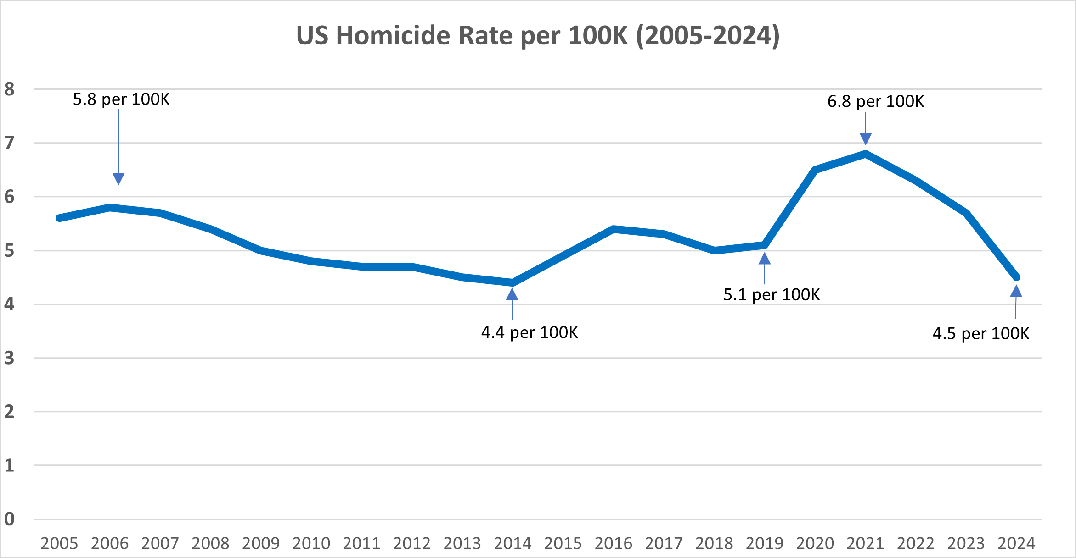
Covid homicide surge

Slide 25
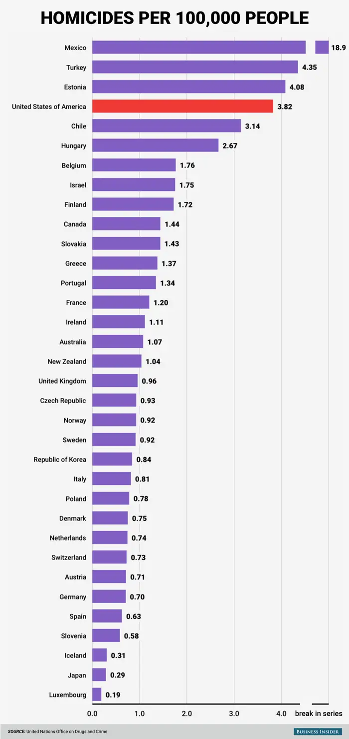
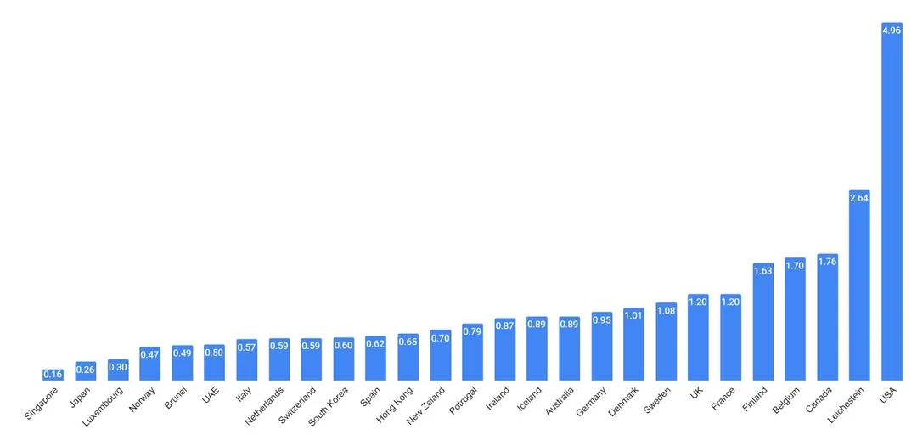

Slide 26
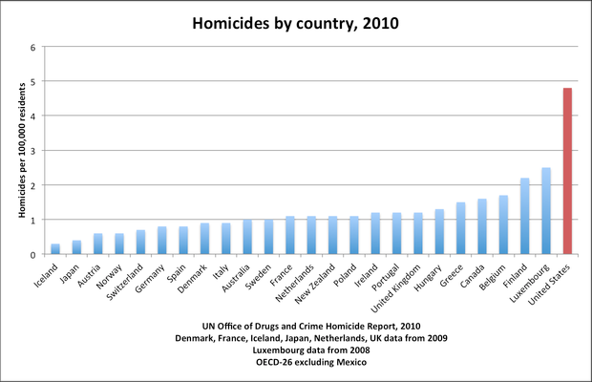
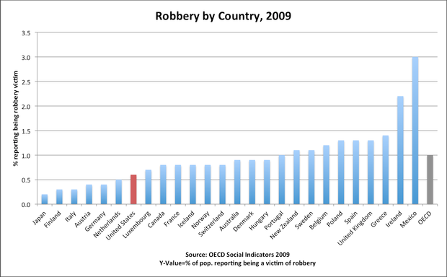
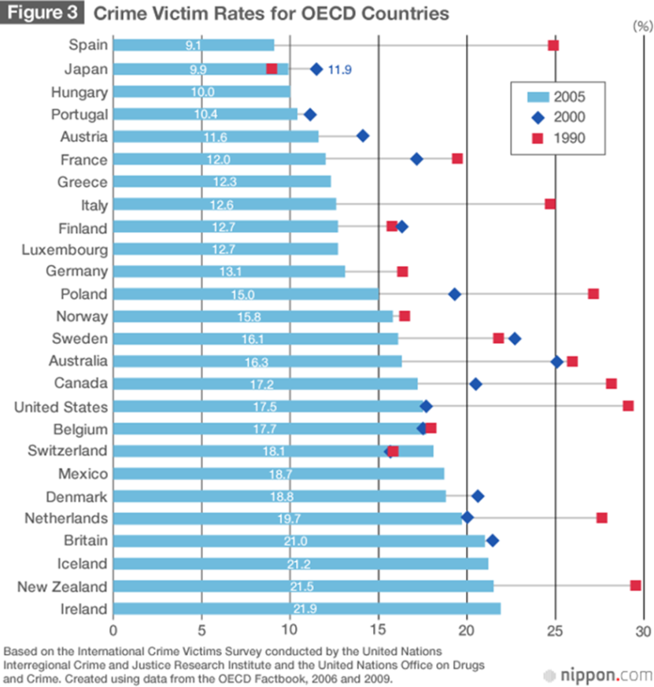
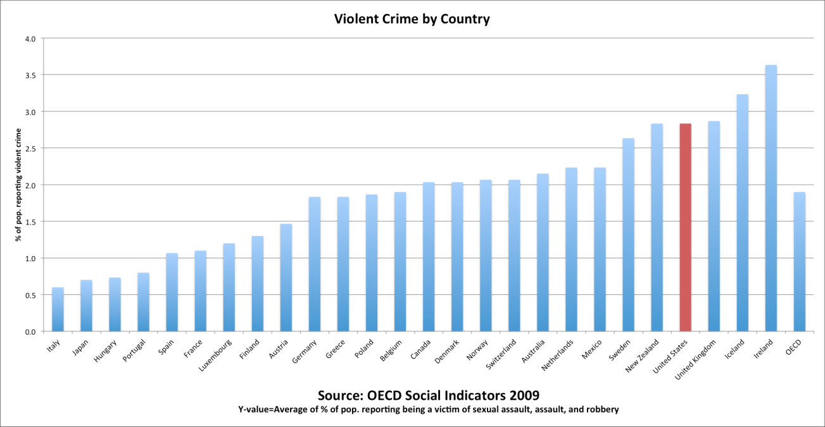

Slide 27
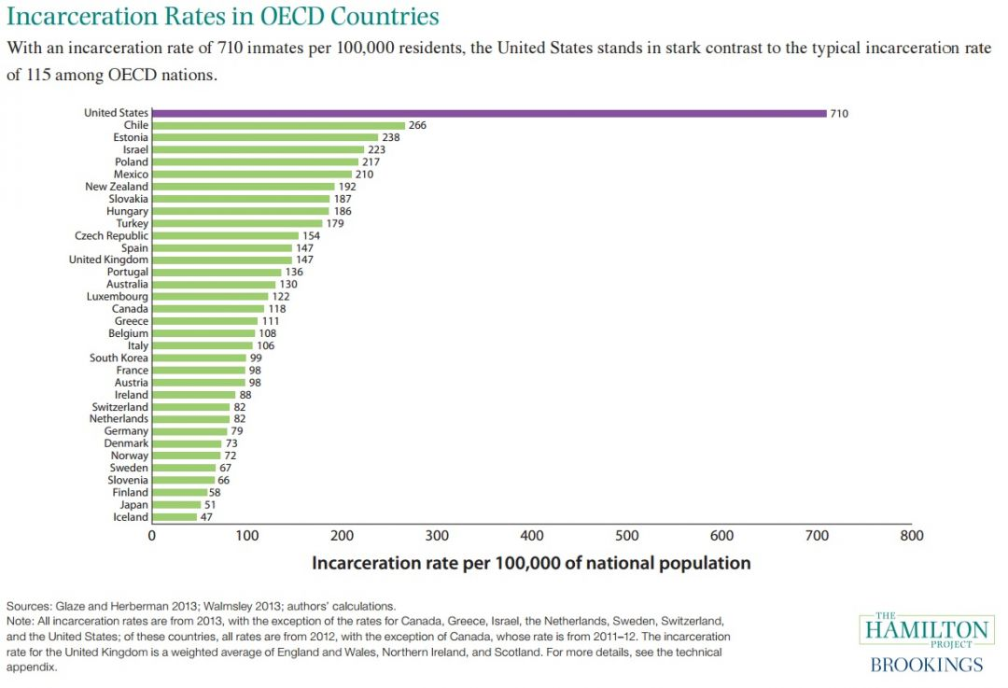

Slide 28
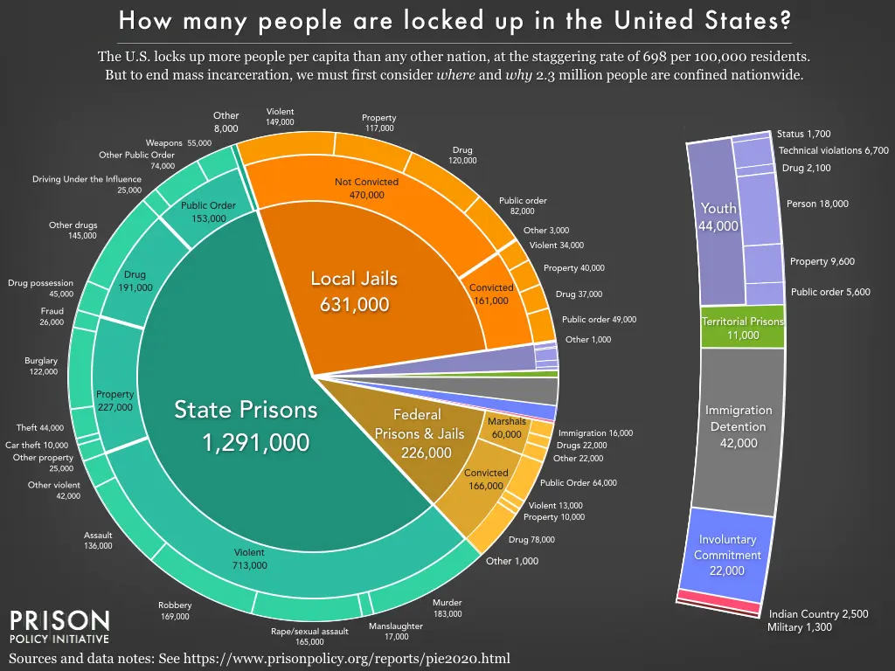

Slide 29
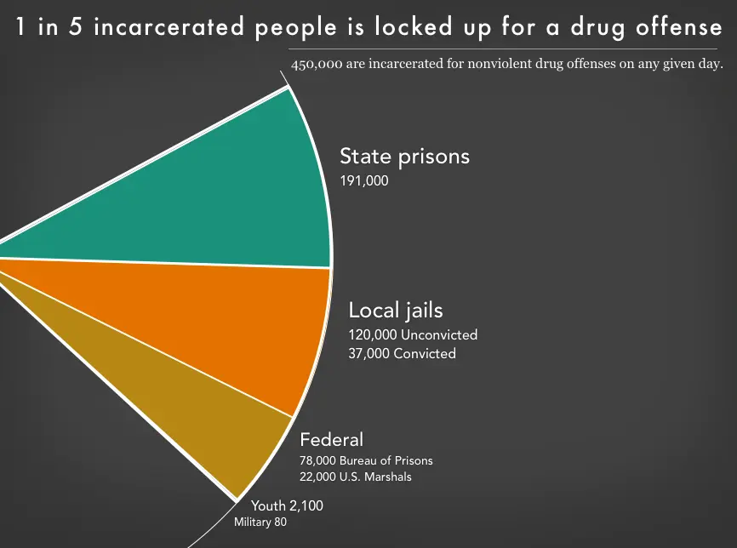

Slide 30
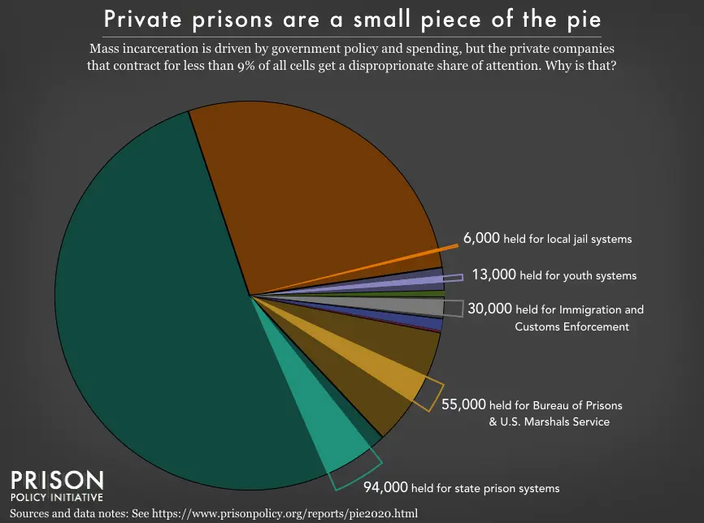

Slide 31
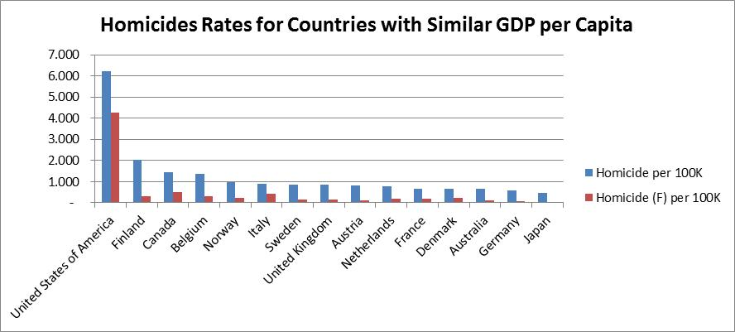
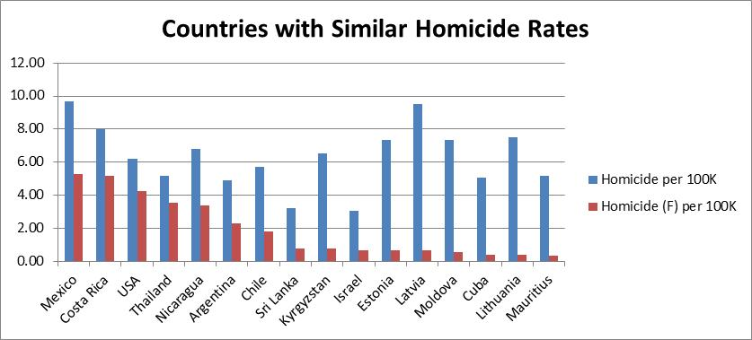
2006 WHO data

Slide 32
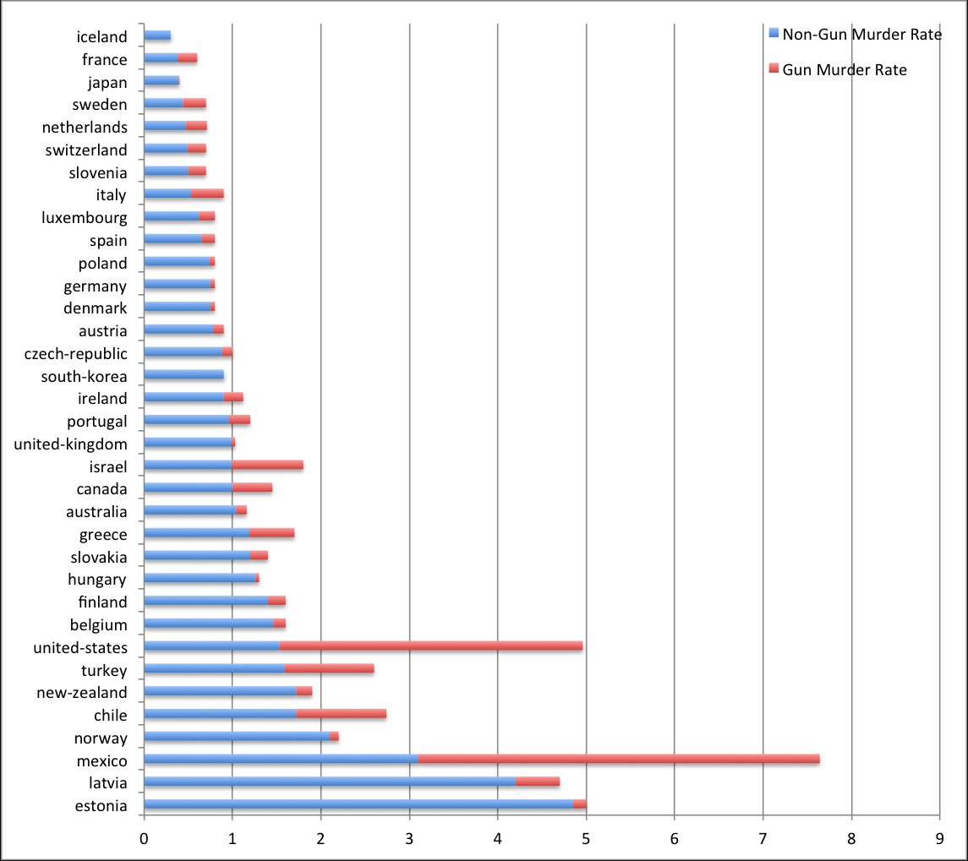

Slide 33
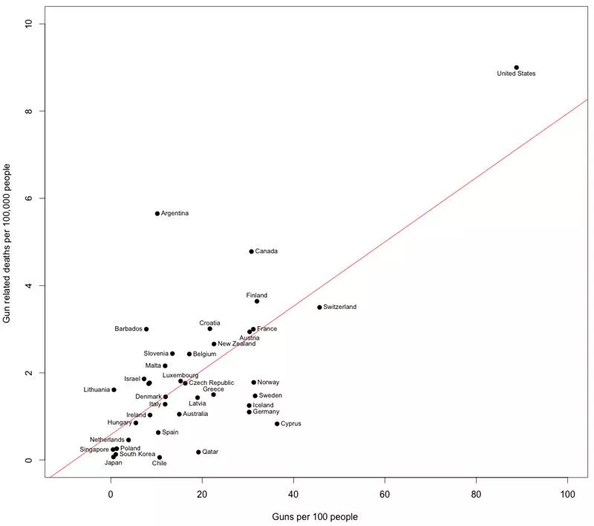

Slide 35
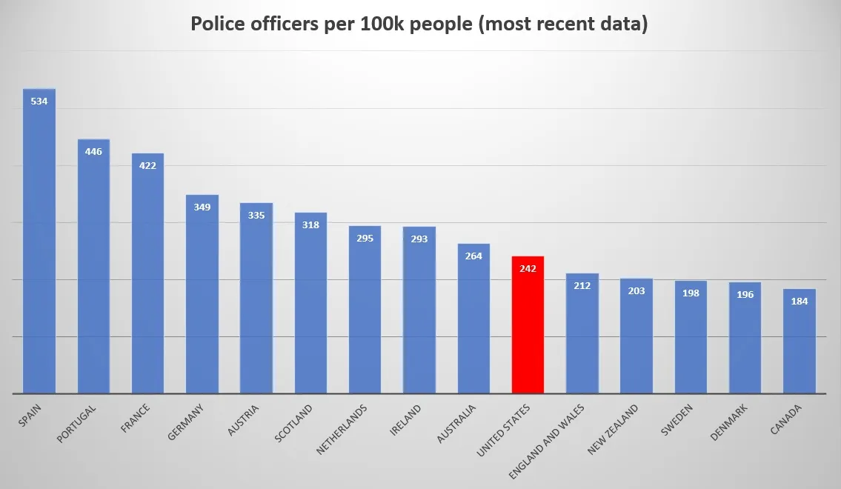

Slide 36
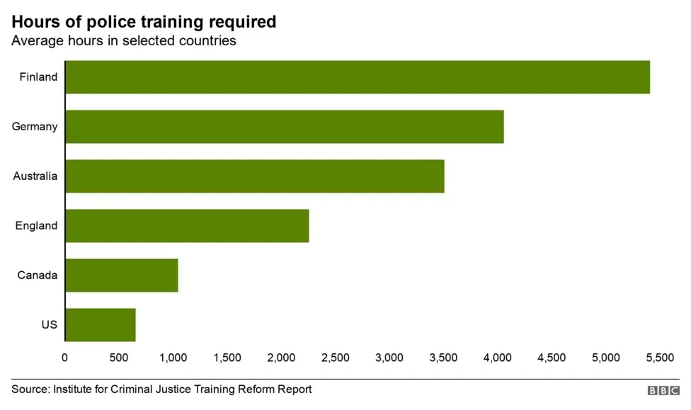

Slide 37
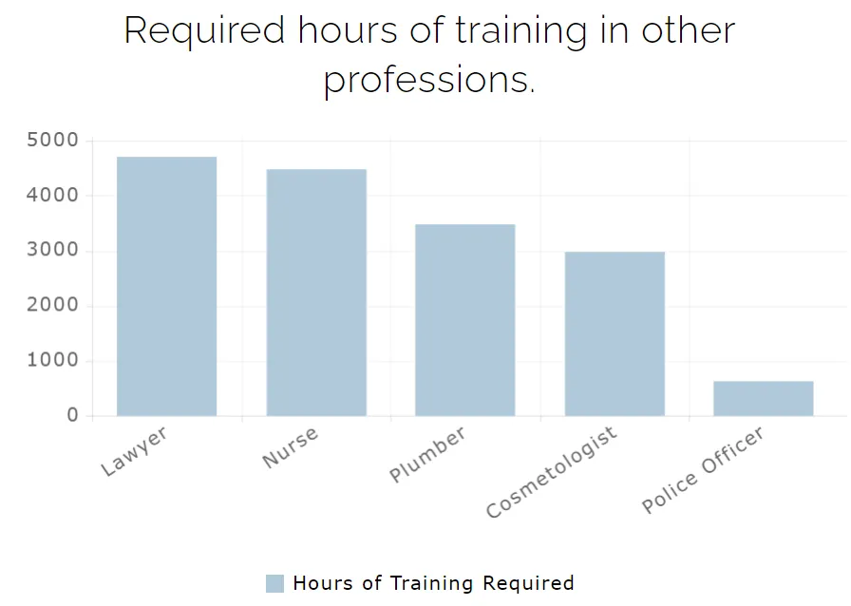

Slide 38
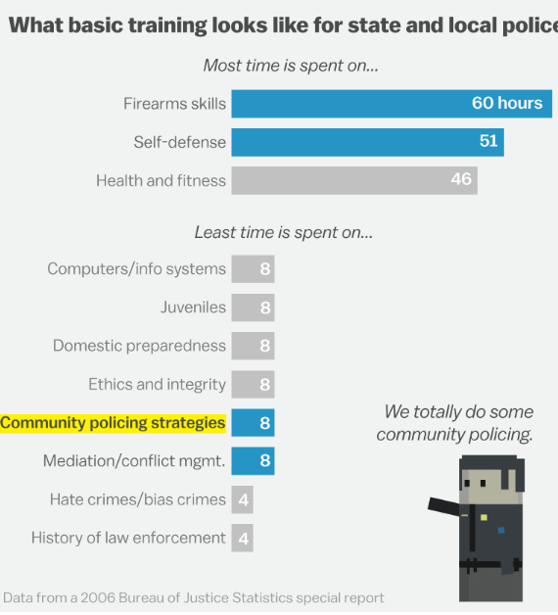

Slide 39
Myths of immigration policy
Immigration hurts the economy and takes away jobs from Americans
Illegal immigrants do not pay taxes
Current immigrants are not assimilating as well as previous generations of immigrants
  Immigrants are more likely to commit crimes
Americans, especially Republicans, have become more anti-immigration

Slide 40
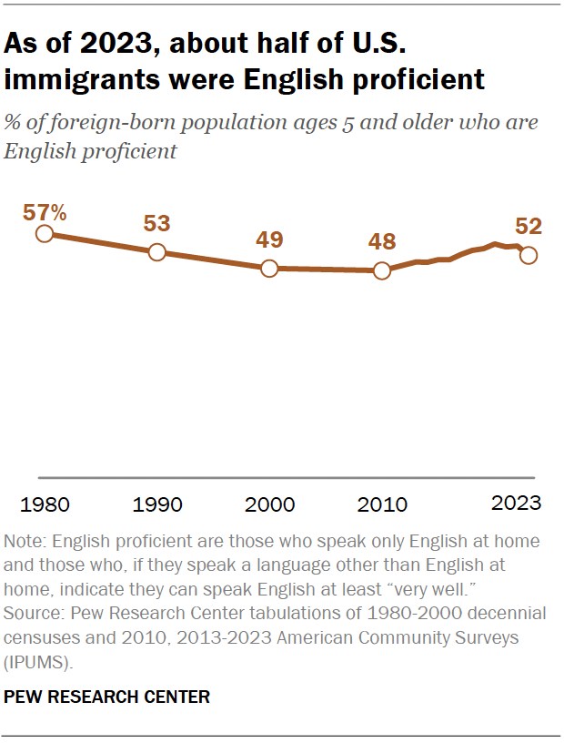

Slide 41
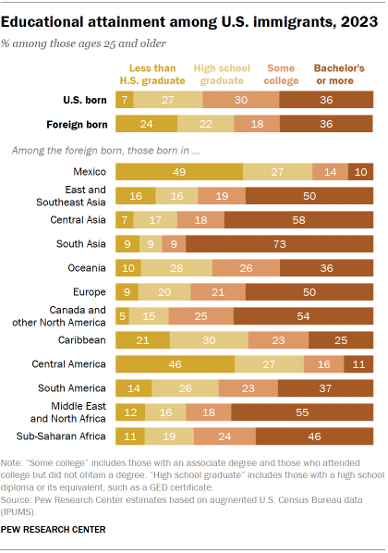

Slide 42
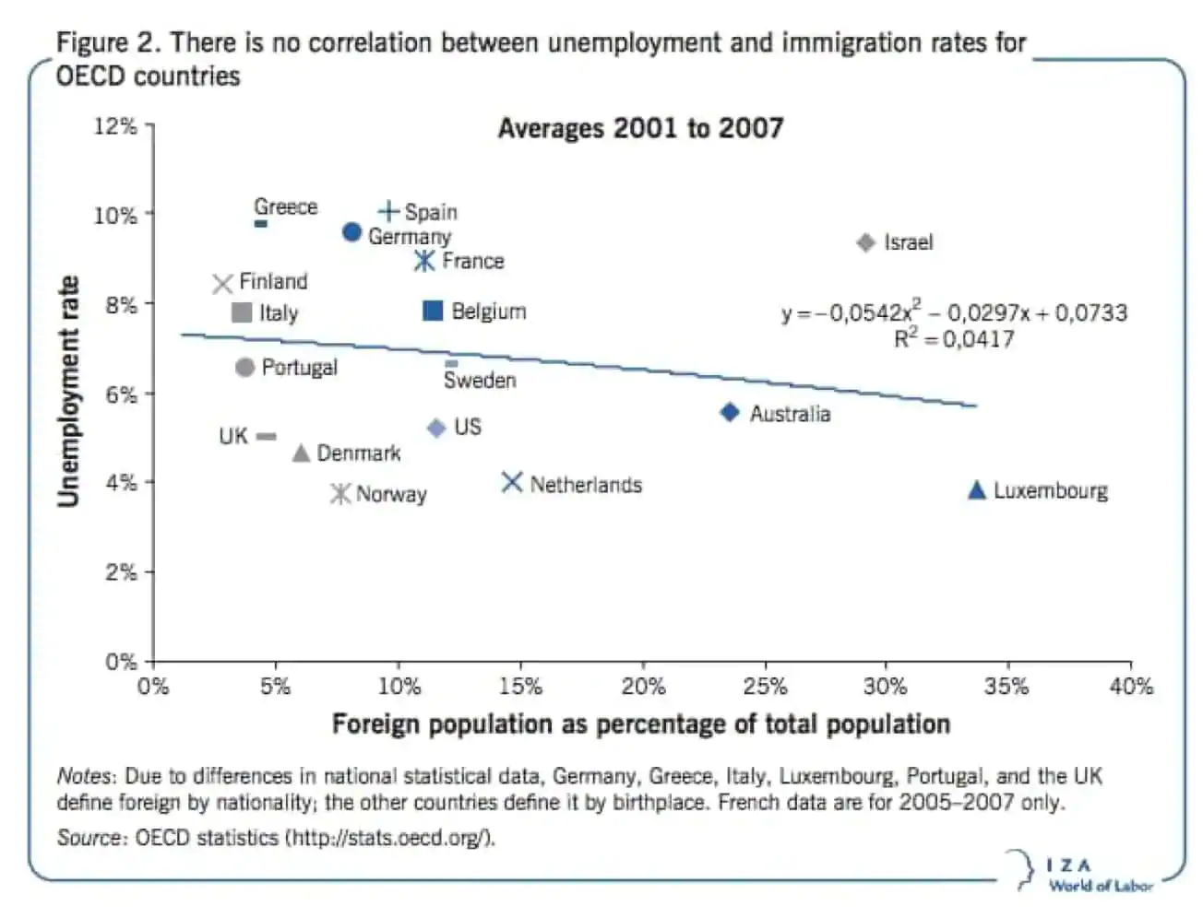

Slide 43
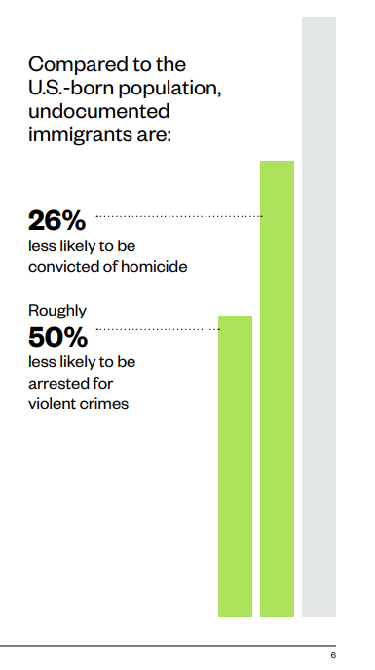

Slide 44
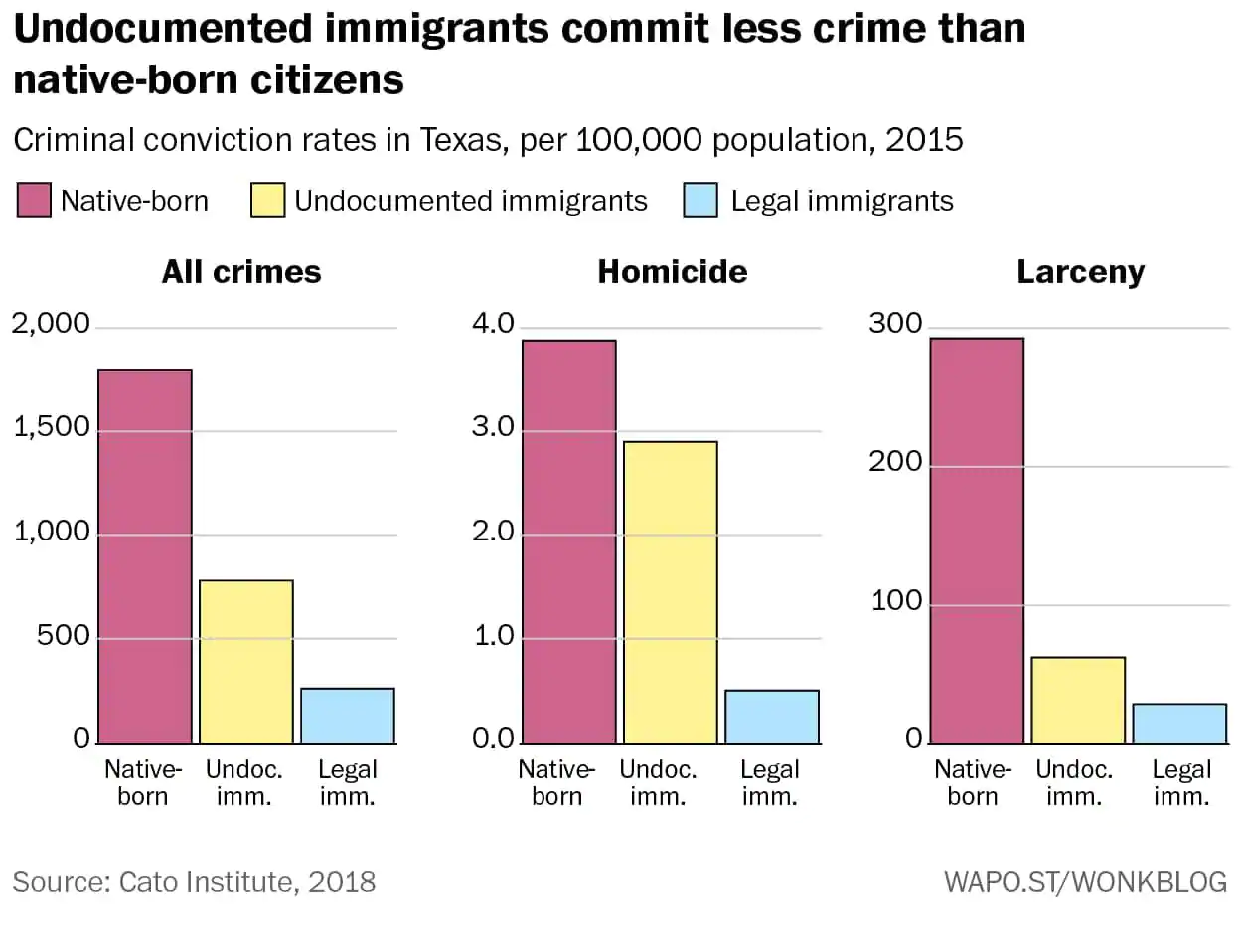

Slide 45
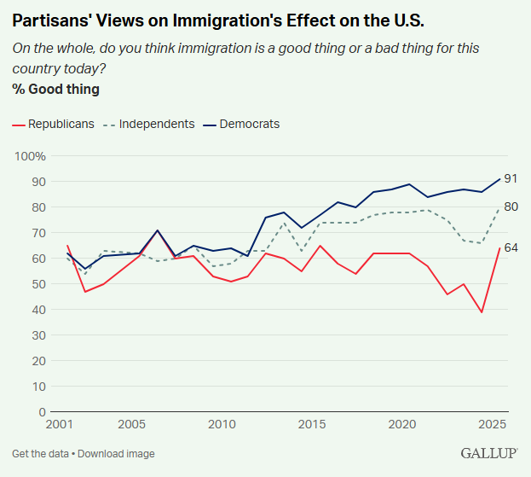

Slide 46
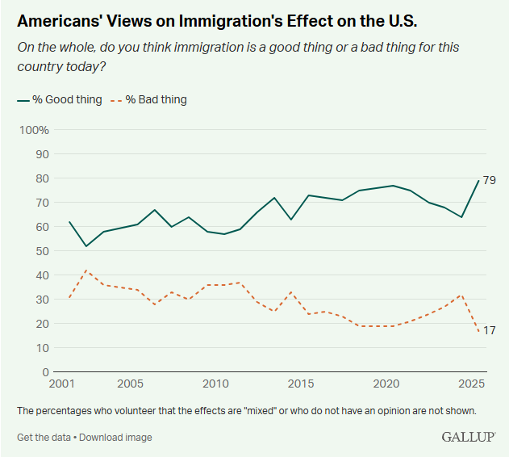

Slide 47
Abortion Policy myths
Americans are extremely polarized on abortion
There are no trade-offs for women’s life/health with abortion bans

Slide 48
Miscellaneous Policy Myths
Your social security taxes (FICA) will pay your social security

Slide 49
Final takeaways
This matters!

