Slide 1
Civil Liberties & Civil Rights

Slide 2
Introduction
Bill of Rights
Civil Liberties
Civil Rights
Role of the Courts
Nationalization of the Bill of Rights
14th amendment

Slide 3
1st Amendment: Freedom of Speech
Absolutely protected speech
Symbolic speech
Libel and Slander
Hate Speech
Free speech on campus
Obscenity and Pornography

Slide 4
1st Amendment: Religion
Separation between church and state
Prayer in public schools (Engel v. Vitale)
Public displays of religion
Free exercise of religion
Employment Division v. Smith
The Supreme Court and expanding free exercise

Slide 5
Rights of the Accused
Double jeopardy
Right to counsel
Self-incrimination
Unreasonable search and seizure
Exclusionary rule
Cruel and unusual punishment

Slide 6
Polarizing Constitutional Rights
Privacy (Griswold v. Connecticut)
Abortion
Roe v. Wade, Casey, Dobbs
2nd Amendment

Slide 7
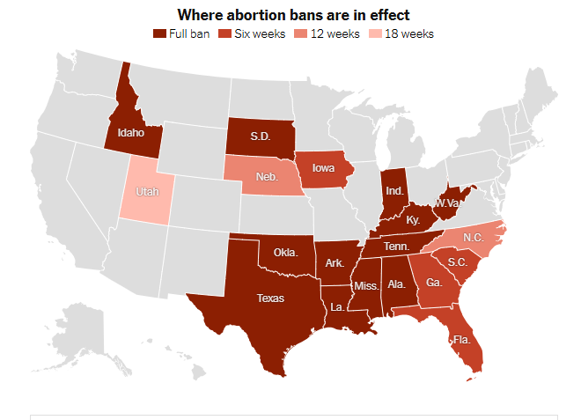

Slide 8
Civil Rights: Race
School segregation
Brown v. Board of Education
Resistance to Brown decision
Civil Rights movement
Civil Rights Act of 1964
Civil Rights in the era of BLM and George Floyd

Slide 9
Affirmative Action
Value conflict
Affirmative action in employment
Affirmative Action in Higher Education
Students for Fair Admissions vs Harvard

Slide 10
Civil Rights: Women
Equal protection
Modern Women’s movement
Women’s Rights in the Workplace
Title VII of Civil Rights Act
Earnings Gap
Equal Rights Amendment (ERA)
14th Amendment reconsidered

Slide 11
Civil Rights and LGBTQ
Gay marriage and federalism
Homosexuality and the 14th amendment: Lawrence v. Texas
Supreme Court and same-sex marriage: Windsor and Obergefell
Bostock

Slide 12
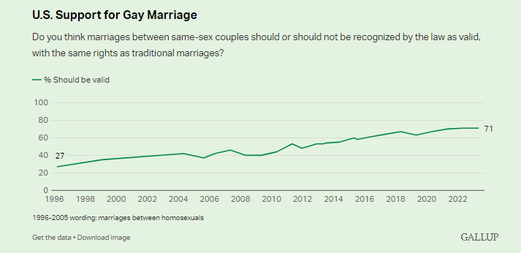
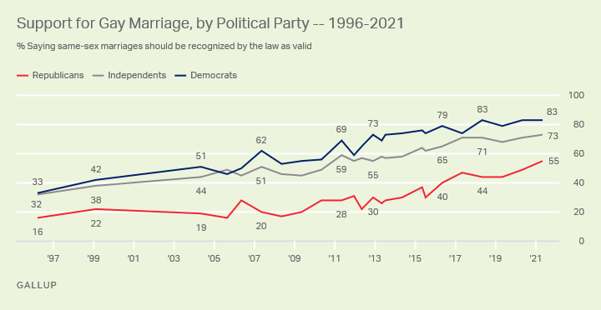
Changing public opinion ➔ changing policy

Slide 13
Concluding thoughts

Slide 14


