Slide 1
Bureaucracy

Slide 2
Introduction
Image of the bureaucracy
What is a bureaucracy

Slide 3
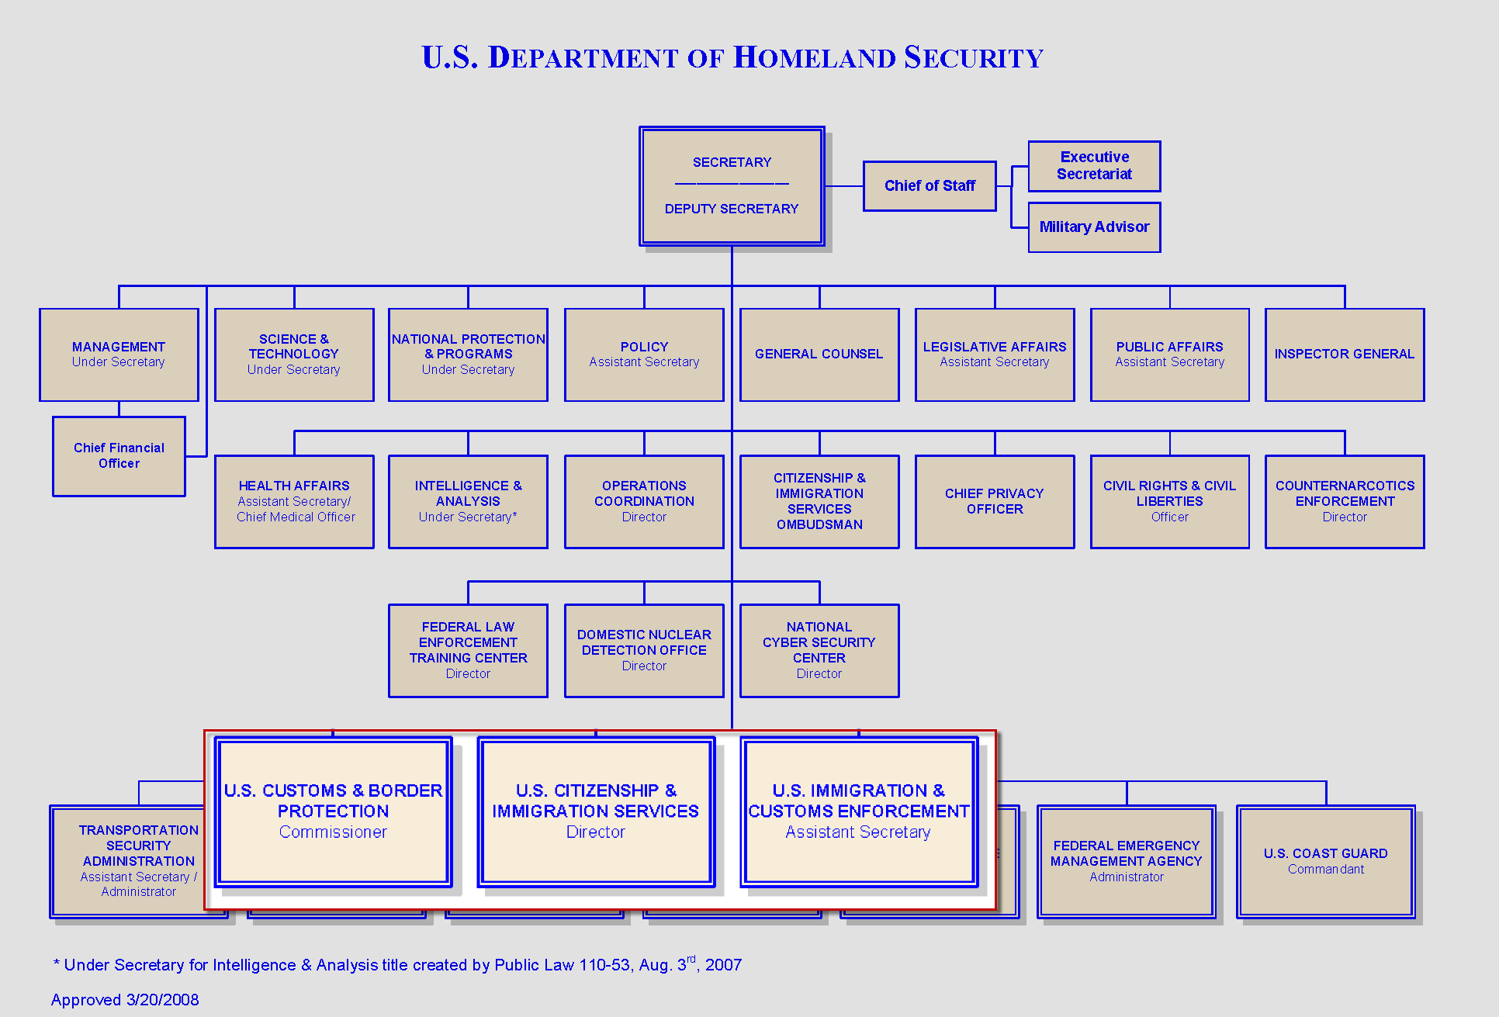

Slide 4
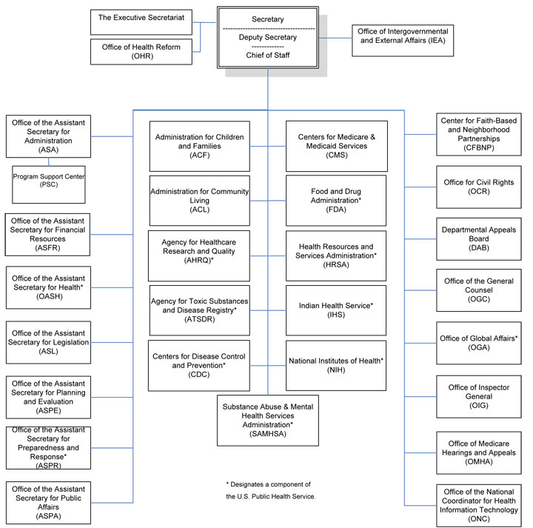

Slide 5
Key Features of US Bureaucracy
Merit system
Neutral Competence
New Deal
Growth of the bureaucracy

Slide 6
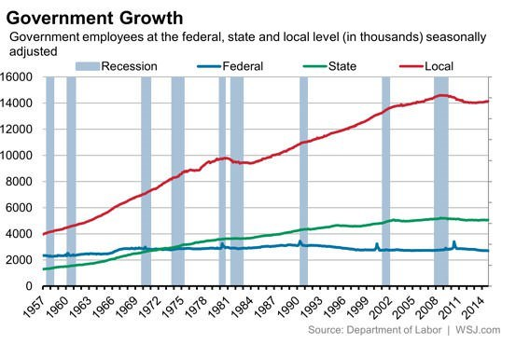

Slide 7
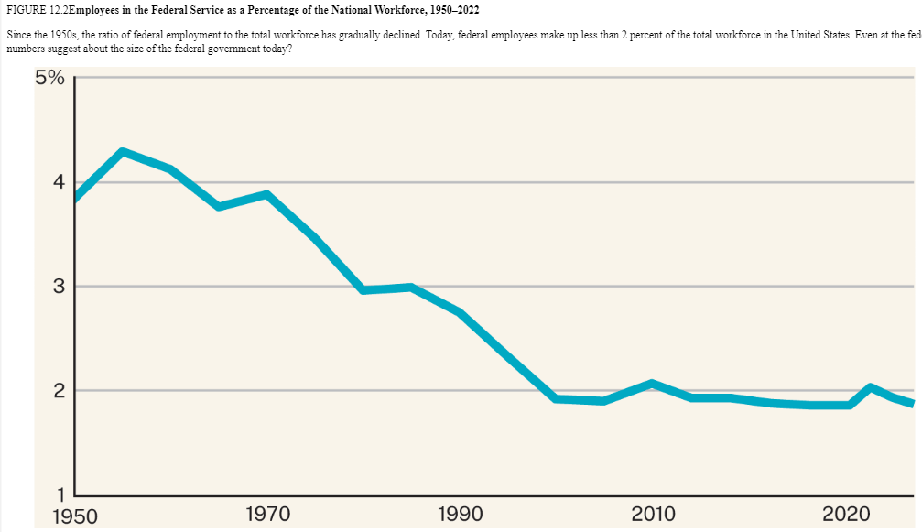

Slide 8
Bureaucratic policy-making
Making policy
Regulations
Iron Triangles
Regulatory capture
Issue Networks

Slide 9
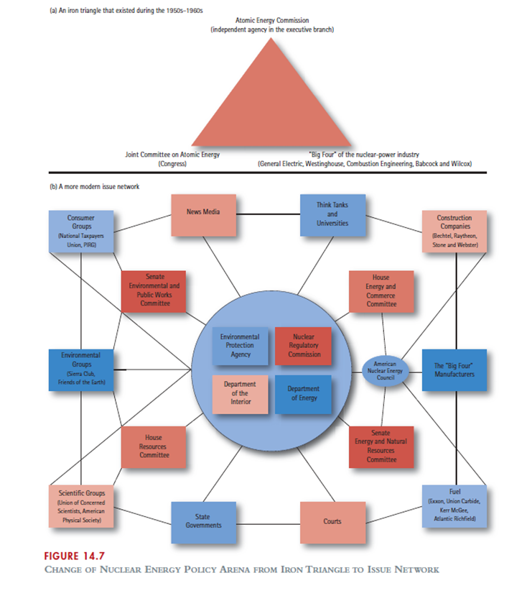

Slide 10
What’s wrong with bureaucracy
Excessive accountability / red tape
“Run-Away” bureaucracies
Impossibility of tasks
Trump and the modern bureaucracy
So, what’s the answer?

