Slide 1
Judiciary

Slide 2
Introduction
Independence of judicial branch
Complexity of judicial branch
Judicial Review
Courts are political

Slide 3
Structure of Court System
State vs. Federal Courts
Article III
Judiciary Act
Jurisdiction
U.S. District Courts
Courts of Appeals (Circuit Courts)
Supreme Court

Slide 4
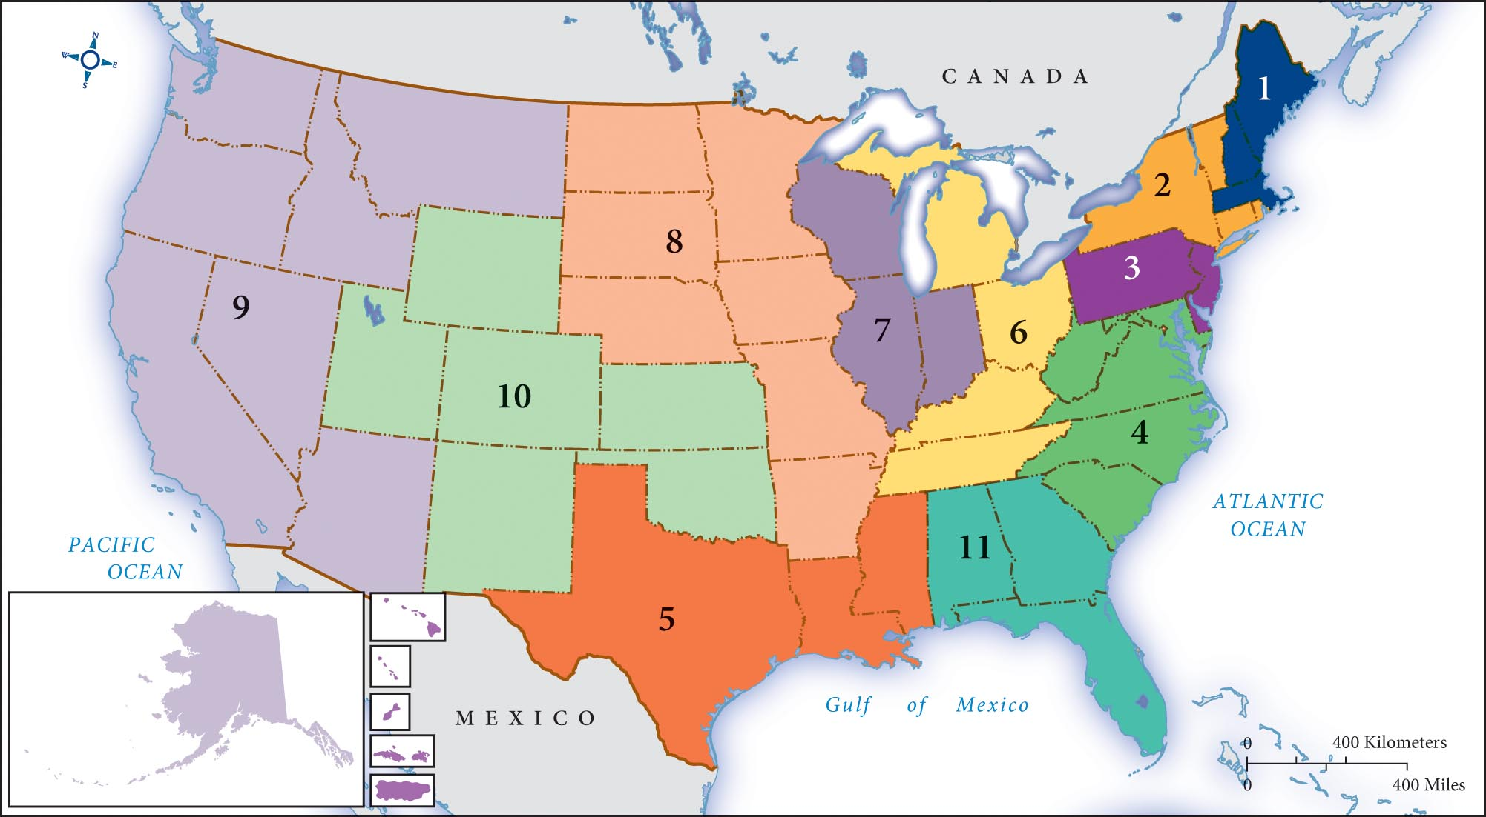
A Map of the Federal Circuit Courts

Slide 5
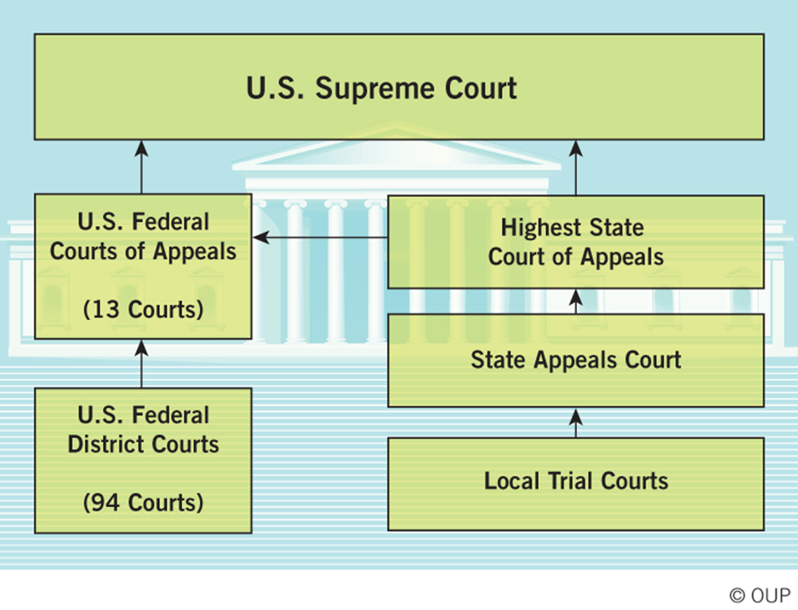

Slide 6
Appointing Judges and Justices
Changing politics of federal judicial appointments
Supreme Court appointments
Merit
Ideology
Politicization of modern nomination process

Slide 7
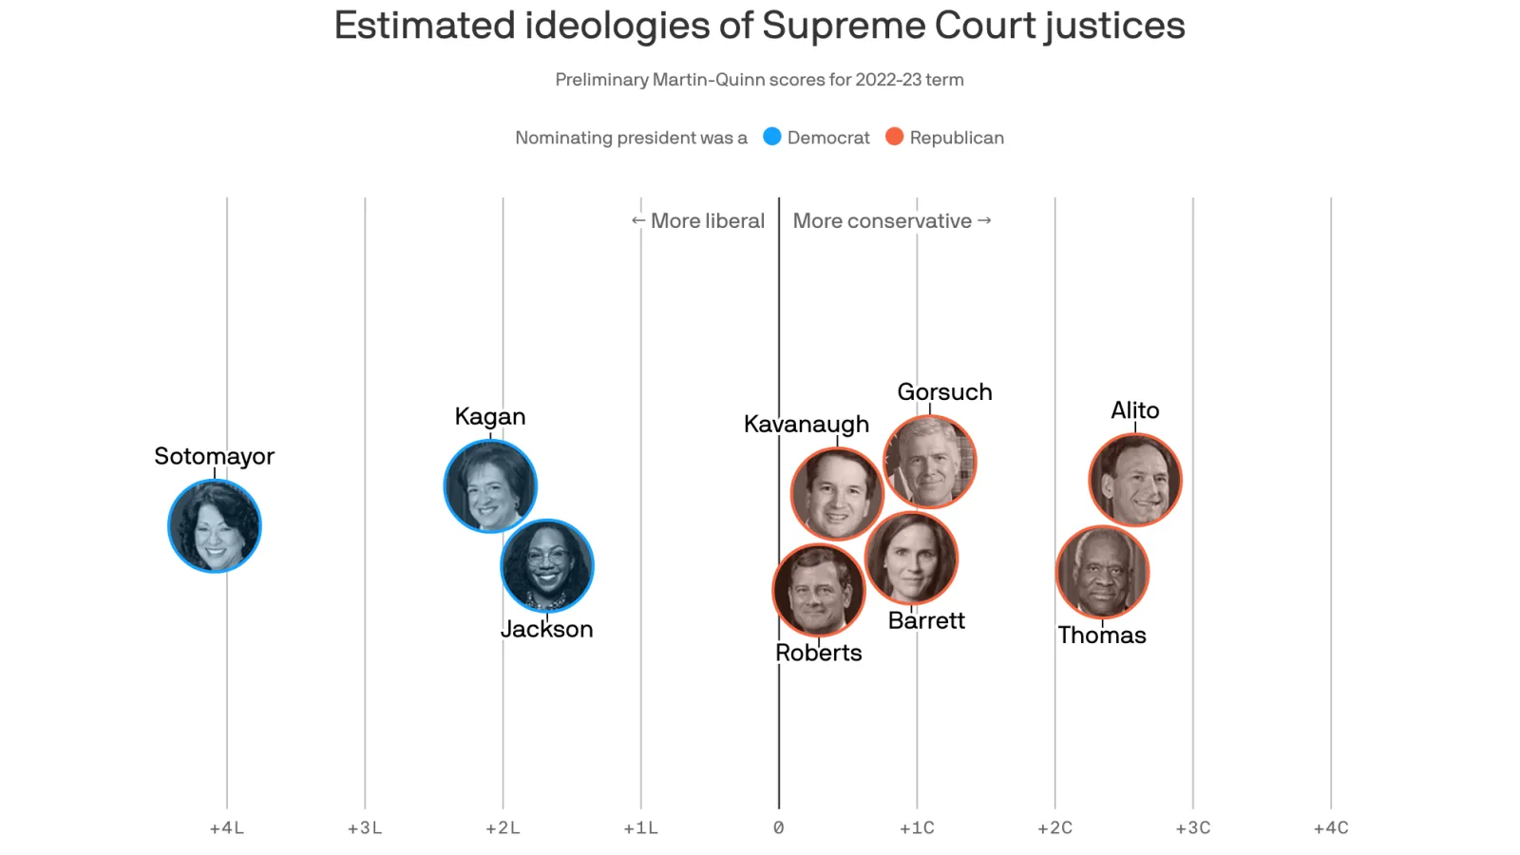

Slide 8
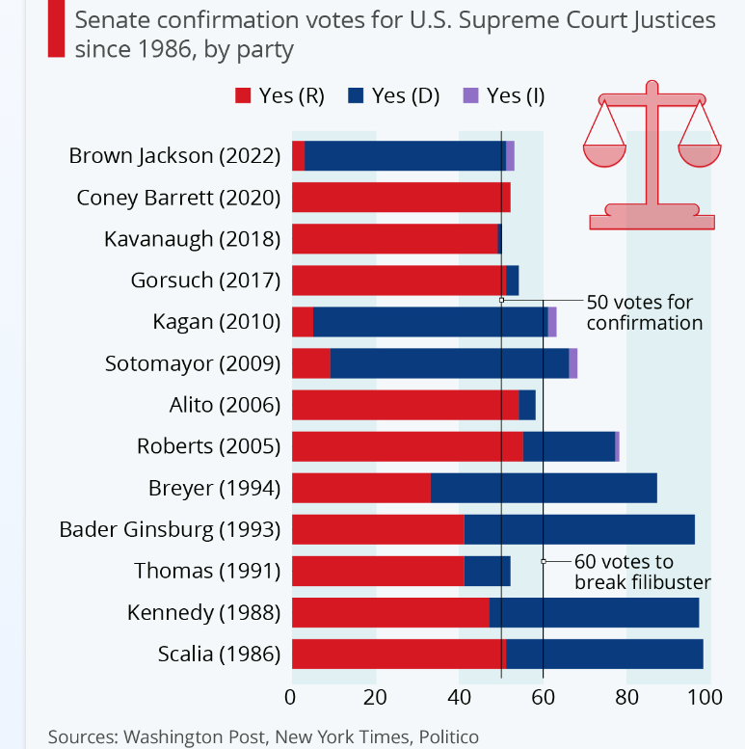
Politicization of SC Nominations

Slide 9
Supreme Court Cases
Making it to the court
Writ of Certiorari
Shadow docket

Slide 10
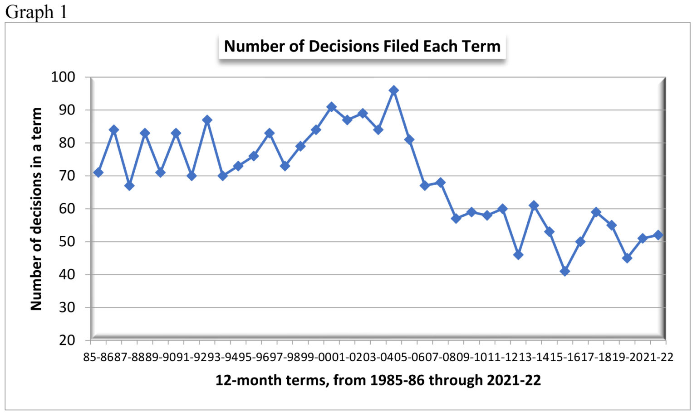
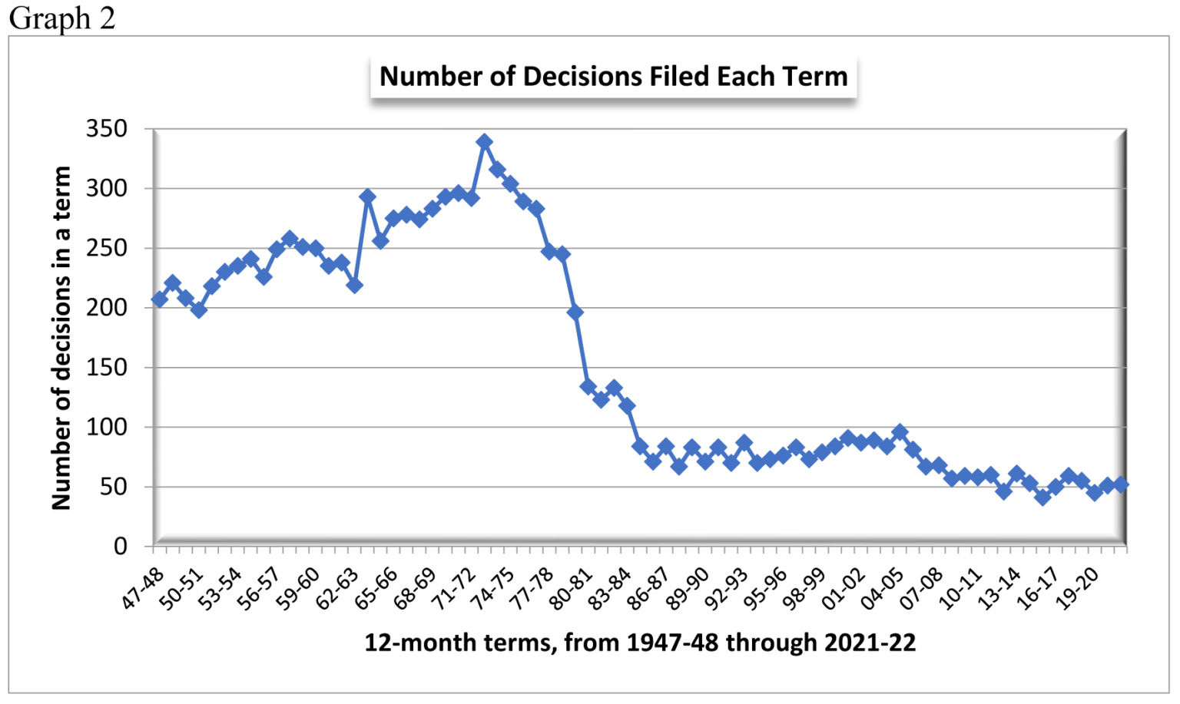

Slide 11
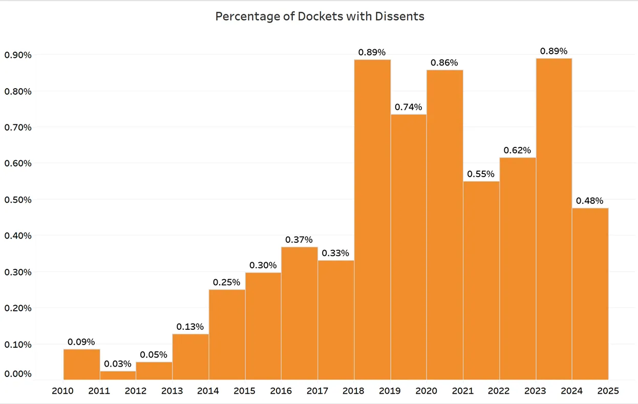

Slide 12
Deciding the Case
Interpretation
Precedent (stare decisis)
Judicial restraint and judicial activism
“Activist Judges”
Attitudinal Model
Strategic model
Briefs and arguments
The Opinion

Slide 13
Courts and the Public
Public policy
Public Opinion and court decisions
Courts under Trump
Time to re-think the Court?

Slide 14
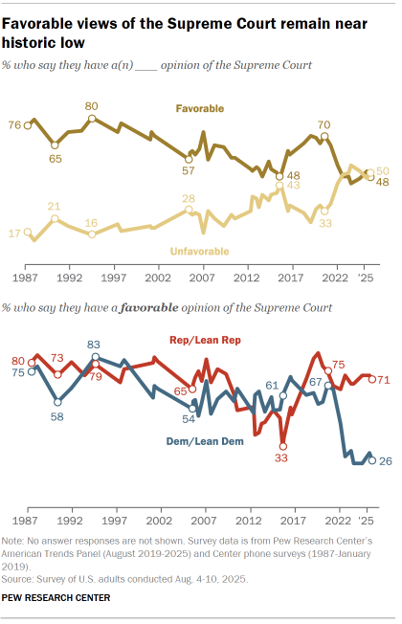

Slide 15
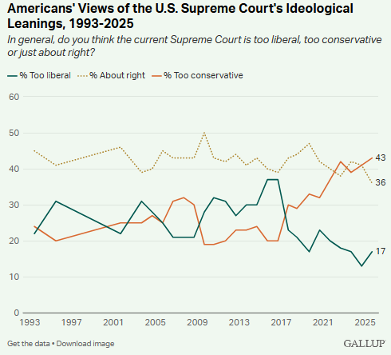
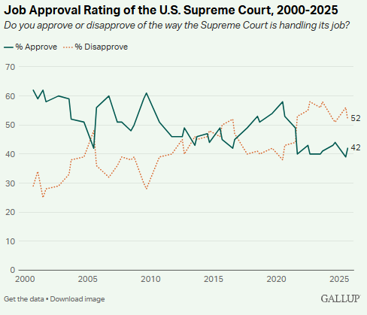

Slide 16
