Slide 1
Presidency

Slide 2
Introduction
Centrality of the presidency
National constituency
Presidential power

Slide 3
The Presidency: Design and Evolution
Presidential vs. Congressional power
Limited formal powers
Vague formal powers
Constitutional ambiguity as opportunity
Modern presidency

Slide 4
Roles of the Modern President
Head of government
Head of state
Chief administrator
Chief legislator
Party leader

Slide 5
What Do Presidents Do?
President
Commander in Chief
Top Diplomat
First Legislator
Chief Bureaucrat
Economist in Chief
Head of State
Party Leader

Slide 6
Formal Presidential Powers
Veto power
Commander-in-Chief
Appointment power
Judicial appointments
Pardon

Slide 7
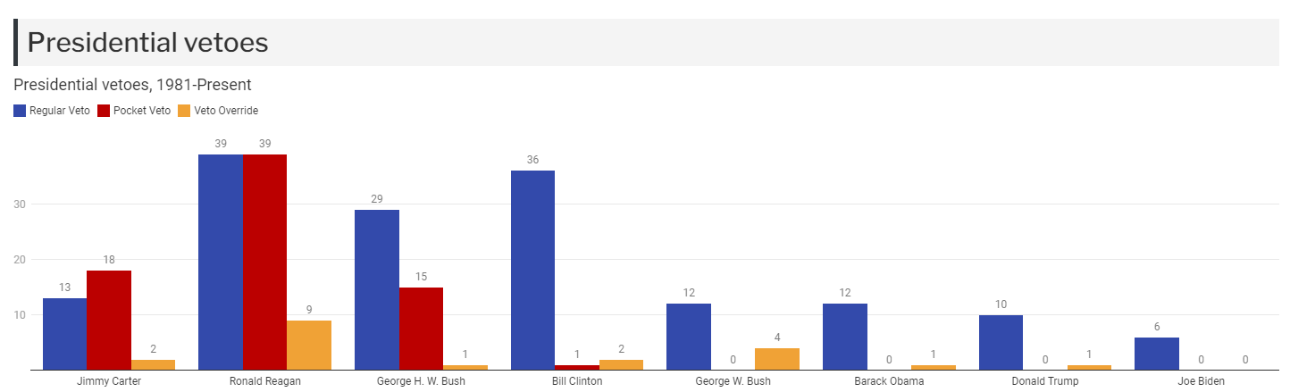
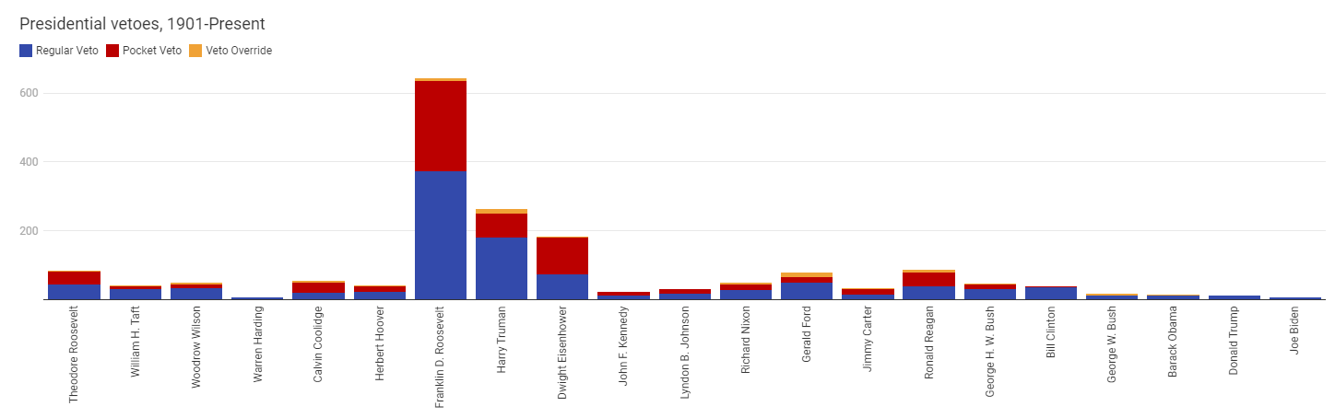

Slide 8
Implied Powers
Military intervention
Executive orders
Emergency powers
One-way ratchet of presidential power

Slide 9
Informal Powers
Power to Persuade
Going Public

Slide 10
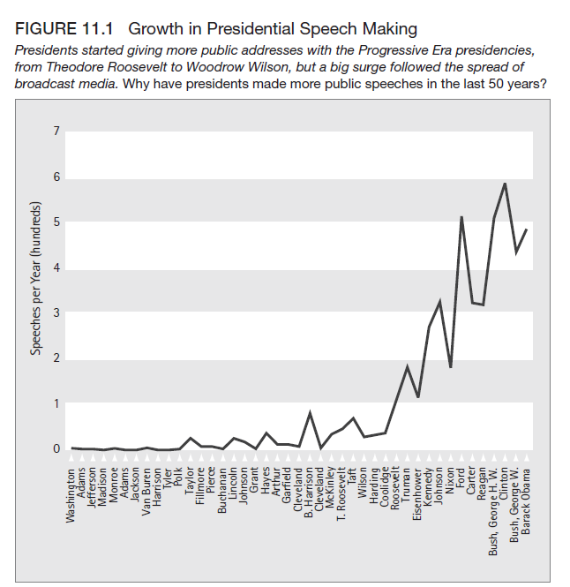

Slide 11
Presidential Power in Policy-Making
The President’s Agenda
Presidential popularity
Sources of popularity
Character and image
“honeymoon”
Crises (“rally round the flag”)

Slide 12
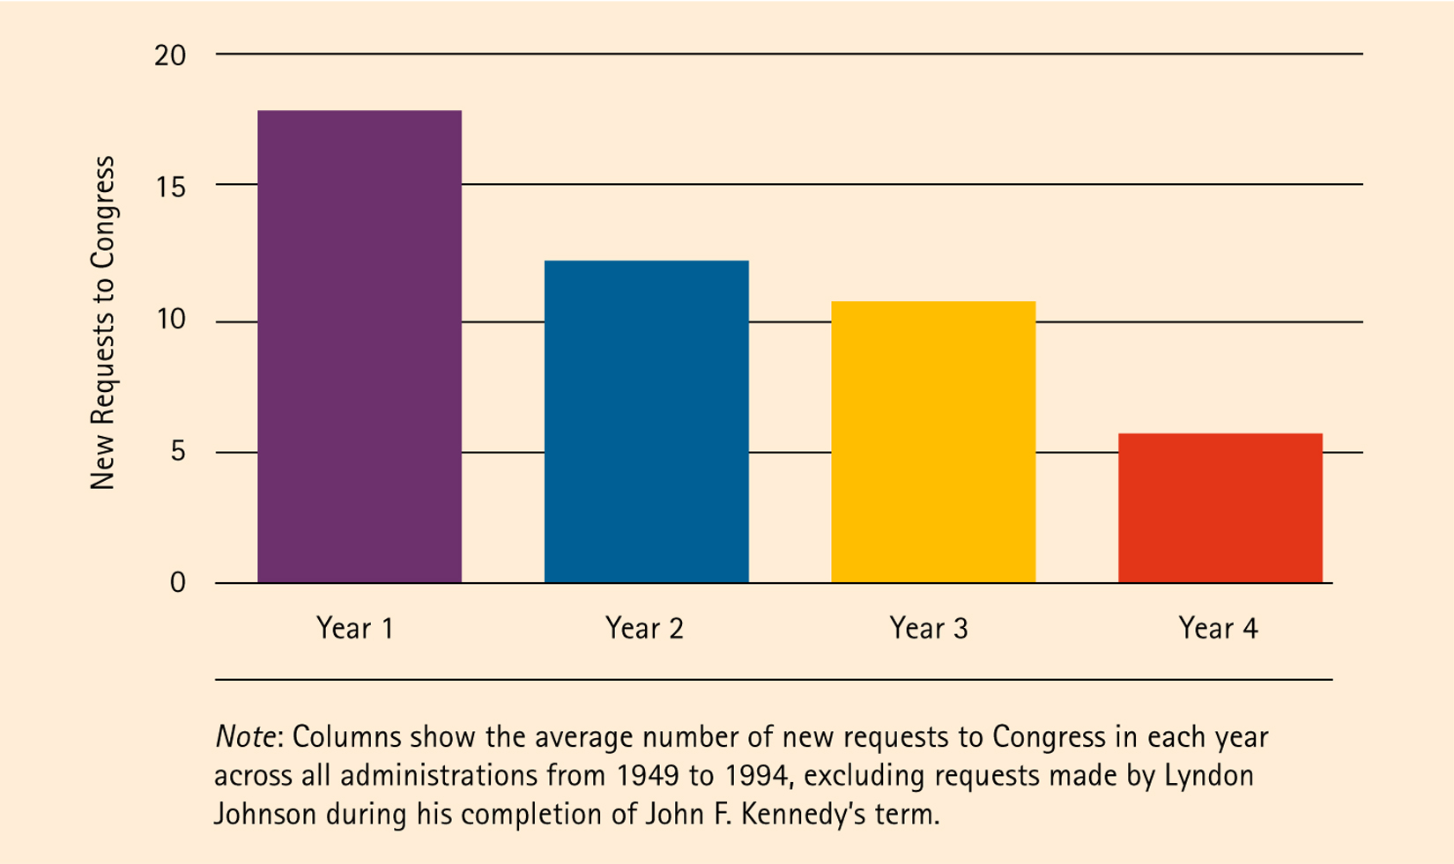
The Presidential Legislative Agenda by year in office

Slide 13
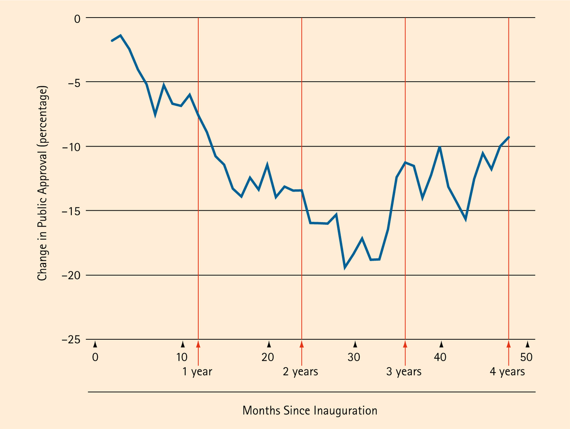
Decline in Presidential Popularity Over the First Term

Slide 14
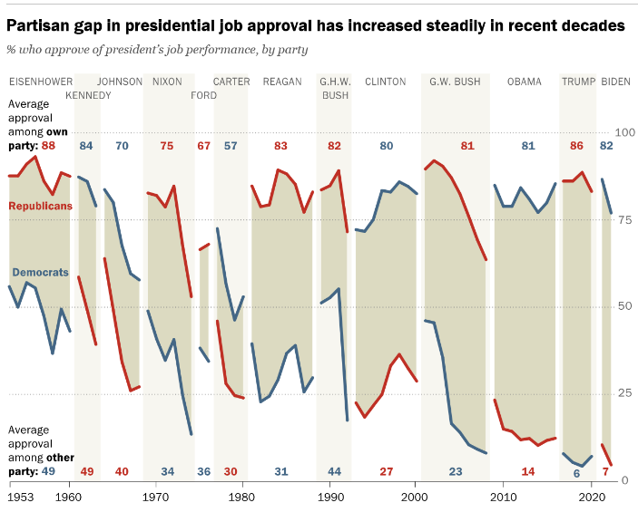
Fig. 13.4

Slide 15
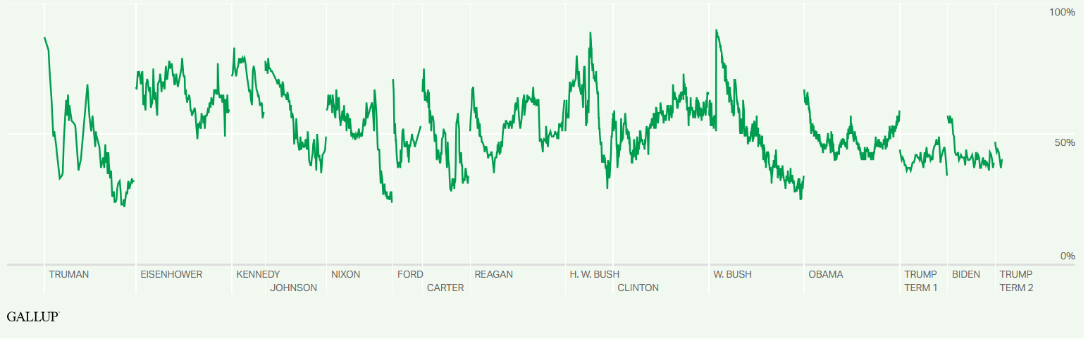
The shape of presidential approval

Slide 16
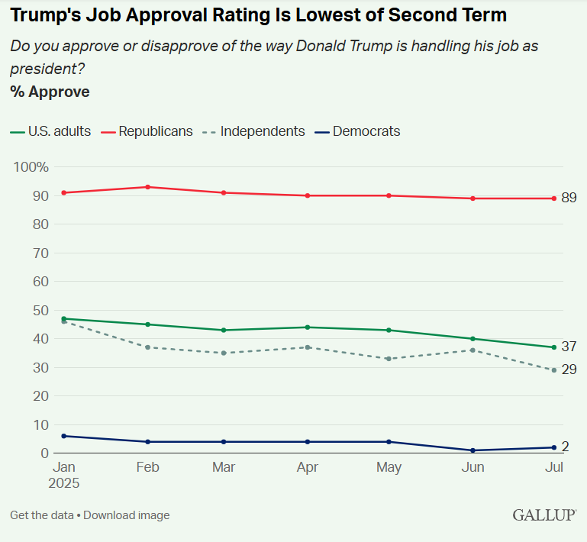

Slide 17
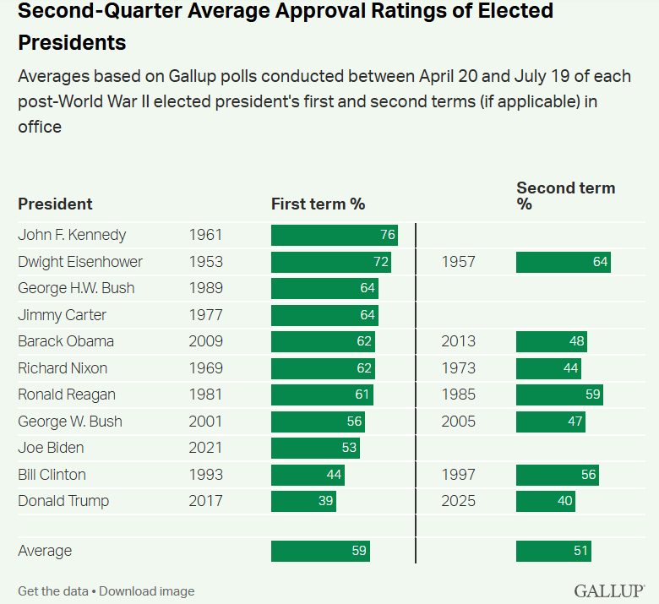

Slide 18
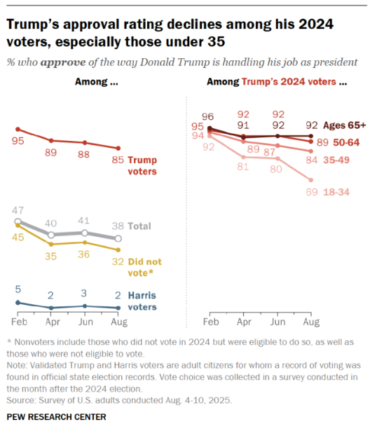

Slide 19
Conclusion: Trump and power
Power in an age of hyper-polarization
Norms and the presidency
New norm or anomaly?

Slide 20
