Slide 1
Congress

Slide 2
Members of Congress
Constitutional provisions
Member characteristics/ descriptive representation
Substantive representation

Slide 3
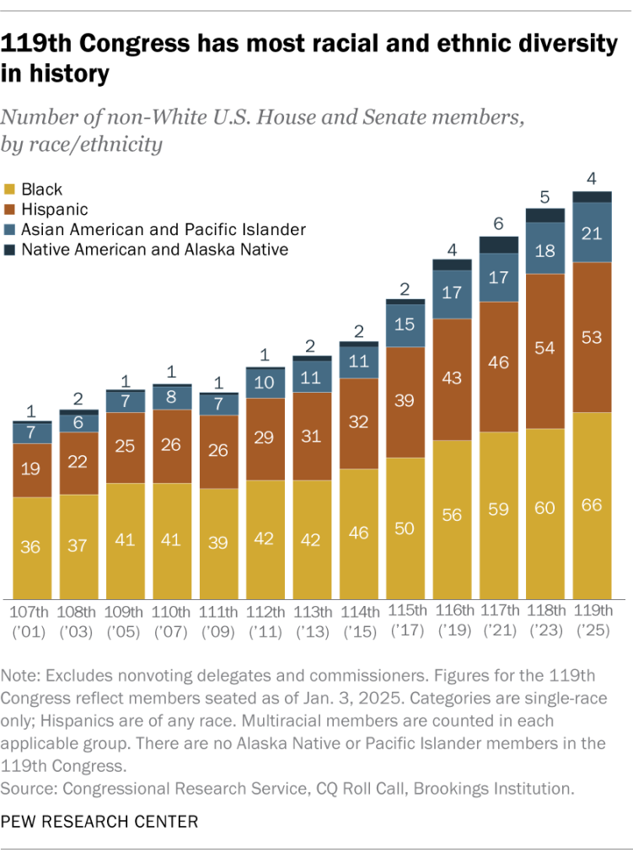

Slide 4
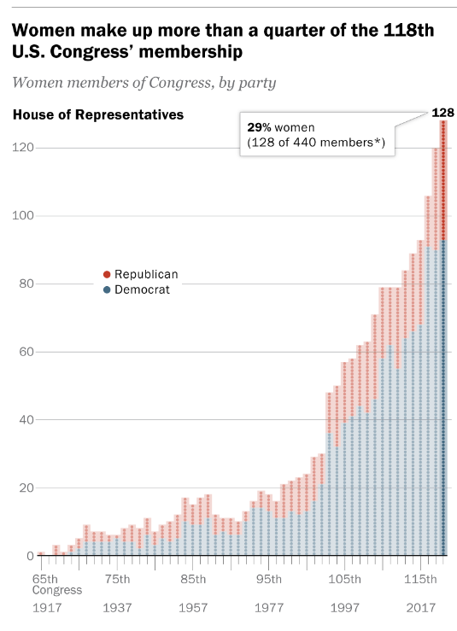
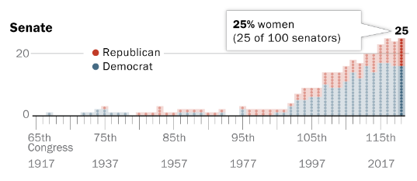

Slide 5
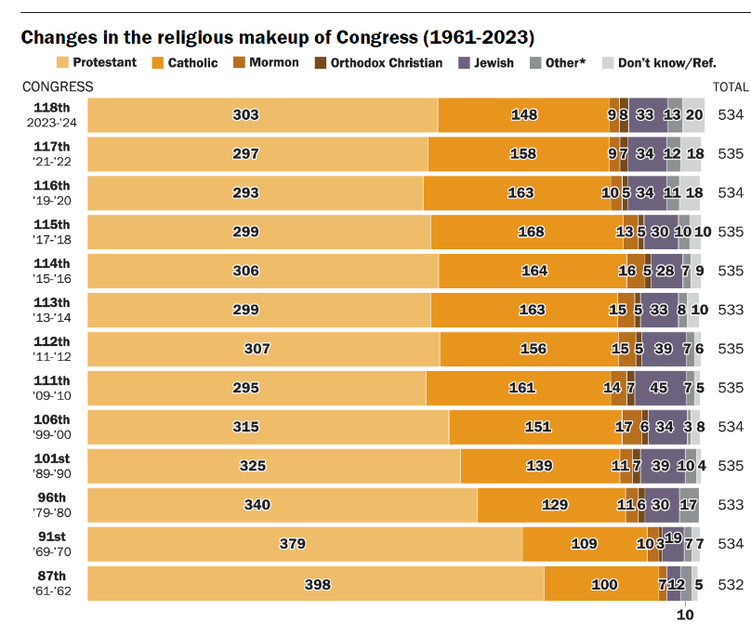

Slide 6

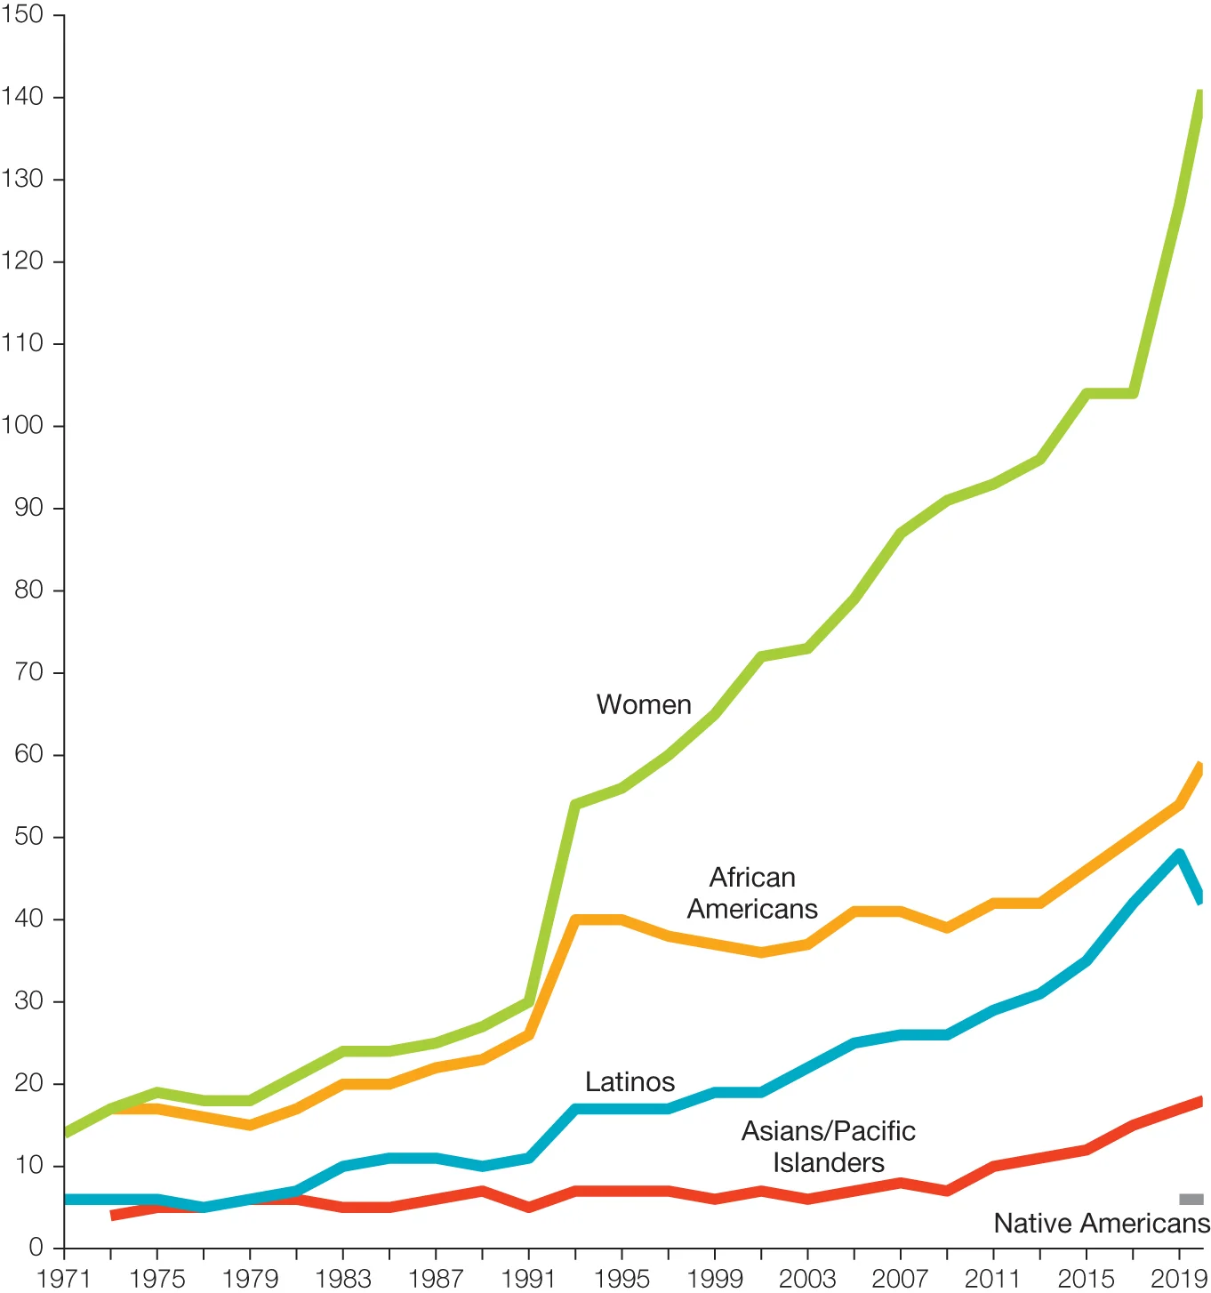

Slide 7
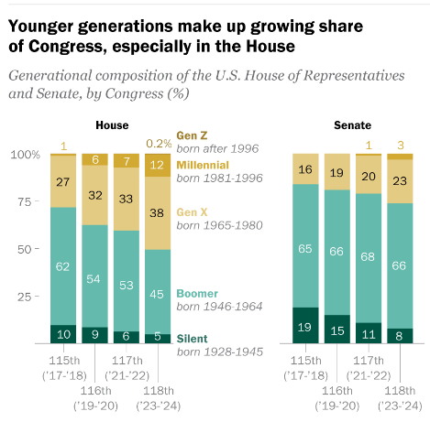
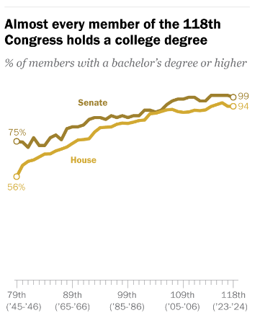

Slide 8
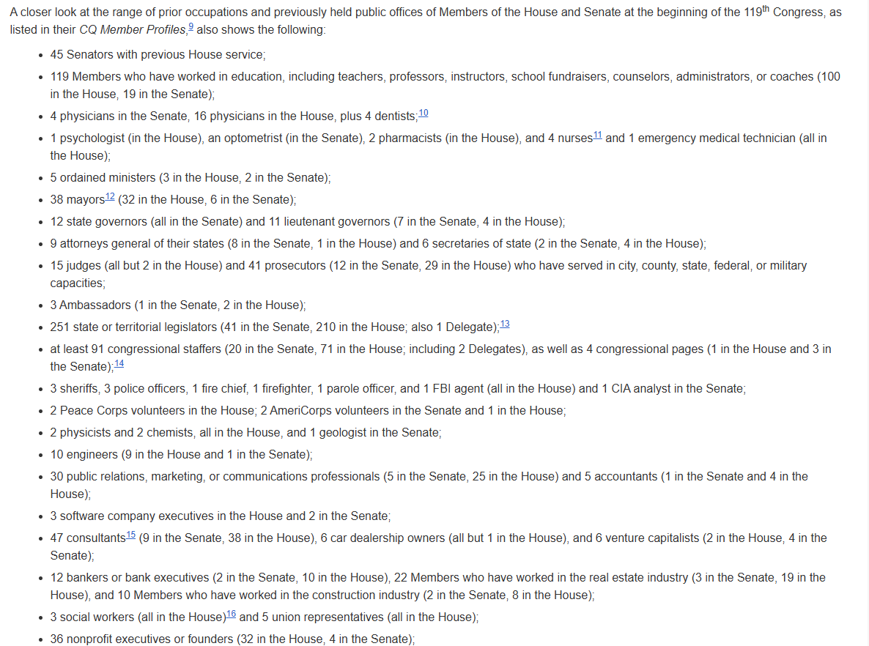

Slide 9
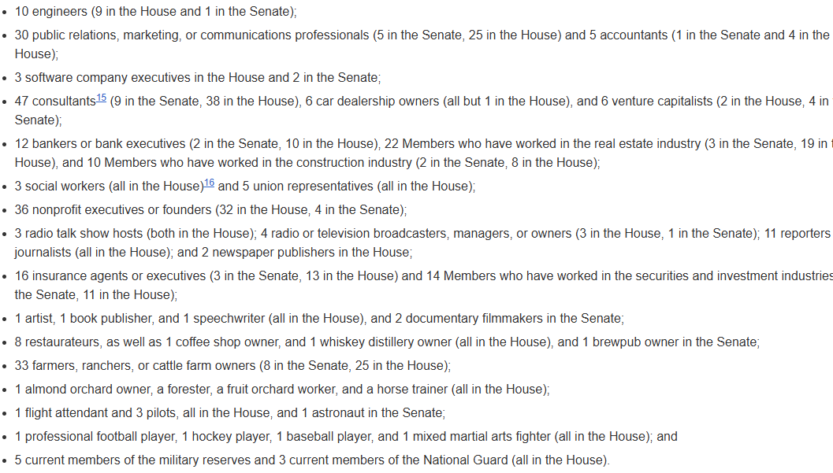

Slide 10
Leaders and Parties in Congress
Party and Leadership structure
Speaker of the House
Majority and Minority leaders
Whips

Slide 11
Leaders and Parties in Congress
Party and Leadership structure
Speaker of the House
Majority and Minority leaders
Whips
The Senate

Slide 12
Committee System
Importance of Committees
Standing committees
Committee chairs
Committee membership
Subcommittees

Slide 13
How a bill becomes a law

Slide 14
How a Bill becomes a law
I’m Just a Bill
Introducing a bill
Committee stage
[Floor debate]
Filibusters
Reconciliation
Voting
Conference Committee
Presidential Signature

Slide 15
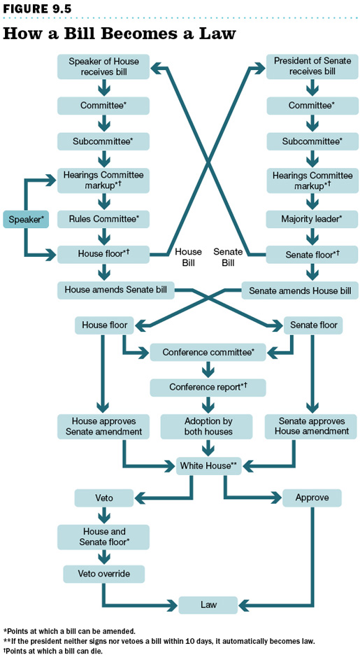

Slide 16
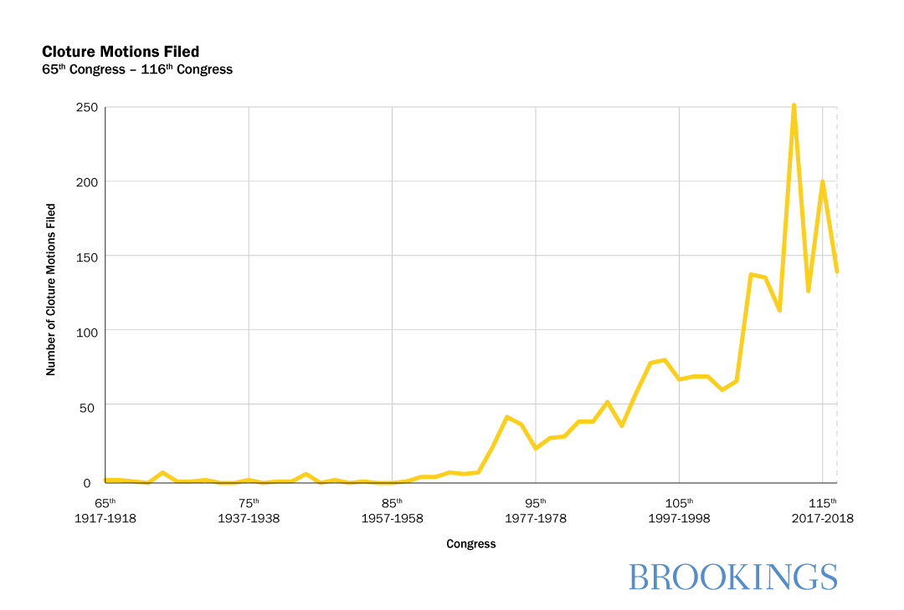
Growth in Filibuster

Slide 17
Features of Law Making
Difficulty of making new laws
Specialization and deference to committees
Cooperation
Pork Barrel
Universalism
Polarization and the difficulty of modern law-making

Slide 18
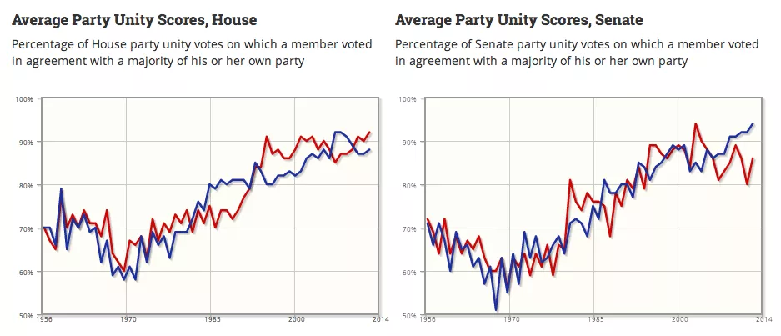

Slide 19
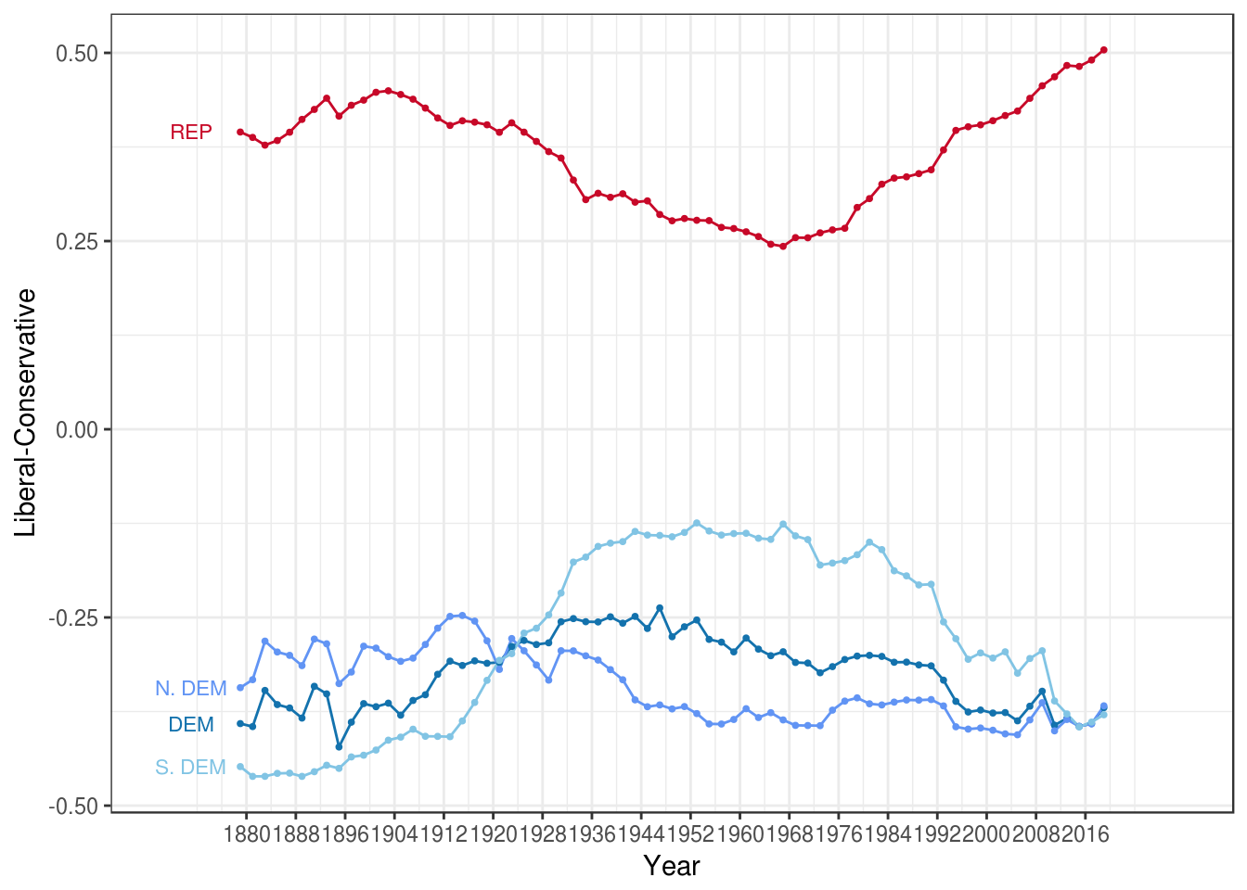
House of Representatives

Slide 20
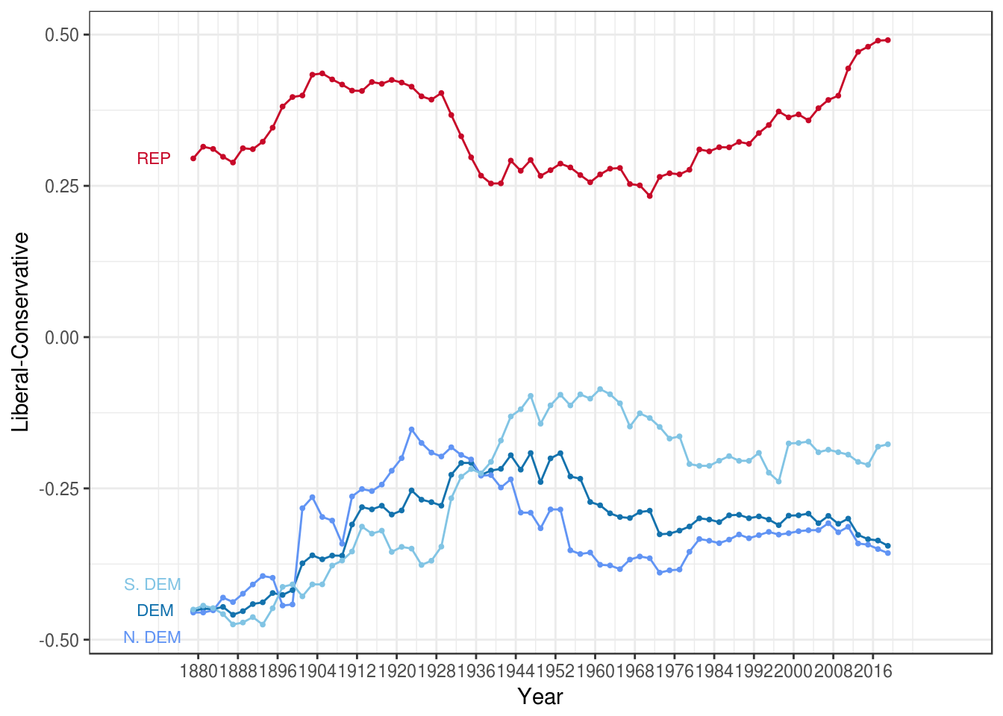
Senate

Slide 21
Conclusion: the trouble with Congress
Polarization and oversight/legislative vs executive
Why Congress is dysfunctional
An Institution designed for compromise in a polarized world

Slide 22
