Slide 1
Campaigns and Elections

Slide 2
Key Features of Presidential Nomination Campaigns
Winning delegate
Timing matters
Preseason/invisible primary
Money matters. Some.
Media matters. A lot
It’s a dynamic environment
The Parties matter. Sometimes. Maybe.
Convention

Slide 3
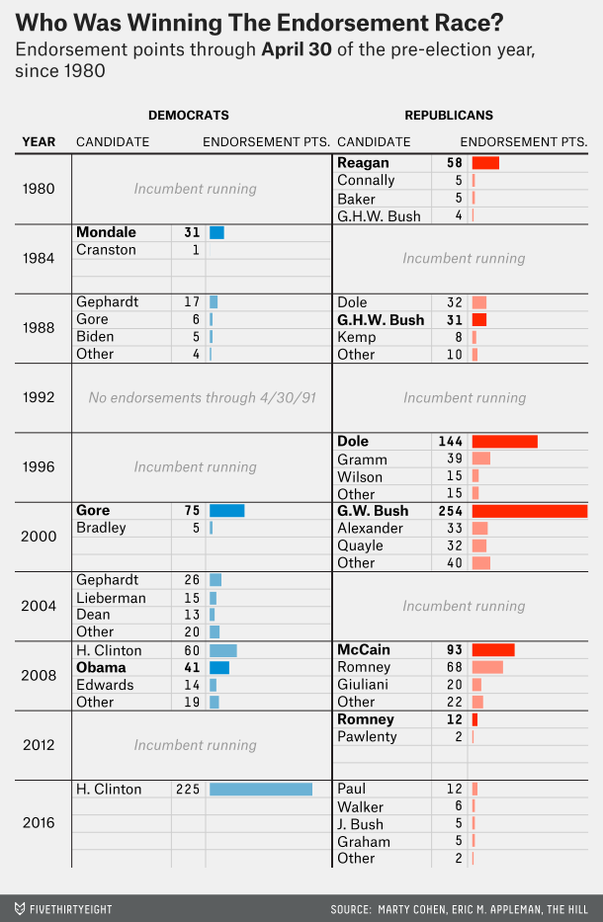

Slide 4
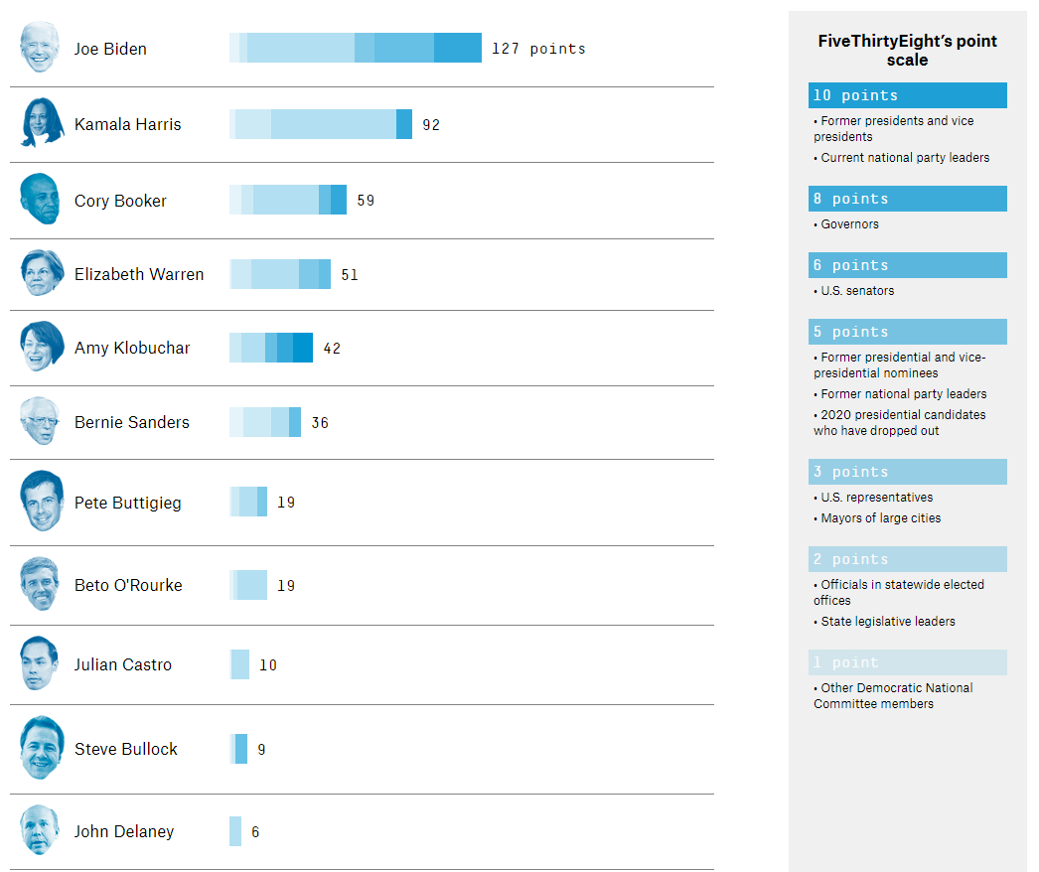

Slide 5
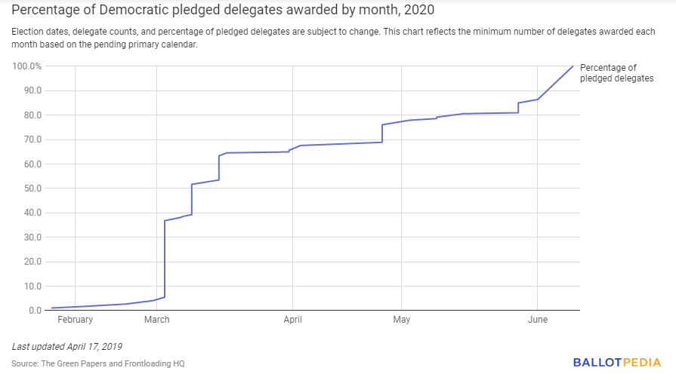

Slide 6
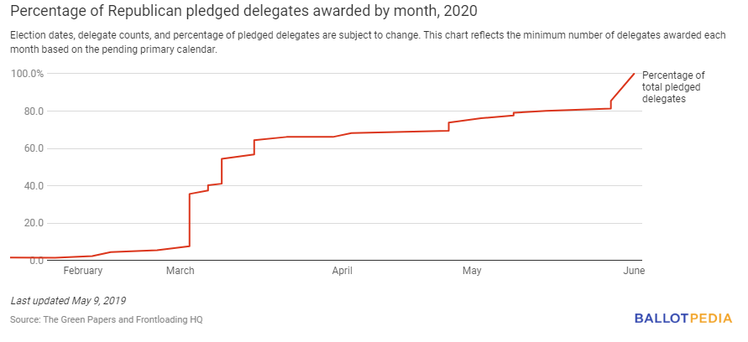

Slide 7
General Election Campaign
Electoral College Strategy

Slide 8
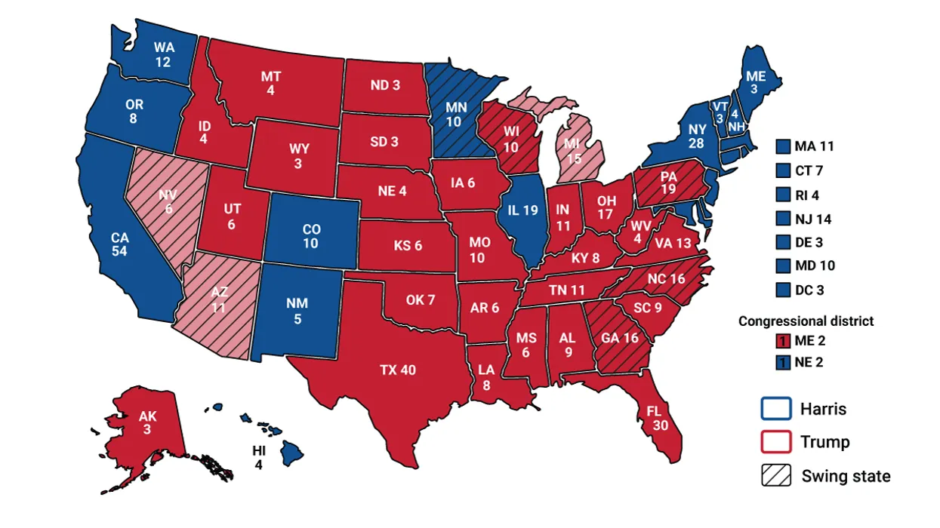
2024 Electoral Votes

Slide 9
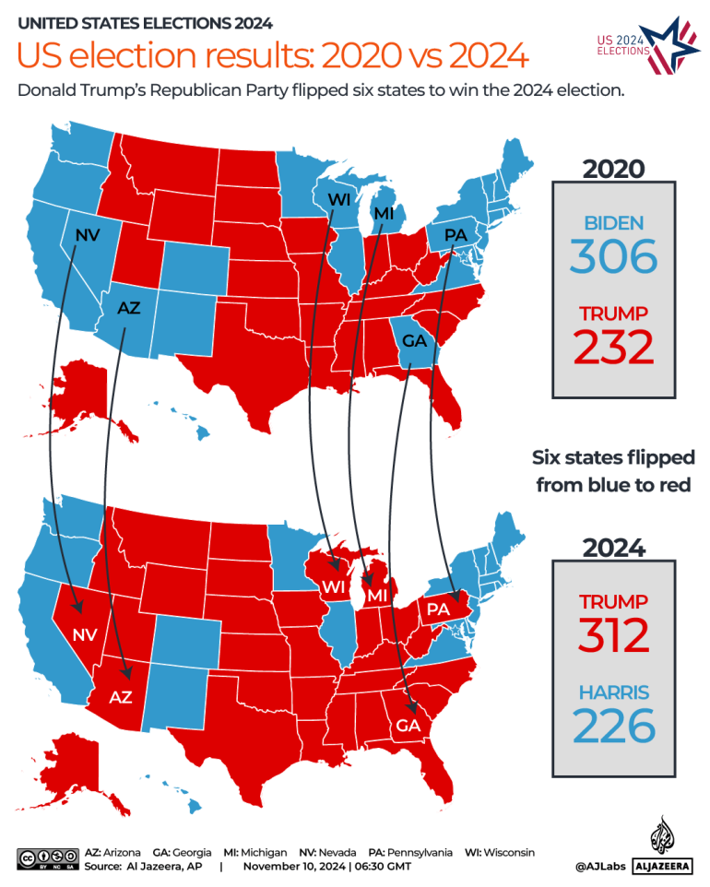

Slide 10
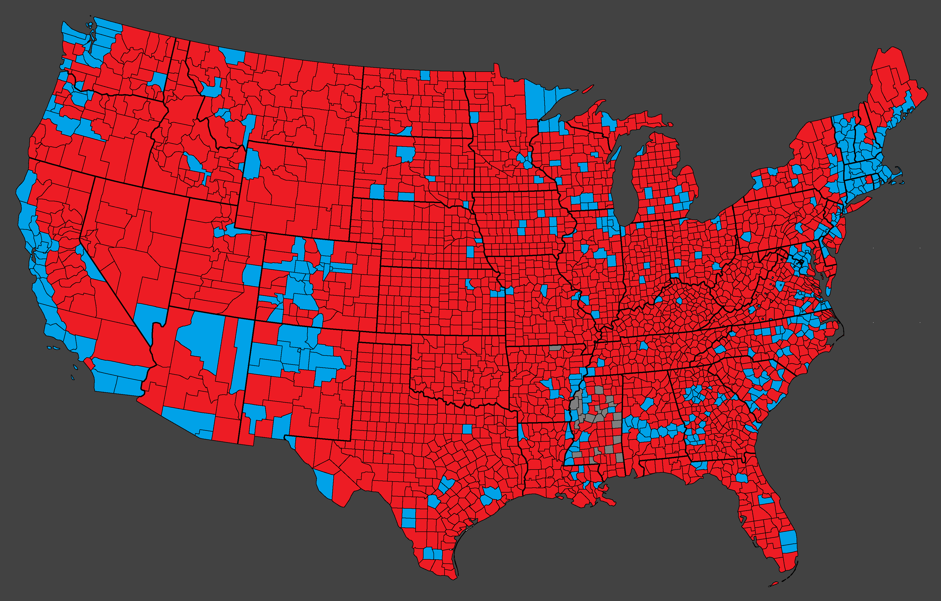
2024 Vote by county
Detailed Map
By county

Slide 11
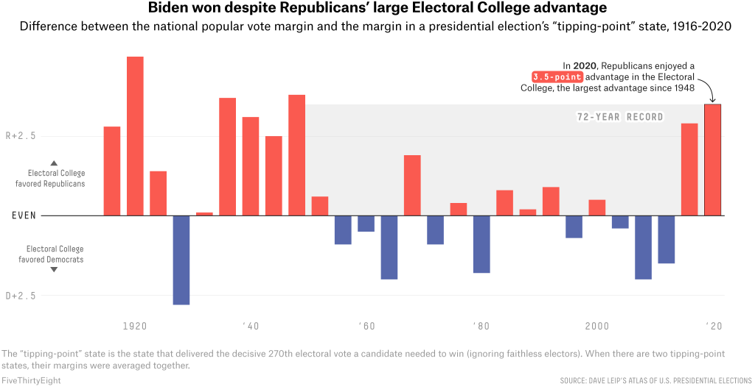

Slide 12
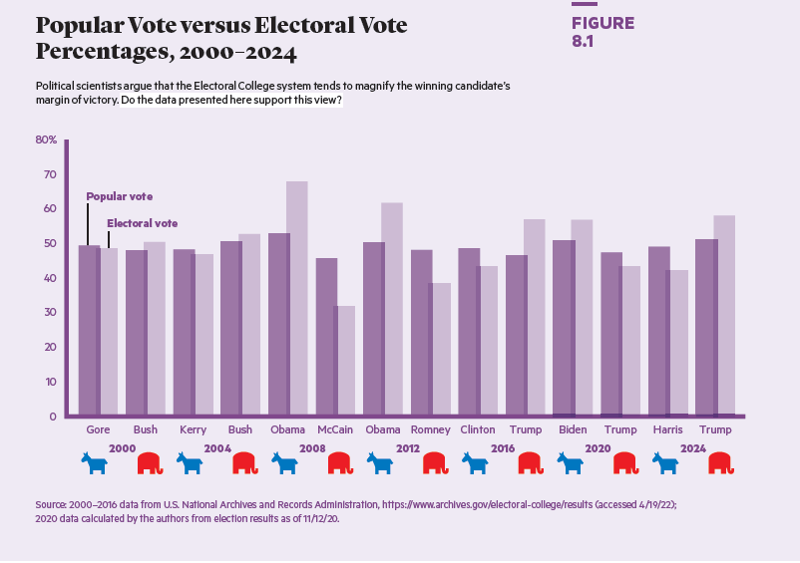

Slide 13
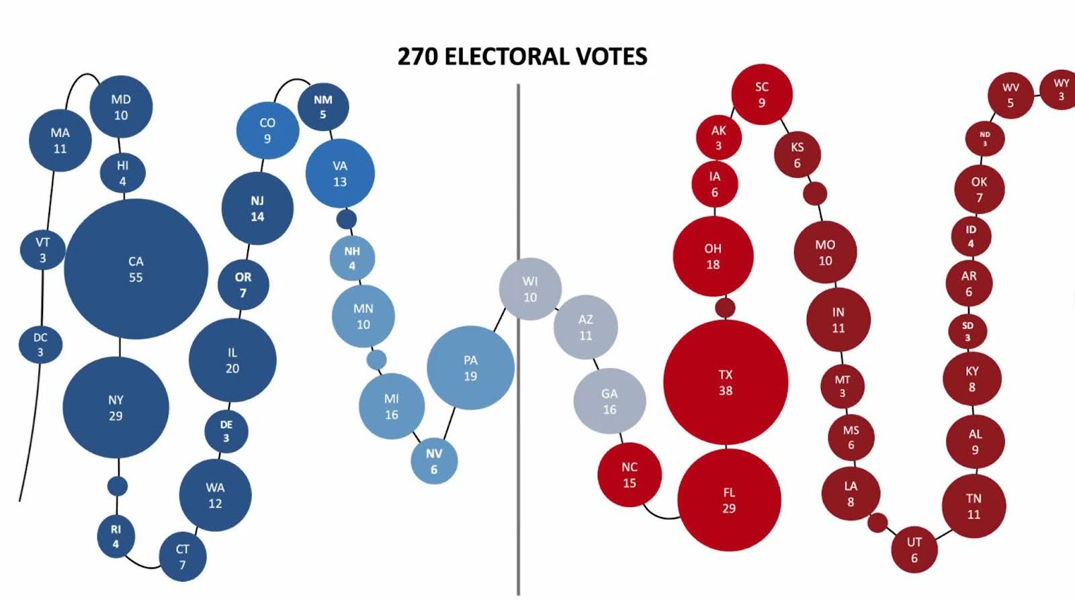
Tipping Point State 2024

Slide 14
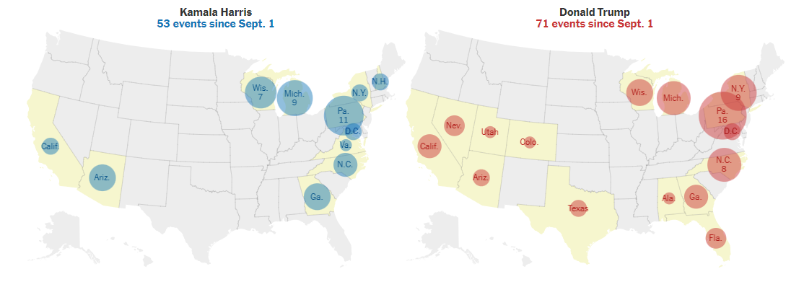
Where the candidates went 2024

Slide 15
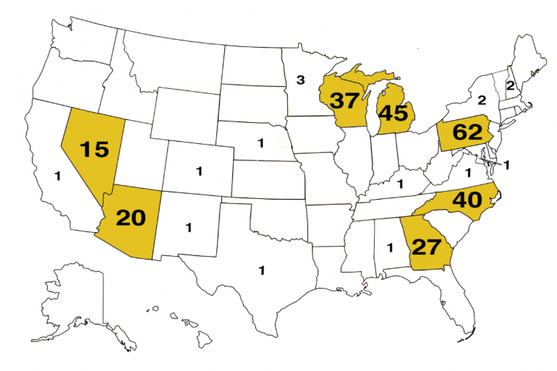
Where the candidates went 2020

Slide 16
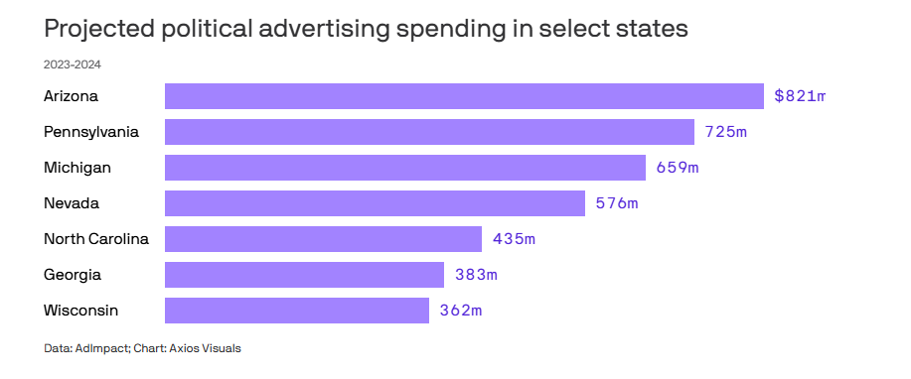
Where the money went 2020

Slide 17
General Election Campaign
Electoral College Reform?

Slide 18
Candidate strategy
Managing the news
Debates
Advertising campaign

Slide 19
The Voters Decide
To vote or not to vote
Party identification

Slide 20
Party Identification and Vote Choice
Party Identification | All | Harris | Trump
Democrat | 35% | 98% | 3%
Republican | 34% | 5% | 95%
Independent | 31% | 55% | 45%

Slide 21
Party Identification and Vote Choice (II)
Party Identification | All | Harris | Trump
Strong Democrat | 23% | 99% | 2%
Weak Democrat | 12% | 96% | 4%
Lean Democrat | 13% | 93% | 7%
Pure Ind | 7% | 55% | 45%
Lean Republican | 14% | 13% | 87%
Weak Republican | 11% | 13% | 87%
Strong Republican | 21% | 2% | 98%

Slide 22
The Voters Decide– everything else
Issues
Economy
Candidate evaluations
The demographics of elections
Do campaigns matter?

Slide 23
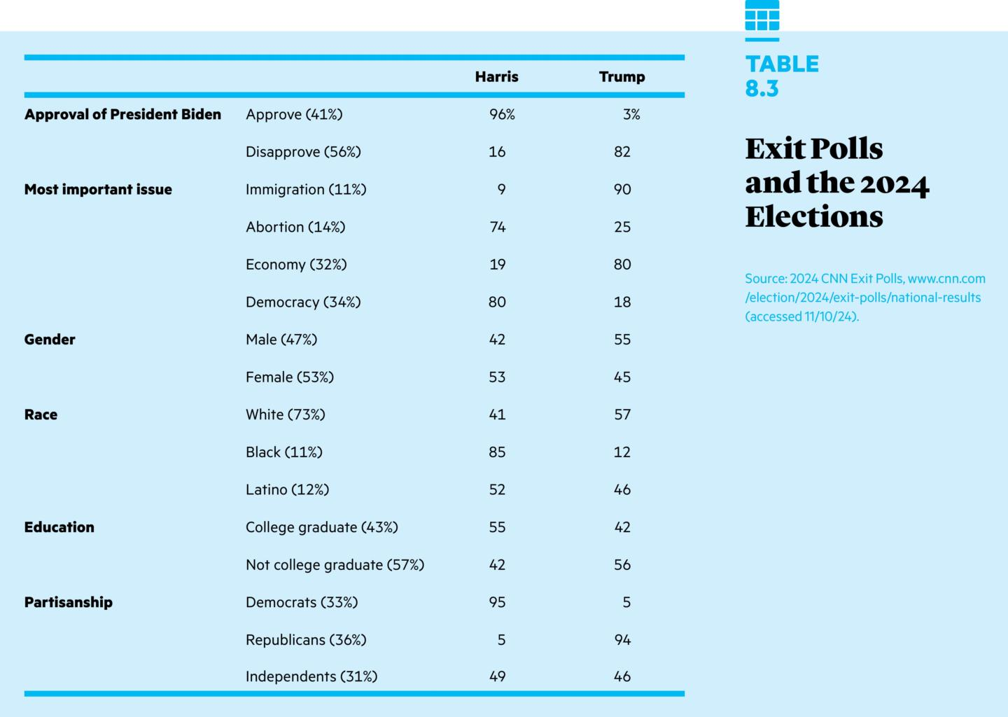

Slide 24
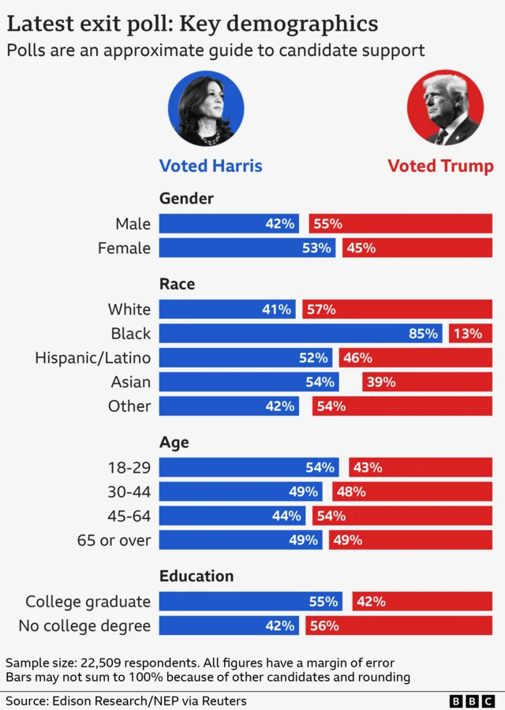

Slide 25
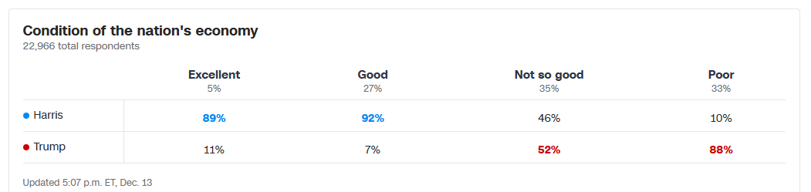

Slide 26
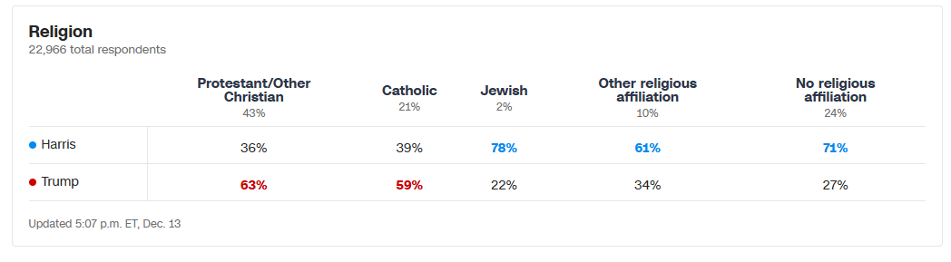
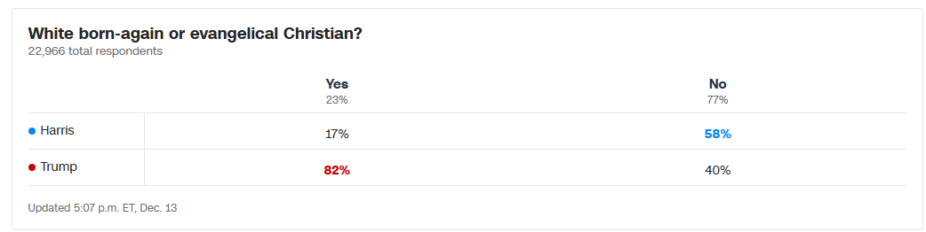

Slide 27
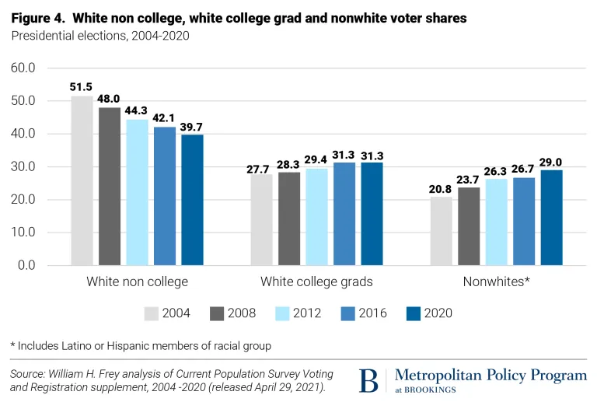
The changing electorate

Slide 28
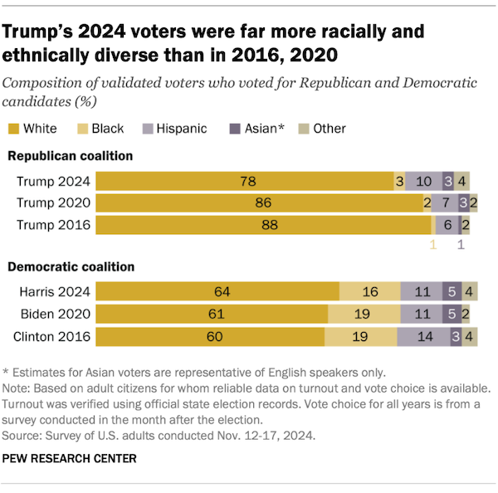

Slide 29
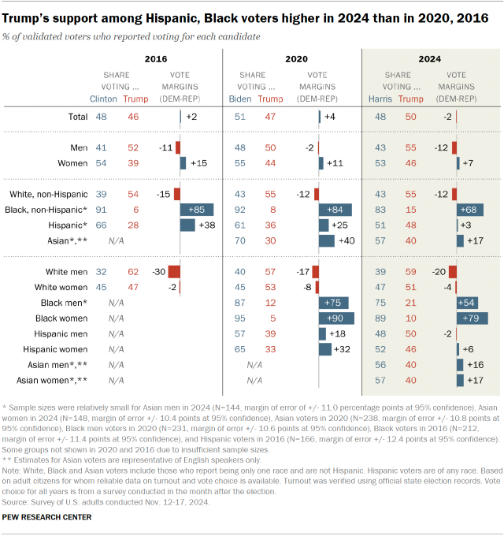

Slide 30
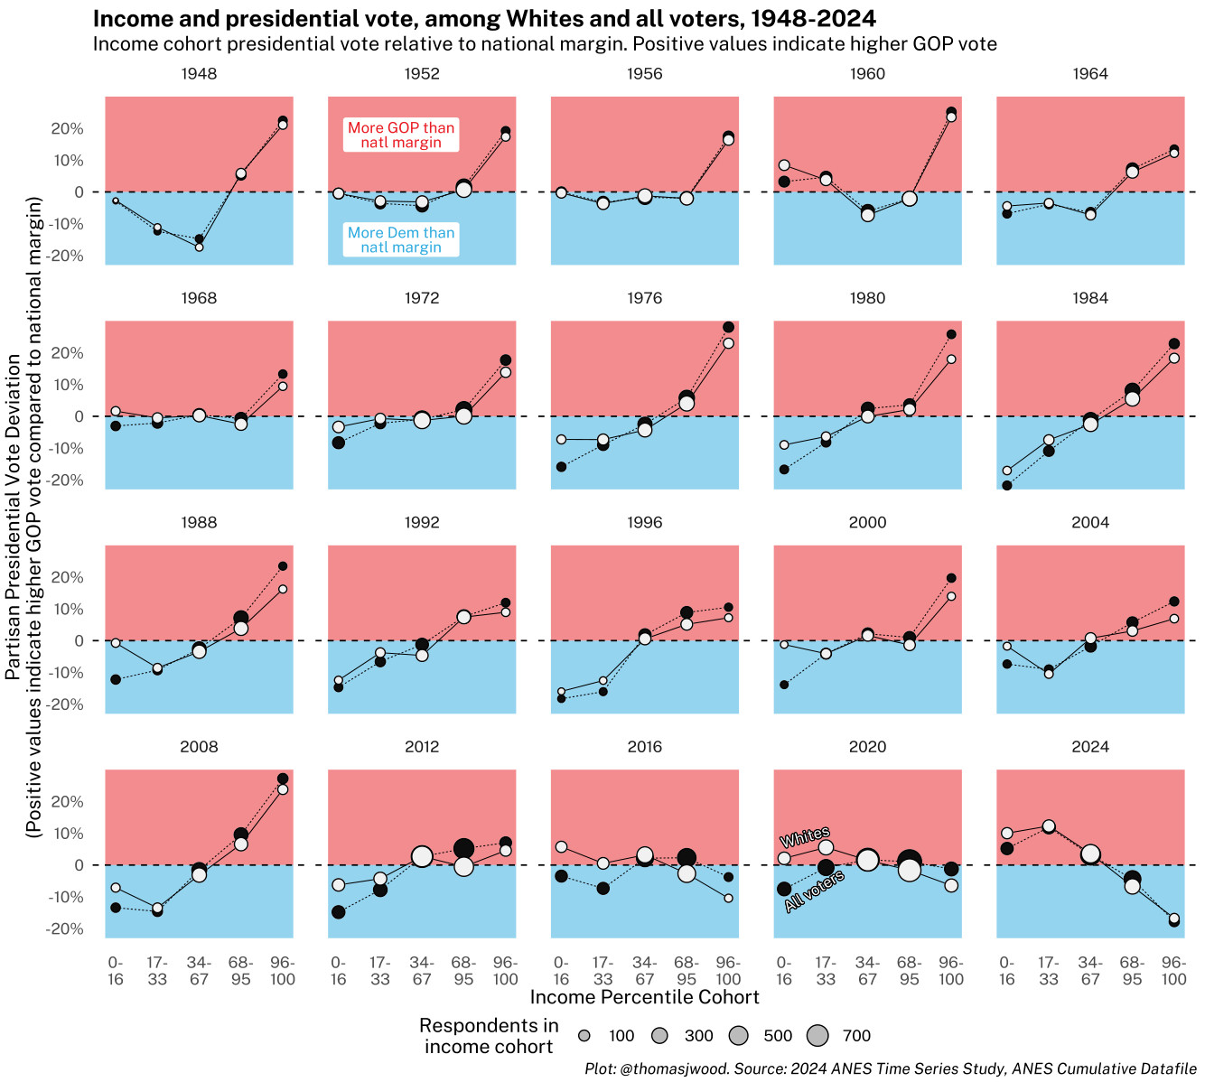

Slide 31
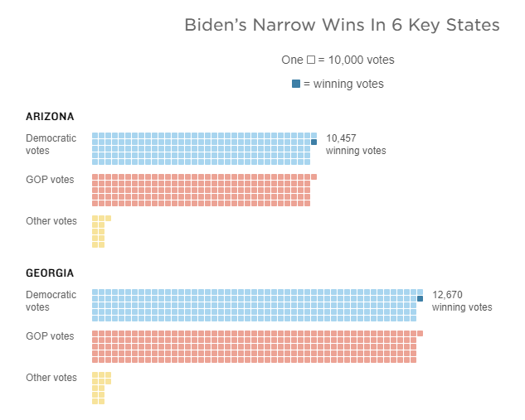
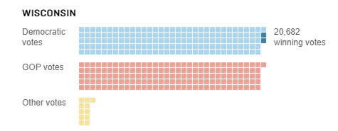
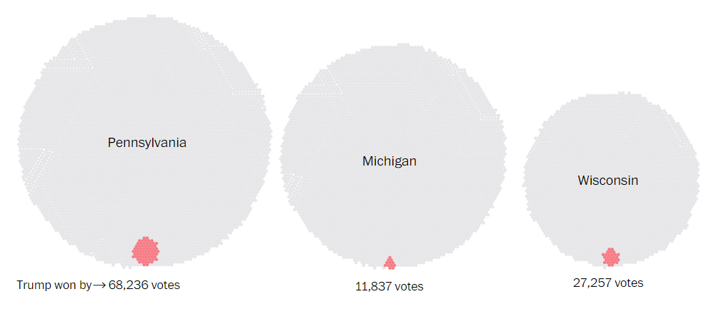
Do campaigns matter?
2020
2016

Slide 32
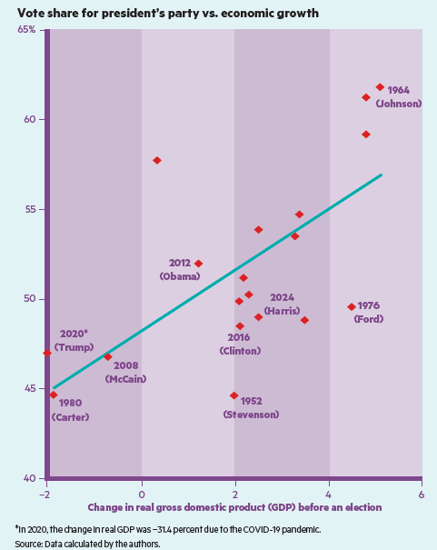

Slide 33
Congressional Elections
Incumbency Advantage

Slide 34
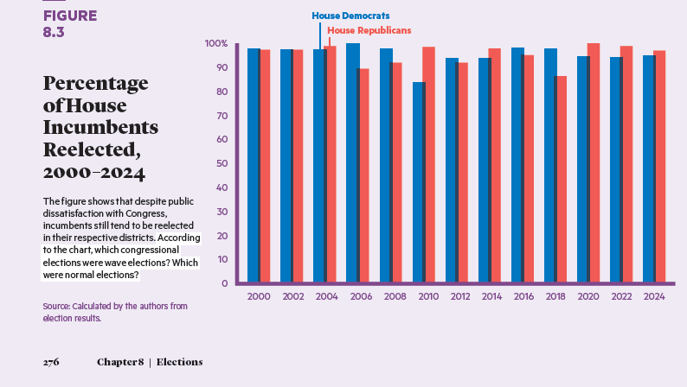

Slide 35
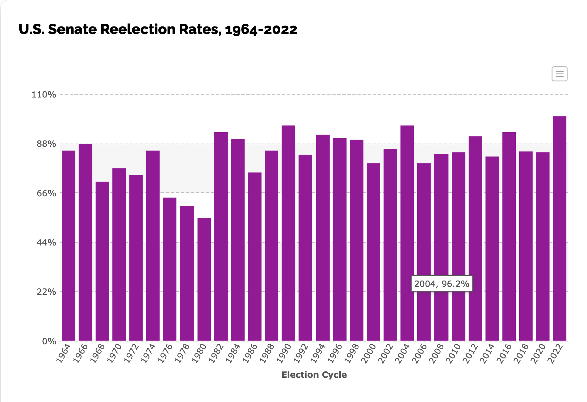

Slide 36
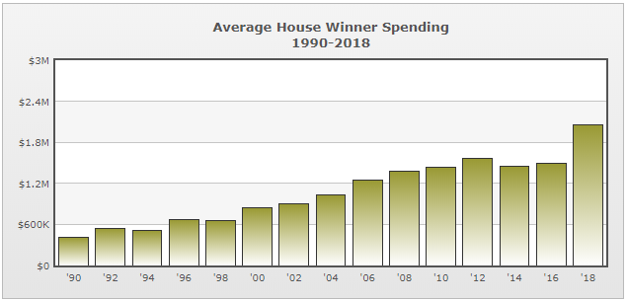
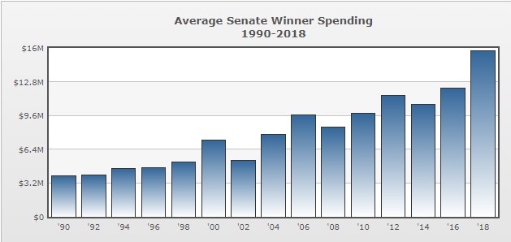

Slide 37
Congressional Elections
It’s (almost all) partisanship/Polarized elections (all politics is national)
Gerrymandered districts
Public attention
District service
Money
Senate campaigns

Slide 38
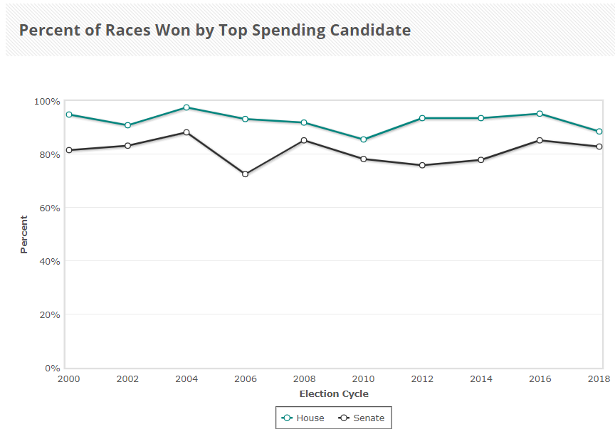

Slide 39
Voters in Congressional Elections
Partisanship
Information
Incumbency
Nationalizing politics and the declining advantage of incumbency

Slide 40
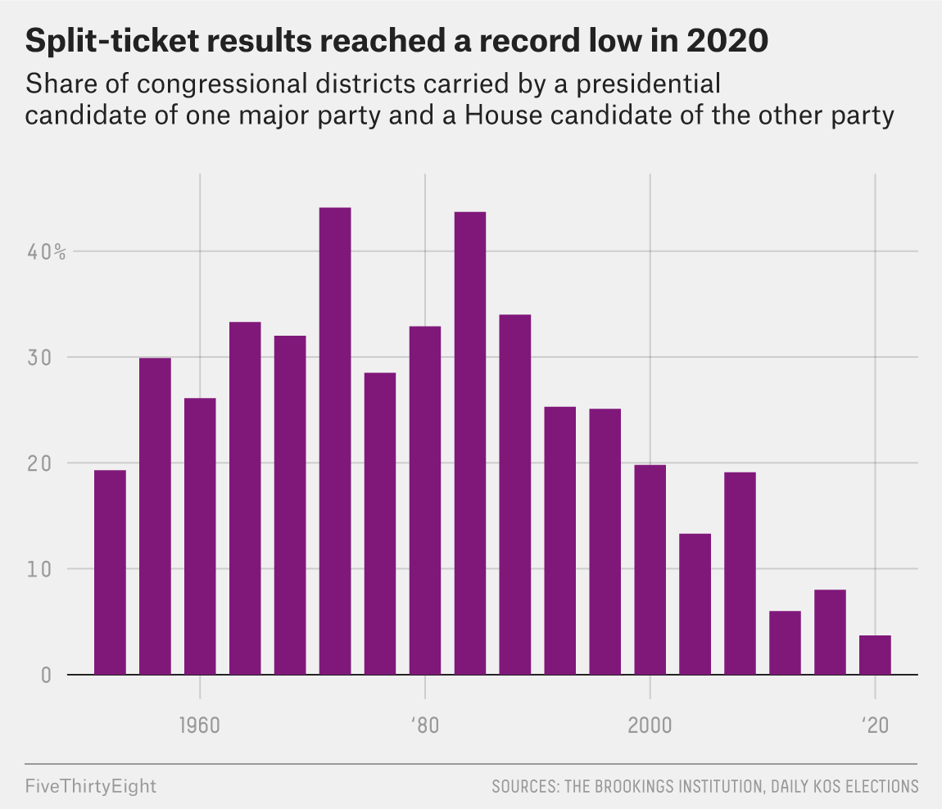

Slide 41
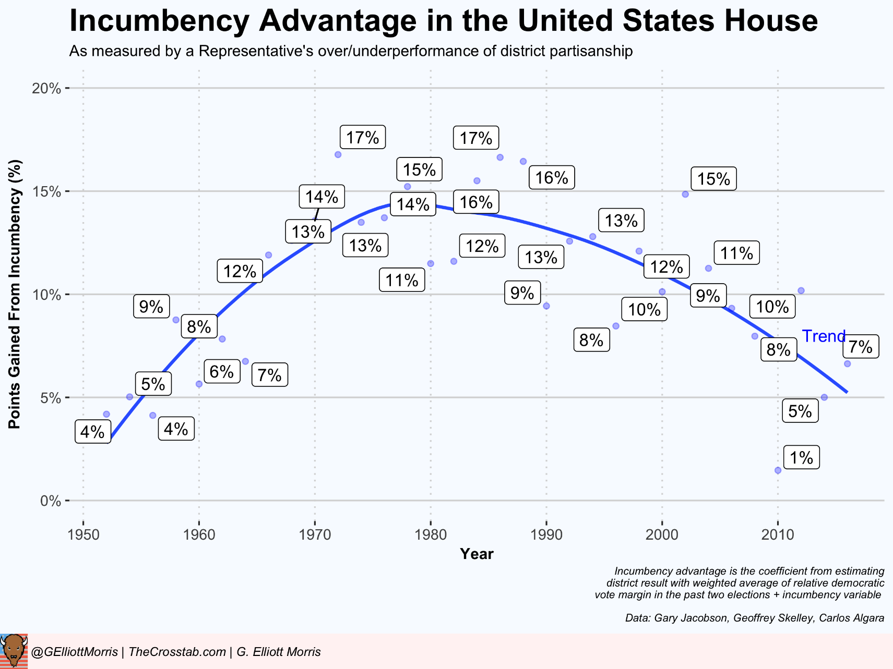

Slide 42
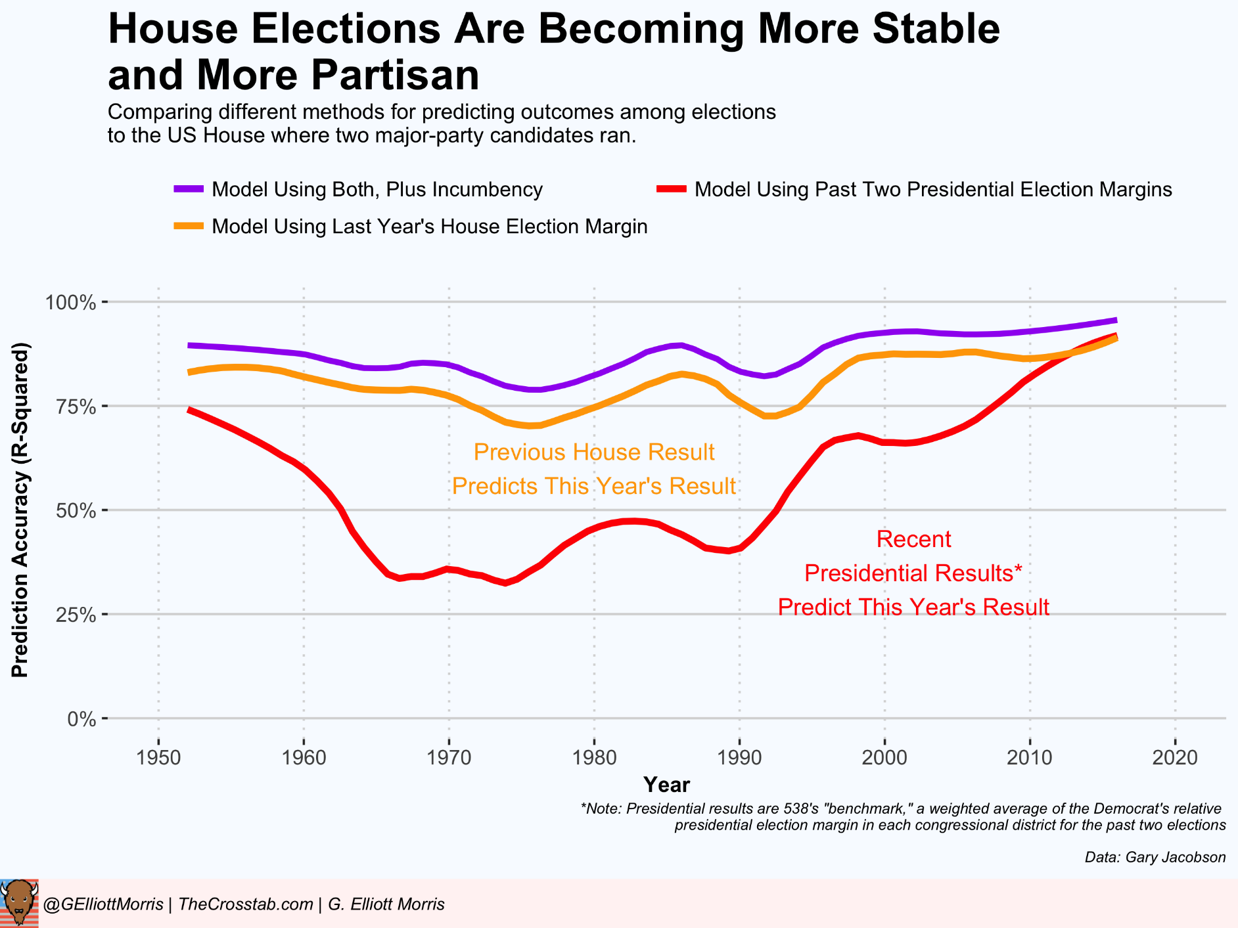

Slide 43
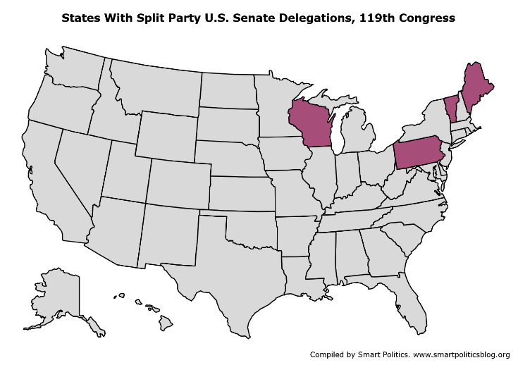

Slide 44
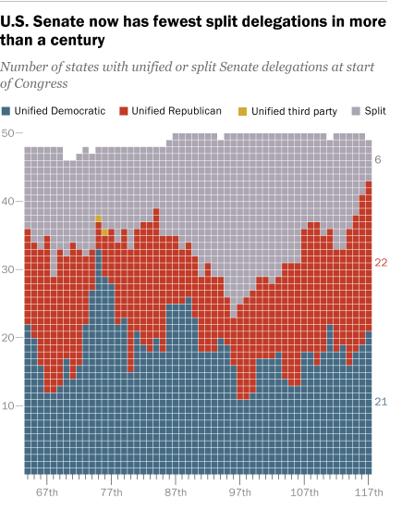

Slide 45
Campaign Finance
The two campaign finance systems
The regulated system
The unregulated system

Slide 46
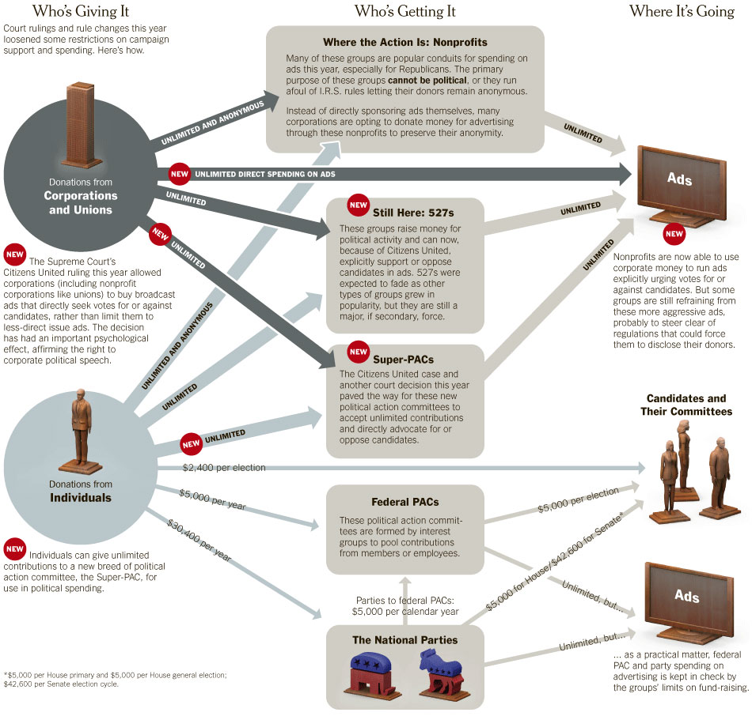

Slide 47
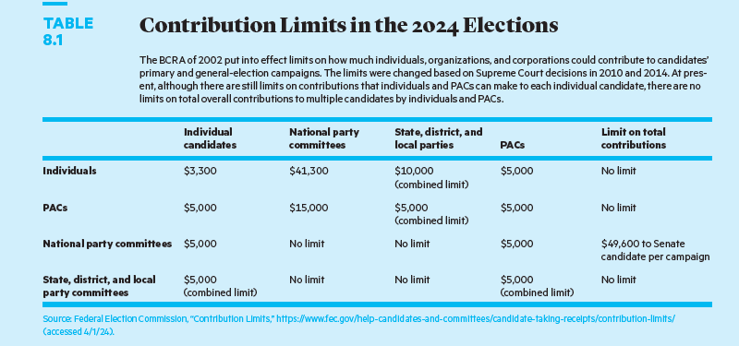

Slide 48
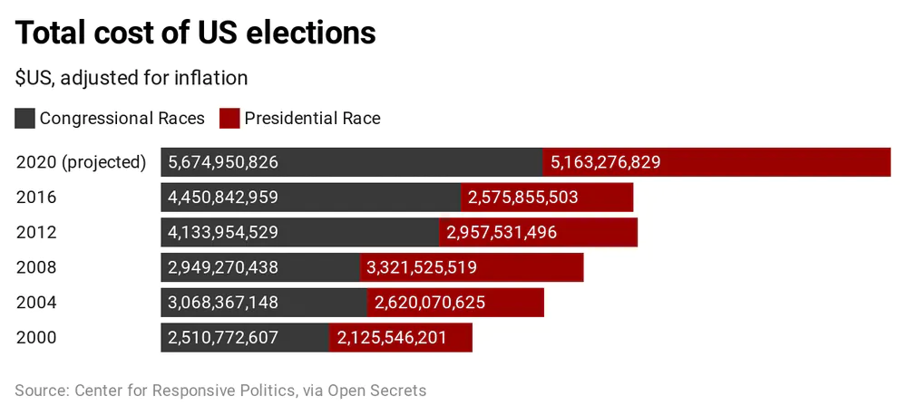
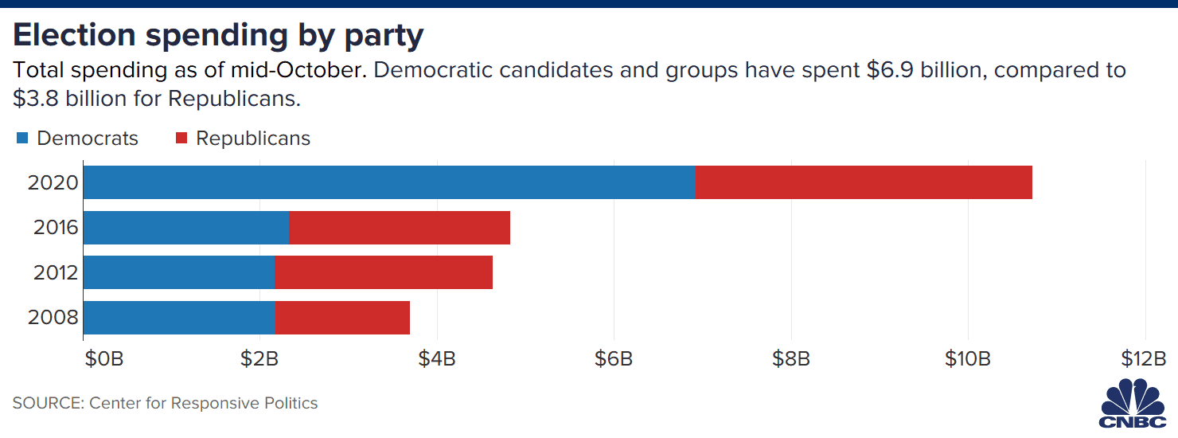

Slide 49
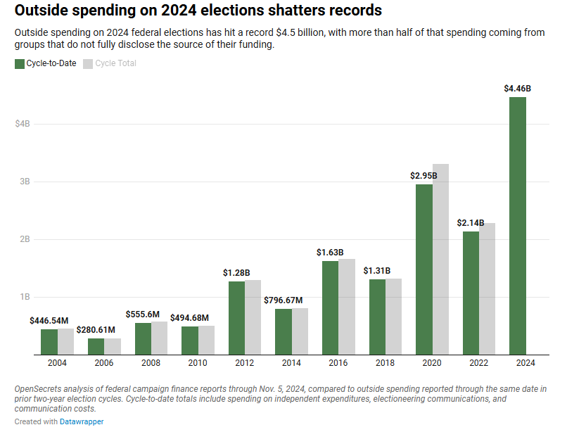

Slide 50
Concluding Thoughts
The Rules of the Game
Partisanship is everything
Money is not everything (but it really matters)
We can do better

Slide 51
