Slide 1
Political Parties

Slide 2
What is a political party?
Defining Parties
Party Organization
Party in government
Party in the electorate
What Parties do

Slide 3
History of Parties in America
ΔΛΘ “Free beer blowout” of 2012
ΘΚΡ "Karaoke Rage" of 2016
ΩΒΦ "WiFi Broke Forever" of 2017
ΦΔΣ "Finals Week Pajama Formal" of 2018
ΨΔΚ “Dress like your favorite professor” of 2021
ΥΒΩ "Rate My Professor Revenge" of 2022
ΔΦΚ “Dance like no one is watching mixer” of 2023

Slide 4
History of Parties in America
1st party system: Constitutional Debate
2nd party system: Mass-based parties
3rd party system: Gilded Age
4th party system: Progressive Reforms
5th party system: New Deal
6th party system: Realignment & Dealignment
Parties Today

Slide 5
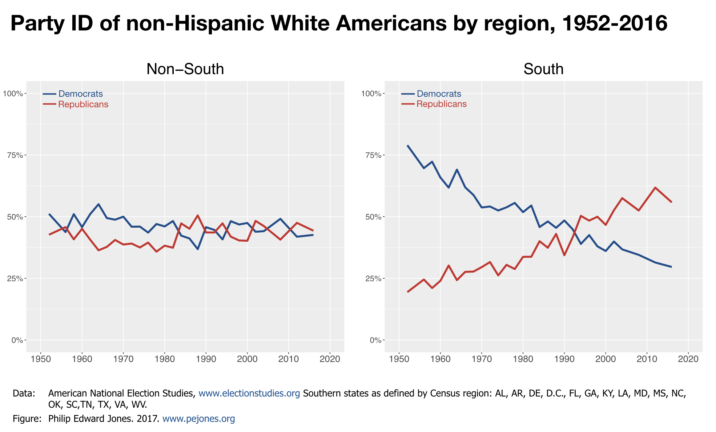
8.5
Realignment in the South
Notes:
The swapping of party loyalty of Southern white voters from the Democratic Party to the Republican Party over the issue of civil rights has been crucial to the GOP gaining majority party status in Congress.

Slide 6
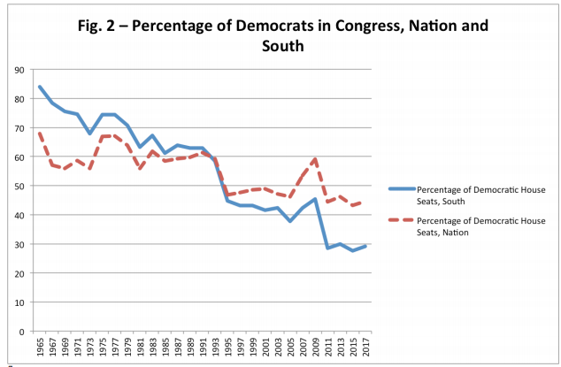

Slide 7
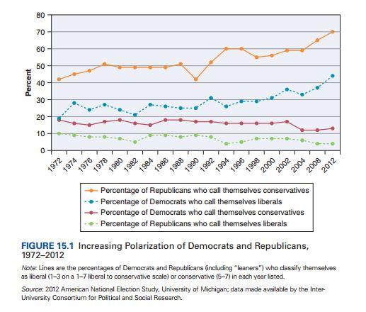
The sort

Slide 8
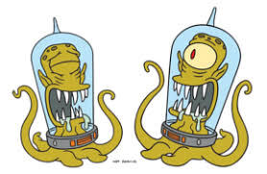
The American two-party system
Plurality voting vs PR (Duverge’s Law)
Legal barriers
Primaries
Kang and Kodos
Third Parties

Slide 9
The Party Organization
Party organizations exist to elect candidates
Local, state, and national
The “party in service”

Slide 10
Party in the Electorate
Party Identification (PID)
Measurement of PID

Slide 11
Michigan PID measure
1. Generally speaking, do you usually think of yourself as a Democrat, Republican, Independent or what?
2A. Do you consider yourself a strong or not so strong Democrat/Republican
2B. Do you consider yourself to be closer to the Democratic Party, the Republican Party, or neither?

Slide 12
3 point and 7 point Michigan PID Scales
Strong Democrat
Democrat
Weak Democrat
Independent Democrat
Independent
Pure Independent
Independent Republican
Weak Republican
Republican
Strong Republican

Slide 13
2024 Party Identification (3 point)
Democrat | 34.8
Independent | 33.7
Republican | 30.3

Slide 14
2024 Party Identification (7 point)
Strong Democrat | 23.2% (26.3)
Weak Democrat | 11.6% (11.6)
Ind Democrat | 13.0% (12.9)
Pure Independent | 6.9% (3.3)
Ind Republican | 13.8% (12.2)
Weak Republican | 10.5% (10.3)
Strong Republican | 22.8% (23.3)

Slide 15
2024 Party Identification (3 point)-- reconsidered
Democrat | 47.9
Independent | 6.9
Republican | 45.2

Slide 16
Party in the electorate (continued)
Party Polarization
Affective polarization (party tribalism)
PID and Issues
PID and Demographics

Slide 17
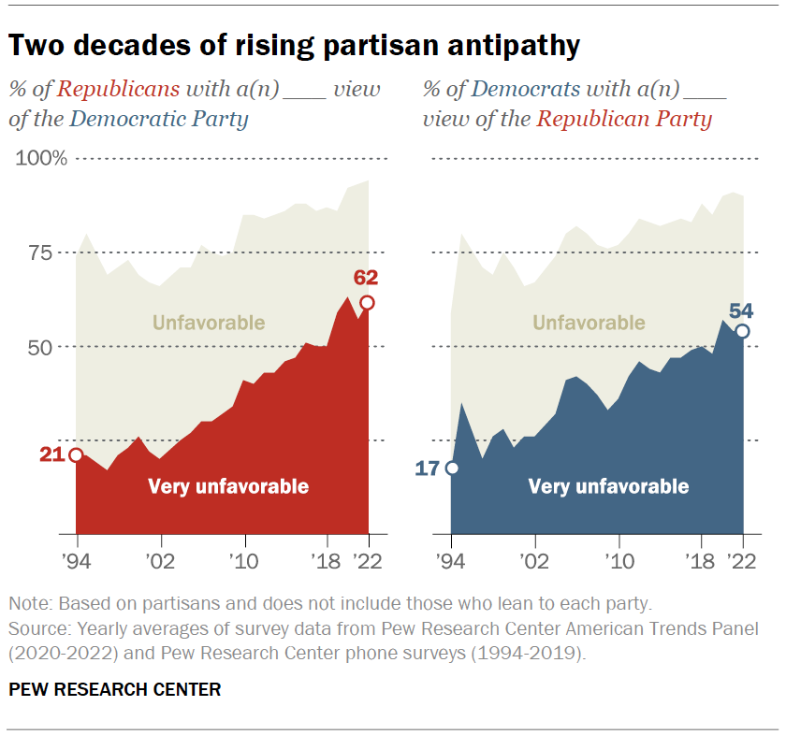

Slide 18
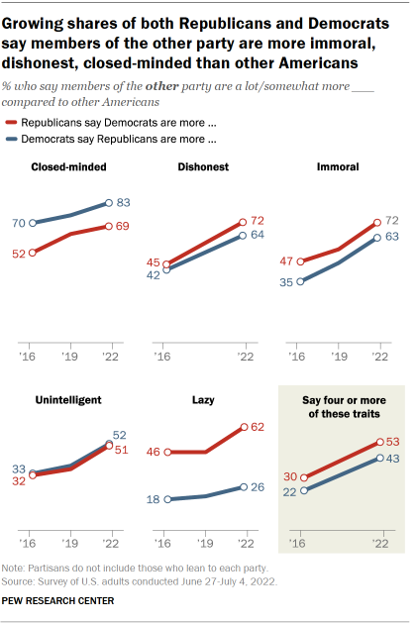

Slide 19
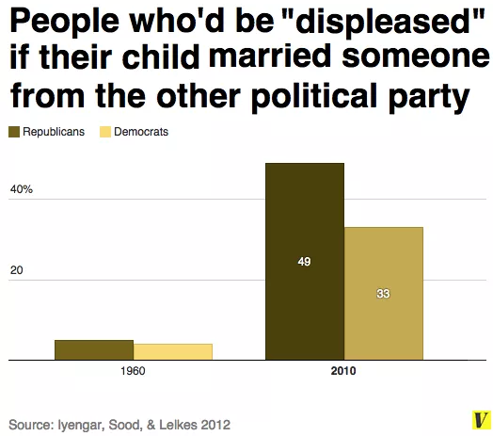

Slide 20
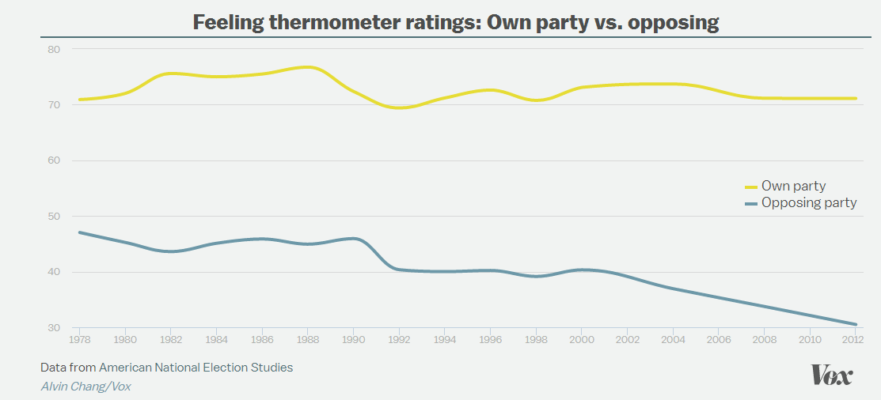

Slide 21
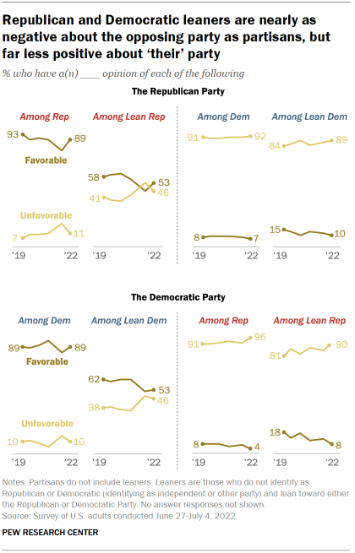

Slide 22
PID and Issues

Slide 23
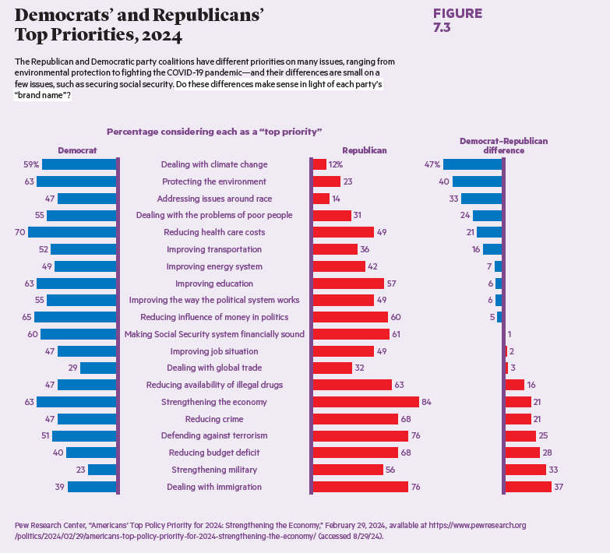

Slide 24
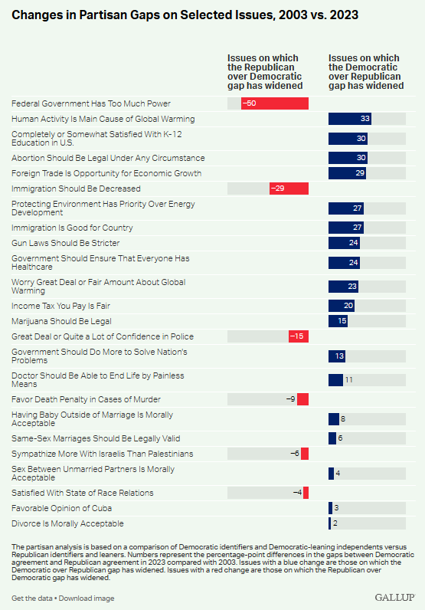

Slide 25
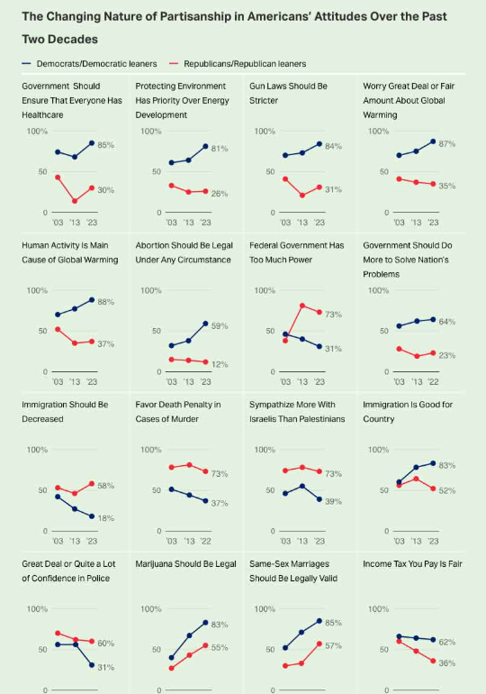

Slide 26
PID and Demographics

Slide 27
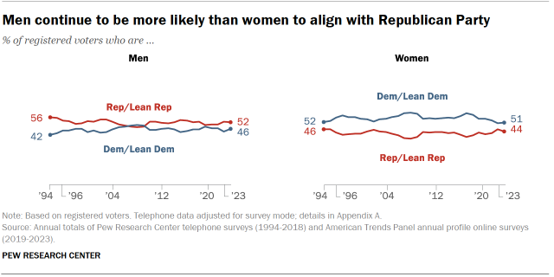
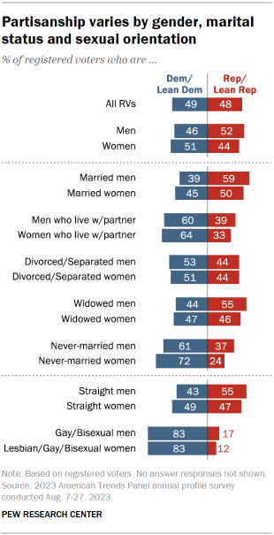

Slide 28
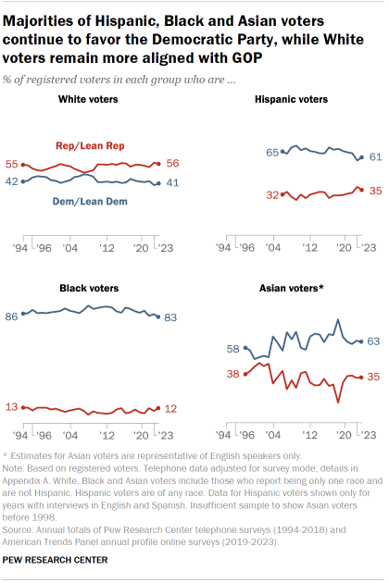

Slide 29
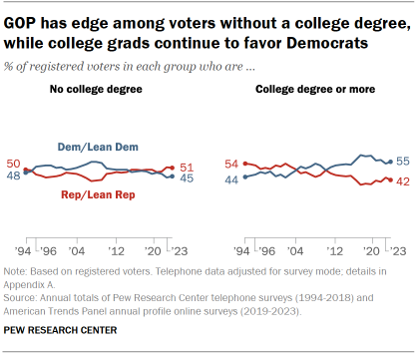
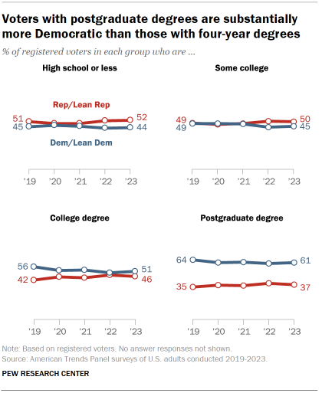

Slide 30
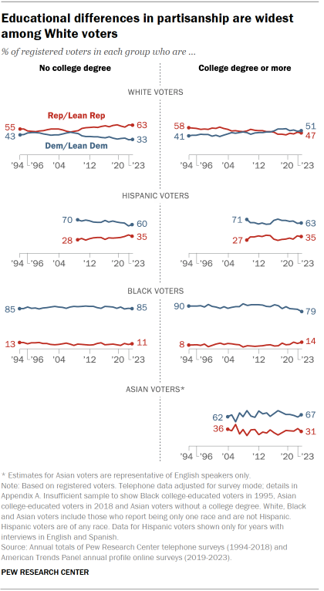

Slide 31
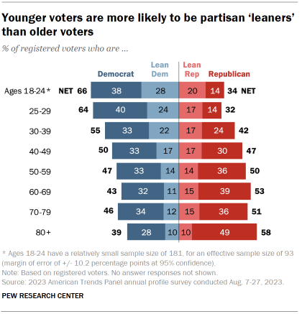
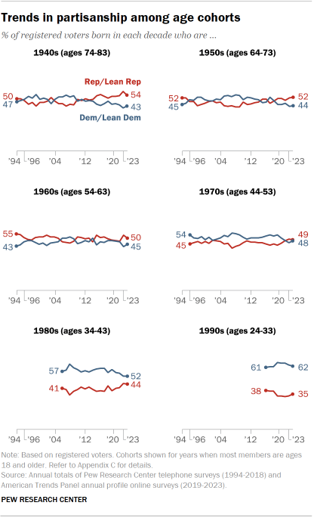

Slide 32
Party in Government
Defining party in government
Rise of party in government

Slide 33
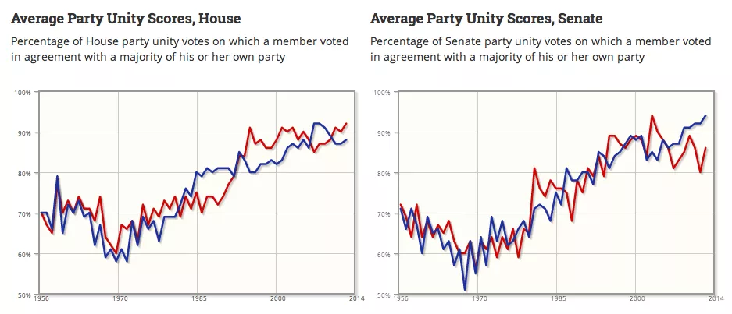

Slide 34
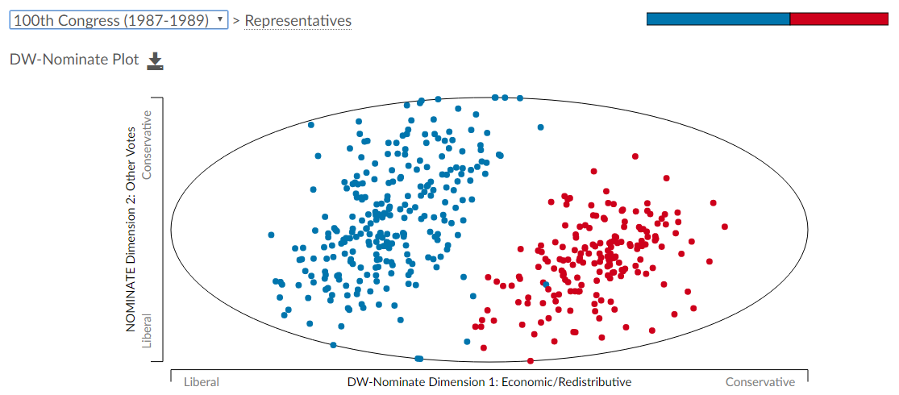
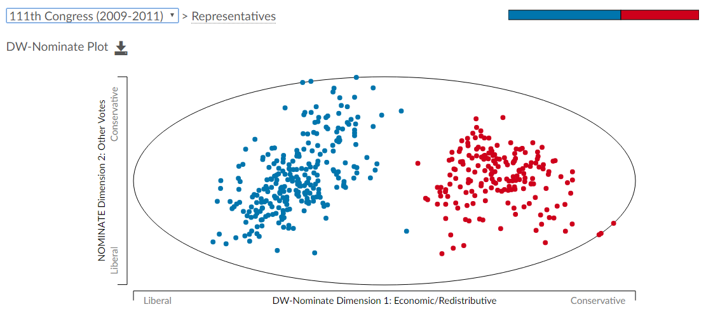
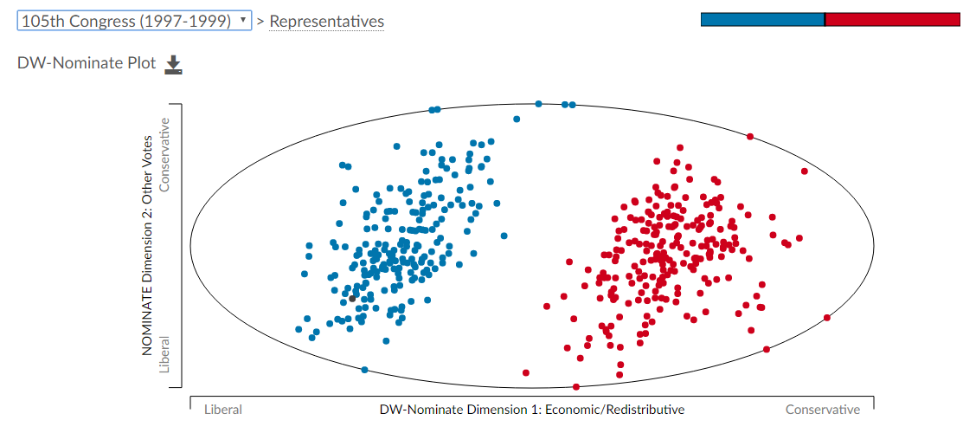
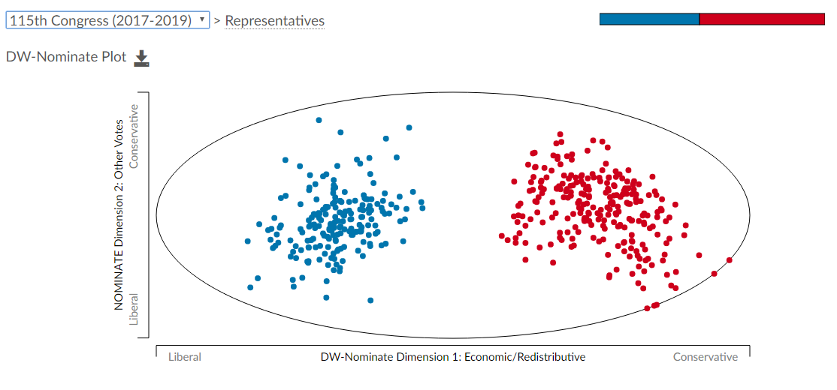

Slide 35
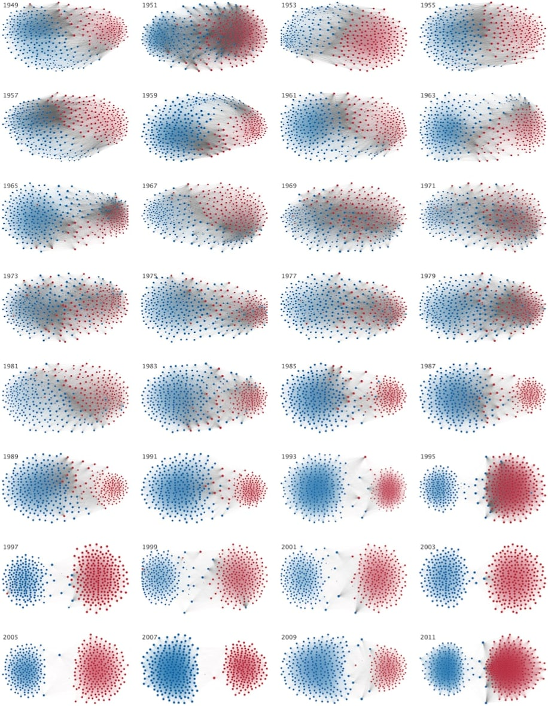

Slide 36
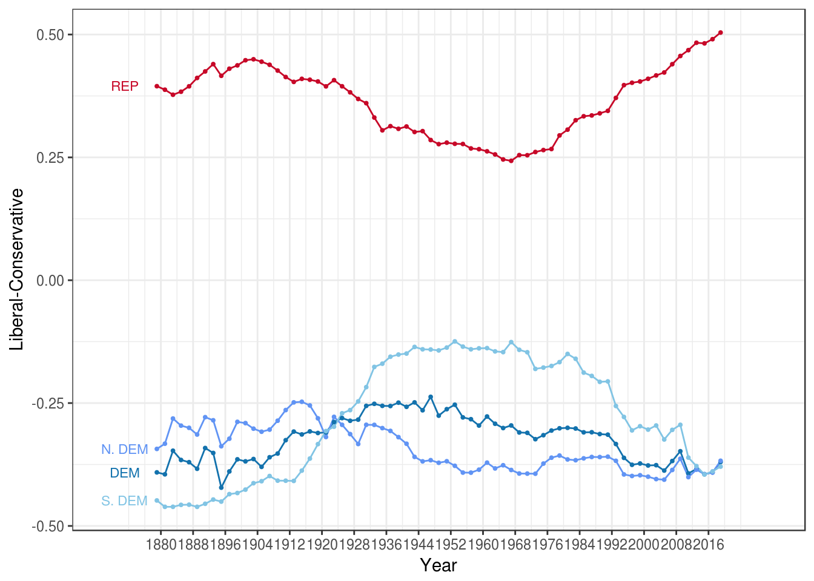
House of Representatives

Slide 37
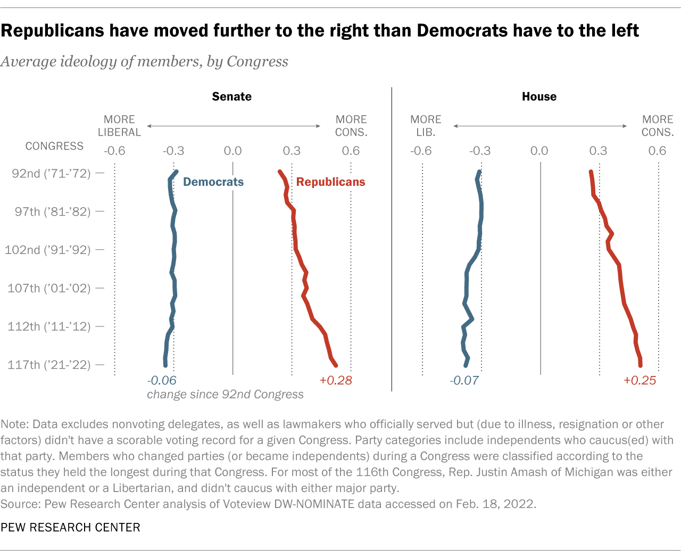

Slide 38
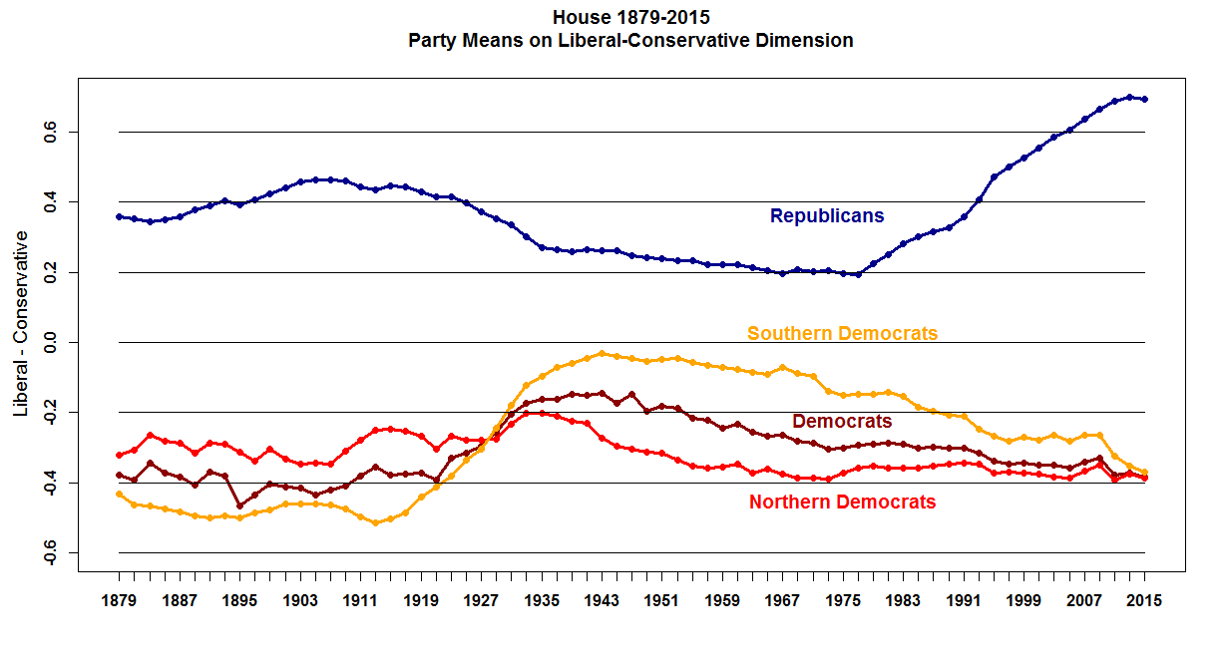

Slide 39
The Parties today
Weak (organizational) Parties in an era of strong partisanship
A polarization “doom loop”
The future?

Slide 40
