Slide 1
Political Participation

Slide 2
Introduction
Voting and Democracy
Turnout in Historical Perspective
Turnout in Comparative perspective

Slide 3
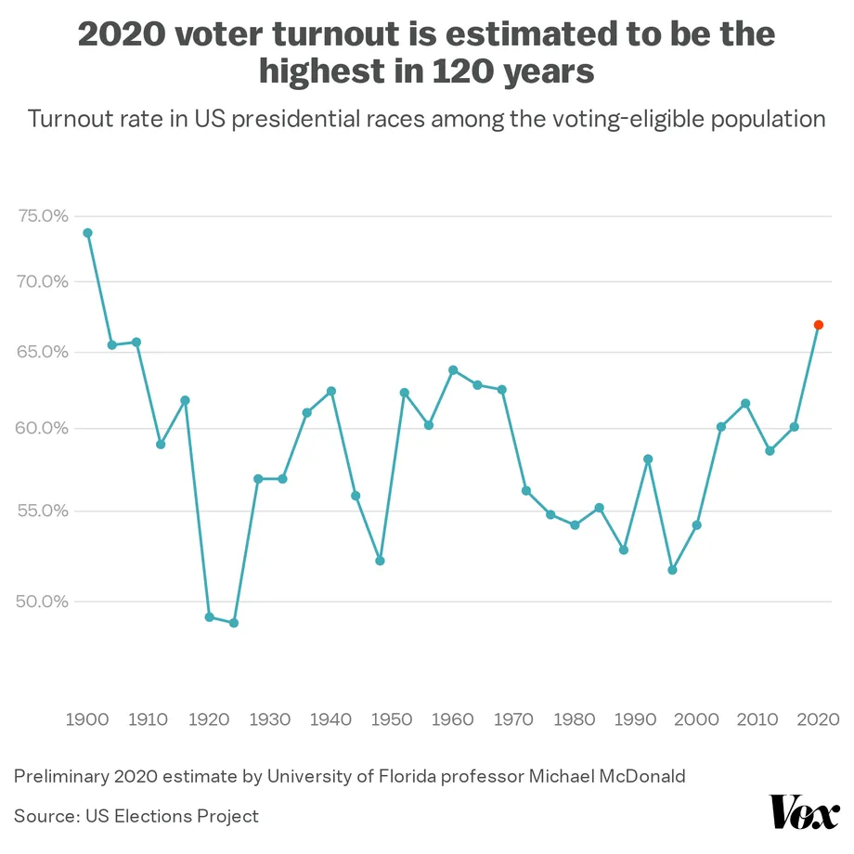

Slide 4
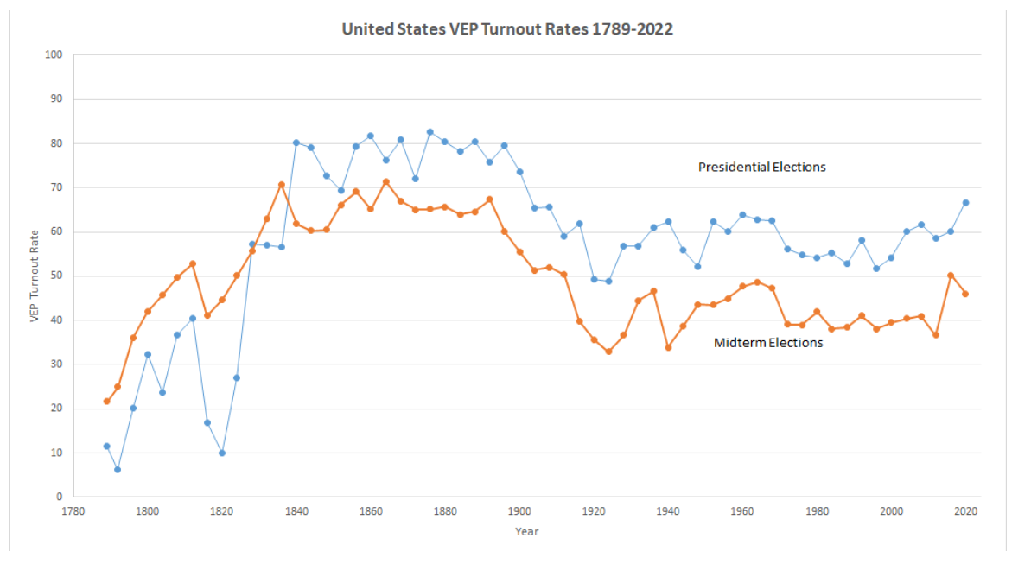

Slide 5
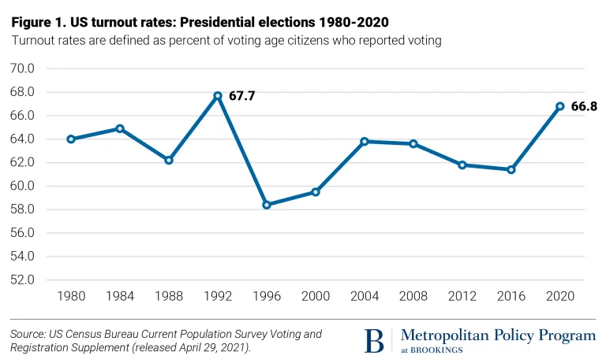

Slide 6
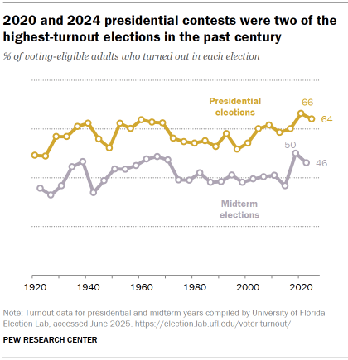

Slide 7
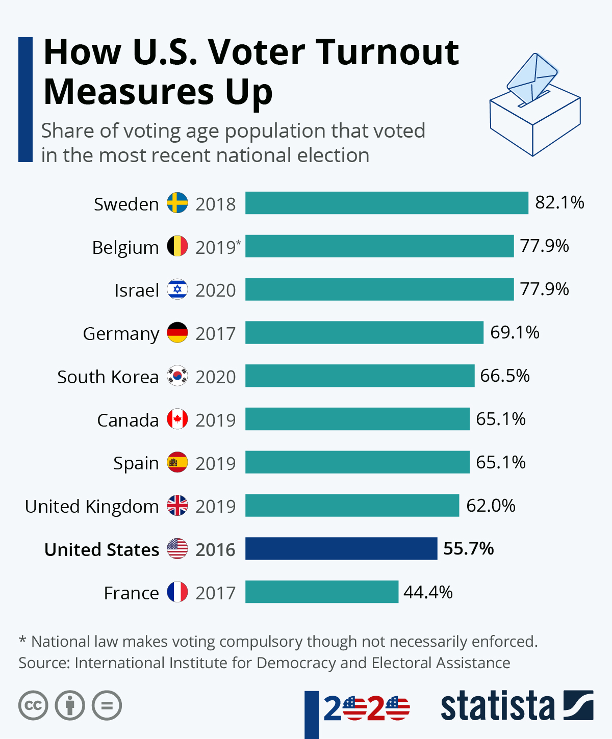

Slide 8
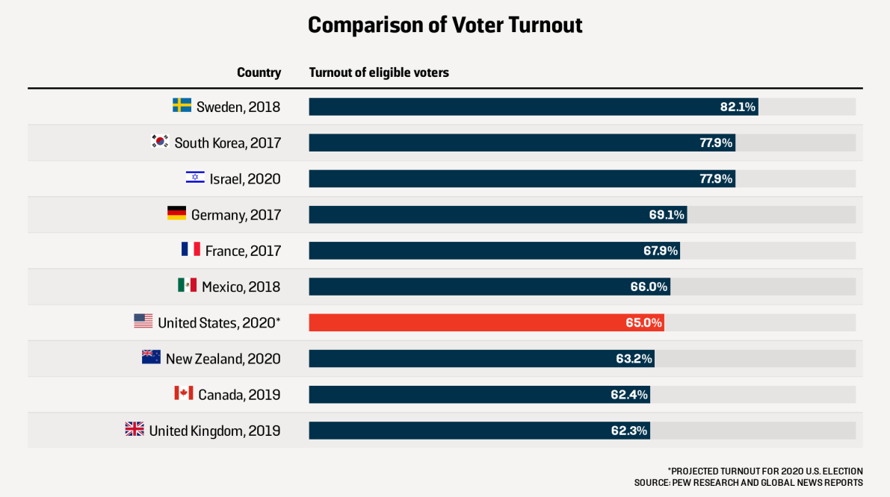

Slide 9
Factors influencing turnout
Cost/benefit equation

Slide 10
Demographic Factors
Age
Race
Region
Education
“Stake in the system”
  Marriage
  Employment
  Residential Stability

Slide 11
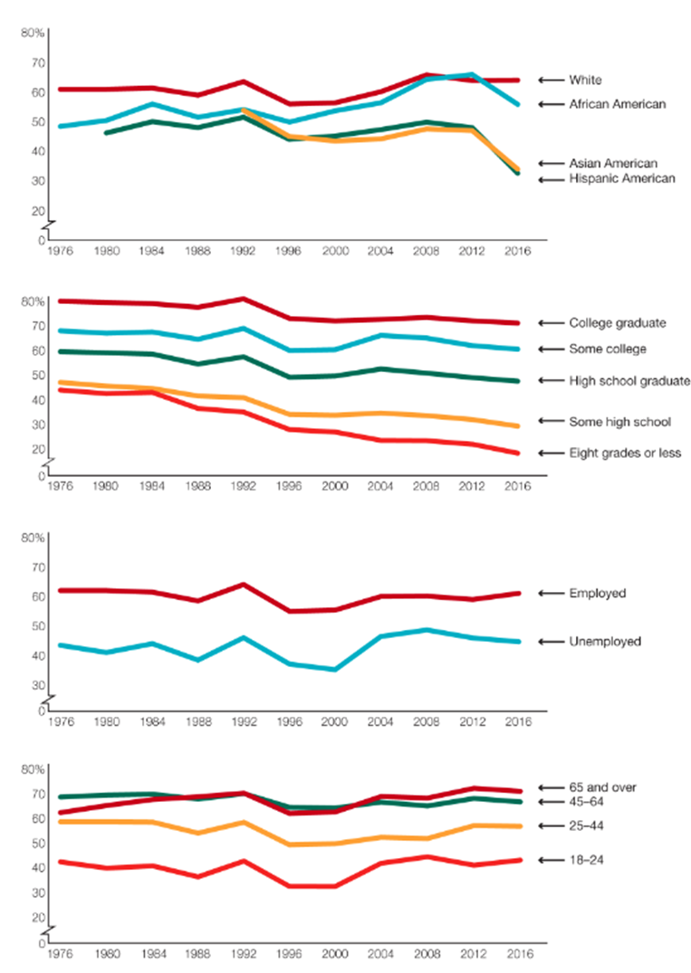
Group differences in turnout

Slide 12
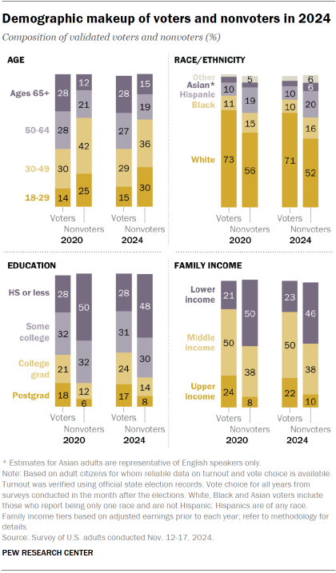

Slide 13
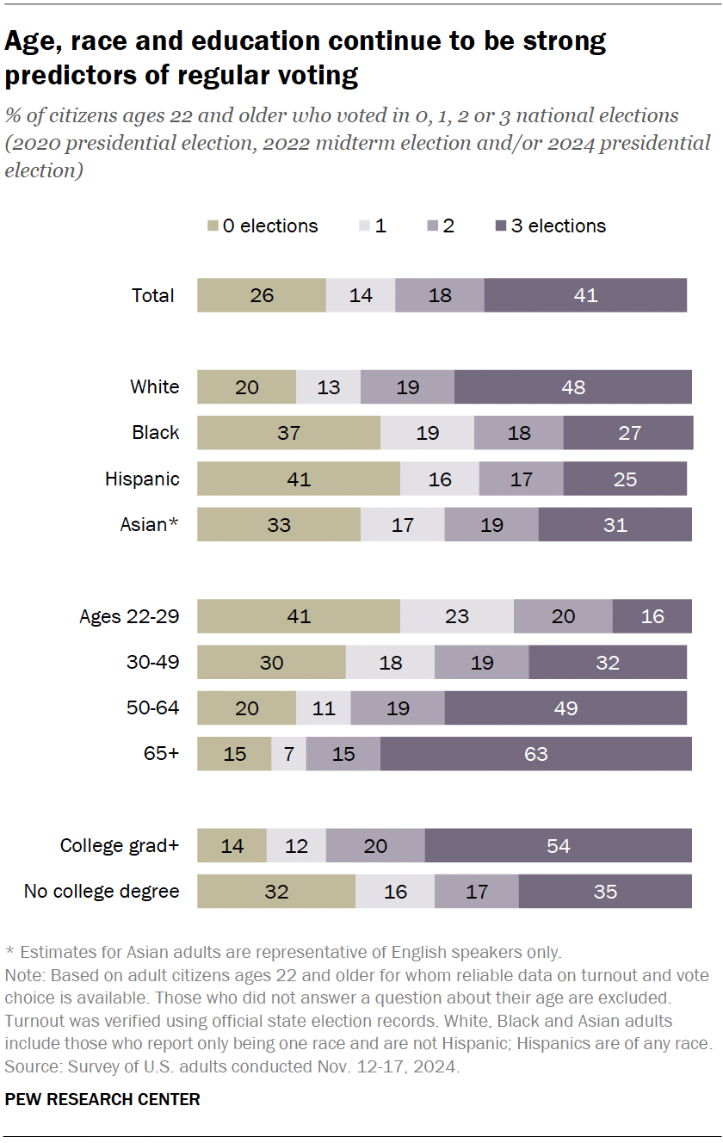

Slide 14
Legal/Institutional factors
Registration
Election day registration
Early voting/Mail voting
Photo ID controversy

Slide 15
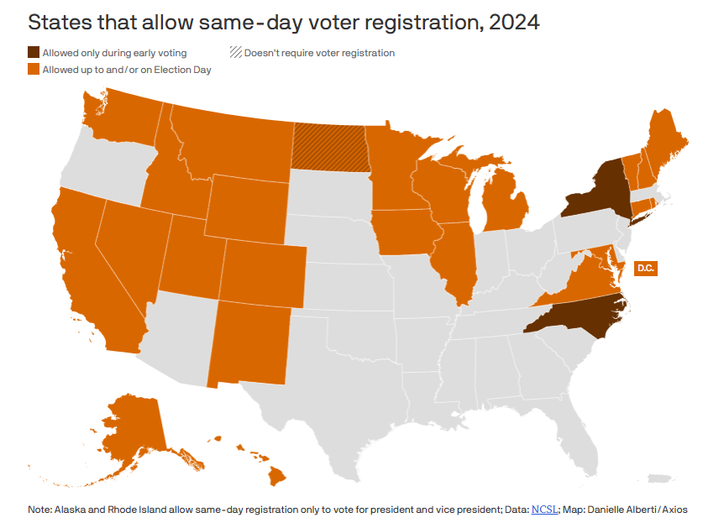

Slide 16
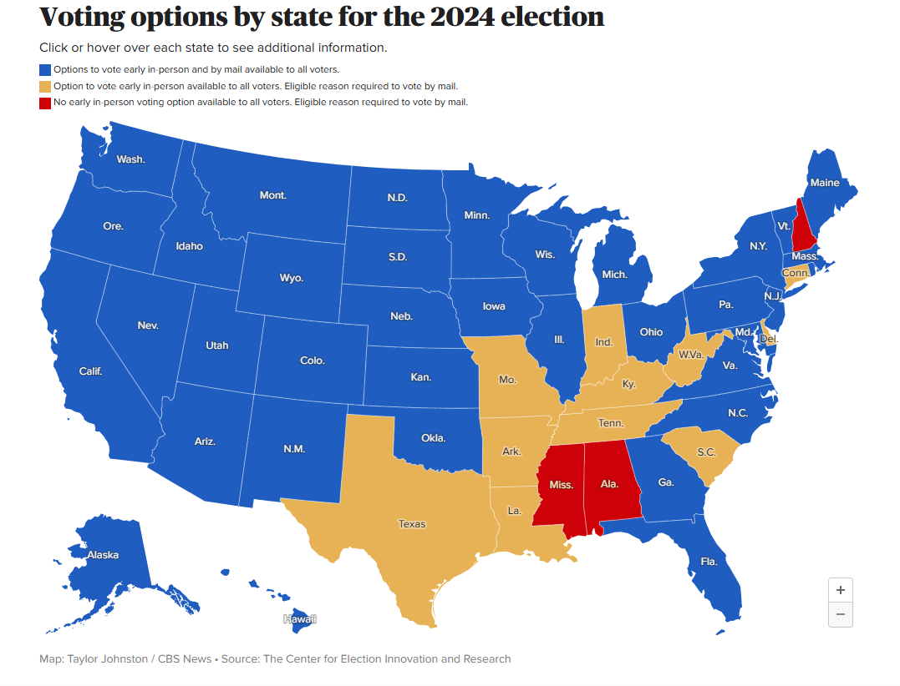

Slide 17
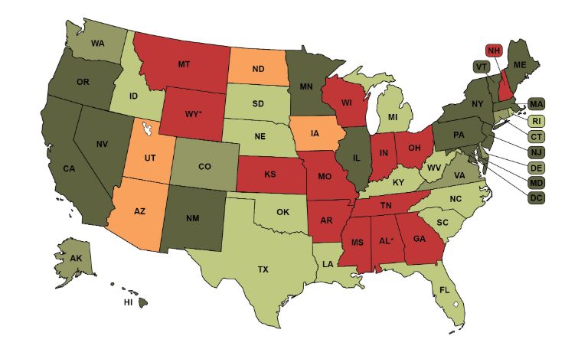
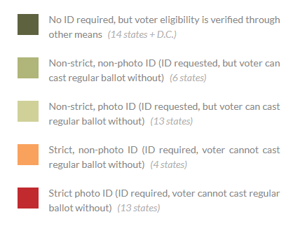

Slide 18
Political Factors
Political party strength
Media emphasis vs mobilization
Interesting/close races

Slide 19
Attitudinal Factors
Partisanship
Political efficacy
Interest

Slide 20
The big picture
Decline and resurgence in turnout
Comparative perspective revisited

Slide 21
Other forms of political participation
Contacting politicians
Joining interest groups
Using courts
Protest
Comparative perspective
Role of the Internet

Slide 22
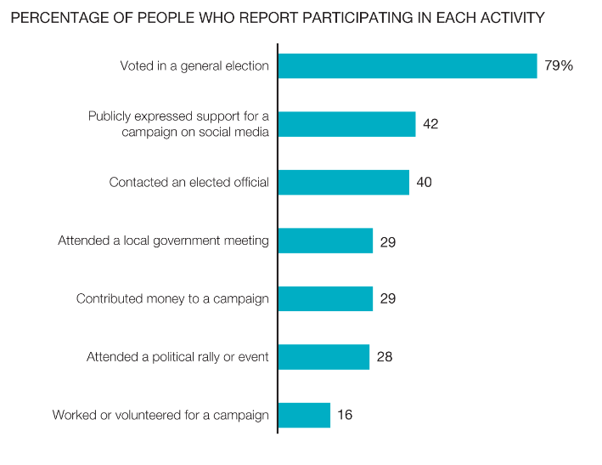
Forms of Political Participation

Slide 23
