Slide 1
Mass Media

Slide 2
Introduction: the two keys
Free media are essential to democracy
Media are a business

Slide 3
Trends in modern media
Changing economics
Changing news values
Changing consumption patterns
Evolving federal regulation
The new media landscape and what it means for politics
  Decline of newspapers
  Rise of social media

Slide 4
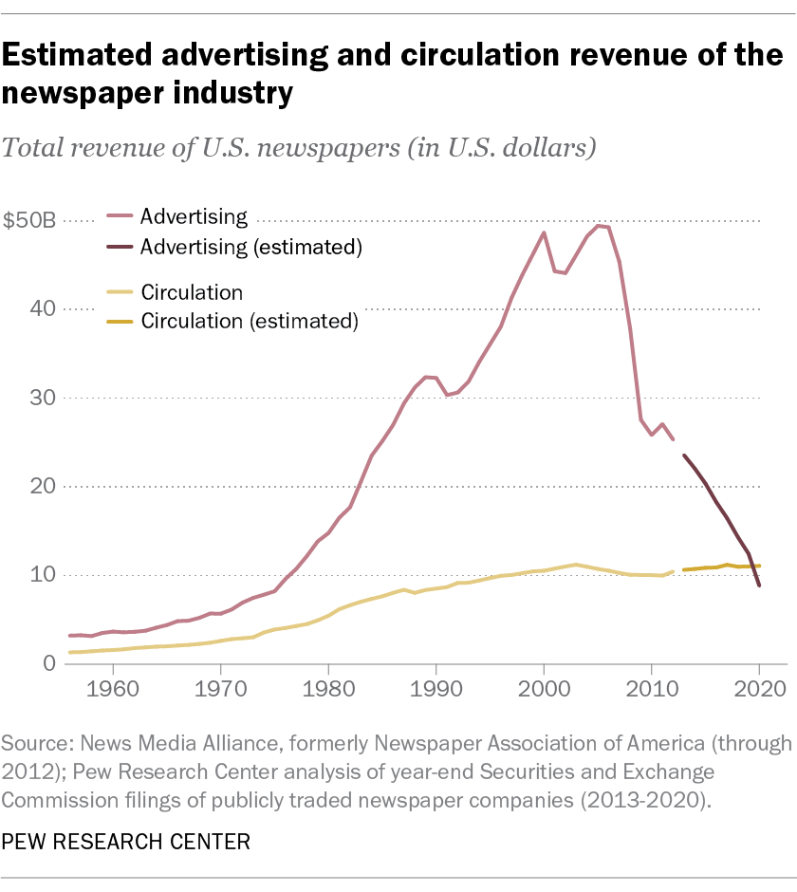

Slide 5
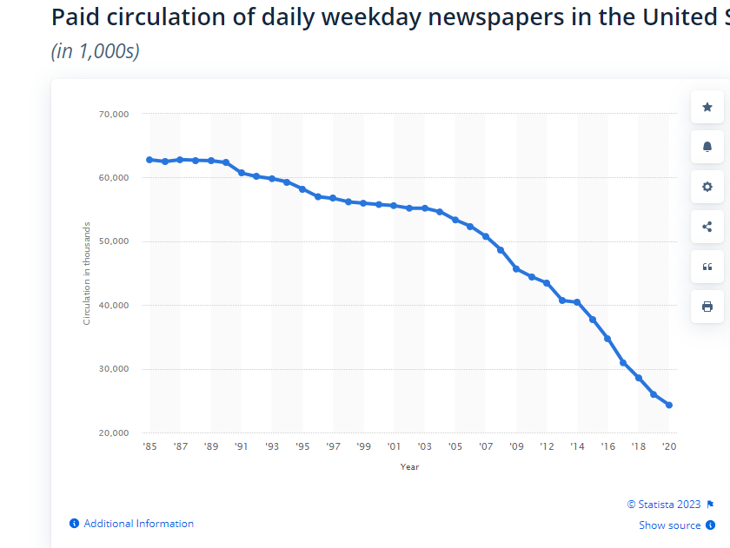

Slide 6
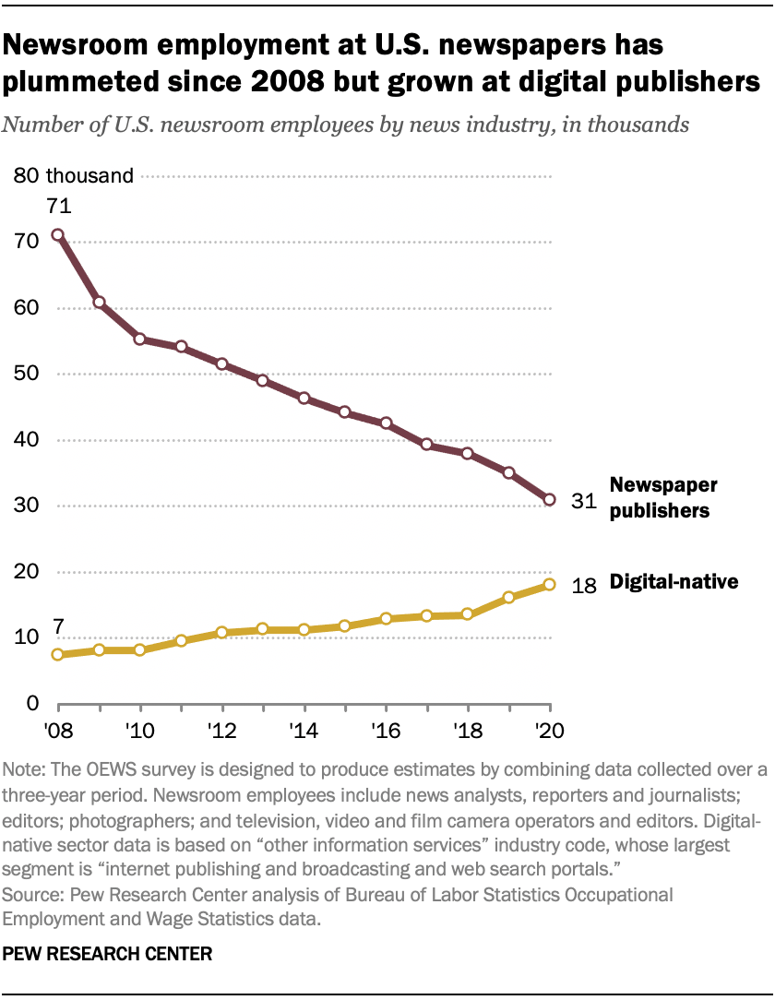

Slide 7
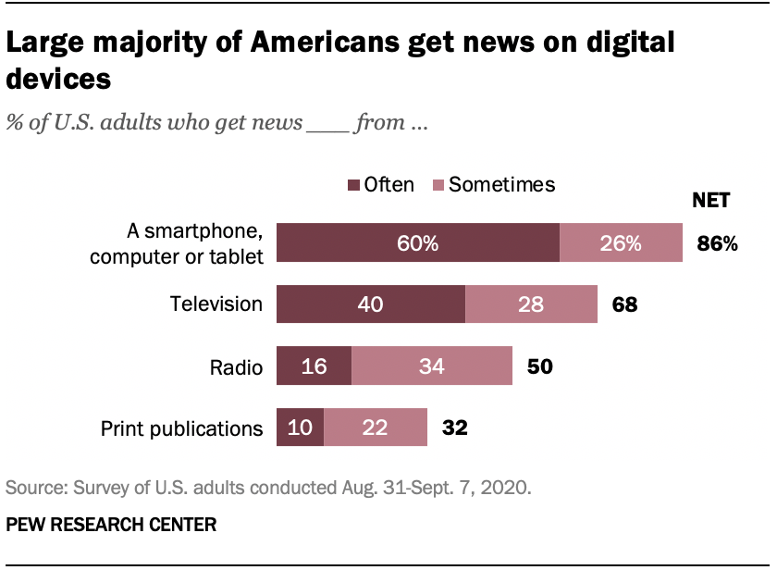

Slide 8
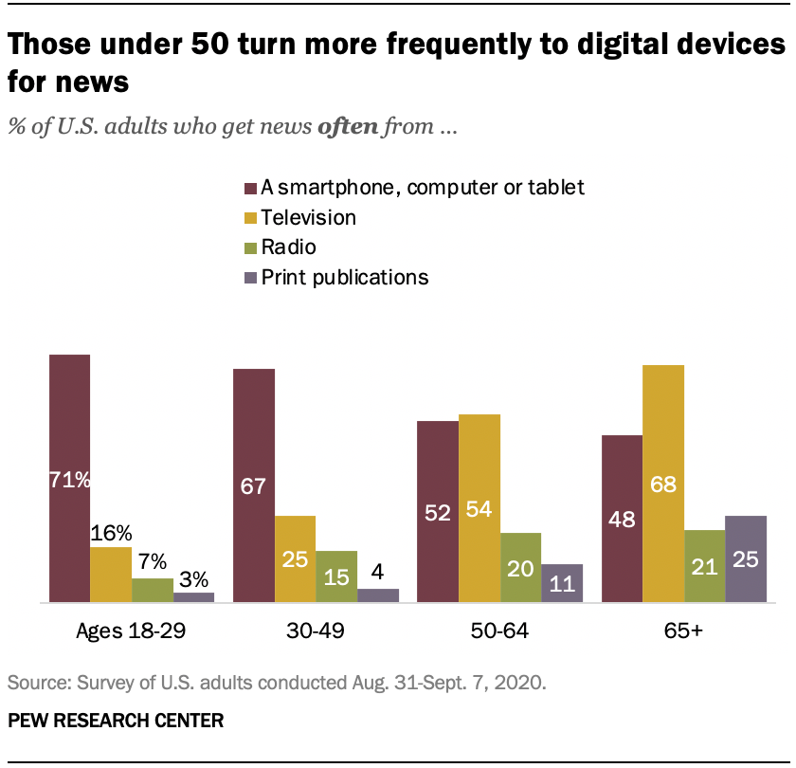

Slide 9
Roles of the Media
Linkage mechanism
Gatekeeper
Scorekeeper
Watchdog

Slide 10
Symbiotic Relationship
Information
Press as stenographer

Slide 11
Adversarial relationship
Conflicting goals
Media cynicism/negative bias
Commercial incentives– eyeballs!

Slide 12
Media Bias

Slide 13
How journalists cover news
News stories
Frames
Ideological bias?
Pack journalism/Conventional Wisdom
“He said, she said” journalism
  Over-reliance on official sources

Slide 14
Commercial Bias
Infotainment
News hole/hamster wheel
Clickbait/lack of proportion
Game orientation
  Horserace
Conflict
Visuals
“News” bias
  Crisis du jour
News on the cheap/(insufficient news resources)

Slide 15
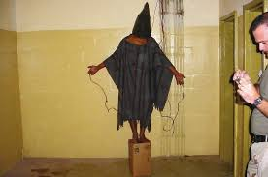
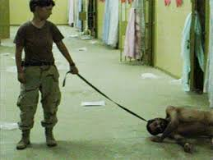
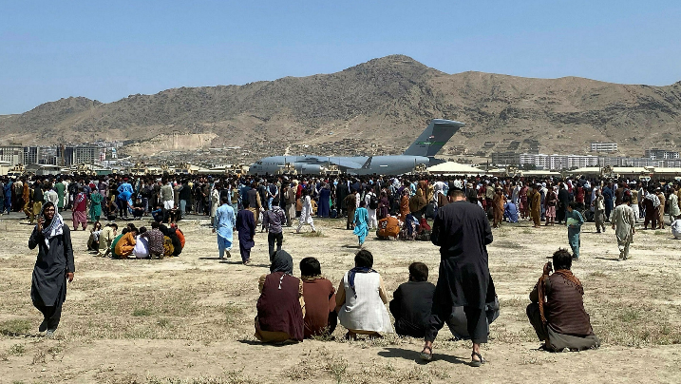
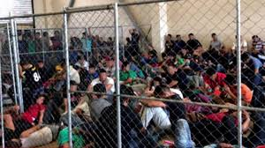
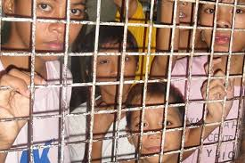
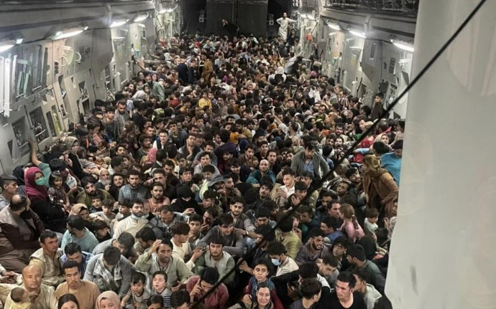
The power of visuals

Slide 16
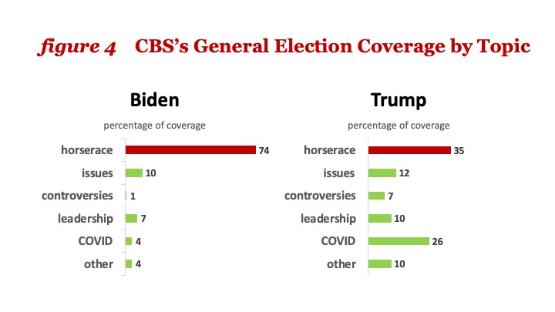
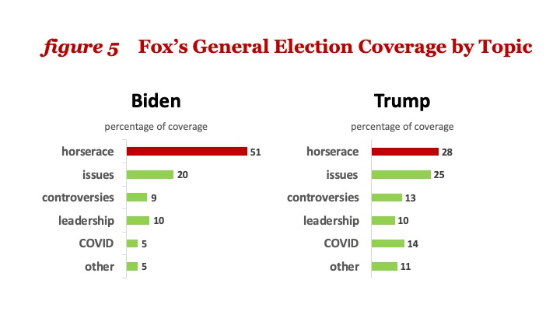
2020 Election Coverage

Slide 17
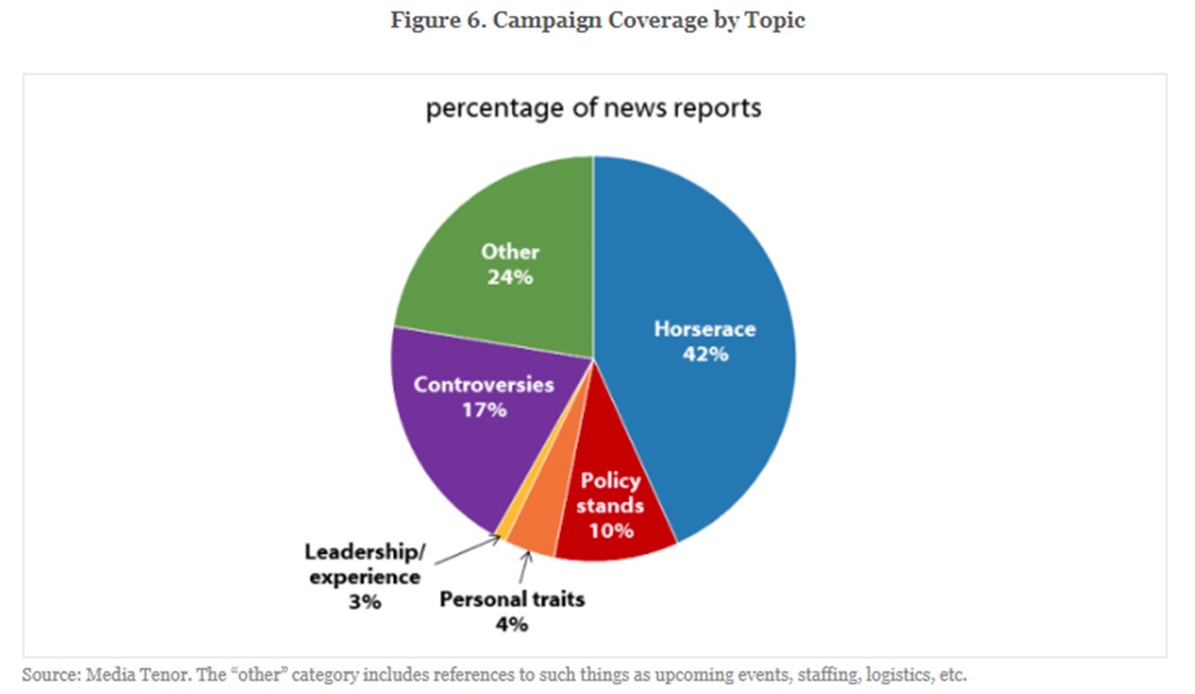
2016 Campaign Coverage

Slide 18
Conclusion: The Media and Democracy
Importance of media
Balance of power
Who’s to Blame?
Citizen’s role

Slide 19
