Slide 1
Public Opinion

Slide 2
Introduction
Your opinions
It’s complicated
Public opinion, polls, and democracy

Slide 3
Sources of Public Opinion
Political socialization
Family
Genes
Personality
Big 5
Moral values
School
Higher education

Slide 4
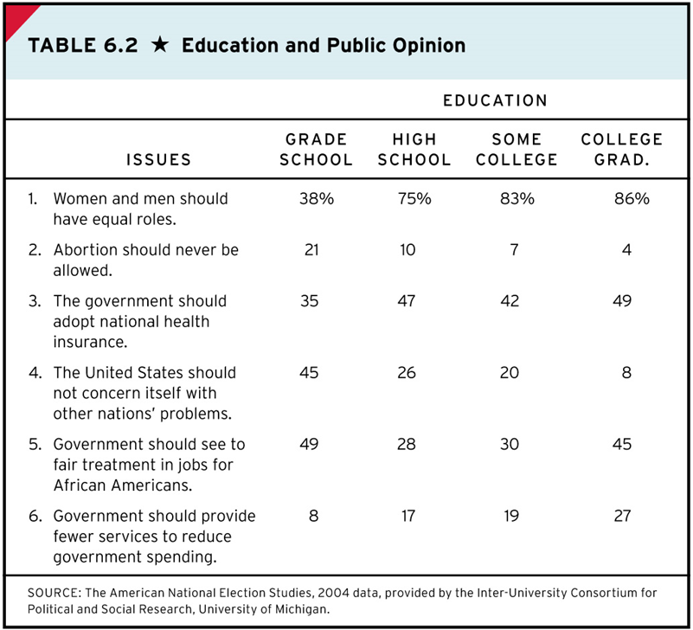

Slide 5
Sources of Public Opinion
Peers
Media
Adult Socialization

Slide 6
Measuring Public Opinion
Public opinion surveys
How to know what Americans think from only 1000 people?
Polling error
The survey response crisis
Solution one: weighting
But… Trump
Solution two: online polls
Unique problems in election polls

Slide 7
Sample Size and Sample Error

Slide 8
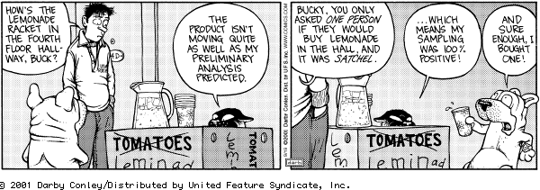

Slide 9
Measuring Public Opinion (continued)
Question wording
Non attitudes and weak attitudes
Considerations model
Social desirability bias

Slide 10
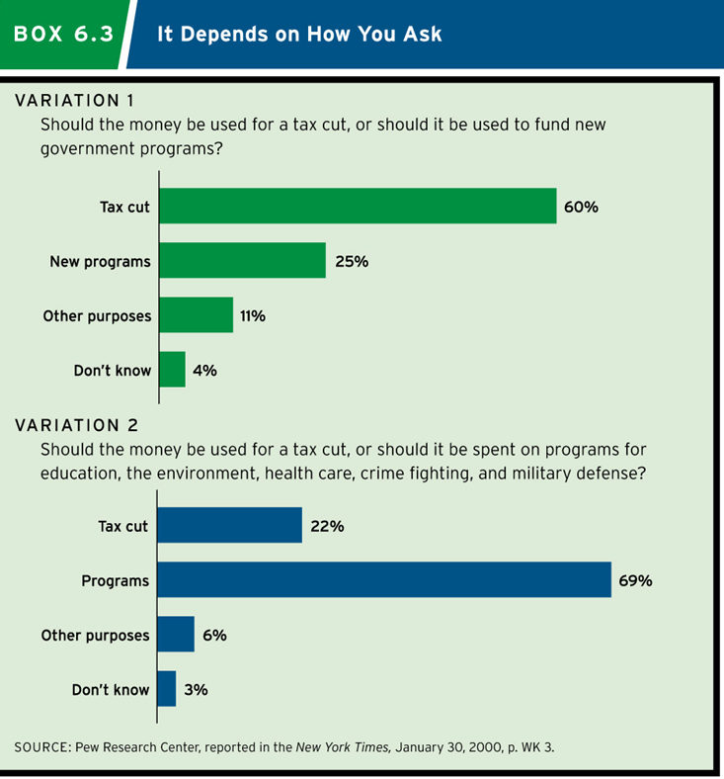

Slide 11
Political Ideology
Defining ideology
Dimensions of ideology
Liberal ideology
Conservative ideology
Your ideology?
Labels vs. Beliefs (symbolic vs. operational)
Motivated reasoning

Slide 12
Group Differences
Group identity and opinion formation
Gender
Age
Class
Race
Region
Religion

Slide 13
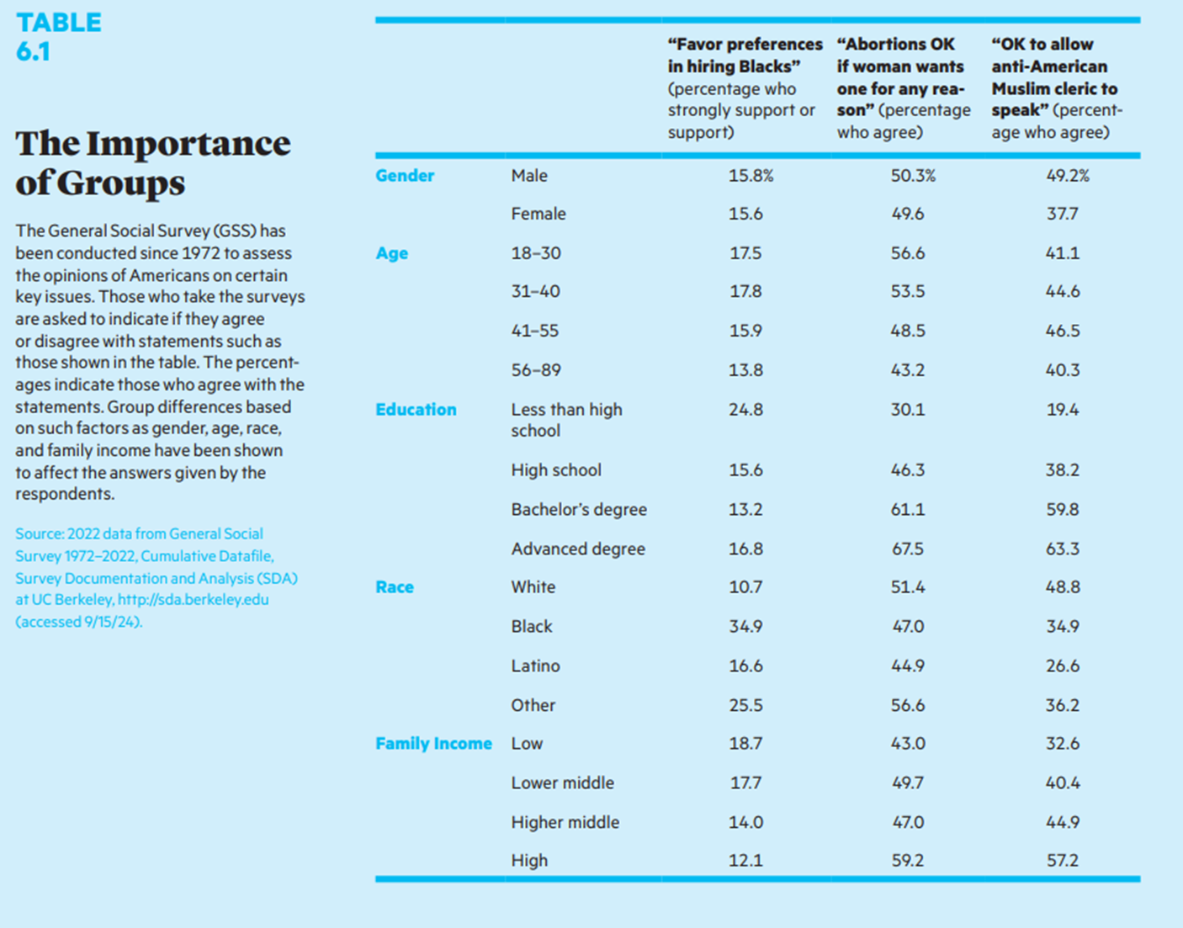

Slide 14
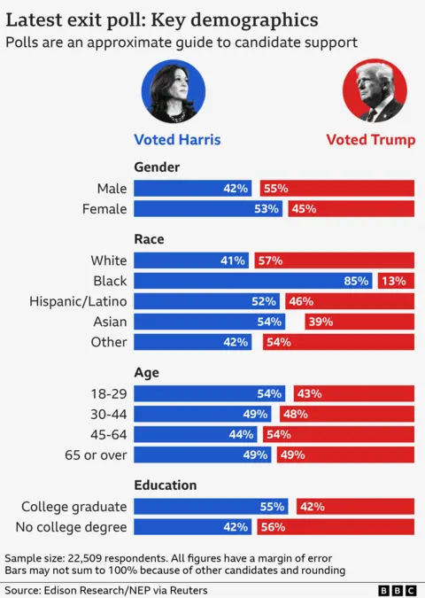
7.2
Notes:
This table displays how ideology is correlated to sex, race, age, religion, education, and political party. In which factors do you see the strongest and weakest correlations, and how might you account for that?

Slide 15
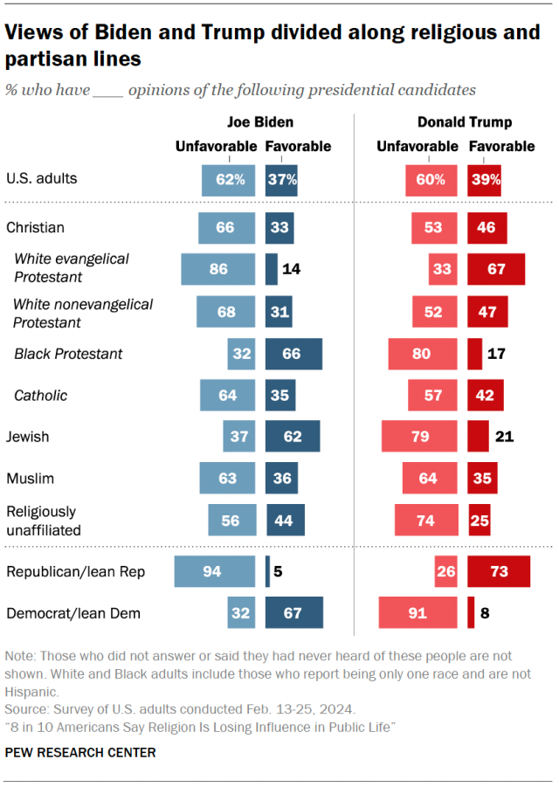

Slide 16
Relationship between public opinion and public policy
How much influence?
Influence of public on government
Ability to govern
Role of intensity
Influence of government on public
Presidential agenda
Elite leadership & Elite framing
Thermostatic model

Slide 17
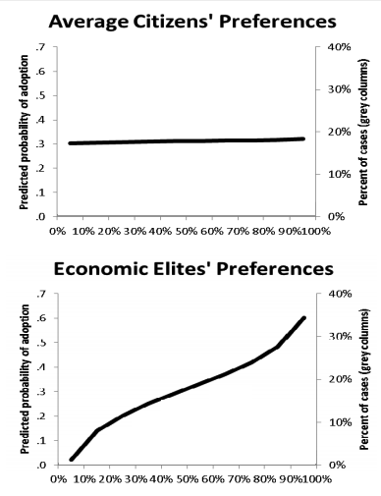
The most disturbing chart in American politics?

Slide 18
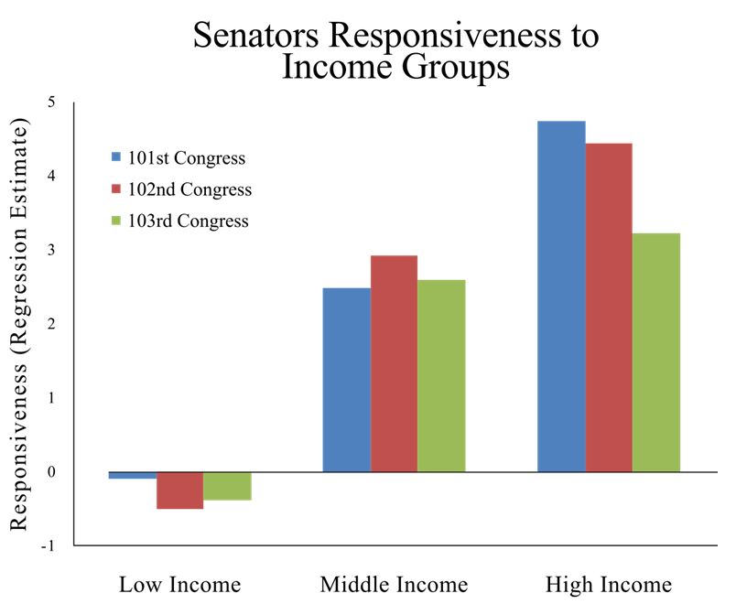

Slide 19
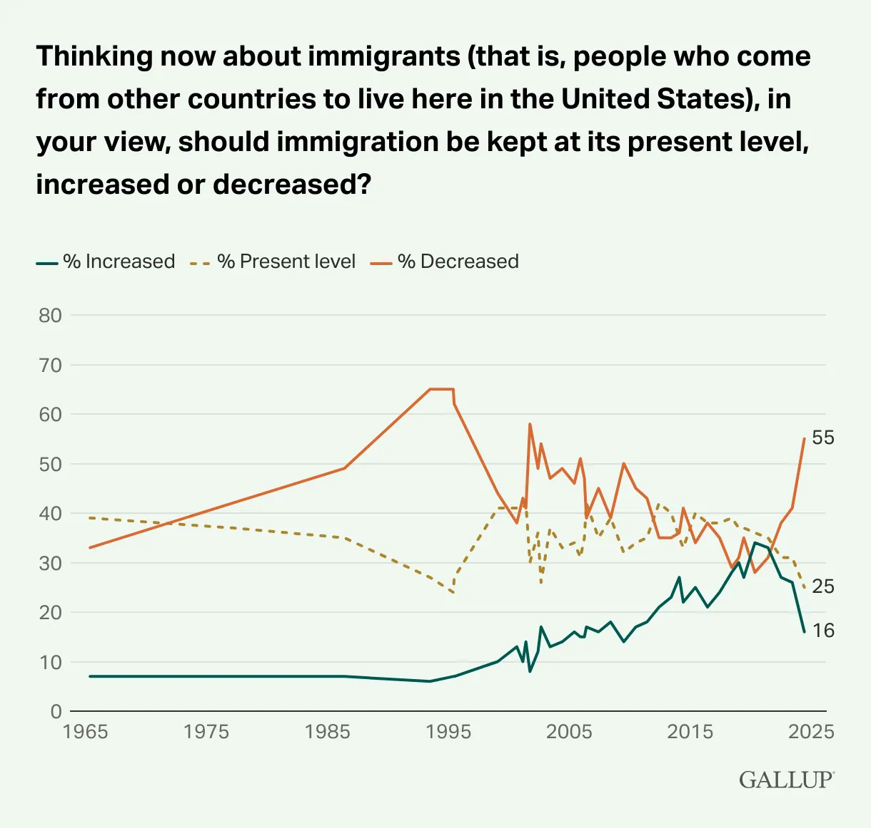

Slide 20
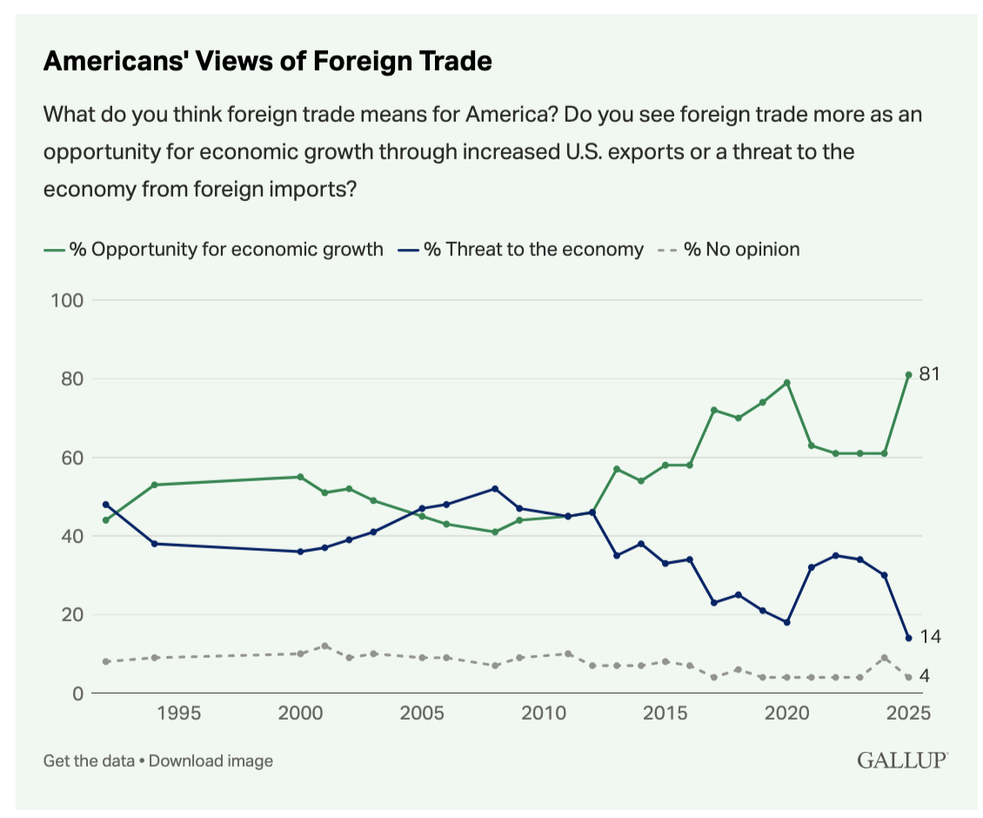

Slide 21
Concluding thoughts
It’s a dynamic two-way street
It’s complicated
Be appropriately skeptical
But not always
But, yeah, it’s complicated
Resist the temptations of over-simplification and motivated reasoning.

Slide 22
