Slide 1
Federalism

Slide 2
Introduction
Federalism in the Constitution
Federalism vs. Unitary government
Federal Powers
State powers

Slide 3
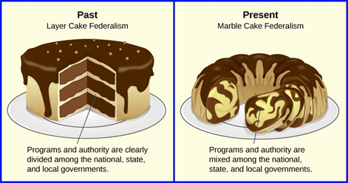
Modern federalism
Historical context
Expanded national government
  Devolution
Federalism today: marble cake federalism (vs layer cake)
Block grants vs categorical grants

Slide 4
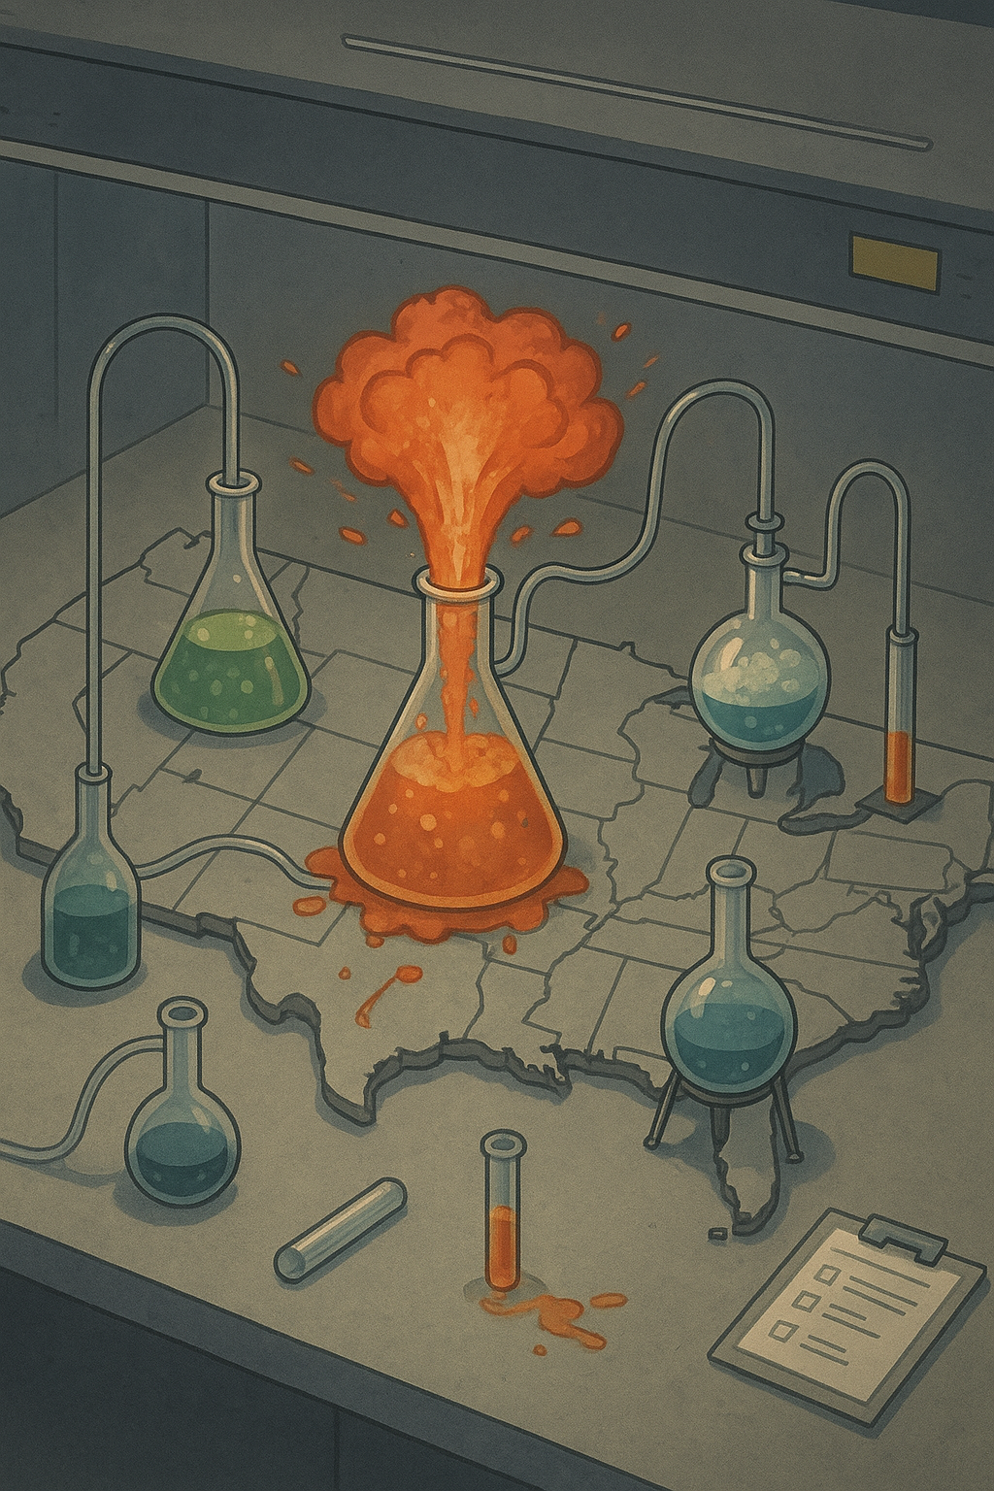
Assessing Federalism
Increased state power in policy-making
Laboratory of federalism
Disadvantages
Inter-state disparities
Federalism and contemporary policy controversies
Finding a balance

Slide 5
