Slide 1
Political Science 201 Introduction to American Government and Politics
Professor Steven Greene

Slide 2
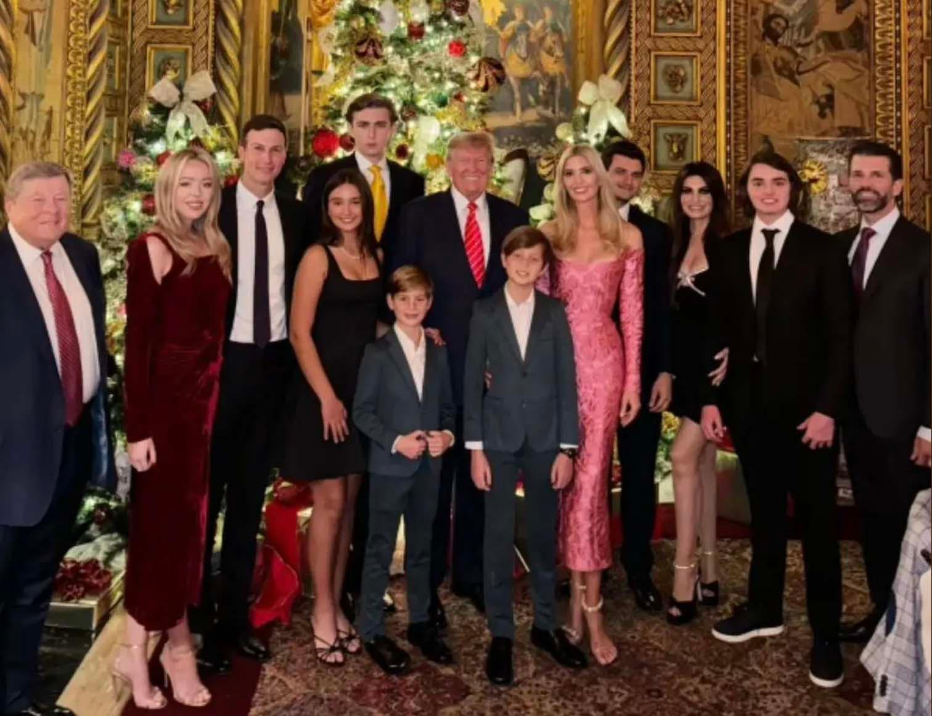

Slide 3
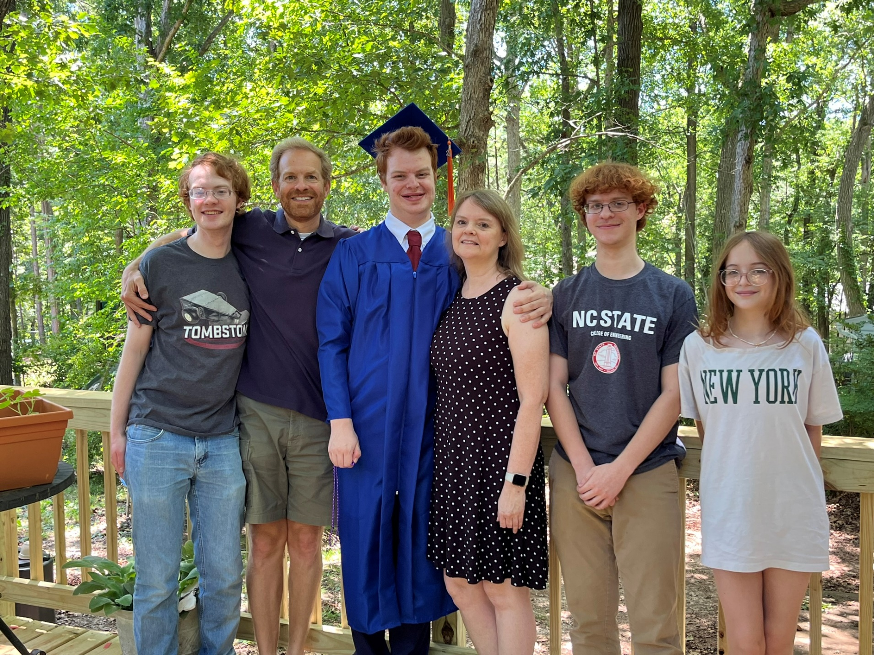

Slide 4
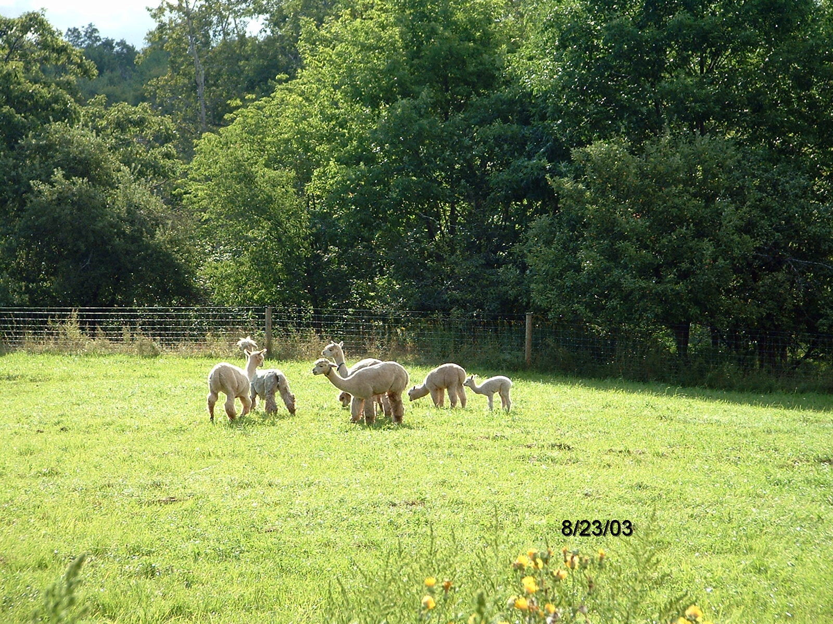

Slide 5
Why Study American Government?
It’s easier than Math
“I’m going to law school”
It actually is important stuff
It’s your government
Learning to think like a social scientist
There really is a good chance it will help you to know this stuff and how to think about it no matter your future career(s)

Slide 6
Important Syllabus Stuff
Office Hours
Reading
Textbook (ebook)
Inquizitive
Reserves for discussion
Current events
Requirements, papers, etc...
Discussion Sections
Meet your TA’s

Slide 7
Keys to Success
Do well on the tests and papers
Read
Attend class
Take good notes
Participate in discussions
Study

Slide 8
General Course Policies
Show Up (if you want to learn)
Look alive
Minimize in-class disruptions
Laptops
ASK QUESTIONS

Slide 9
Quiz
TopHat

